Slide 1


Rogerian Argument
Common Ground and Compromise
Click for next→

Slide 2
Rogerian Argument
vs.
Traditional Argument
Click for next→

Slide 3

Traditional Argument
Most traditional arguments seek to convince the audience via logic
Reason #1
Reason #2
Reason #3
I will win you over with my logic!
Click for next→

Slide 4
Traditional Argument
Most arguments have 2 separate opposing sides
Little emphasis is placed upon what the 2 sides have in common
Click for next→

Slide 5
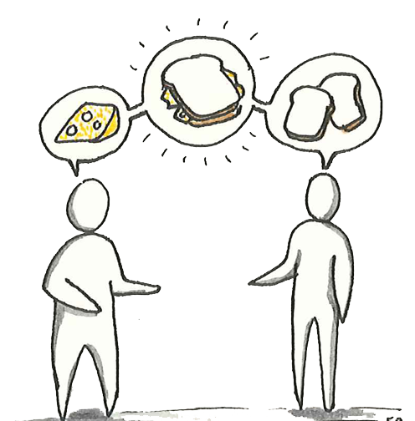
Rogerian Argument is different:
-builds common ground
-uses empathy
- validates the opposition’s beliefs
Click for next→

Slide 6
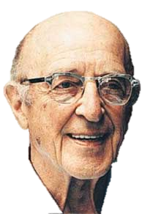
“Rogerian Argument” is based upon the therapy techniques of
Carl Rogers, psychologist
(January 8, 1902 – February 4, 1987)
Click for next→

Slide 7
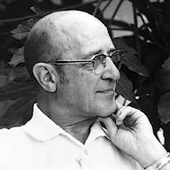
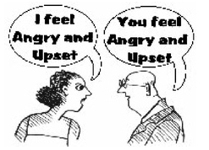
Carl Rogers
-developed "client-centered therapy"
-acted as a facilitator rather than a director of the therapy session
--listened more, advised less
Click for next→

Slide 8

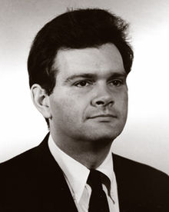
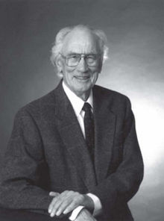
  Rogerian Argument
  = Carl Rogers’ techniques applied to formal argument
Developed by 3 professors of Rhetoric / Linguistics:
Richard Young
Alton Becker
Kenneth Pike
(April 6, 1932 – November 15, 2011)
(June 9, 1912 – December 31, 2000)
Click for next→

Slide 9
Rogerian Argument Model
Explanation and Examples
Click for next→

Slide 10
4 Basic Steps of Rogerian Argument
Step 1: Present the opposition’s stance
Step 2: Validate the opposition’s stance
Step 3: Present your stance + benefits for both sides
Step 4: Present the best compromise
Click for next→

Slide 11

Step 1: Describe the opposition’s side using neutral language
What you believe:
--Water bottles pollute the environment
--Plastics used are unhealthy
Against bottled water
Pro-bottled water
Click for next→

Slide 12

Step 2: Describe contexts in which the opposing view is valid. Give credit to the good points.
Avoiding bottled water does save money and reduce trash.
--Families could save money by drinking tap water
--The amount of trash in landfills and oceans would be reduced
Against bottled water
Pro-bottled water
Click for next→

Slide 13
Step 3: Present your opinion and the benefits for the opposition if your views were adopted.
Water is healthy and bottled water encourages people to drink water rather than soda.
Keeping water in people’s hands is good, and eventually people may recycle or reuse bottles.
Pro-bottled water
Against bottled water
Click for next→

Slide 14
Step 4: Propose the best possible compromise in which both sides benefit.
Best compromise:
Develop eco-friendly containers for re-use and recycling.
Against bottled water
Pro-bottled water
Click for next→

Slide 15
Rogerian Argument = common ground
Compromise
eco-friendly containers
Against bottled water
Pro-bottled water
Click for next→

Slide 16

Rogerian Argument Example:
Campus Internet Censorship
Click for next→

Slide 17


2 Opposing Sides:
  Internet filters maintain academic focus
Internet filters are unnecessary and restrictive
Click for next→

Slide 18

Step 1: Describe the opposition’s side using neutral language
The college wants to ensure that its computers are being used for learning and academic purposes.
  Yes, that’s correct.
Click for next→

Slide 19
Step 2: Describe contexts in which the opposing view is valid. Give credit to the good points.
--Yes, students should be focused upon academics.
--True, non-academic sites and porn can be tempting and distracting.
--Expecting study environments to promote studying is fair.
  You see our point!
Click for next→

Slide 20
Step 3: Present your opinion and the benefits for the opposition if your views were adopted.
--Students need unrestricted freedom to learn
--Students must develop self-discipline skills while studying
--Filtering sites discourages library use, and students need the support of library staff
  That’s reasonable!
Internet filters do not necessarily encourage academic focus.
Click for next→

Slide 21
Step 4: Propose the best possible compromise in which both sides benefit.
Internet monitoring, rather than filtering, is more reasonable.
  We can do that!
Click for next→

Slide 22
Common Ground:
Compromise!
Monitoring library internet use
Click for next→

Slide 23
Rogerian Essay :
Format & Guidelines
Click for next→

Slide 24
Rogerian Essay Format:
¶ #1 Introduce the topic by using an introduction strategy. The introduction should present the topic and importance.
¶ #2 Describe the opposition’s views in neutral language. Be detailed, thorough, and fair.
Each paragraph should be
well-developed and detailed.
¶ #3 Validate the opposition’s good points. Describe contexts in which the opposition’s ideas work best.
¶ #4 Present your opinion and the benefits for the opposition if your views were adopted.
¶ #5 Propose the best possible compromise in which both sides benefit.
Click for next→

Slide 25
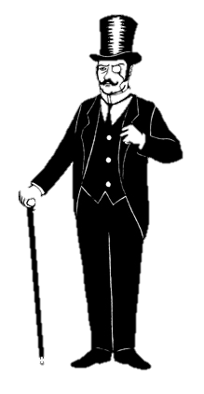

Writing Guidelines:
Remember to maintain a semi-formal academic writing style, regardless of the topic.
  Thus, heretofore,
  the deleterious nature…
  yeah, whatever. It sucks.
Not too casual
Not overly formal
Click for next→

Slide 26
Writing Guidelines:
Avoid Academic Writing Don’ts:
I think
I believe
In my opinion,
I feel
Click for next→

Slide 27
Writing Guidelines:
Avoid Academic Writing Don’ts:
I would like to point out
I do not think there is any problem…
I believe it is possible…
Click for next→

Slide 28
Writing Guidelines:
Avoid Academic Writing Don’ts:
I think there is ultimately some question regarding your argument that helmets save lives.
Ultimately, questions remain regarding the argument that helmets save lives.
Click for next→

Slide 29
Writing Guidelines:
Avoid Academic Writing Don’ts:
I believe it is up to the parents to choose where their children attend school.
Parents should choose where their children attend school.
Click for next→

Slide 30
Writing Guidelines:
Avoid Academic Writing Don’ts:
I do not think there are any significant problems with providing unfiltered internet access in libraries.
Providing unfiltered internet access poses no significant problems.
Click for next→

Slide 31
Writing Guidelines:
Avoid Academic Writing Don’ts:
I believe it is definitely possible to reach a reasonable compromise between meat eaters and vegetarians.
Meat eaters and vegetarians can definitely reach a reasonable compromise.
Click for next→

Slide 32
Writing Guidelines:
Avoid Academic Writing Don’ts:
I would like to point out several factors that influence food choices.
Several factors influence food choices.
Click for next→

Slide 33
Writing Guidelines:
Avoid Academic Writing Don’ts:
It seems to me that there is more than one solution to the problem.
Several solutions to the problem seem possible.
Click for next→

Slide 34
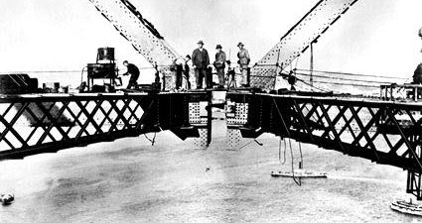
Rogerian Argument
End of presentation.

