Slide 1
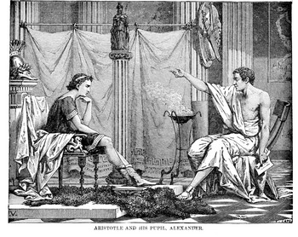
Argumentation
Make your point!
Erin Webster Garrett, Radford University

Slide 2

Argumentation:
What is it?
It is a reasoned, logical way of asserting the soundness of a position, belief, or conclusion.
Erin Webster Garrett, Radford University
Notes:
By evidence we mean all the verifiable information a writer might use as support for an argument. This includes facts, observations, examples, cases, testimony, experimental findings, survey data, statistics … Each type of evidence has pros and cons, and should be viewed in the rhetorical situation: what will work best to sway my audience? How can I frame the data to make my case?

Slide 3

Argumentation:
What is it?
It takes a stand—supported by logical, structured evidence—and urges people to share the writer’s perspective and insights.
Erin Webster Garrett, Radford University

Slide 4
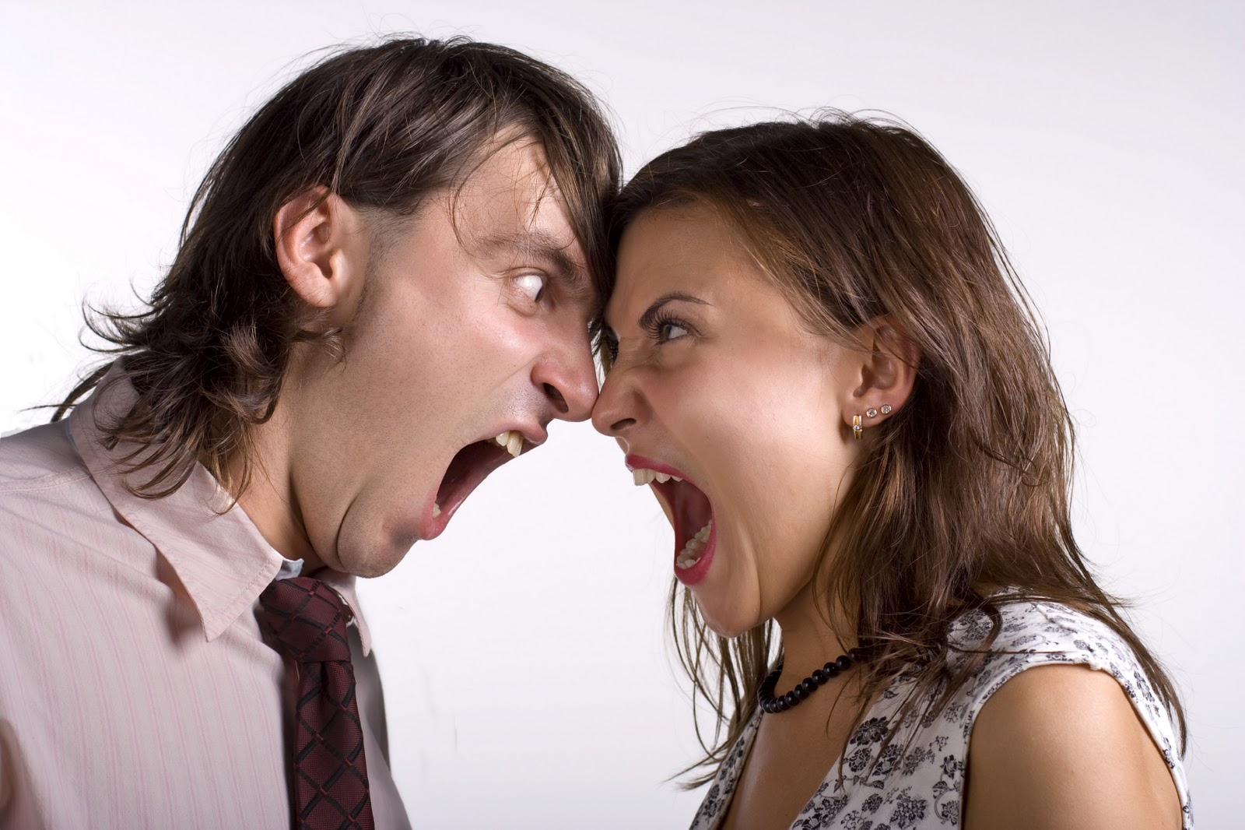
Argumentation:
What is it?
Argument in writing does NOT mean a shouting match, hostility, or rudeness.
Click for next slide→

Slide 5

Argumentation: Purposes
1. Purpose: To convince other people to accept—or at least accept the validity of—your position
Click for next slide→

Slide 6

Argumentation: Purposes
2. Purpose: To defend your position, even if others cannot be convinced to agree
I must defend my position!
Click for next slide→

Slide 7

Argumentation: Purposes
3. Purpose: To question a position you believe to be misguided, untrue, or dangerous without necessarily offering an alternative.
Click for next slide→

Slide 8

Purposes Continued
To achieve these purposes, argumentation has a formal structure which evolves according to a writer’s interpretation and presentation of evidence.
Click for next slide→

Slide 9
Arguments…
→Use APPEALS
→Present EVIDENCE
→Treat Audiences FAIRLY
Click for next slide→

Slide 10
APPEALS
Arguments use 3 APPEALS – or approaches to presenting evidence.
Click for next slide→

Slide 11
Appeal #1: Logical
Click for next slide→

Slide 12

Appeal #1: Logical
LOGICAL Appeal: appealing to the audience with:
  Facts
  Statistics
  Expert testimony
  Measurable data
Sometimes referred to as “Logos”
Click for next slide→

Slide 13

Appeal #1: Logical
Examples of Logical Appeal include:
  scientific studies
  expert opinions
  statistics
  historical narratives
  process explanations
Click for next slide→

Slide 14
Appeal #2: Emotional
Click for next slide→

Slide 15

Appeal #2: Emotional
EMOTIONAL Appeal:
presenting information in an attempt to make the audience feel happiness, fear, anger, sadness, etc…
Sometimes referred to as “Pathos”
Click for next slide→

Slide 16

Appeal #2: Emotional
Examples of using Pathos or Emotional Appeal:
Sharing the story of people who endured a difficult/painful situation
Presenting the first person narrative of an eyewitness
Using emotionally charged words
Click for next slide→

Slide 17

Appeal #2: Emotional
Use Pathos sparingly:
Human examples are essential because people are drawn to one another’s stories
Click for next slide→

Slide 18

Appeal #2: Emotional
Use Pathos sparingly:
However, emotionally moving examples cannot be the only part of any argument
Click for next slide→

Slide 19
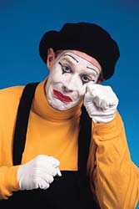
Appeal #2: Emotional
Use Pathos sparingly:
Too much pathos can seem like manipulation and cause the audience to lose trust.
Click for next slide→

Slide 20
Appeal #3: Ethical
Click for next slide→

Slide 21

Appeal #3: Ethical
ETHICAL Appeal: maintaining a fair, calm, and logical tone, acknowledging dissent and opposition’s views, & not relying on fallacies.
Sometimes referred to as “Ethos”
Click for next slide→

Slide 22

Appeal #3: Ethical
Using Ethos or Ethical appeal:
  Acknowledge & give credit to your opponent’s valid points
  Use neutral words whenever possible
  Point out what you and your opponent have in common

Slide 23

Appeal #3: Ethical
The Ethical Appeal is especially important when refuting the opposition.
  You should not appear angry, abusive, closed-minded, or impulsive when arguing against your opponent’s ideas.
Click for next slide→

Slide 24

Arguments…
Use APPEALS
→Present EVIDENCE
→Treat Audiences FAIRLY
Click for next slide→

Slide 25

Evidence
A good argument must present evidence
Click for next slide→

Slide 26

Effective Evidence
Evidence must be Relevant: evidence should support the essay’s thesis and be pertinent to the argument being made.
Click for next slide→

Slide 27


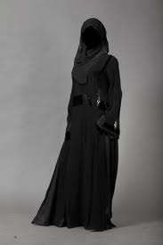



Effective Evidence
Evidence must be Representative or Typical: evidence should represent the full range of opinions about the subject and not just one side or the other.
Click for next slide→

Slide 28

Effective Evidence
Evidence must be Representative or Typical:
  You want a balanced and convincing discussion.
  In addition, the examples and expert opinions you include should be typical rather than extreme.
Oh yeah, that happens all the time…sure…
You see, my client had amnesia and was in a “walking coma” …
Click for next slide→

Slide 29

Effective Evidence
Evidence must be Sufficient: there should be enough evidence to support the claim(s).
  The amount of evidence required depends upon the assignment requirements, your audience, and the nature of your thesis.
One UFO sighting is not sufficient to prove I exist!
Click for next slide→
Notes:
Remember, extraordinary claims require extraordinary evidence. An audience likely to argue with your position will need more evidence than one likely to agree with you.

Slide 30

Effective Evidence
Evidence must be Accurate: Data should not be used unless it is accurate, up-to-date, and from credible sources.
Notes:
Take again the case of Iraq and WMD. Tony Blair, Britain’s PM may have to resign because the case he made for sending British troops relied on inaccurate information that stated that Iraq has a 45 minute launch capability against British troops. It has since been revealed that this statement was not accurate. In 45 minutes Iraq could launch ground troops, but NOT WMD. As a result, his credibility is shot and many argue he has lost his effectiveness as a leader.

Slide 31
Arguments…
Use APPEALS
Present EVIDENCE
→Treat Audiences FAIRLY
Click for next slide→

Slide 32
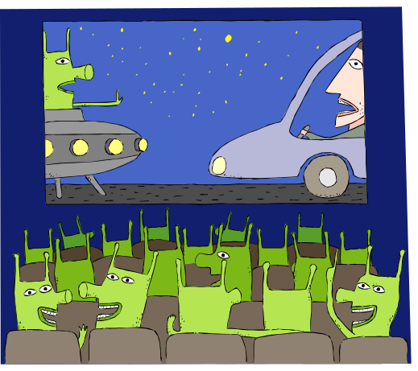
Audience
When writing to or analyzing an audience for an argument, keep the following in mind…
Click for next slide→

Slide 33
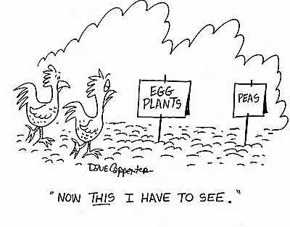
Clear Sense of Audience
In argumentative writing, the audience should be treated as if they are
    educated
    and
    skeptically neutral.
Click for next slide→

Slide 34

Clear Sense of Audience
An audience may not be hostile to an argument’s thesis, but the audience needs to be convinced of the argument’s validity.
Click for next slide→

Slide 35

Clear Sense of Audience
When presenting an argument to an opposing audience, a writer must accommodate the views of that audience.
  Nobody wants to be lectured to or to be told that he or she is a bad person for having certain views, beliefs.
Bad, bad people!
Click for next slide→

Slide 36

Inappropriate Appeals
Always problematic in an argument…
Click for next slide→

Slide 37


Inappropriate Appeal
Too much emotion: writers who feel strongly about a topic often become too wrapped up in it and begin to sound hysterical.
  Writers must balance their passion and their dedication to a fair argument.
Click for next slide→

Slide 38


Inappropriate Appeal
Appeal to FEAR: Attempting to scare the audience with predictions of doom is rarely effective.
You are facing a grim future!
Click for next slide→

Slide 39


Inappropriate Appeal
Exploiting readers’ insecurities:
  Isolating readers - implying that readers who disagree are “outside the norm” or “left behind”
If you disagree, this will be you!
Normal people
YOU
Click for next slide→

Slide 40

Inappropriate Appeal
Exploiting readers’ insecurities:
Flattering readers – giving false compliments to those who agree
Supporters of this argument are the intelligent, successful people—like you!
Click for next slide→

Slide 41

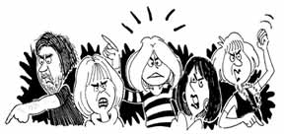
Inappropriate Appeal
Exploiting readers’ insecurities:
Angering readers – inciting anger in an audience to prevent critical thinking
Foreign countries just take handouts from the U.S. and never work for anything!
Lazy freeloaders!
I hate foreign countries!
We should bomb them!
Me too!
Click for next slide→

Slide 42

Inappropriate Appeal
Presenting fallacies as evidence:
Please be familiar with the Fallacies of Argument – Recognize them in others’ arguments and avoid them in your own!
Click for next slide→

Slide 43
Review – Arguments…
Use APPEALS
Present EVIDENCE
Treat Audiences FAIRLY
End of Presentation.

Slide 44
Essay 4: HIP/SLICE "Fix-It" Call‐to‐Action
Objective- this Call to Action essay examines a community issue (like the challenges the characters face in our class novel), and proposes solutions (Rogerian style argument) to those problems.
Primary Source- your HIP/SLICE “Fix-It” journal (20 pages of interviews and observations) about this community issue is your primary source for Essay 4.
Using your journal and research argue for reasonable solutions (the call-to-action, or “Fix-It” as Sonia Sanchez recommends) that can be implemented.
Presentation- you will share in class a 5 slide presentation from your journal.

Slide 45
Outline
Thesis statement- clearly specify the crisis (problem) and your call-to-action (proposed solutions)
Supporting paragraphs- organized subject by subject or alternating style.
One half of the essay should explain the crisis:
  What is the problem? What are the causes?
  What or who is most affected? Who might not see it as a problem?
The other half of the essay should include your call to action:
  What are the possible solutions? What are the benefits of the solutions?
  What are possible limitations of the solutions?
  How much will the solutions cost? Who will pay for them?
  Who might best solve the problem? Individuals, government, businesses, or a combination?

Slide 46
Rhetorical Analysis
Audience- who do you think is the intended reader
Purpose- what do you think was the author's objective
Context- When, Where, Why, Who, What happened, and How did it happen?
Stance- What do you think is the author's attitude or opinion is about the topic?
Media- what publishing format do you think was used for the quote? Tweet, Blog, Article, Interview, Book?
Design- what is the structure of the quote? Ethos(ethics), Pathos(emotion), Logos(logic)? What is the style?
Inclusive Topic Sentence- [write]to make paragraph unified, coherent, and clear (reference the prompt in this sentence here...)
Transitions [write]– advance your argument smoothly (or reference the prompt in this sentence here)
Summation and Prediction write]– what is the future with or without this prompt’s Thesis?

Slide 47
Structure & Content Checklist
Title- creative and informative, plus inventive hook
Introduction- identify the topic, debate, and potential controversy
Thesis- specifically state the problem, reactions to the problem, and your proposed solutions for the problem
Topic sentences- clearly identify the topic
Supporting sentences- supports topic and connects to thesis; sentences and transitions provide structure for your essay
Incorporate logical reasons, analysis of examples, and research to support your thesis
Use HIP/SLICE “Fix-It” Journal of observations and Interviews in every supporting paragraph
ICE: introduce, cite, and explain each quotation, example, or paraphrase
Conclusion- summarizes essay and its thesis, and predicts next conversation on this problem

Slide 48
Research Notes / Problem-Solution Worksheet
the crisis | potential objections to this explanation | evidence to illustrate the problem
• What is the problem or crisis? • What are the causes? • What or whom is most affected? | • Would anyone say this is not a crisis? • Who? • Why? | List & cite research that will explain the crisis & overcome potential objections [facts, statistics, examples, etc.]:

Slide 49
Research Notes / Problem-Solution Worksheet
possible solutions (the call to action) | potential objections to these solutions | evidence to illustrate the solutions
• What are the possible solutions? • What are the benefits of those? • What are the possible limitations? • How much will they cost? • Who or what will pay for them? • What solutions have not worked in the past? • What solutions have worked in other places? | • Would anyone disagree with the solutions? • Who? • Why? | List & cite research that will support your solutions & overcome potential objections [facts, statistics, examples, etc.]:

Slide 50
Writing an Effective Thesis
Clearly state the Problem
Include what others are saying about the problem
Contrast your opinion
Begin with a subordinate (“Although”)
Transition to your opinion (“however”)
Thesis Statements tell your readers exactly what topic you will be discussing and where you stand on the issue. Thesis statements are usually one sentence long and found at the end of the introduction paragraph.

Slide 51
Testing a Working Thesis
Does your thesis answer a question, propose a solution to a problem, or take a position in a debate?
Does the thesis require an essay’s worth of development? Or will you run out of points too quickly?
Is the thesis too obvious? If you cannot come up with interpretations that oppose your own, consider revising your thesis.
Can you support your thesis with the evidence available?
Can you explain why readers will want to read an essay with this thesis? Can you respond when a reader asks “So what?”
  *Hacker/Sommers A Writer’s Reference, 7th edition (Boston: Bedford, 2011)

Slide 52
Classical Argument Strategy
This strategy that you feel strongly about and when you feel you have a good chance of convincing your audience to agree with you. Your audience may be uninformed, or they may not have a strong opinion. Your job is to make them care about the topic and agree with your position. Here is the basic outline of a classical argument paper:
Introduction: announces subject, gets readers interest and attention, makes writer seem trustworthy
Narration: gives background, context, statement of problem or definition
Partition: states thesis or claim and outlines arguments
Argument: makes arguments to support thesis and gives evidence (largest section of paper—the main body)
Refutation: shows why opposing arguments are not true or valid
Conclusion: Summarizes arguments, suggests solution and ties into the introduction or background.
How to Write an Argument Essay Step by Step
May 24, 2018
Virginia Kearney

Slide 53
Rogerian Strategy
Rogerian argument strategy attempts to persuade by finding points of compromise and agreement. It is an appropriate technique to use in highly polarized debates, but you must be sincere about willingness to compromise and change your point of view for the reader to take you seriously. Qualities of this strategy:
The author is Reasonable: Present your character as a person who understands and empathizes with the opposition. Often this means you state opposing position fairly and sympathetically. Example: it is not fair that animals are subjected to painful experimentation to help humans find new cures.
Common Ground: Establish common ground in beliefs and values you share Example: As the dominant species, we do have responsibilities.
Willingness to Change: Be willing to change views and show where your position could be modified. Example: It is a good idea to invest in trying to find ways to get information without using live animals in experiments.
Compromise: Direct your argument toward a compromise or workable solution. Example: let’s look for other ways to get information without using animals, but until we do, we probably need to continue experimentation.
How to Write an Argument Essay Step by Step
May 24, 2018
Virginia Kearney

Slide 54
Toulmin Strategy
Toulmin is another strategy to use in a highly charged debate. Instead of attempting to appeal to commonalities, however, this strategy attempts to use clear logic and careful qualifiers to limit the argument to things that can be agreed upon. It uses this format:
Data: Evidence presented. Example: Pornography on The Internet is bad for kids.
Claim: the thesis the author hopes to prove. Example: Government should regulate Internet pornography.
Warrant: The statement that explains how the data backs up the claim. Example: Government regulation works in other instances.
Backing: Additional logic and reasoning. Example: We have lots of other government regulations on media.
Qualifier: The short phrase (usually uses “typically,” “usually,” or “on the whole”) which limits the scope of the claim. Example: In most cases, the government should regulate pornography.
Exceptions: This further limits the claim by describing situations the writer would exclude. Example: Where children are not involved in pornography, regulation may not be urgent.
How to Write an Argument Essay Step by Step
May 24, 2018
Virginia Kearney

