Slide 1
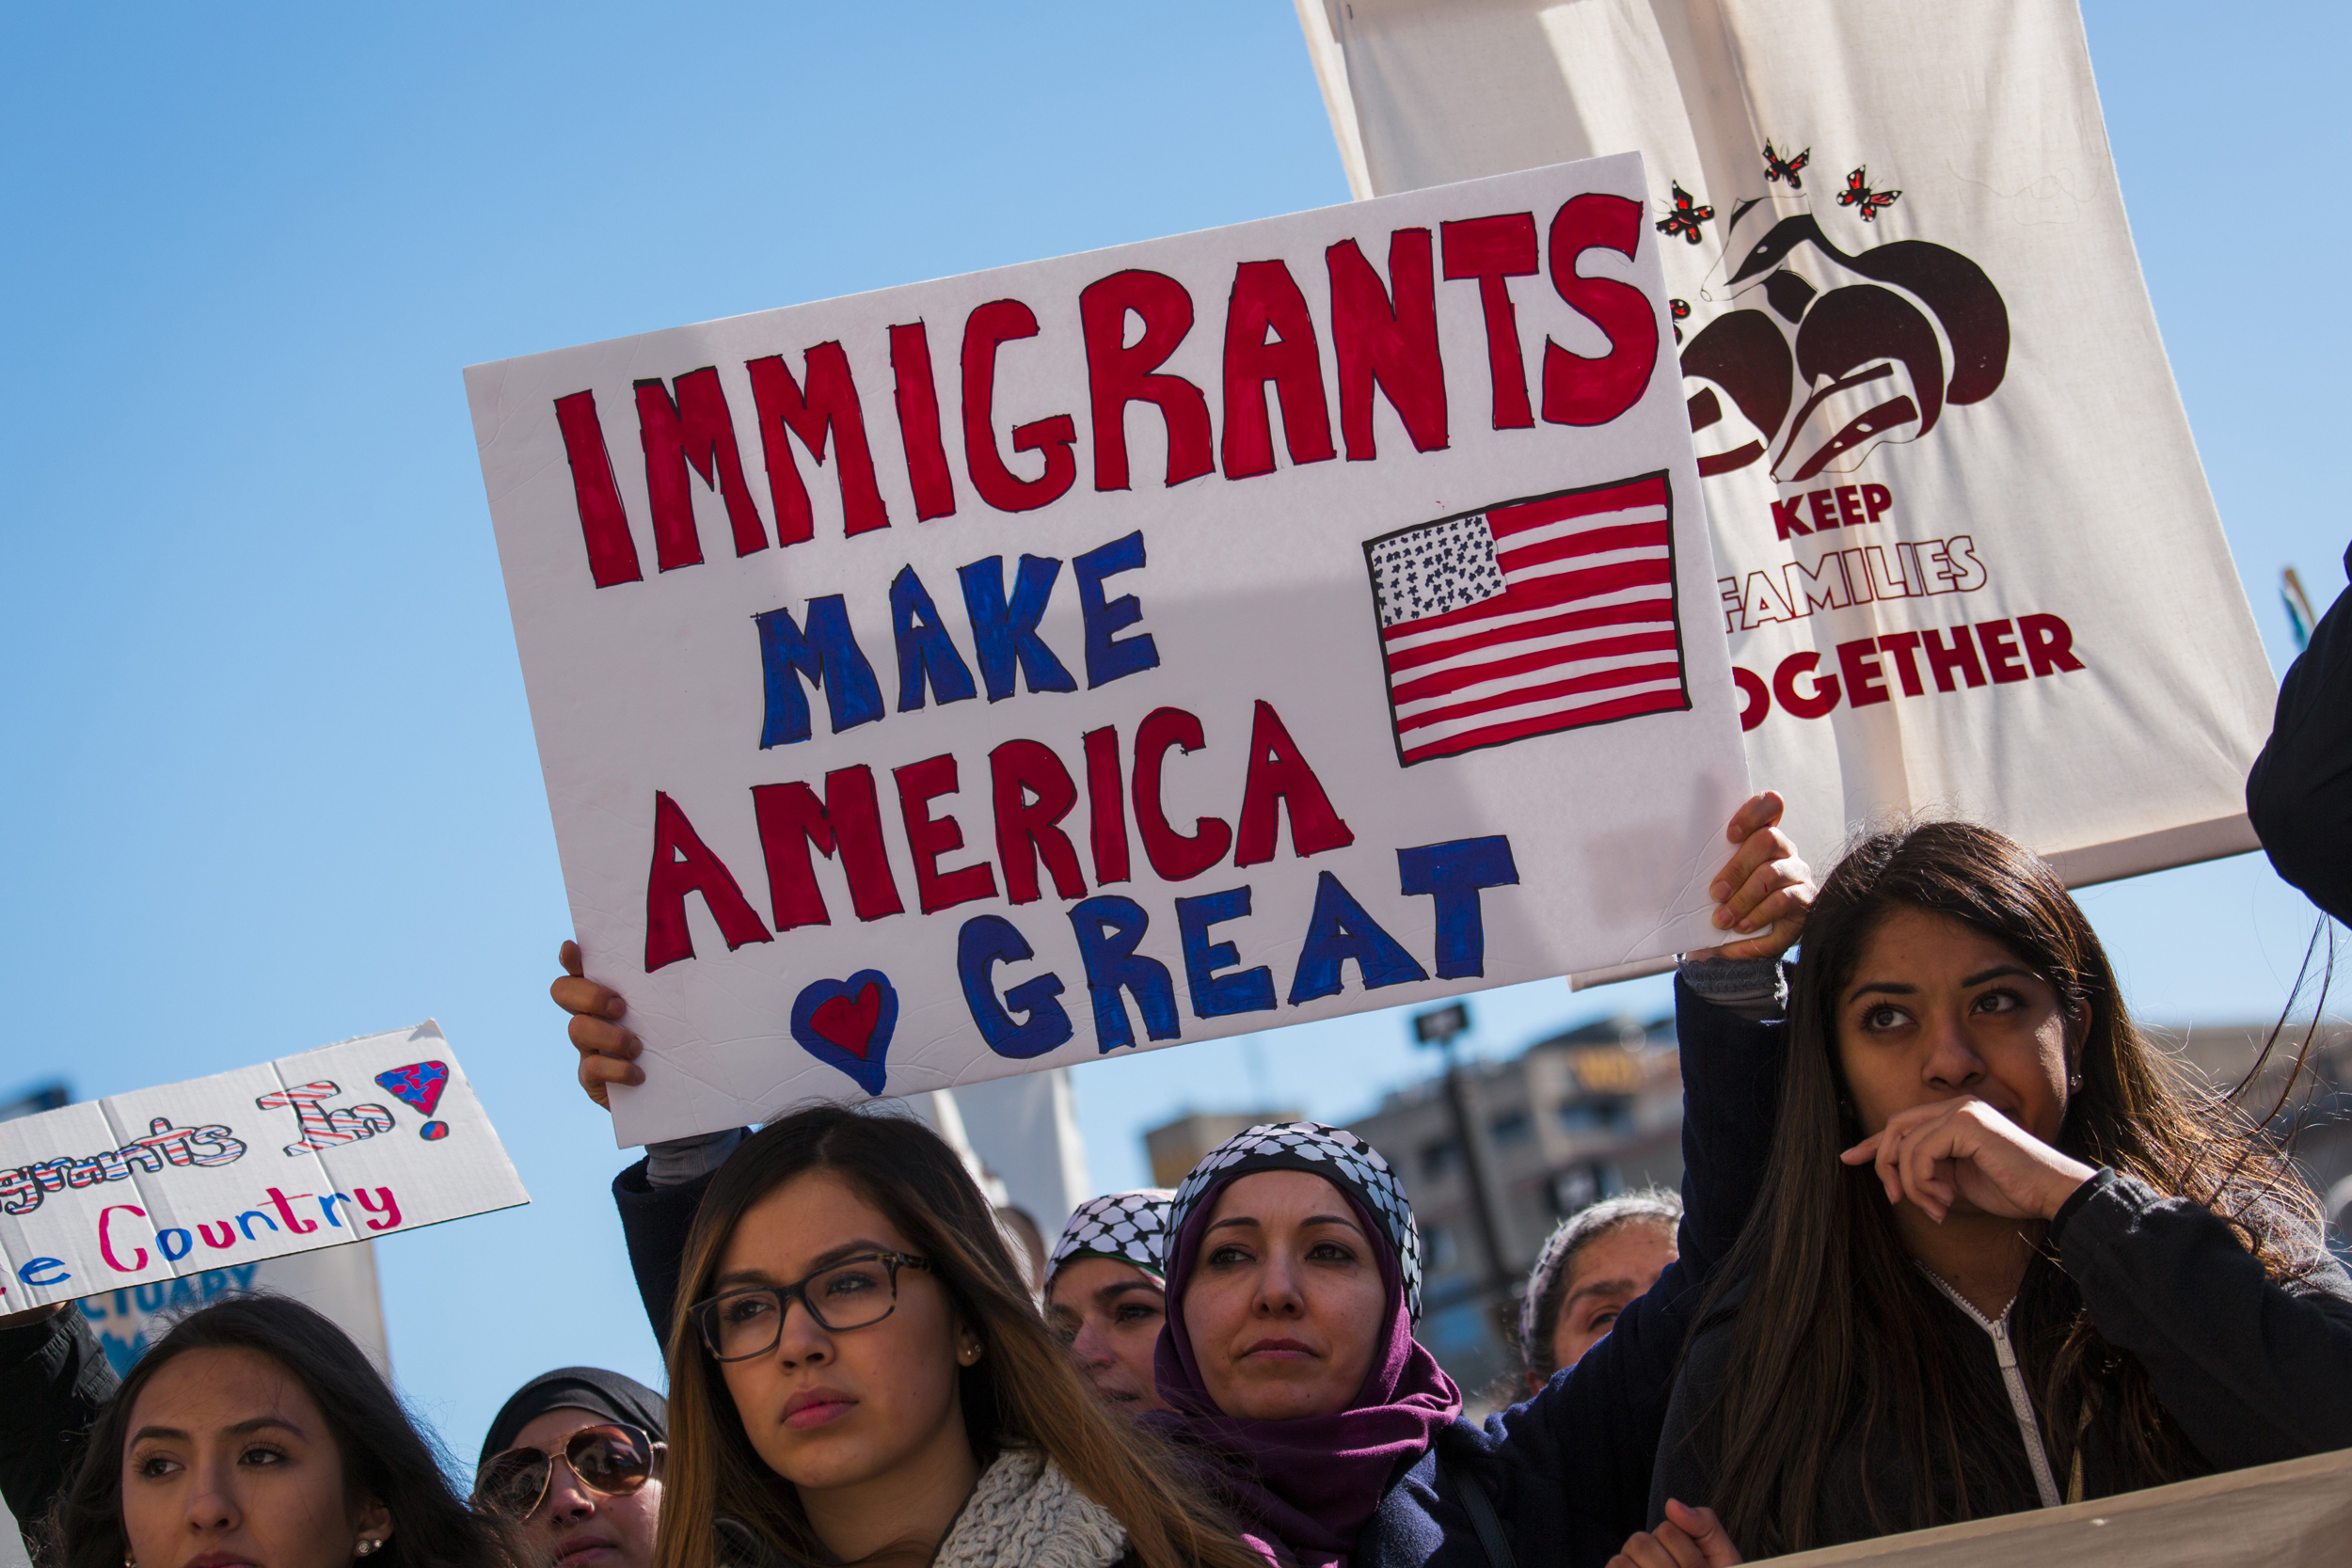
Xenophobia and its Solutions
Notes:
I decided to do my presentation on Xenophobia. At first, I was disappointed because of the double down effect. People don't seem to want to change their minds about anything they feel strongly about. But how did they get to that place in the first place?

Slide 2
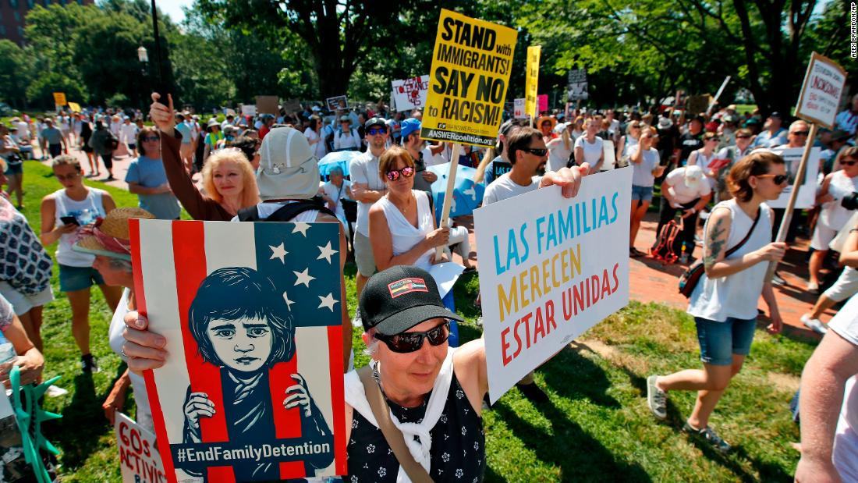
We use propaganda in everything we do.
Notes:
Propaganda seems to be the number one way that people convince others of their story. Propaganda is information in a biased nature which is publicized to convince people of a political cause or point of view.

Slide 3
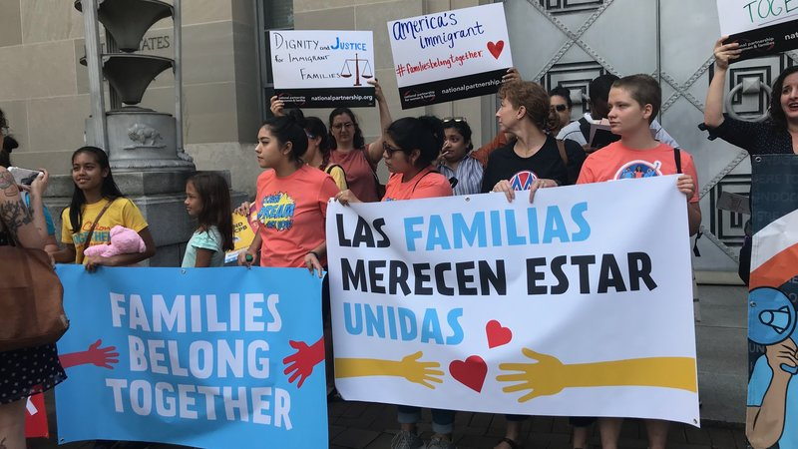
We fight for our human rights using rhetoric and appeal to emotions/ pathos
Notes:
So why not use propaganda for things we believe are right? That is what the other people seem to be doing too. Propaganda can be grounded in reason and pathos. If we be honest with ourselves, all rhetoric is some form of propaganda.

Slide 4
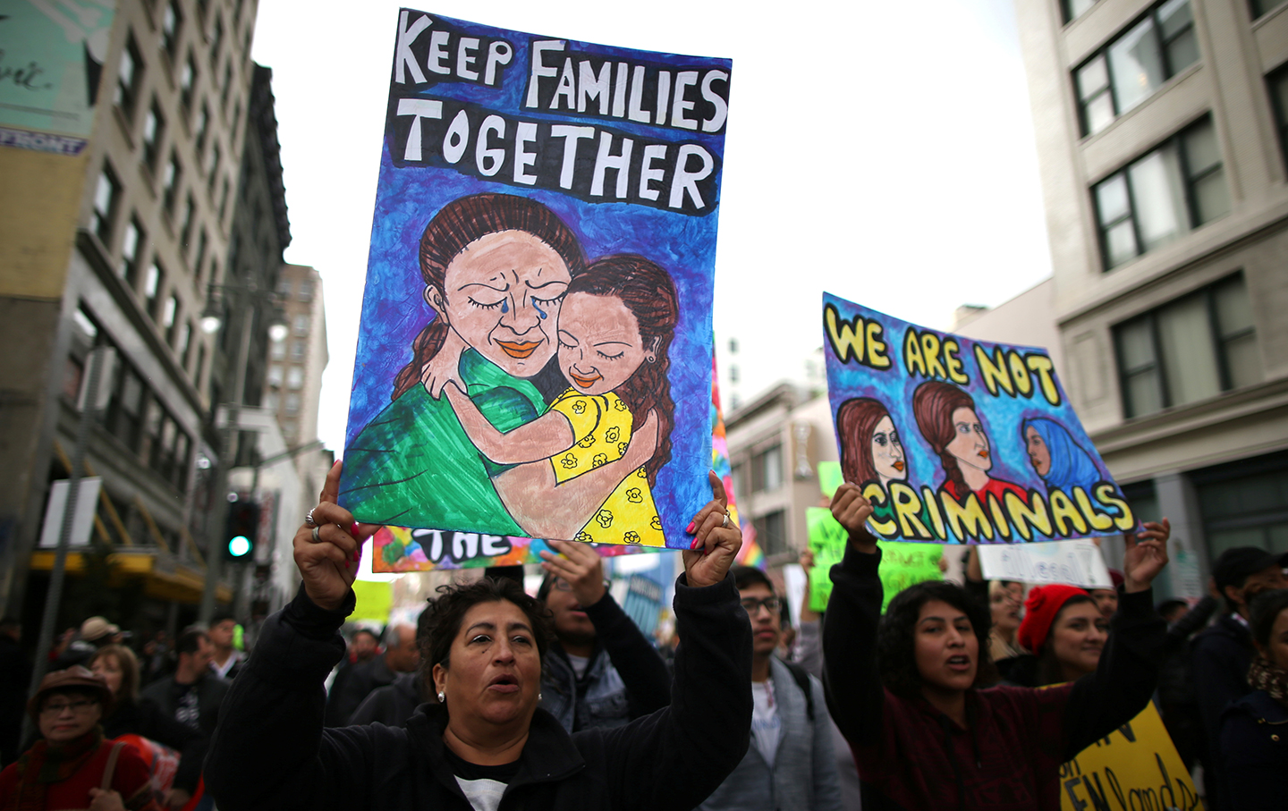
Our country’s reality is contingent upon the consensus of the people. The consensus creates a mythology to which we can subscribe to: like a YouTube channel.
Notes:
The reality we create is contingent upon the rhetoric that we use. The sapir-whorf hypothesis is the notion that language shapes experience. The more positive language and accepting language we use as a society of immigrants, the more we can create a society that would have the greatest good for the greatest number of people.

Slide 5
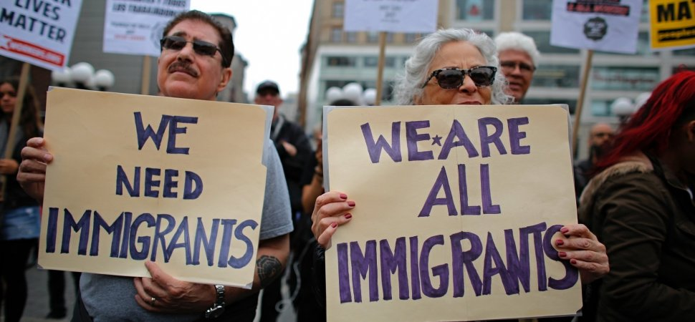
To combat Xenophobia we must use art, music, poetry, and other forms of rhetoric/ propaganda to create the reality we want as citizens. The more consensus, the more power it has.
Notes:
We can use any medium we want to convey our point. We can use maps, art, sculpture, literature, architecture, film, poetry, essays, etc. Whatever the medium, propaganda normalizes the ideology of the people implementing it.

Slide 6
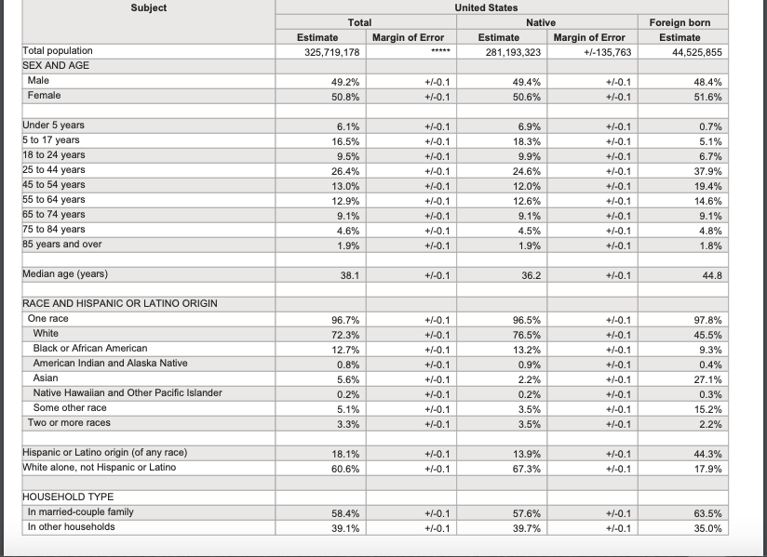
U.S.
Census
Bureau
2017
Report on
Immigration
Notes:
This is from the census bureau's website. Most foreign born people in the United States are women. The largest age group is 25 to 44 years old. The median age is 44 years old. 45 percent are white. 44 percent are hispanic or latino. 63 percent of all immigrant households include a married couple with children.

Slide 7
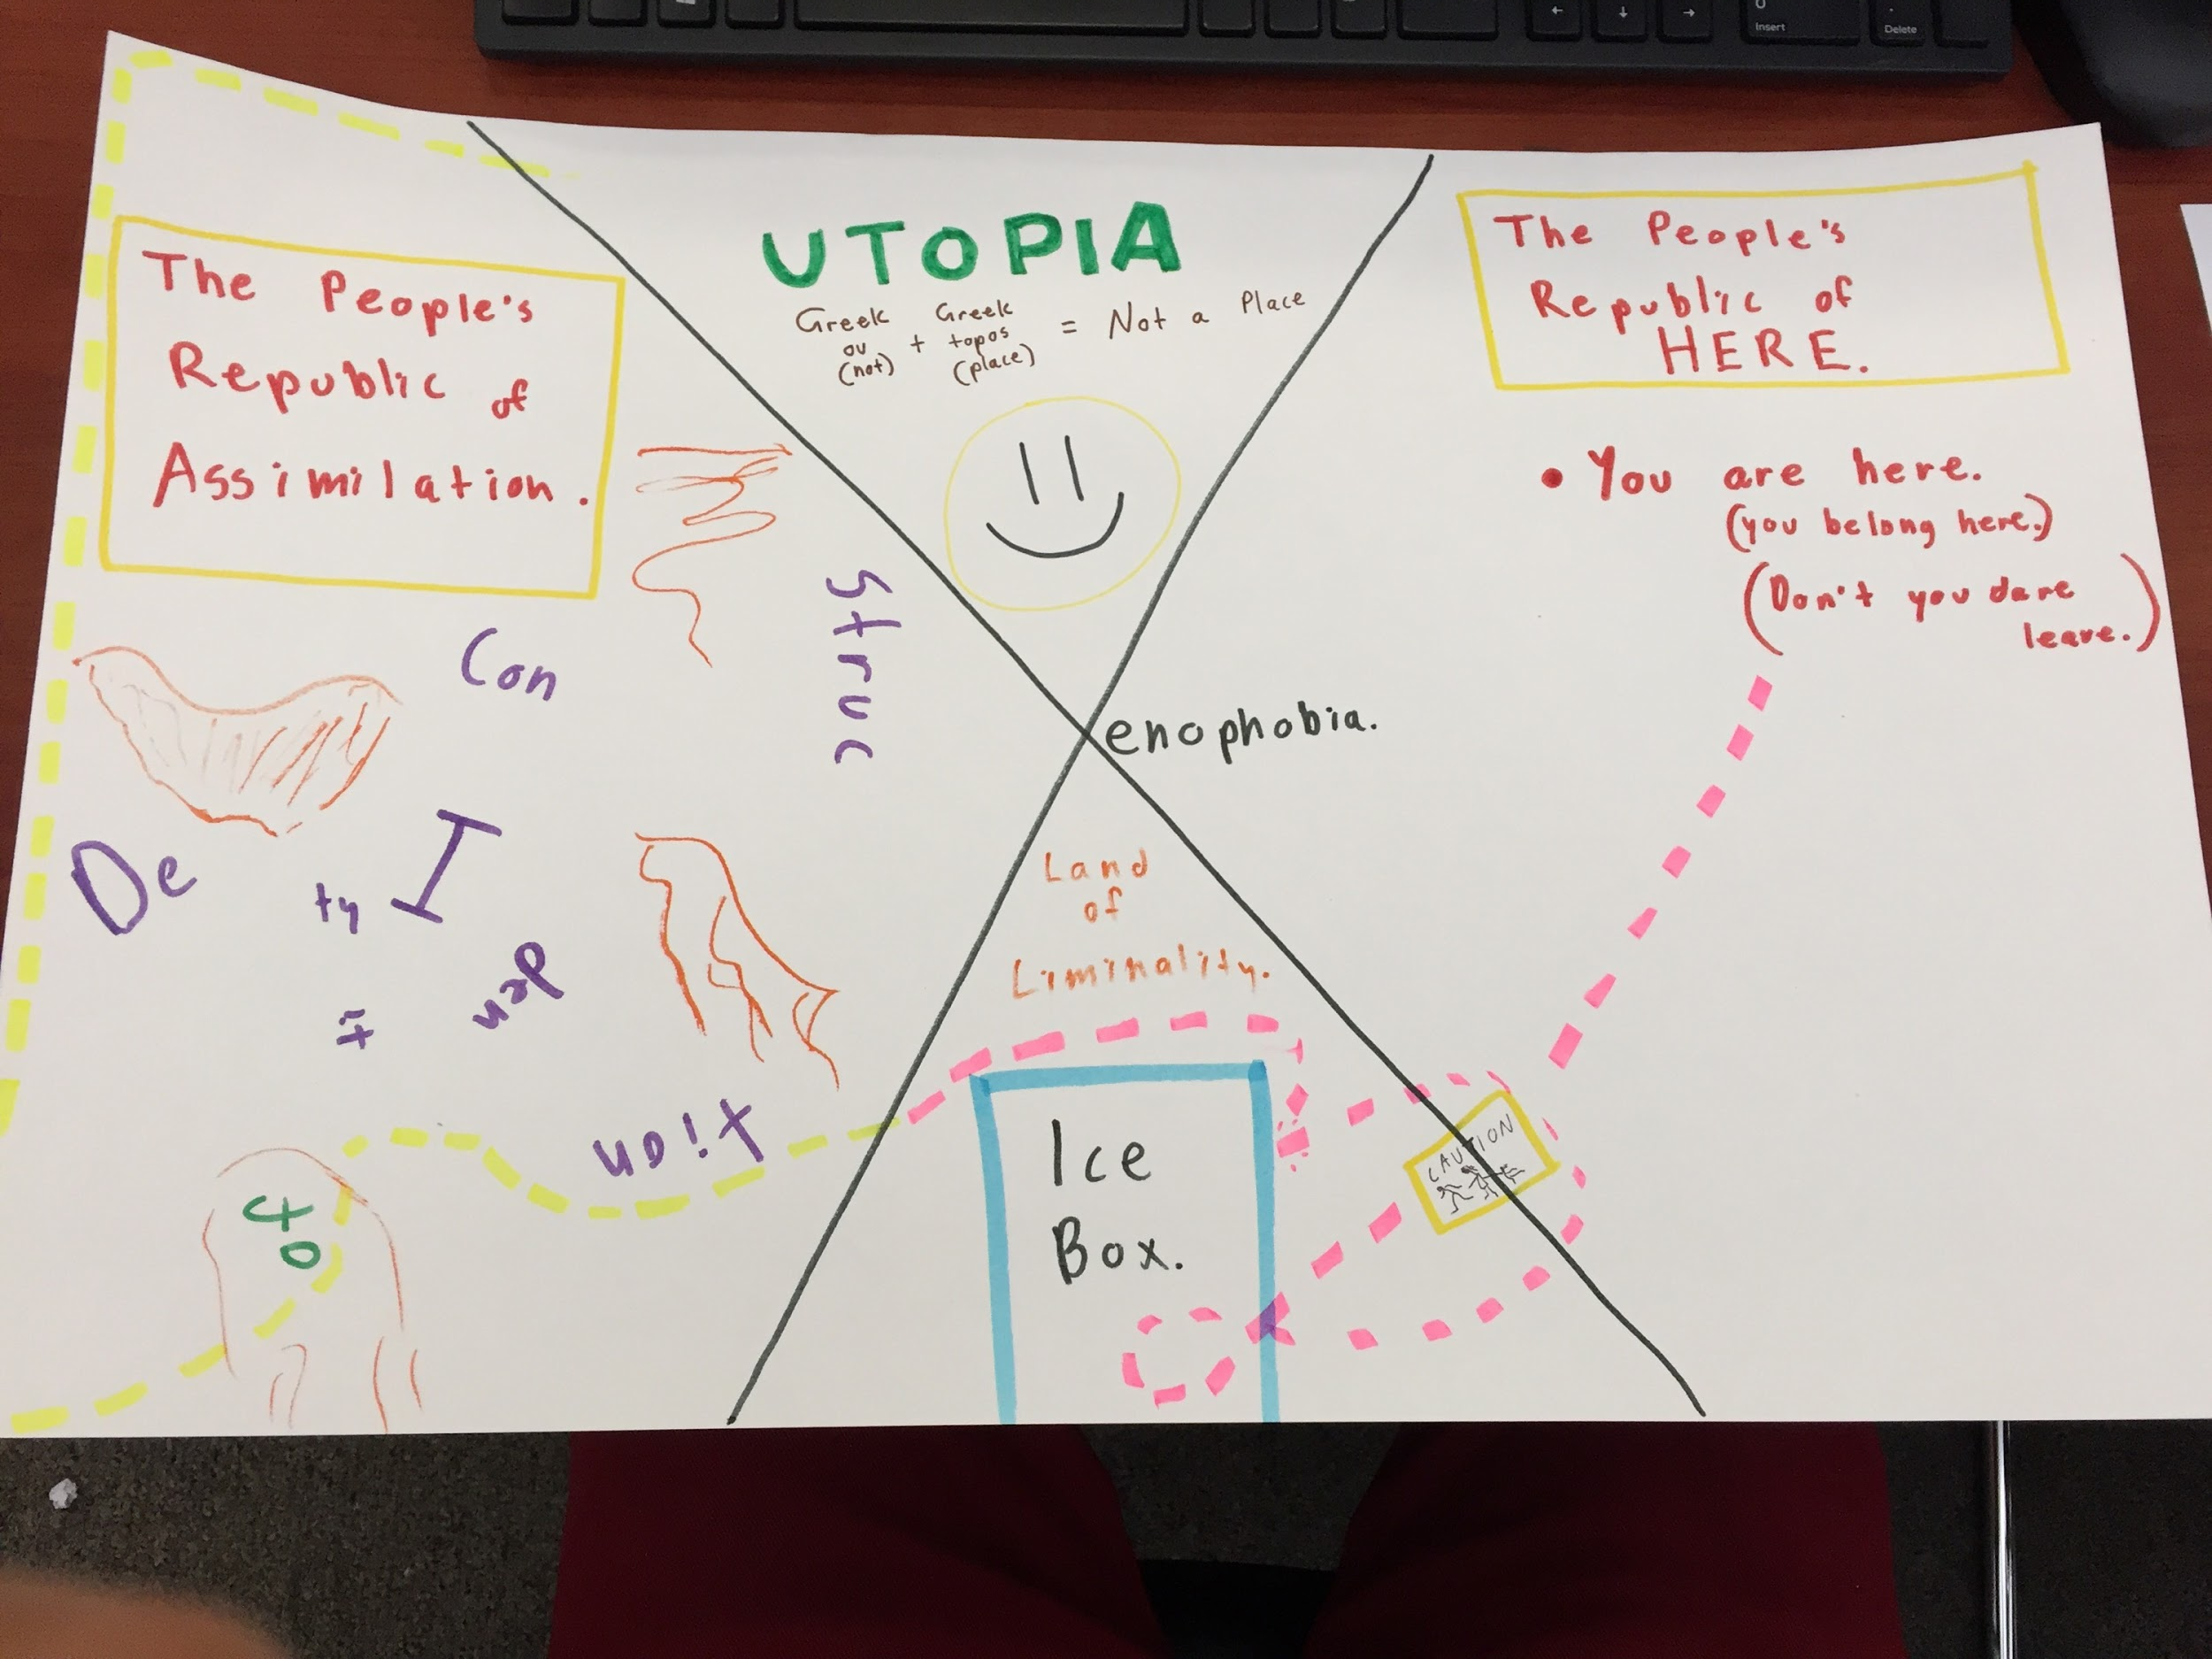
Notes:
I liked the idea of love maps. This is a lovemap with a twist: it’s the idea of what goes on when somebody is forced to leave their country.

Slide 8

Spoken
Word
Notes:
Spoken word is on Youtube so it should play anywhere.

