Slide 1
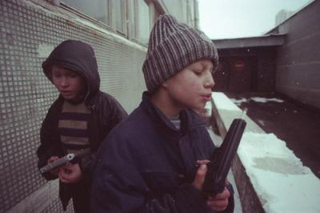
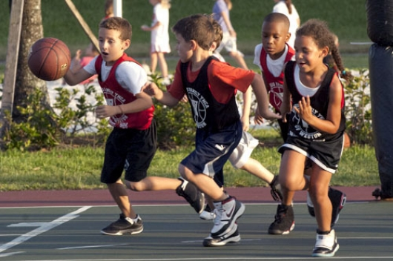
Juvenile Gun Violence
Edward Rocha
ENG 350

Slide 2
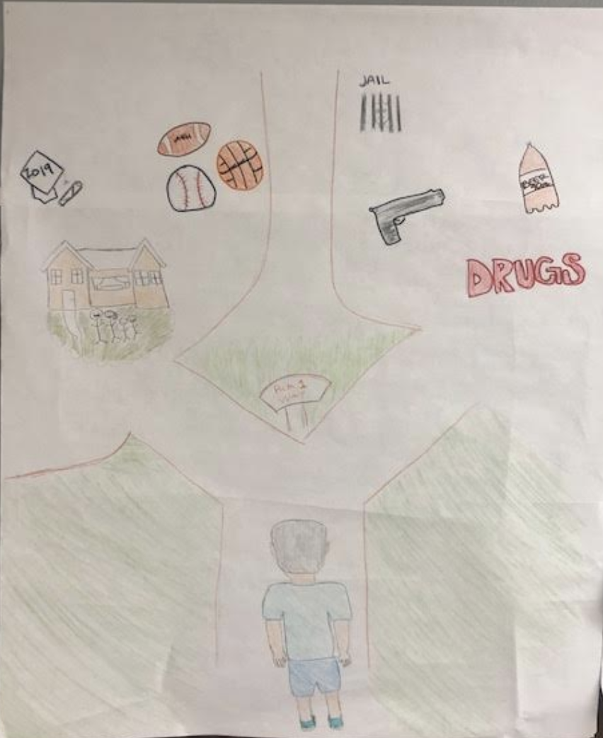

Slide 3


Slide 4


Slide 5


Slide 6
