Slide 1
HIP/SLICE “Fix-it” with spoken word Presentation
Kimberly Cruz
The American Dream
English 350

Slide 2
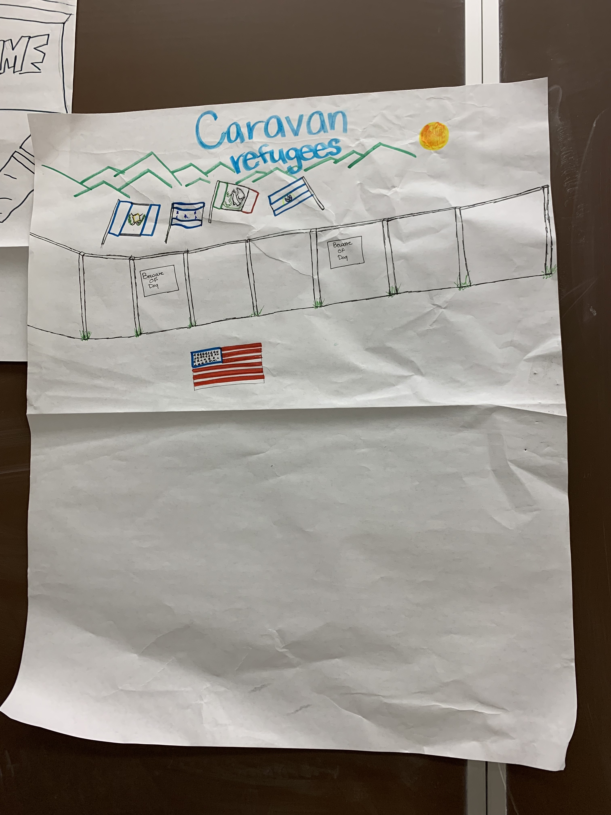
My poster in class

Slide 3
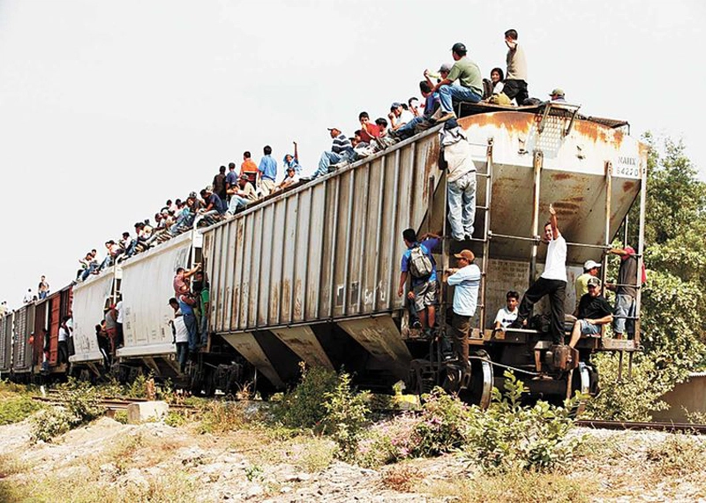
Risks that refugees have to face with to Come to the U.S.

Slide 4
Spoken Word
The Migrant Caravan, who comes to America needs to feed its children. The migrant Caravan needs to get their children off the violent streets. The migrant Caravan doesn’t pay attention to the Second Amendment. The migrant caravan doesn’t have power. The migrant Caravan doesn’t have the power to work. The migrant Caravan doesn’t have rights. The migrant Caravan does not take medication to fight depression and anxiety. Though they may have been suffering from traumas. The migrant Caravan woman may be carrying their children with them suffering from migraines. The migrant caravan doesn’t understand what Donald Trump says in English. The migrant Caravan is not an alien, but rather a human fighting for the American dream. The migrant Caravan chose to flee their country because of violence, persecution, war, discrimination, racism, gender inequality, and sexism.

