Slide 1
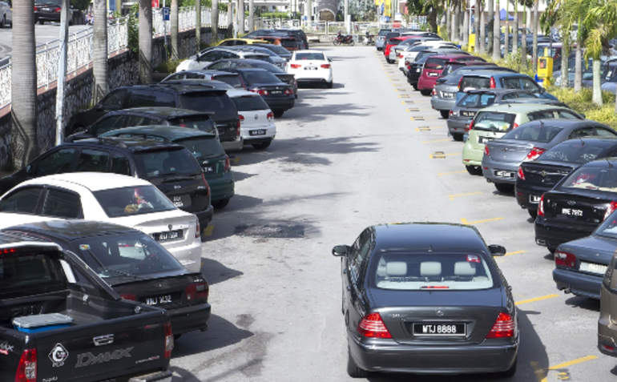
The Parking Problem
By: Mirna Benavides
Professor Ramser
English 350-07

Slide 2
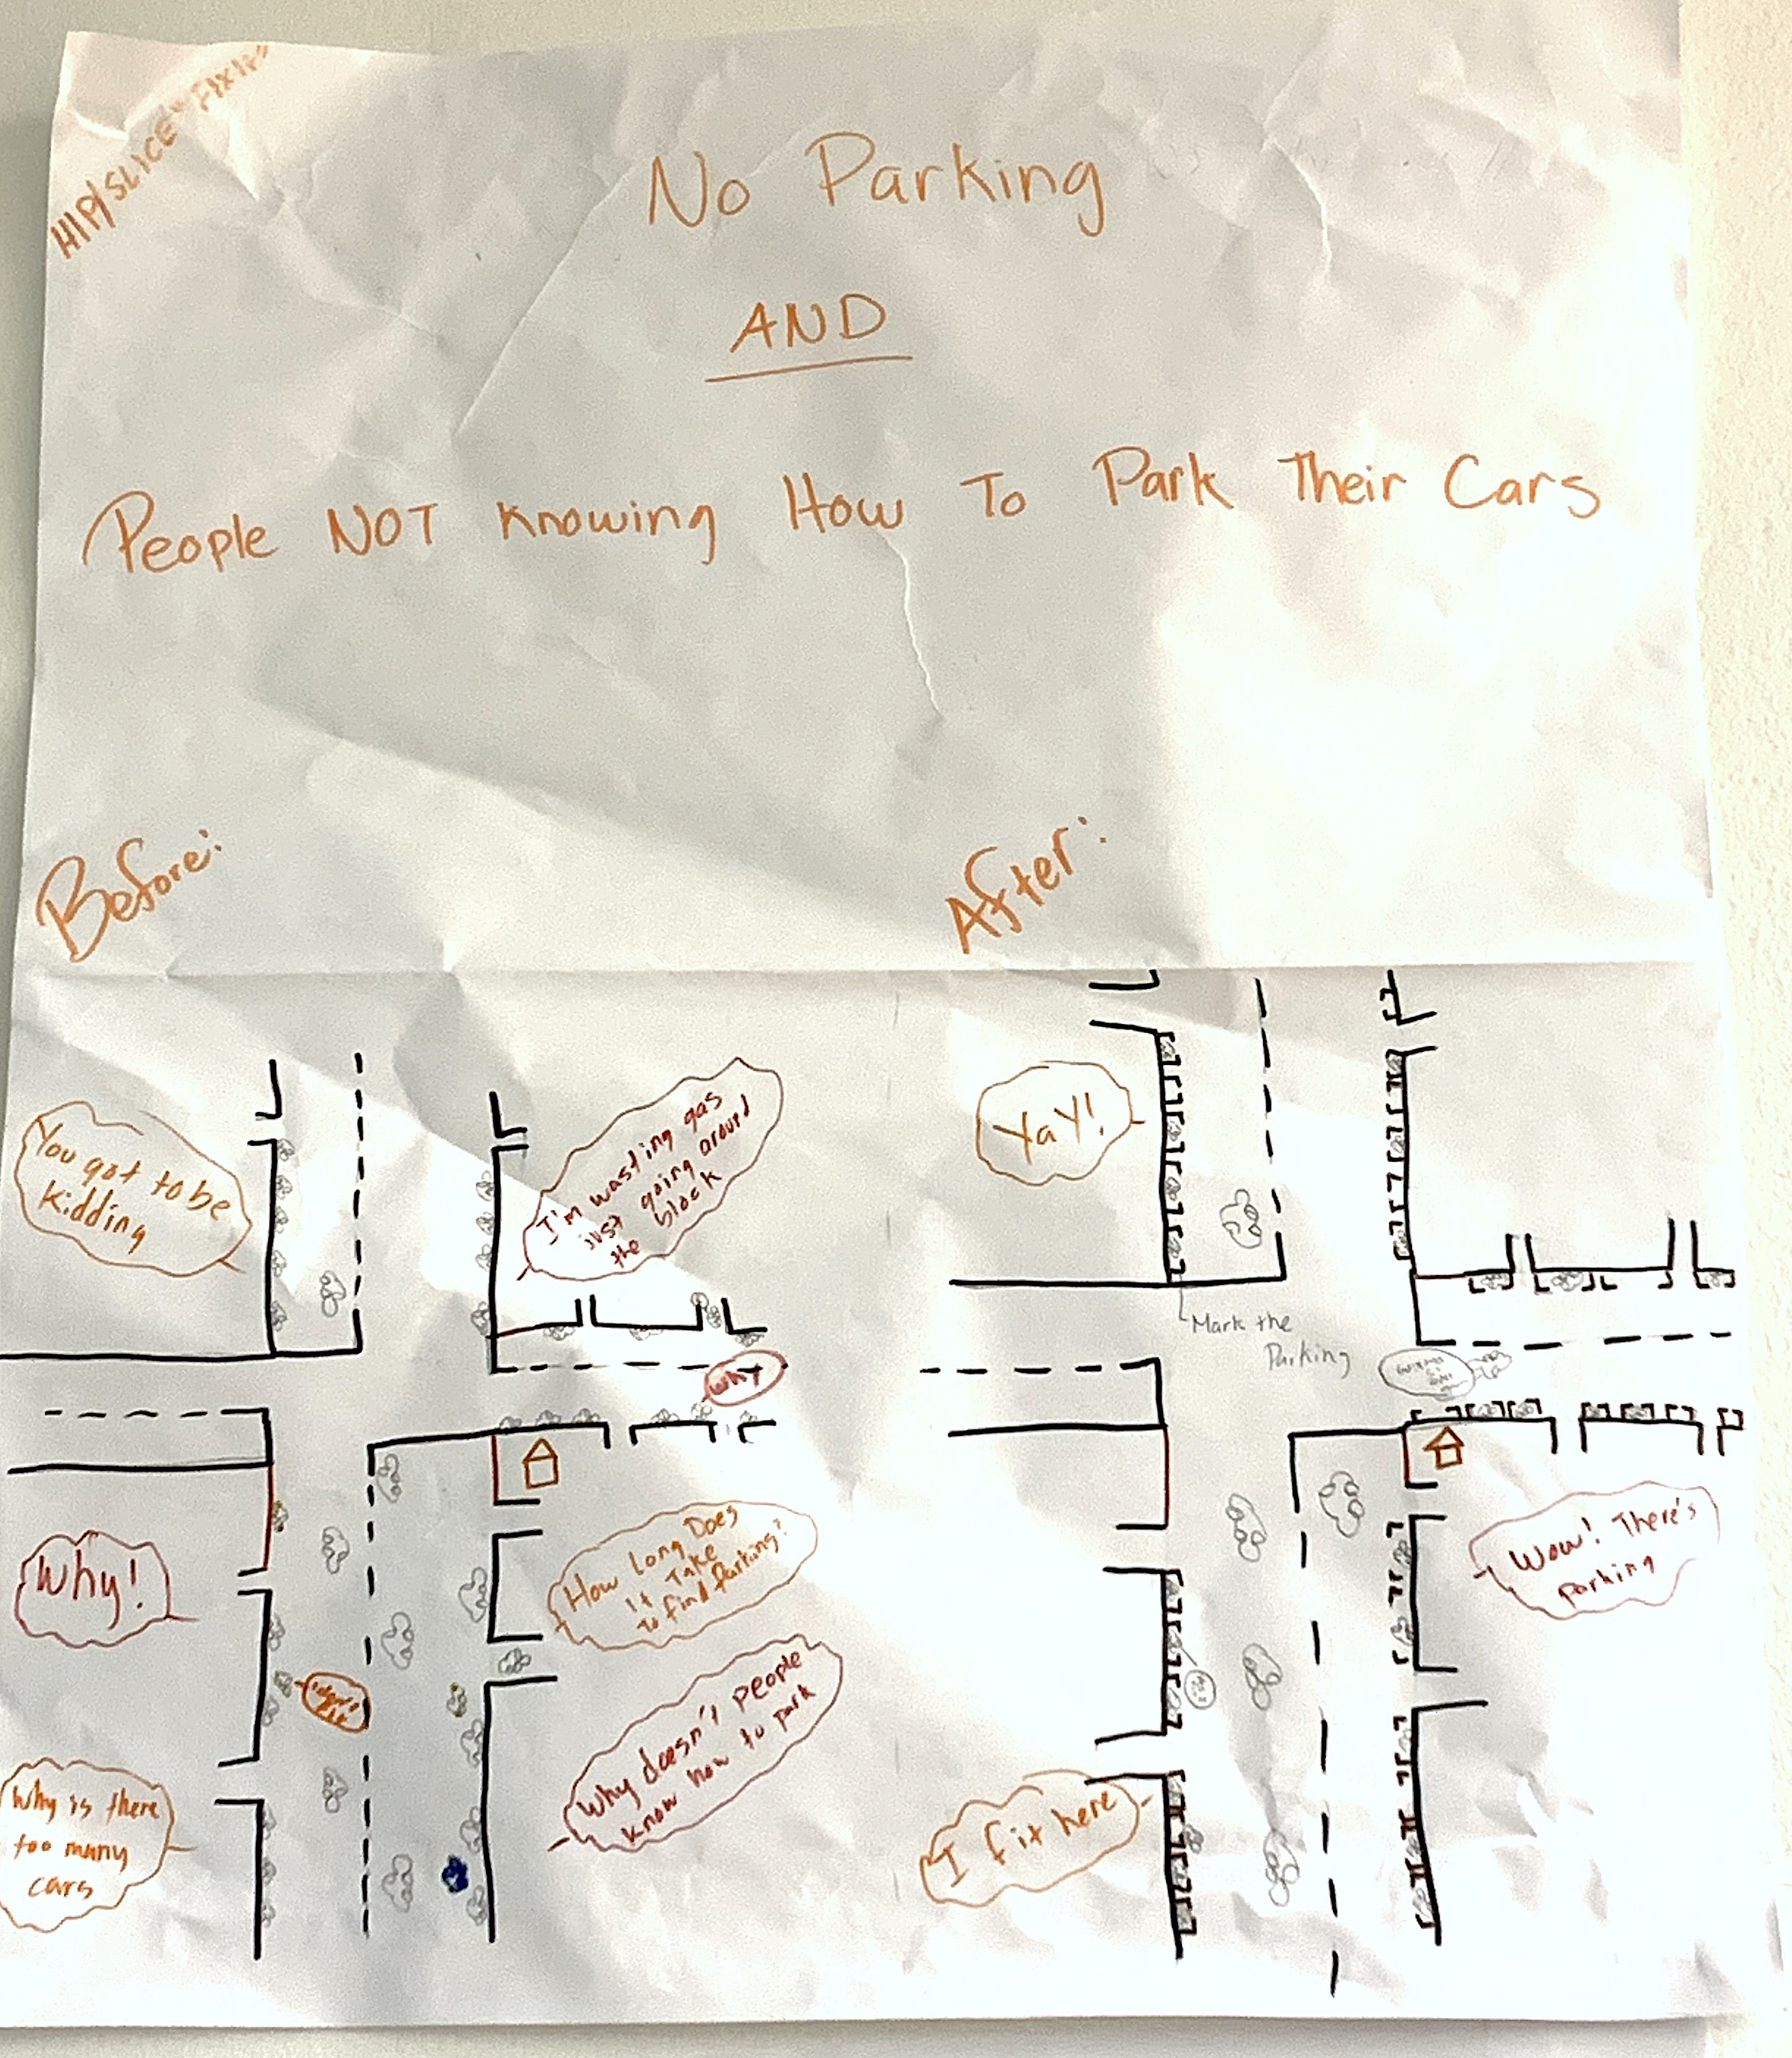

Slide 3
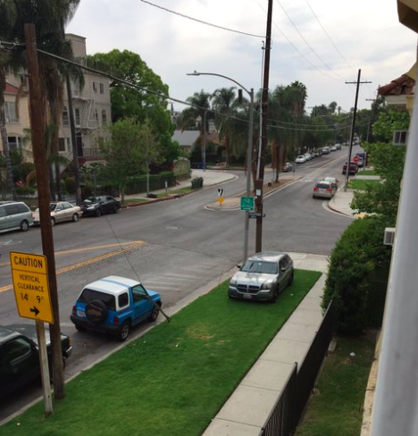
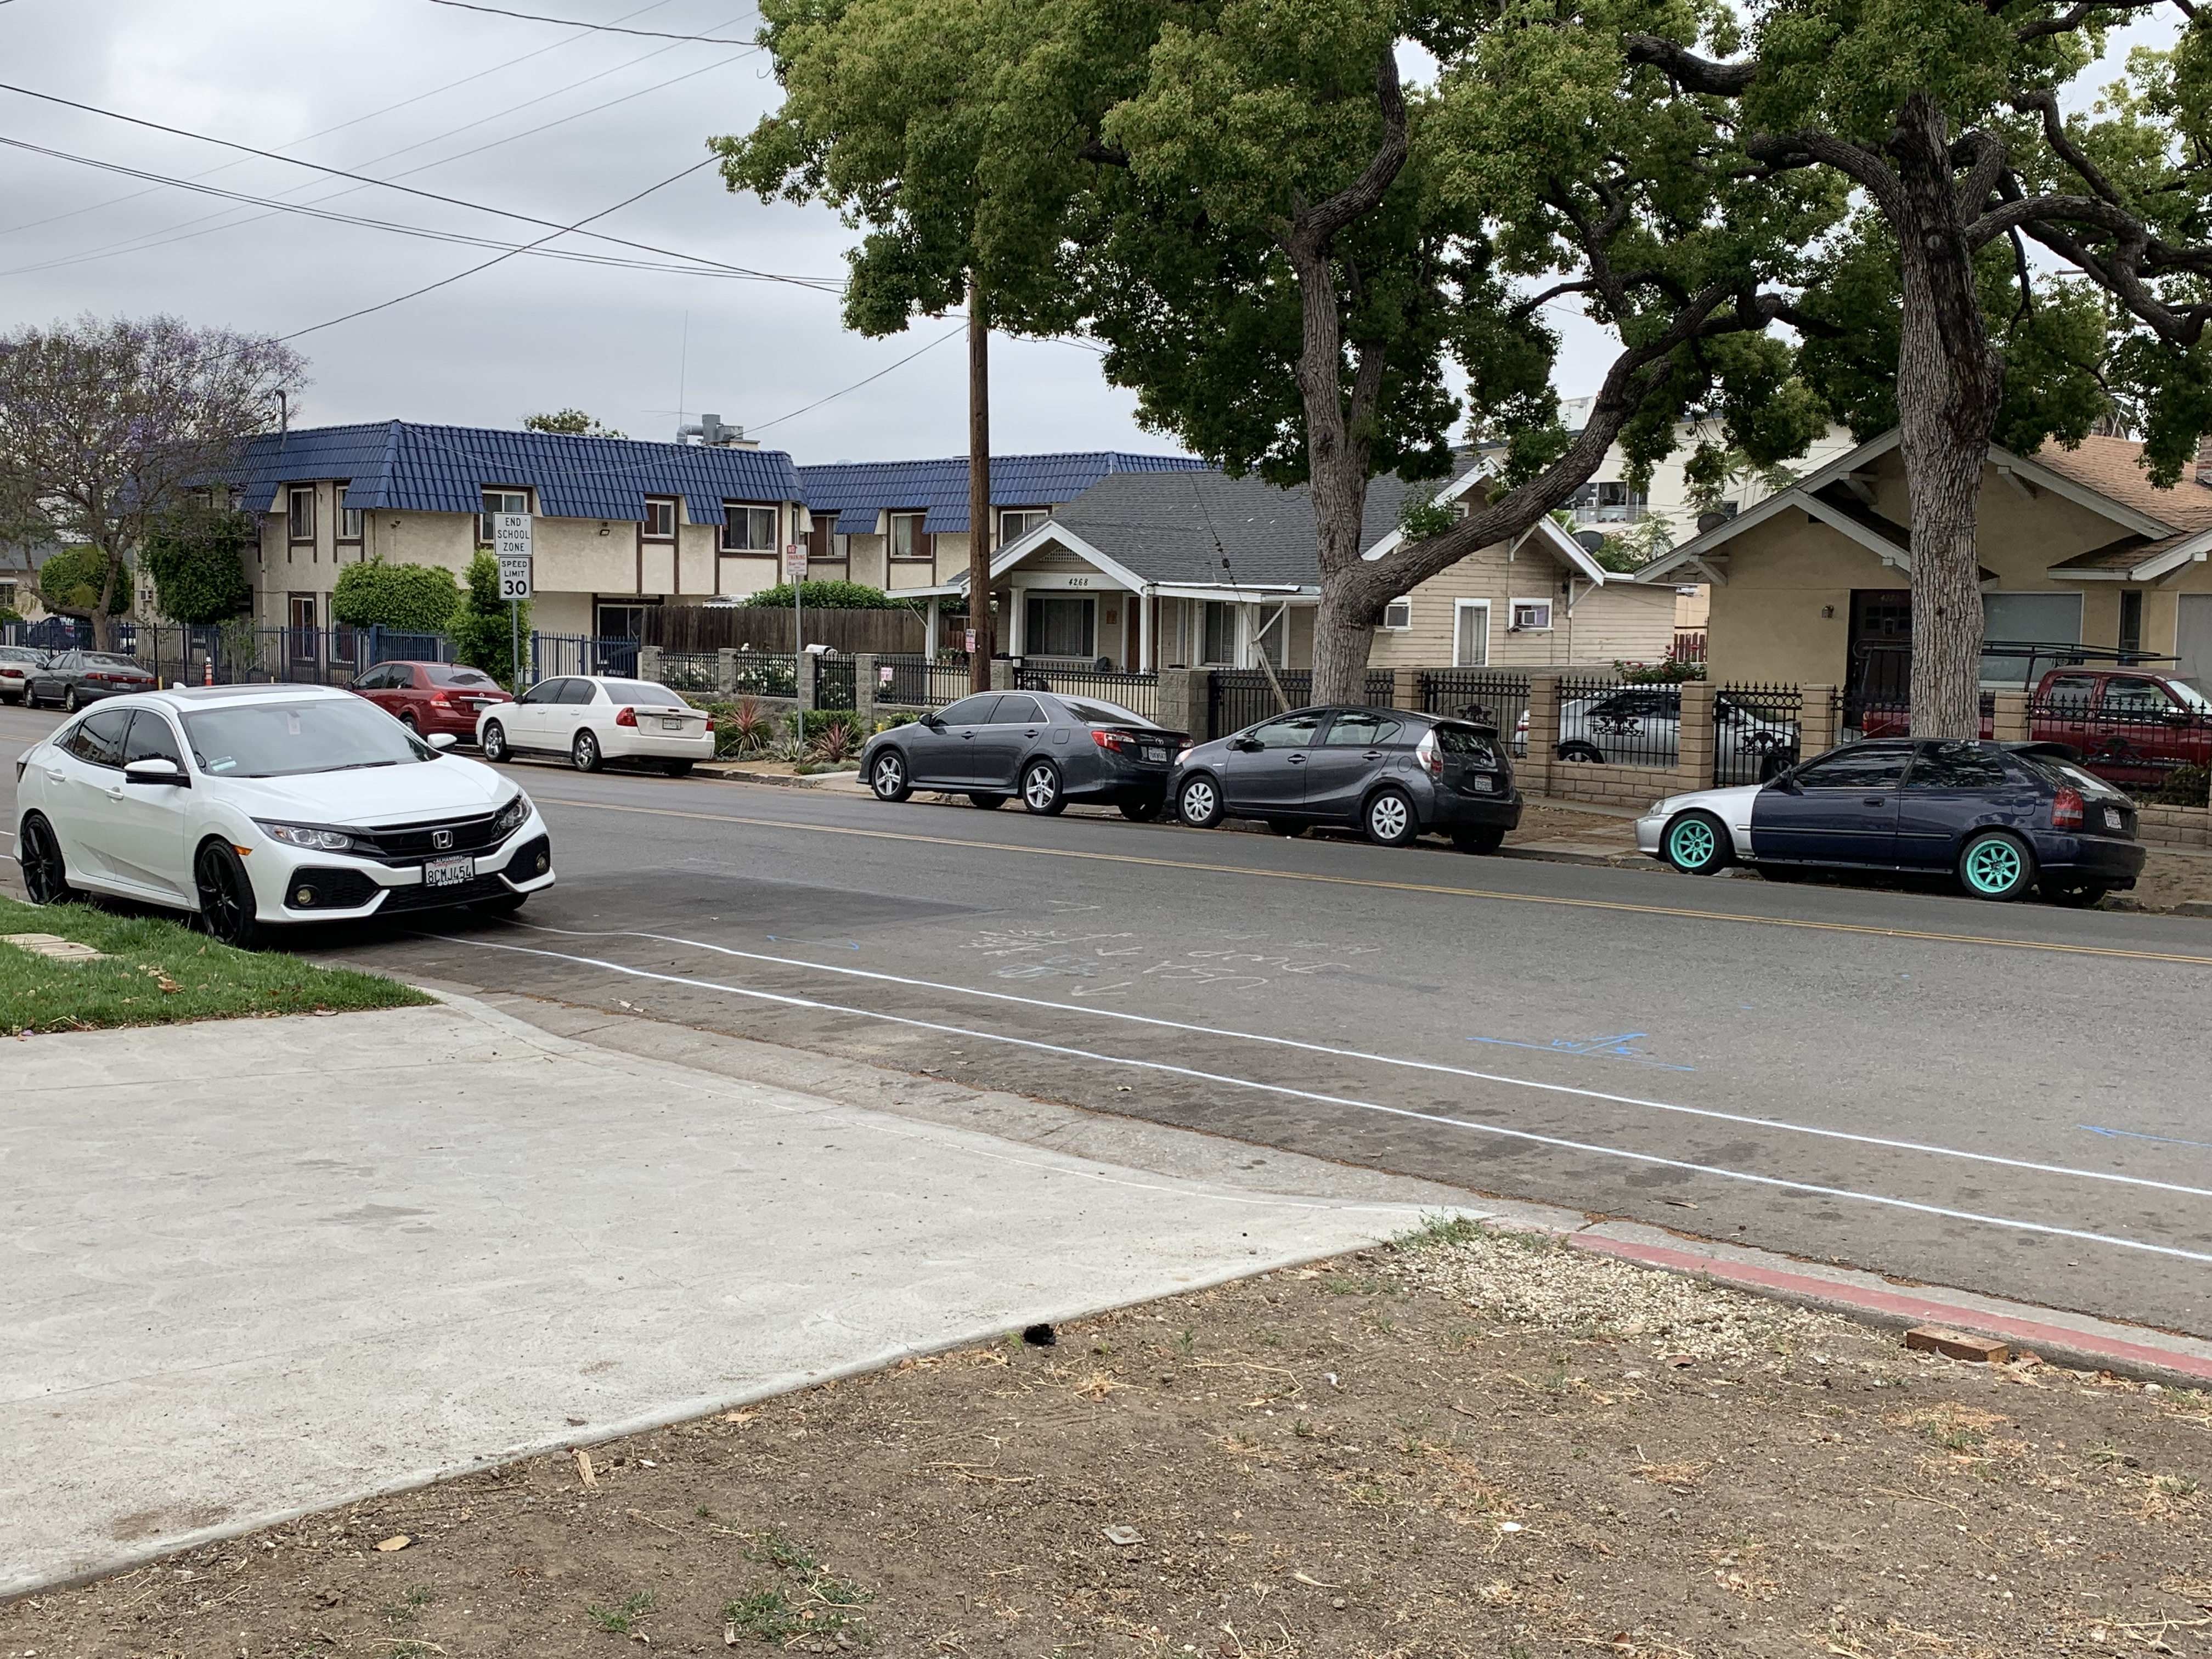
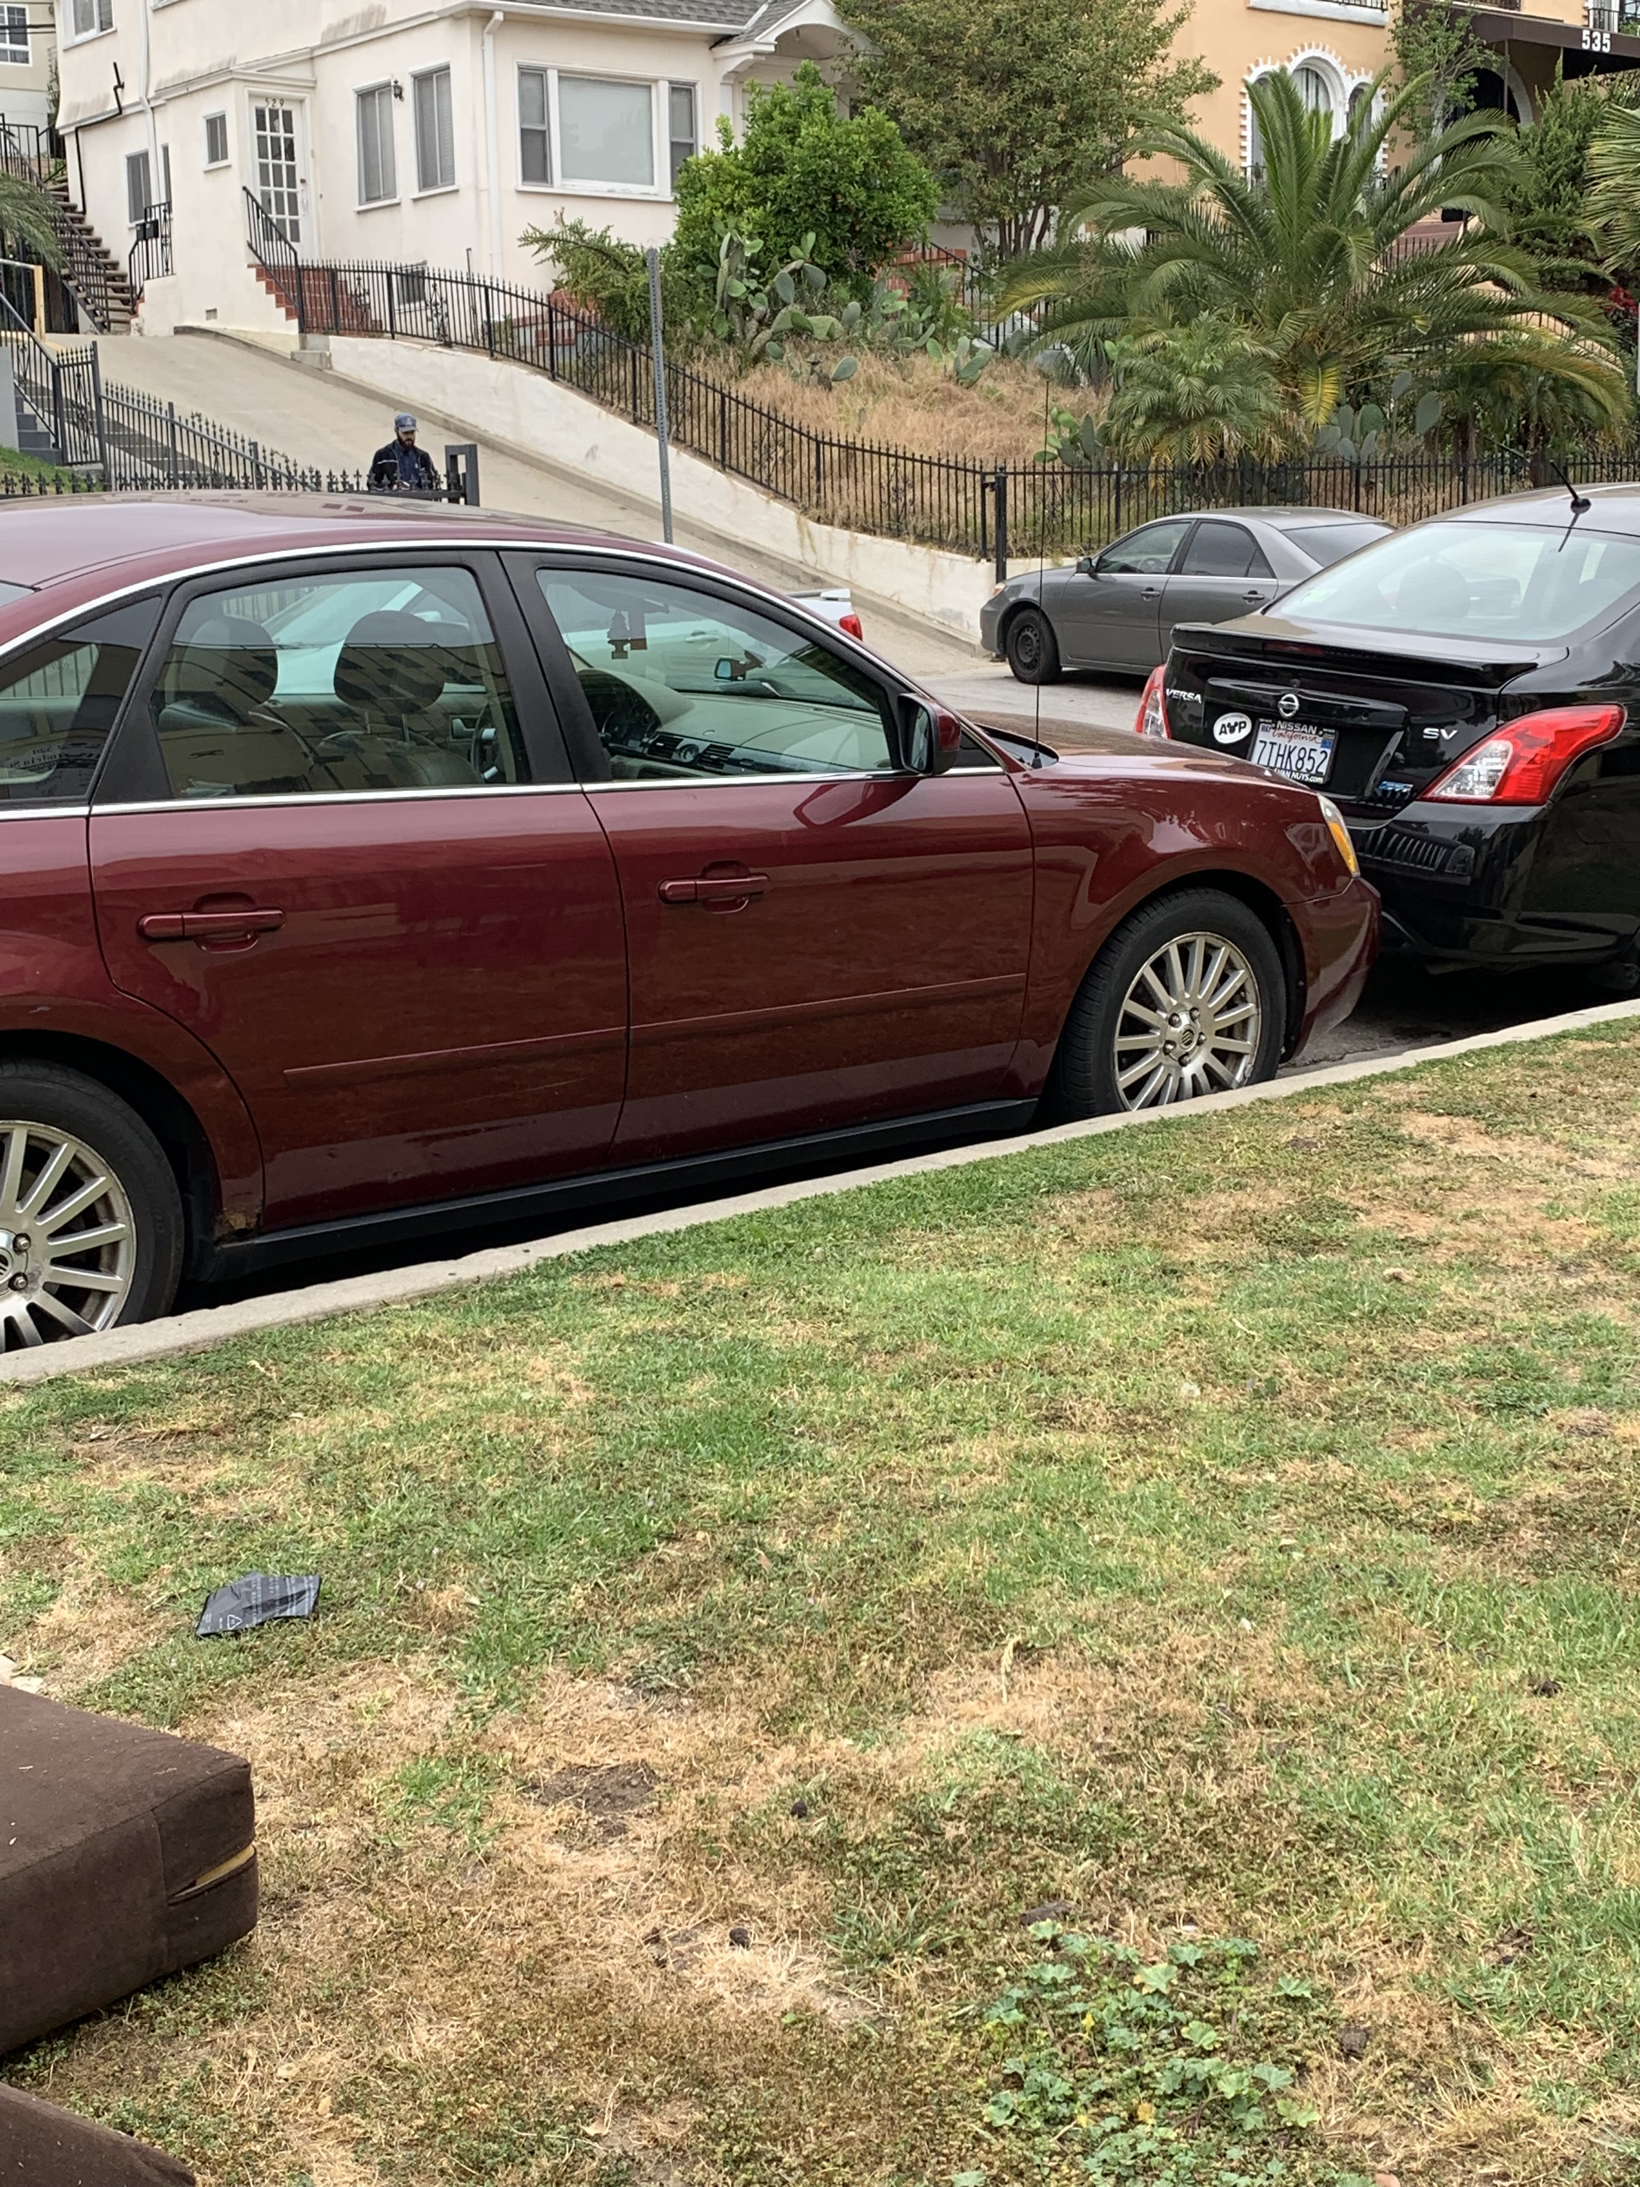
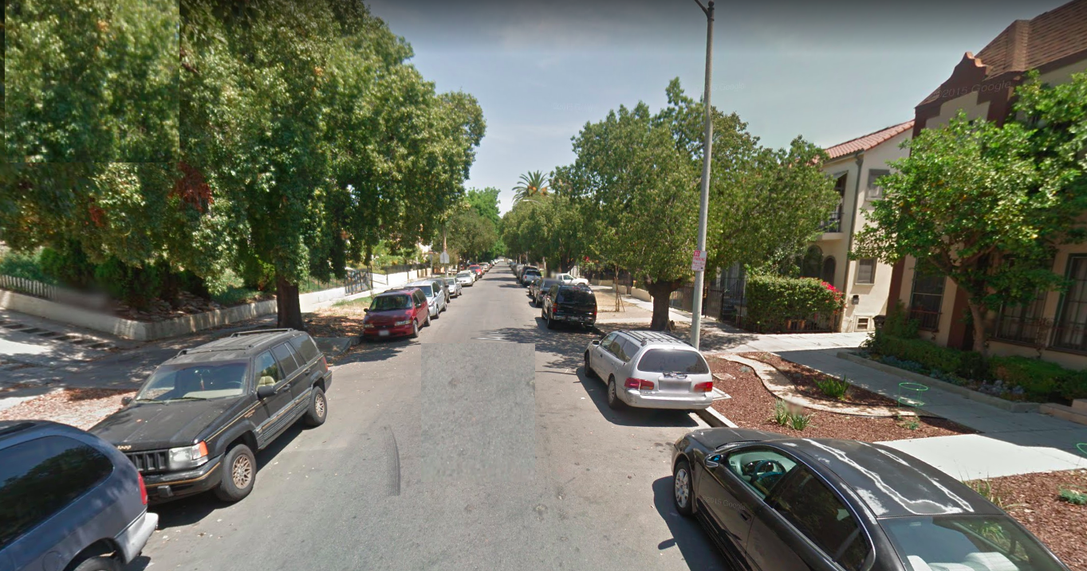
Not enough parking for every car
No gap to come out
The Issue

Slide 4
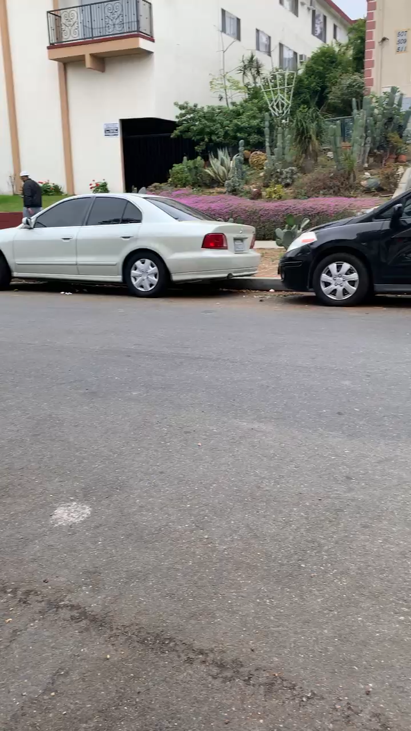
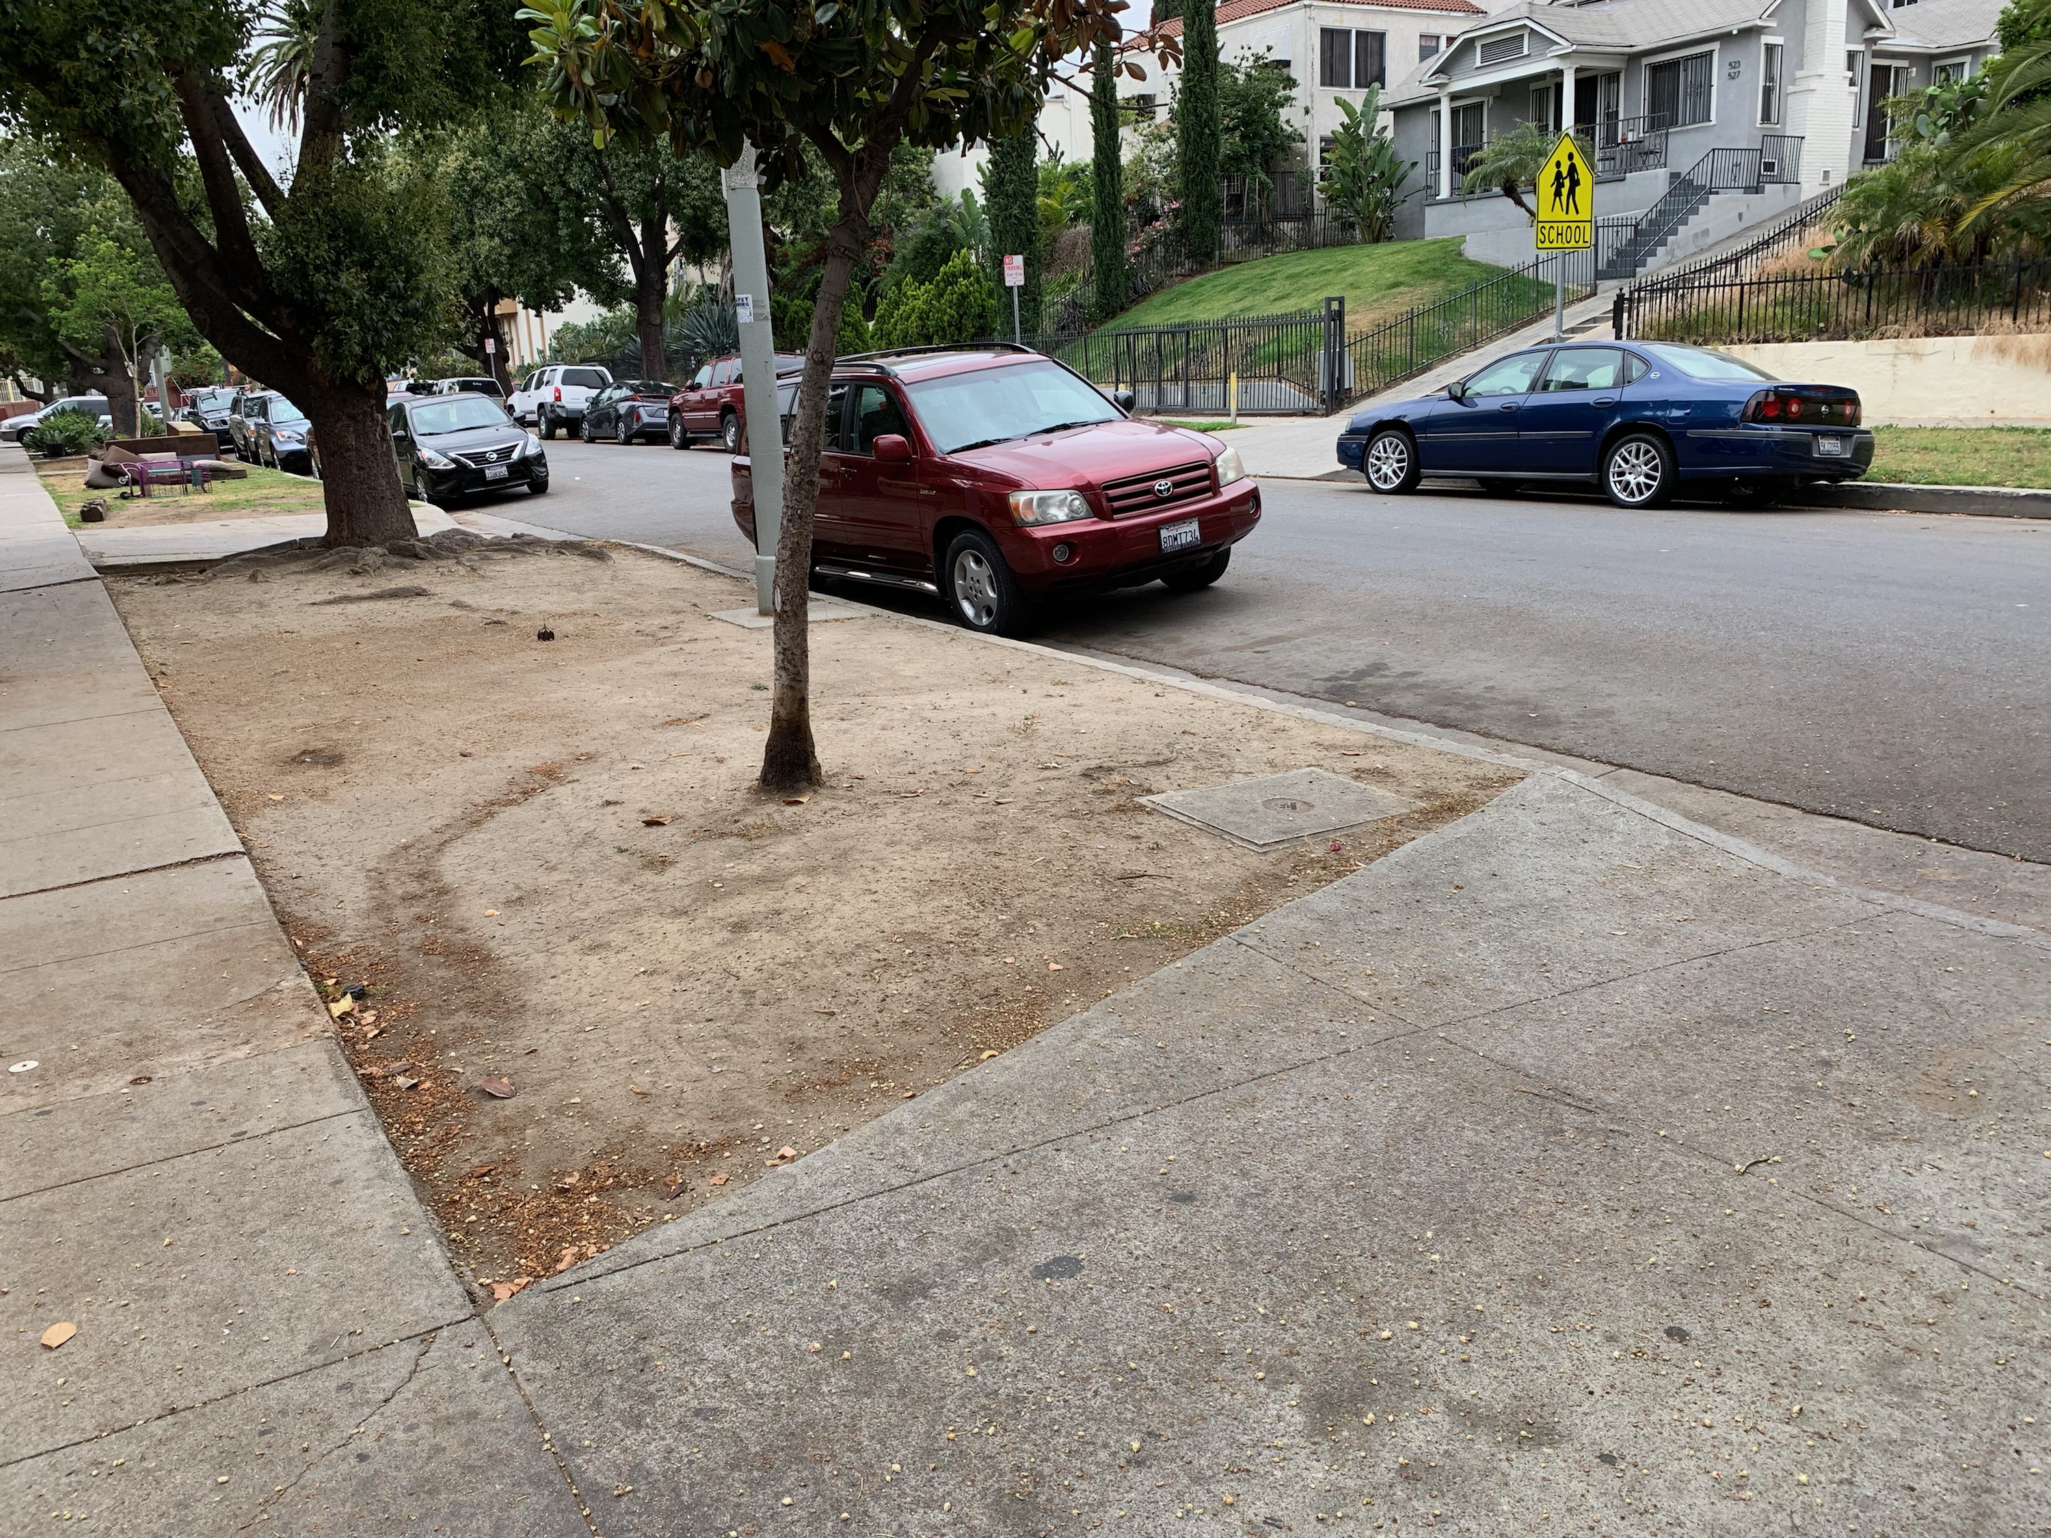
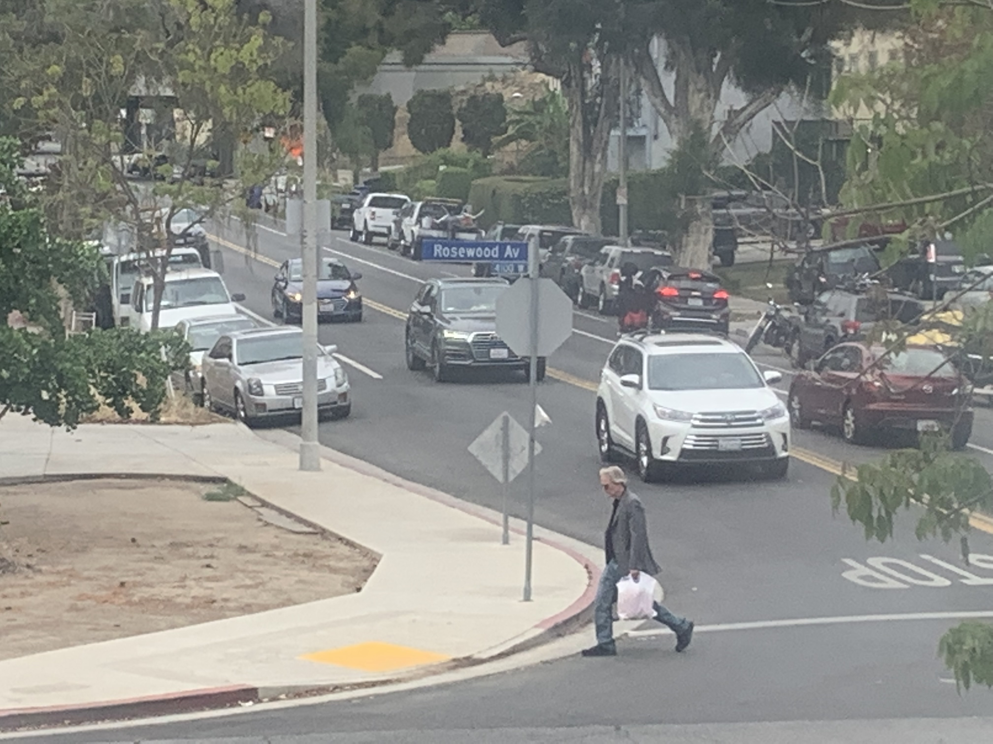
Saving parking
After 2pm there is no parking
People waste a lot of time looking for parking

Slide 5

15 Minutes
1 minute.
Arriving the same old street with the same old problem.
2 minutes.
I need to find a parking spot.
3 minutes.
As I drive along, there is no empty space.
4 minutes.
Been driving around and around and there is nothing. Maybe next block.
5 minutes.
Waiting.
6 minutes.
Is it coming out?
7 minutes.
Deciding to wait along next to all these cars, hoping one will come out.
8 minutes.
Still waiting.
9 minutes.
Maybe if I go around one more time there may be a spot.
10 minutes.
How can this happen to me?
11 minutes.
You got to be kidding me. You could’ve move up a little more.
12 minutes.
Wondering if a parking ticket is worth it
13 minutes.
Seeing a person walking towards his car. Please sir, do move your car.
14 minutes.
Following right behind him. He goes to the driver side and opens the door. Climbs in and turn his car on. Never have I been happier in my life.
15 minutes.
There it is the spot I been waiting for, for 15 minutes.

