Slide 1
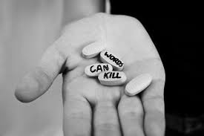
1-800-273-8255 HOTLINE
Bullying Crisis in Our Community

Slide 2
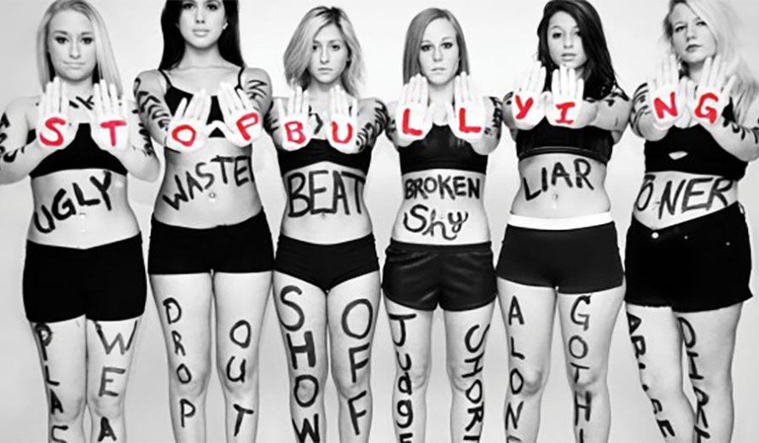
Types of bullying
Cyber-Bullying
(This is any bullying that happens over any form technology, like cellphones, computers, and forms of social media: Facebook, Twitter, Instagram etc.)
Physical-Bullying
(This is any bullying that hurt's someone's body or damages their possessions)
Social-Bullying
(This is any bully that is done with the intent to hurt somebody's reputation or social standing)
Verbal-Bullying
(This is when someone, who is a bully, uses insulting or demeaning language to mock, embarrass or insult another person)

Slide 3
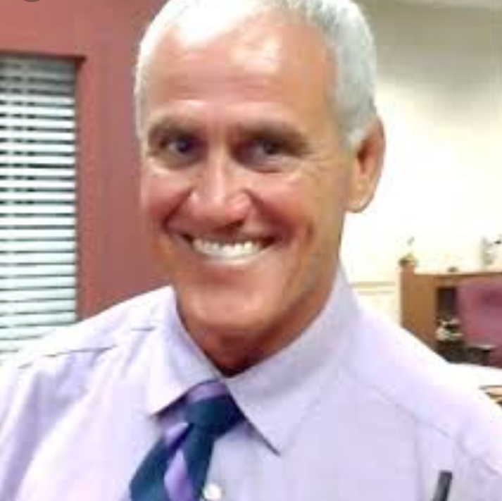


Interviewed these lovely people

Slide 4
Bullying Fact's
Every 7 second's a child/teenager is bullied
The 2nd leading death in the United Sates is suicide
Over the past 3 decades, suicide rates have increased by 50 percent
More than 160,000 childern miss school because they fear their bully
1/3 of students surveyed that they have heard a student threaten to kill someone
100,000 students carry a gun to school
Approximately 54% of school shootings are results of revenge on their bullies

Slide 5
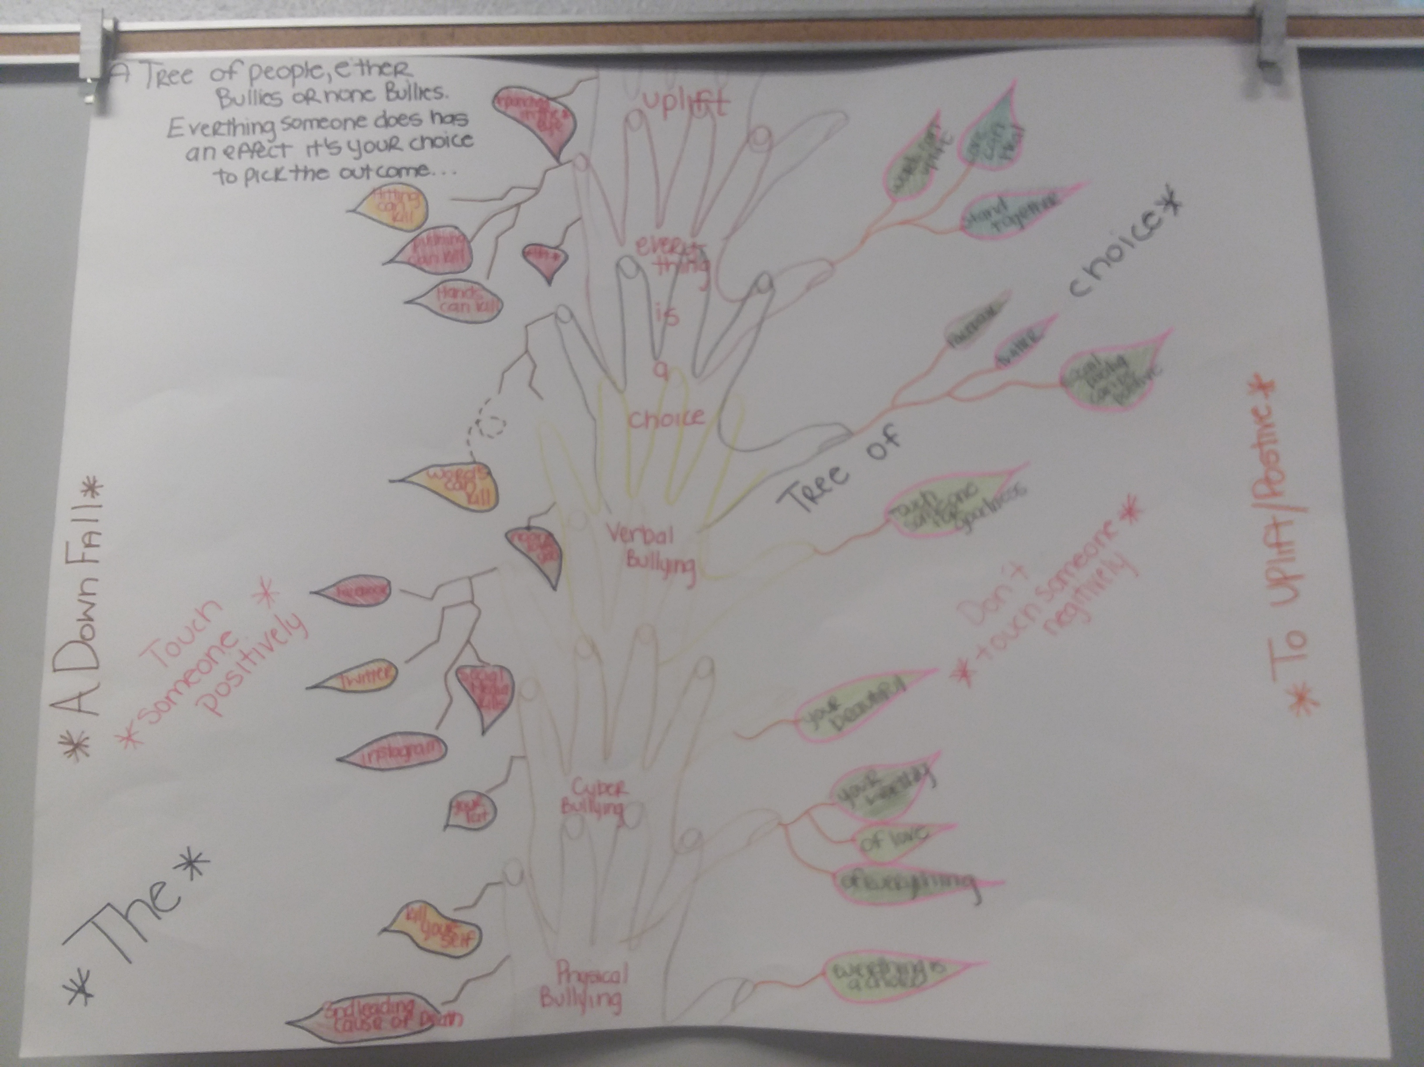
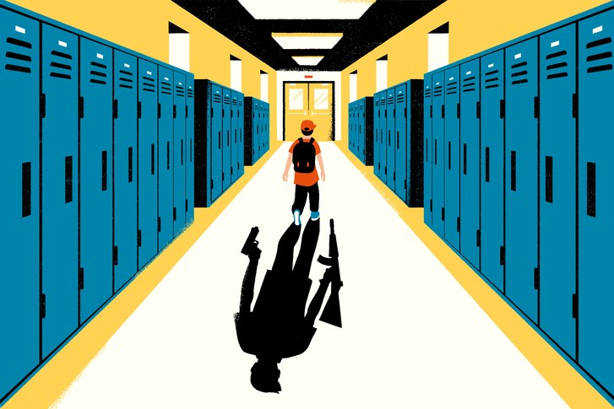
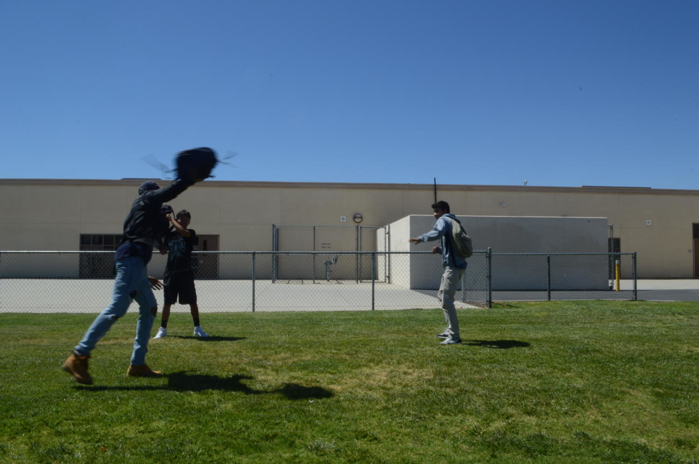
Photo's & Drawings

Slide 6


