Slide 1
The Silent Killer in America
By: Jenny rodriguez.

Slide 2
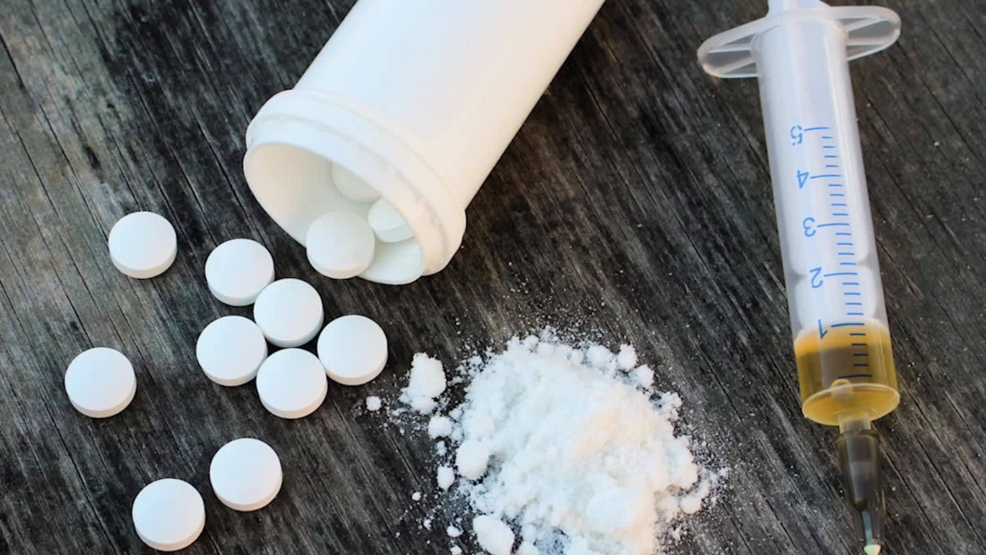
Opioids
Oxycodone (OxyContin®)
Hydrocodone (Vicodin®)
Morphine
Codeine
Fentanyl
Heroin.
Opioids act as central nervous system depressants, slowing down nerve signal transmissions and blocking pain sensations from reaching the brain.
Opioids work by increasing the production of neurotransmitter chemicals at brain cell receptor sites
The brain easily develops a tolerance for opioids, while the tolerance happens a chemical imbalance in the brain starts taking shape, thus making users up there dosage gradually.

Slide 3
History of the opioids
Prior to the 1990's opioid drugs were reserved for the most unbearable types of pain such as cancer related symptoms.
Purdue Pharma went on a media campaign for OxyContin, soon other pharmacies started claiming their opioids were non addictive
Morphine, Oxycodone, Heroin, etc. are all chemical cousins of each other with the same addictive chemicals.
https://youtu.be/pYgMS7wbxHo

Slide 4
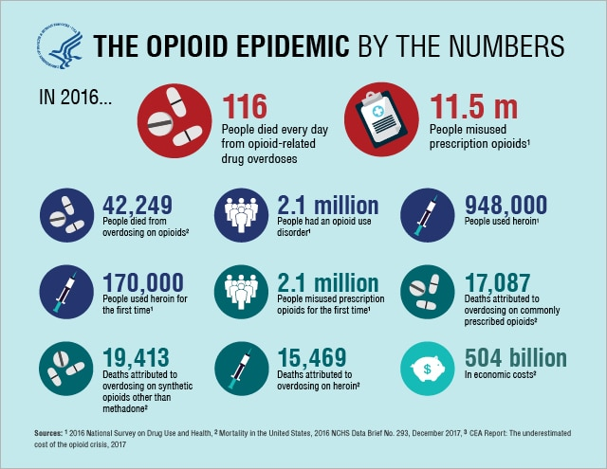

Slide 5
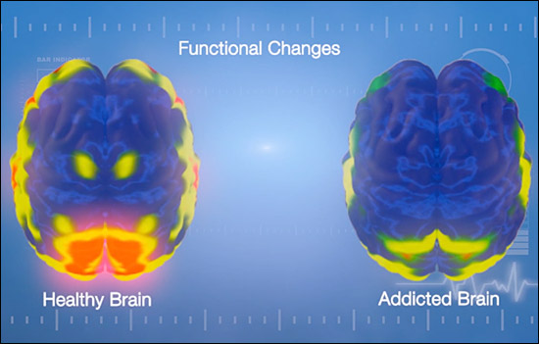
Other Facts
Roughly 80% of people who use heroin first misused prescription opioids first.
Over 1,000 emergency room visits a day to the hospital in 2017 was opioid overdose related.
Relapse statistics show that more than 85% of individuals relapse and return to drug use within the year following treatment.
Opioids change the chemical structure of a users brain (even if they take as prescribed) if they are on a pill for more than 3 months.

Slide 6
Plan of Action
Mandating prescriber education.
Require prescribers to have ongoing medical education on effective pain management and identifying substance use disorders.
Implementing opioid prescribing guidelines
includes recommendations on the use of opioids in treating pain that lasts longer than three months, or past the time of normal tissue healing to ensure that a patient does not become dependent on opioids in the long run.
Integrating Prescription Drug Monitoring Programs (PDMPs) Into Clinical Settings
states where physicians were required to check an electronic database before writing an opioid prescription saw a 80 % reduction rate in over prescribing opioids.
Increasing availability of opioid use disorder (OUD) treatment
Expand use of medication assisted treatment (MAT); ensure it is offered and available at state-funded treatment providers
MAT works by staving off withdrawal symptoms and breaking a psychological link between taking a drug and immediately feeling high with a similar drug to opioids while the addict also gets counseling to have an emotional support system.

