Slide 1
HIP/SLICE
By Ana Beatrix Rivera
Social Media’s influence
English 1B
22 May 2019

Slide 2
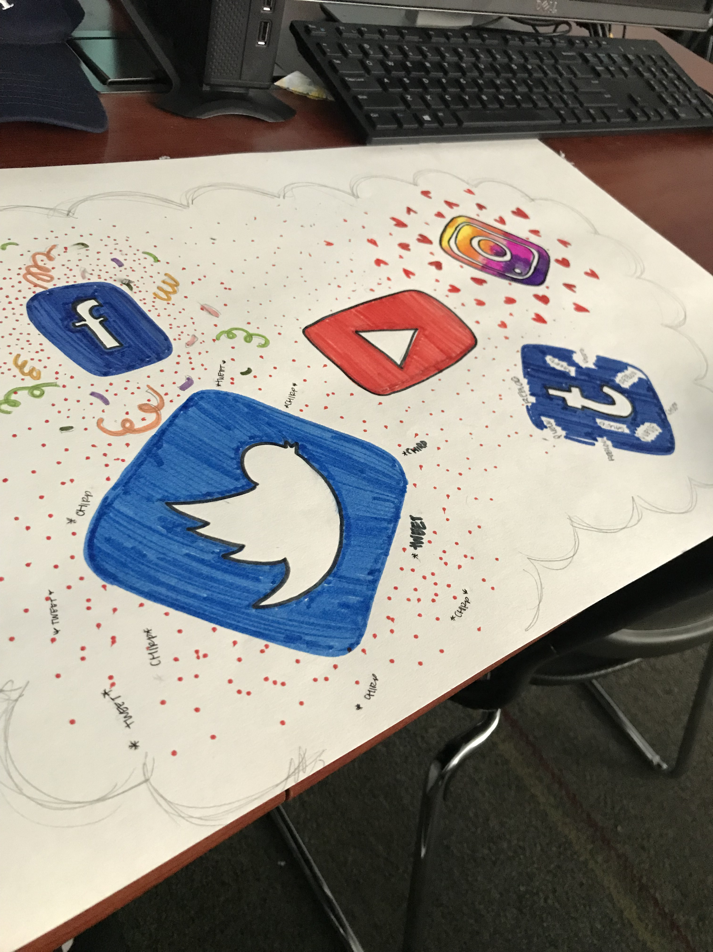

Slide 3
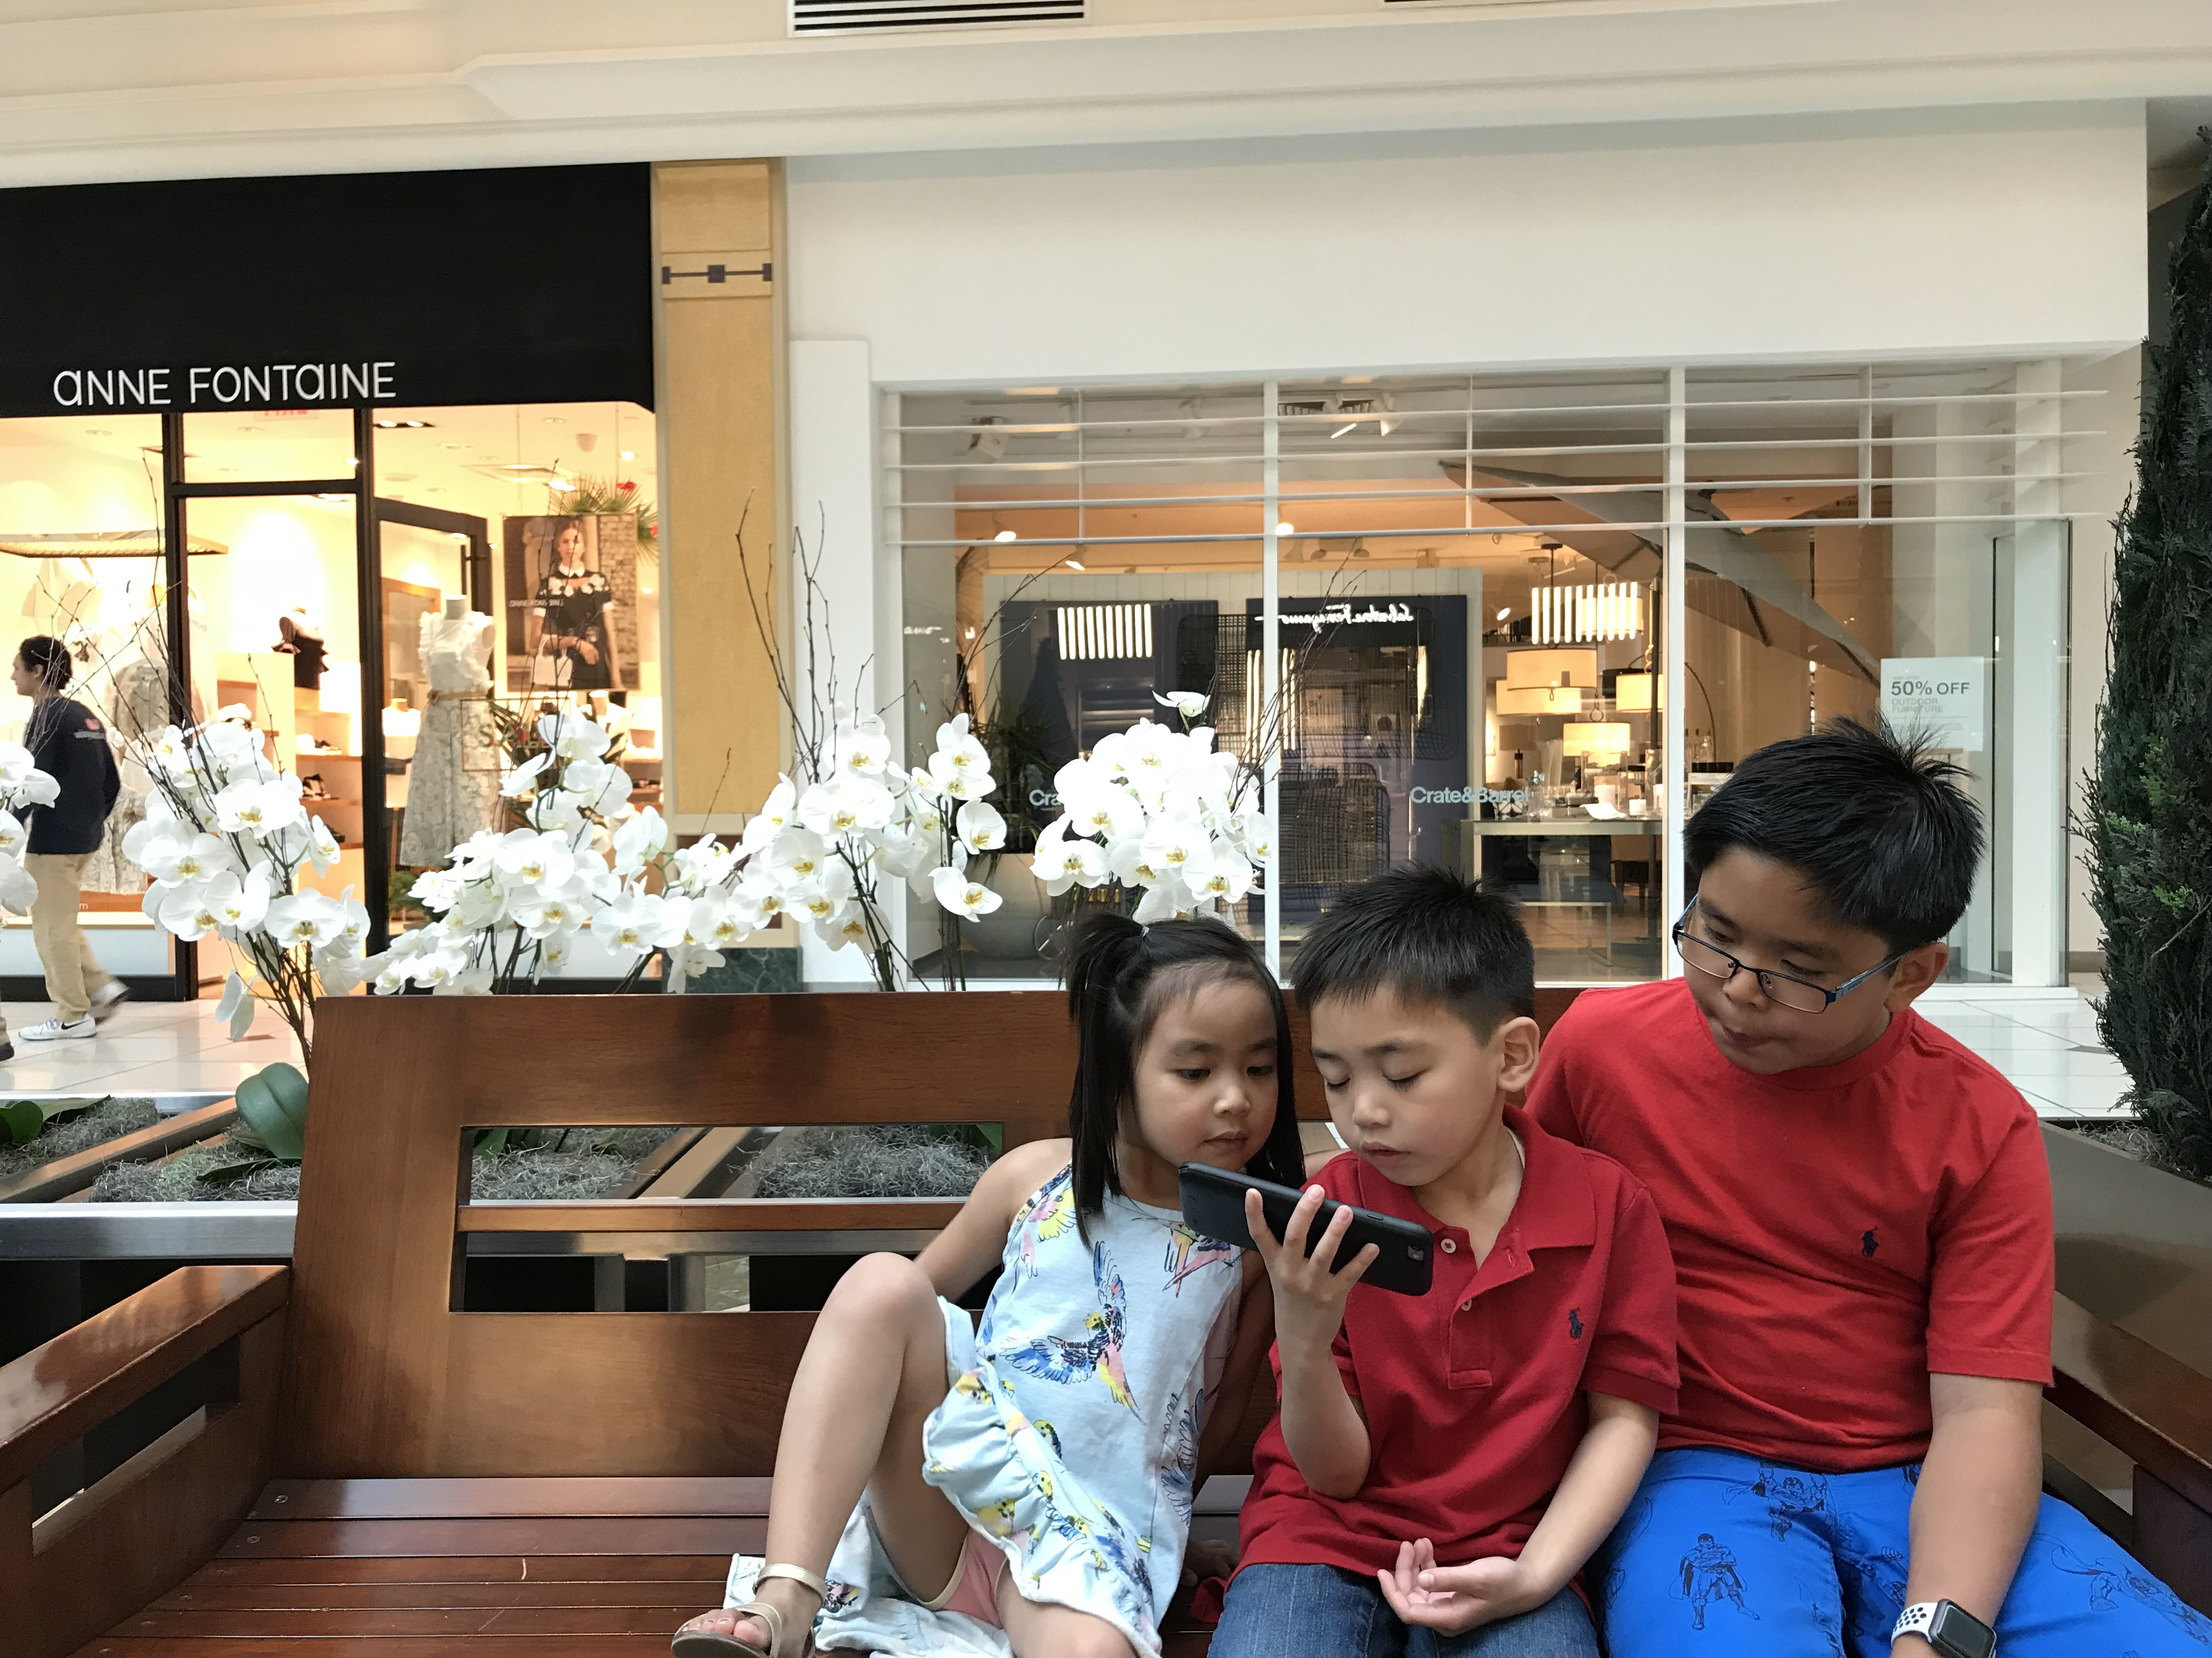

Slide 4
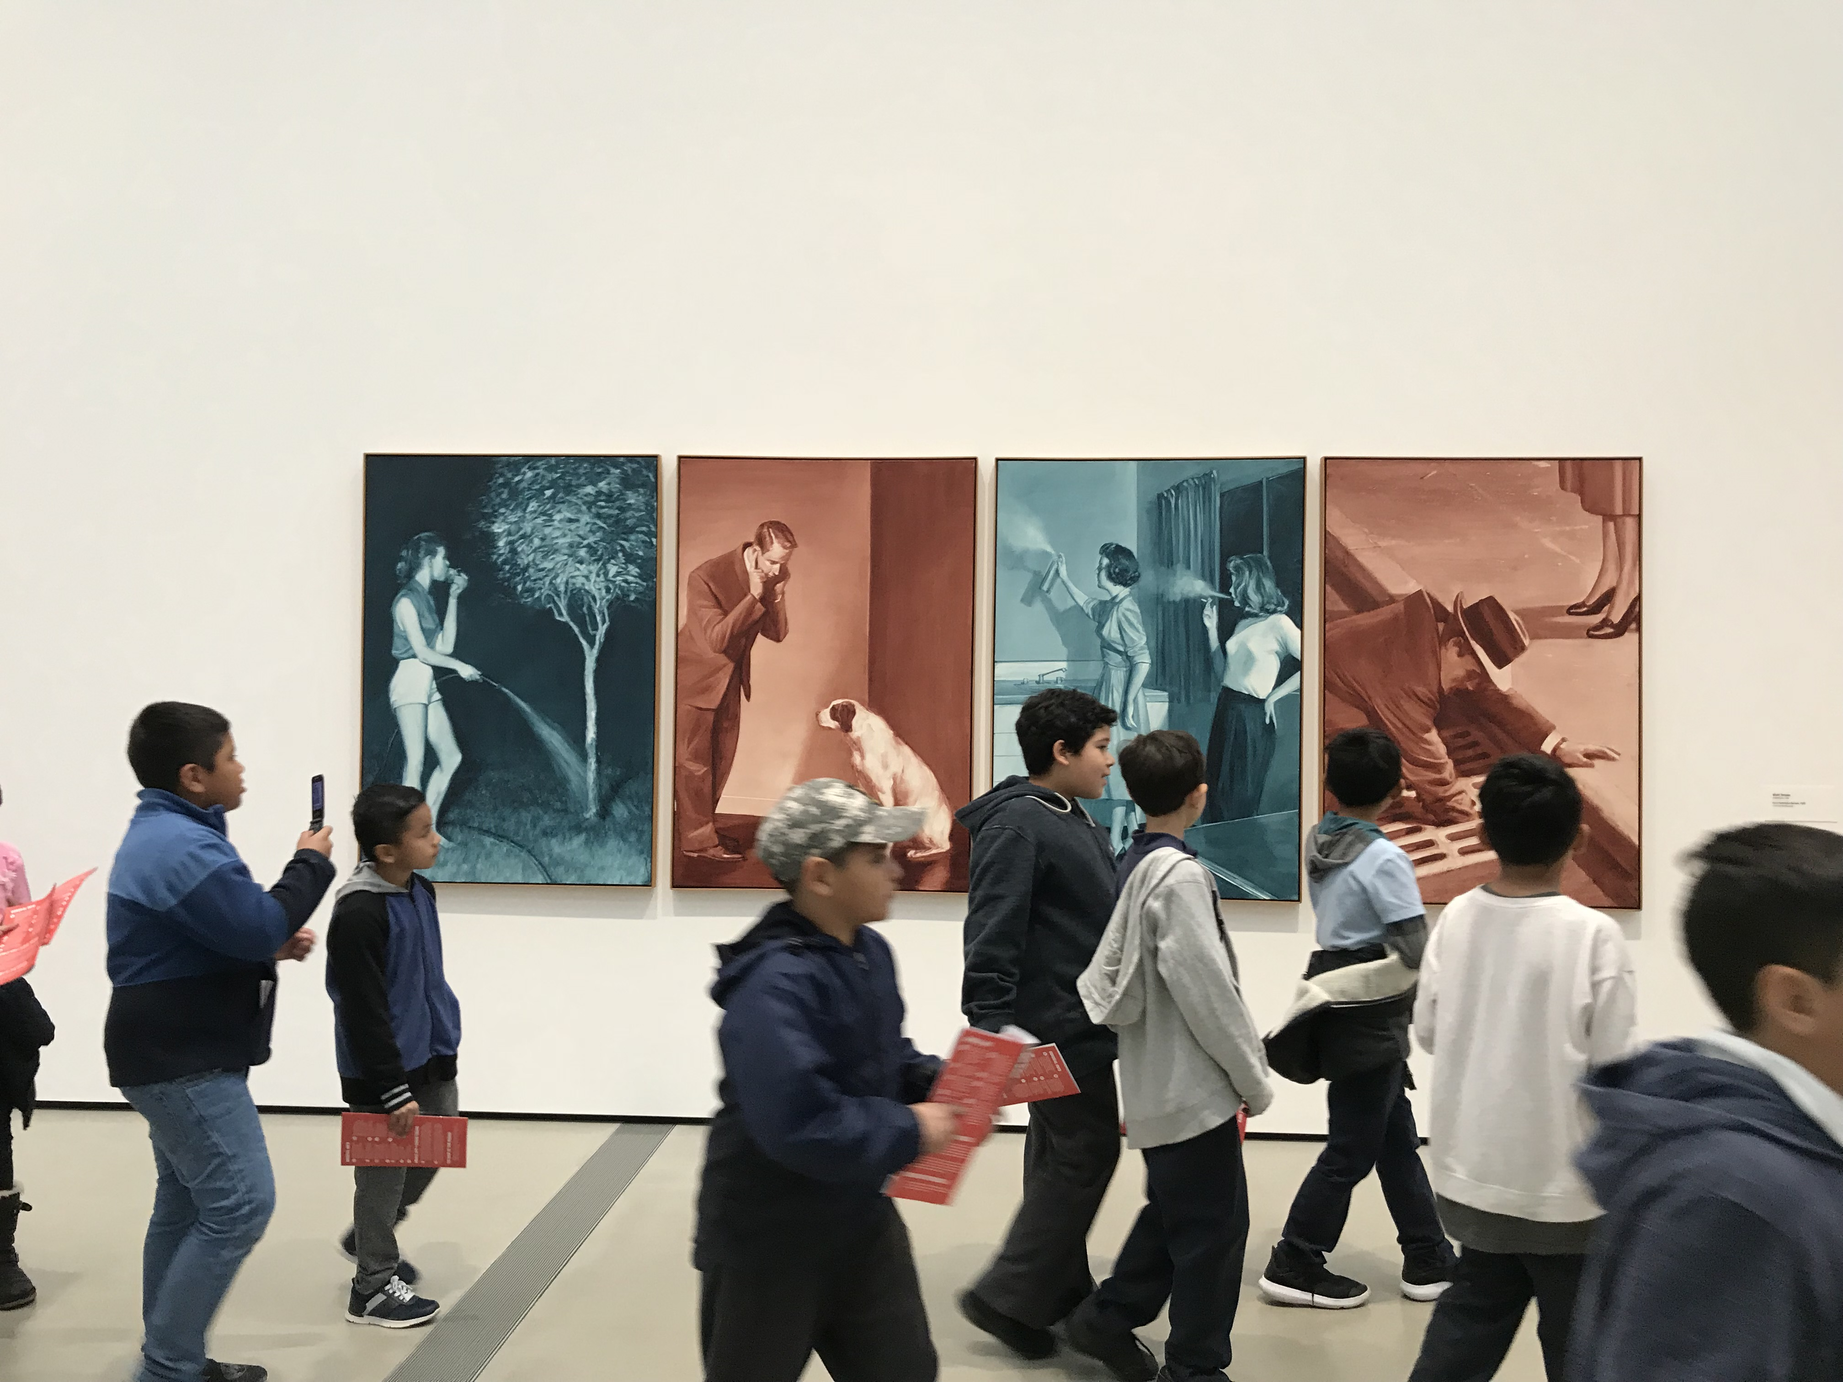

Slide 5
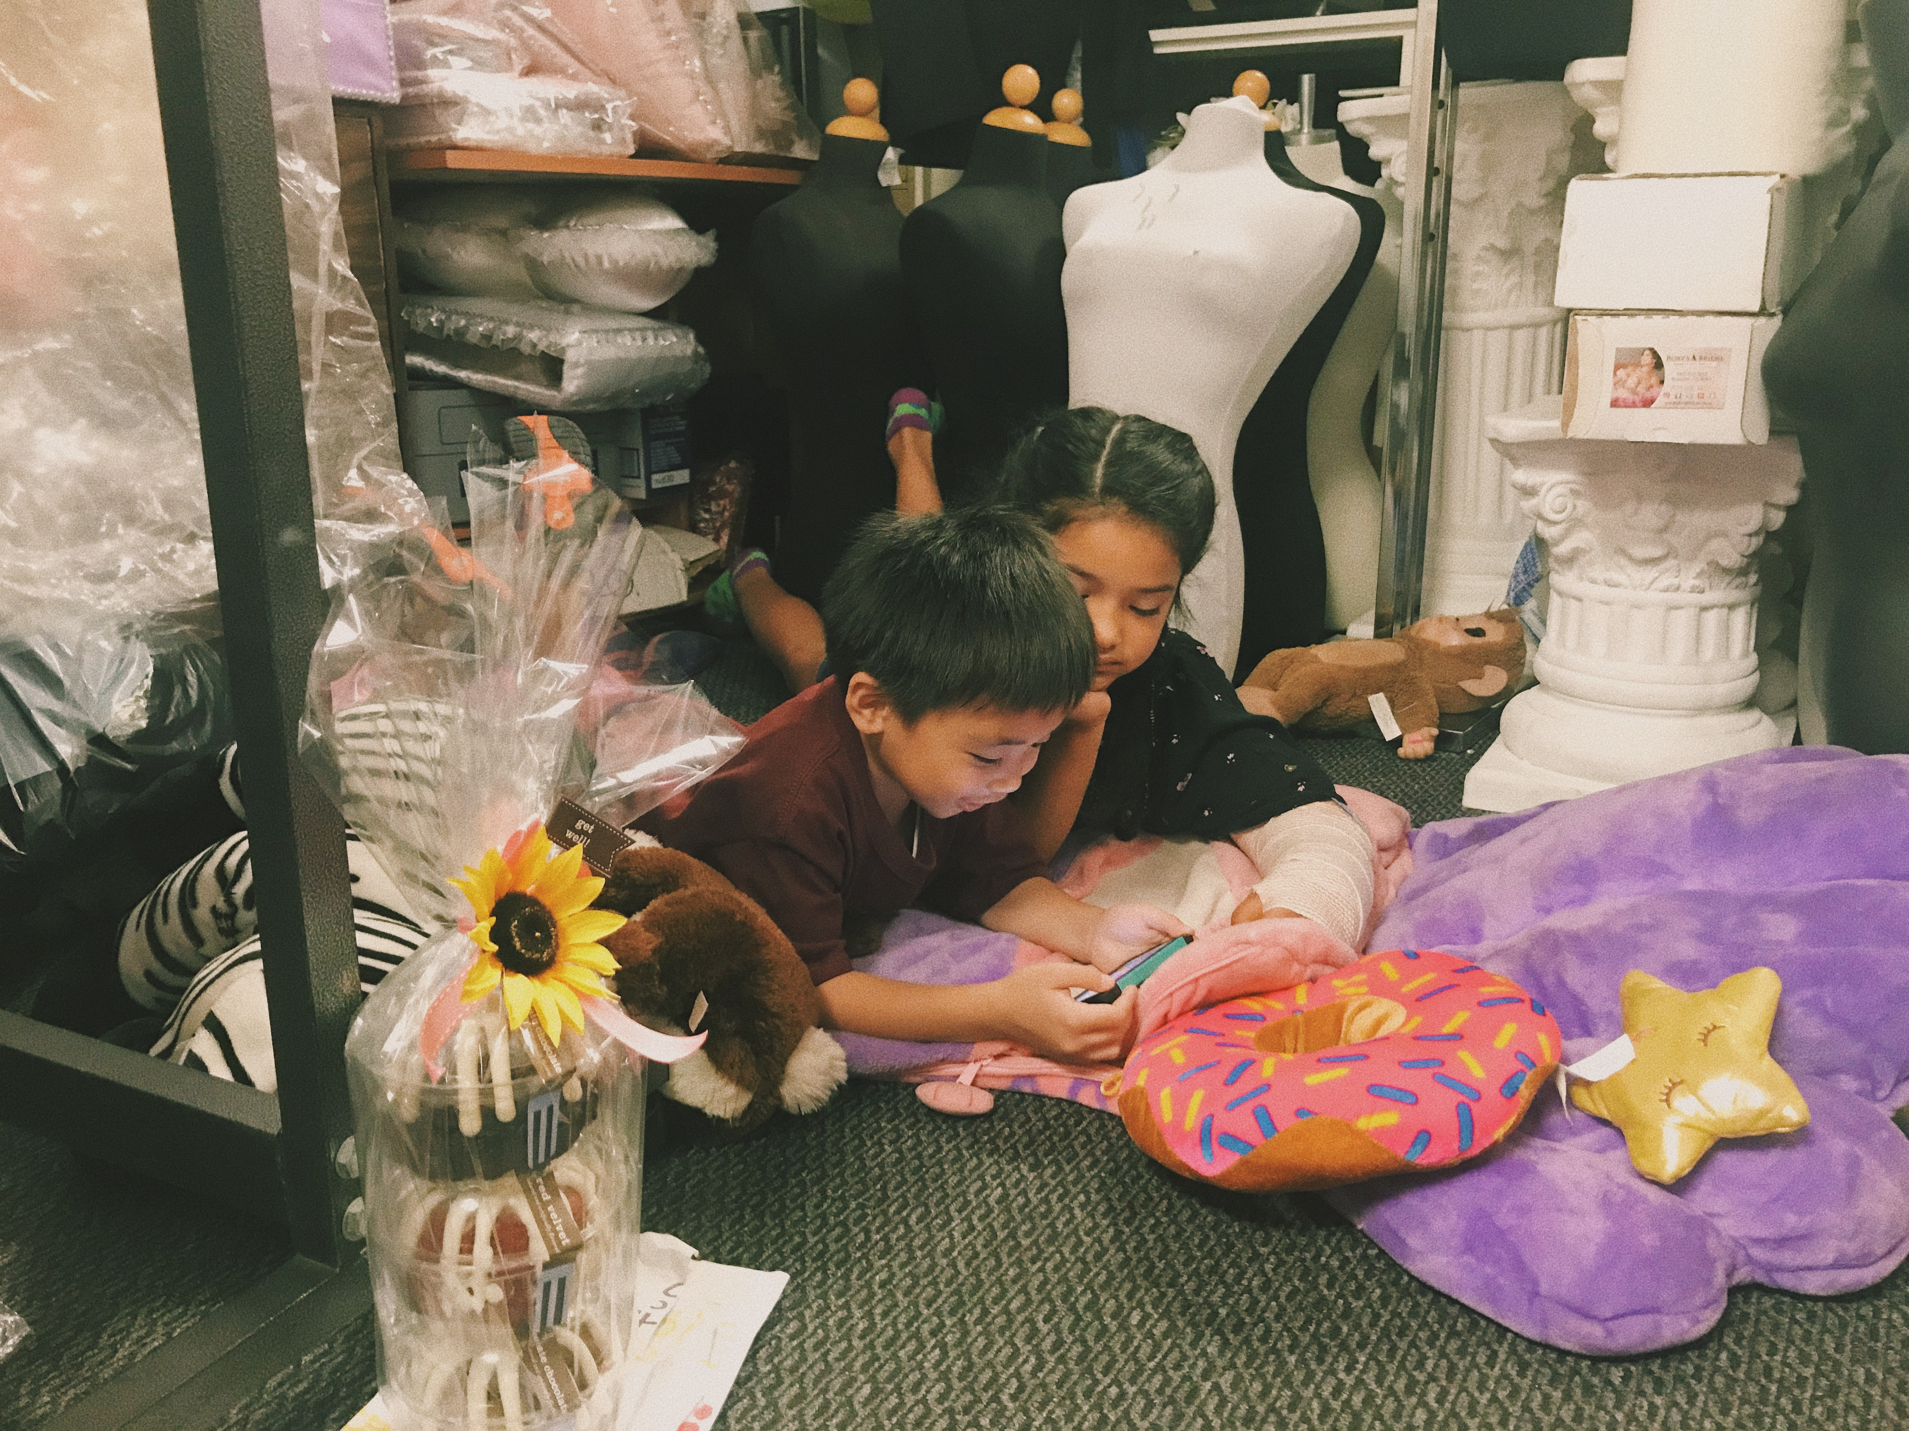

Slide 6
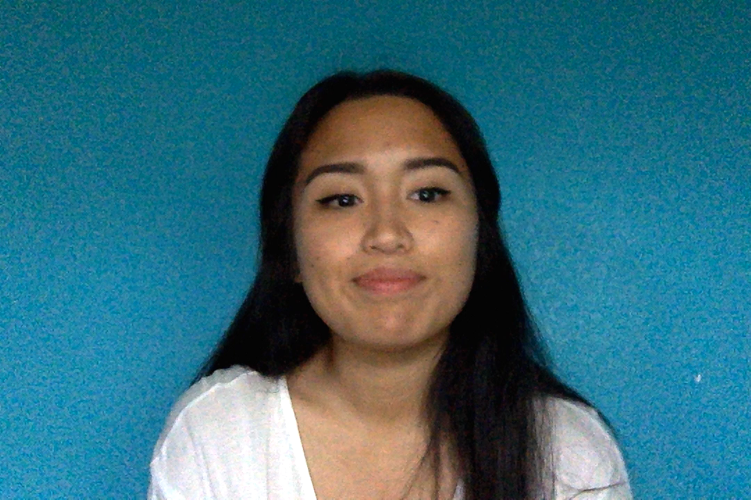
SPOKEN WORD:
INFLUENCE

