Slide 1
High Impact Practices (HIP) Service
Learning Internship Community
Engagement (SLICE)with Spoken
Word “Fix-It” Presentation
Alexie Rivera
Traffic Congestion and Accidents
English 1b
16 May 2019

Slide 2
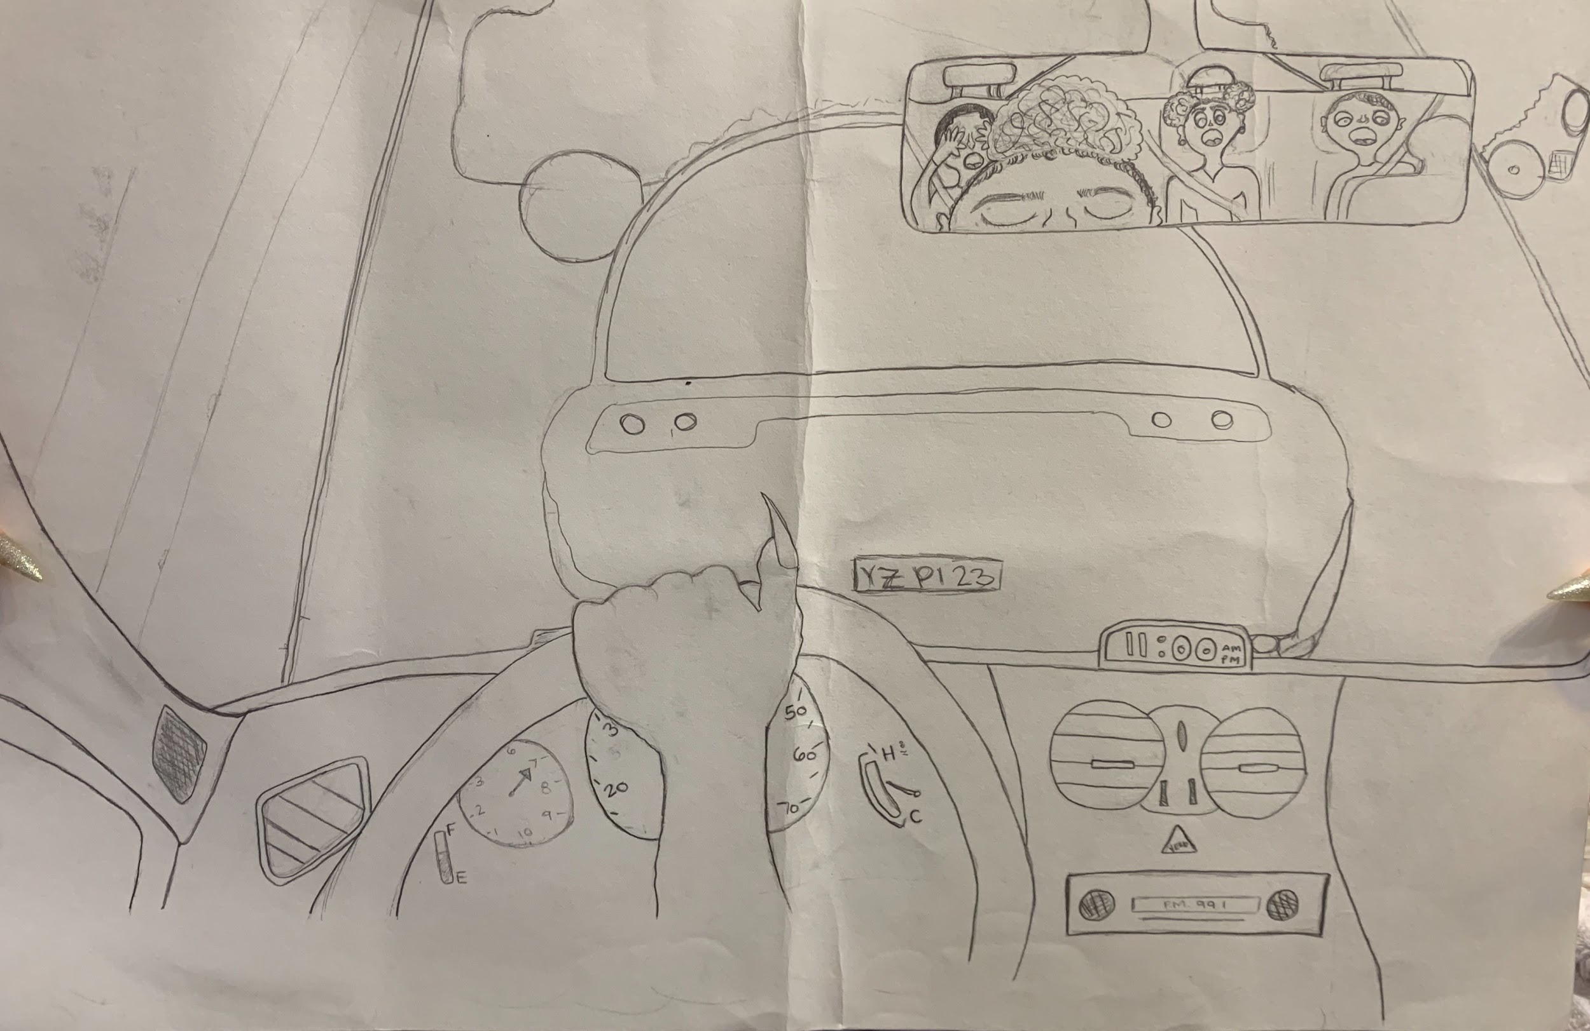
Poster

Slide 3
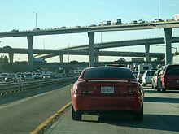
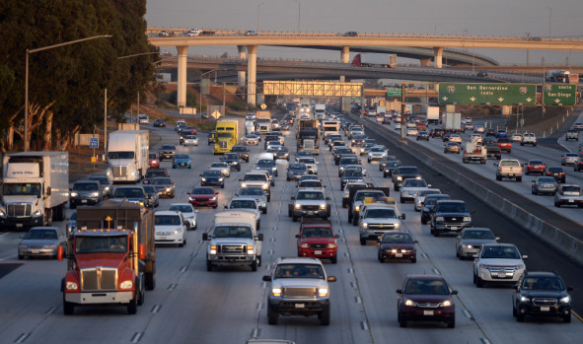
Photograph

Slide 4
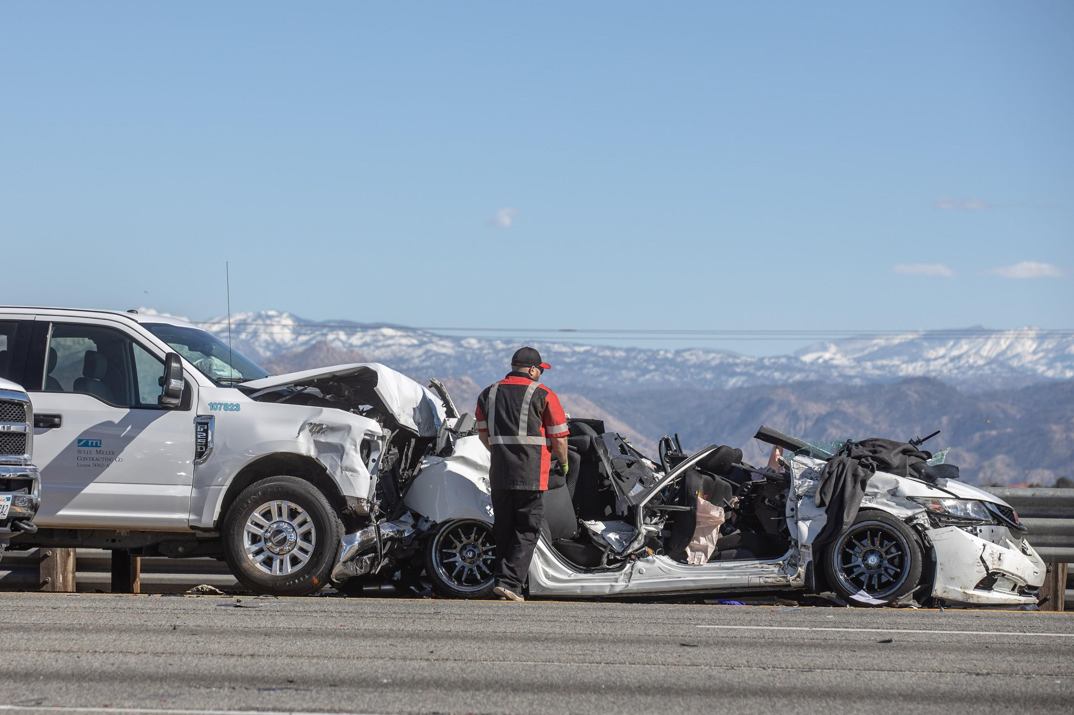
Photograph

Slide 5
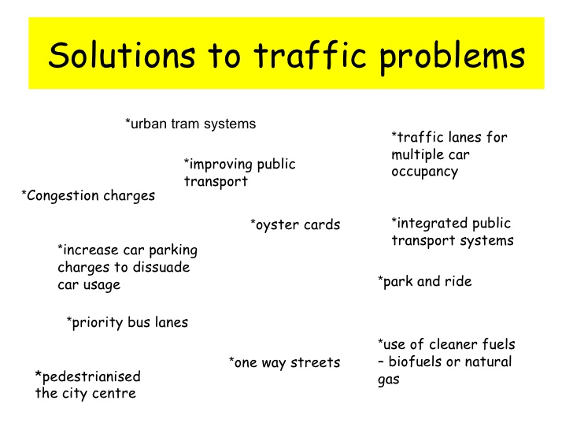

Slide 6
Spoken Word
To the driver who’s eyes
Roamed elsewhere
While you were in the middle of nowhere
Without realization of the consequences
You faced death without hesitation
As you zoomed down the long weary road
Not knowing where things would go
the gas pedal touches the floor
And you lose control
Eyes opened
Though your mind closed
The passenger turns to you
Eyes gleaming with sorrow
To the driver who’s mind
Roamed elsewhere
Anger ran through you so vividly
As you’ve became aggravated
Due to the imagery
That sat beside you
One thought
Two thoughts
Four
You managed to hit three
While trying to flee from traffic
On your way to a local store
To the driver who drive’s
Please be considerate of yourself
And those around you
Although I know accidents happen
And there is no control of the others
Have control over yourself
Cars Accidents
Can happen at any given moment
While Congestion
Varies
Just don’t ever become
The driver who carries
The mess that none wants to marry

