Slide 1
GRAFFITI
- writing or drawing scribbled, scratched, or sprayed illicitly on a wall or other surface in a public place.
Riccardo Messino

Slide 2
What might be the problem with that?
PAINT EVERYWHERE PAINTEVERYWEHRE PAIN TEVERY WHERE PAINT EVERY WHEREPAIN T EVER YWHERE PAI NTEVE RYWHER EPAINT EVE RYWHERE PAINT EVERYWHERE PAINTWPJWERFN FBPWERBVPWERIVERJN PEWHBVWEPV NPIEJNPIEWRJNEJV EWRV NEPWIVJNERW V PWEJVN WEJEWFNEWPIRFN WPIEU NWER DSNERFNEPQIWUDCNPIUNCIPNUC PAINNECPIERNERE PAINTWPJWERFN PAI NTEVE RYWHER EPAINT EVE RYWHERE PAINTEVE RYWEHRE PAINT EVERYWHERE PAINT EVERYWHERE
“IT’S ILLEGAL” “IT COSTS MONEY” “IT’S A VANADLISM” “IT BELONGS ON PAPER”

Slide 3
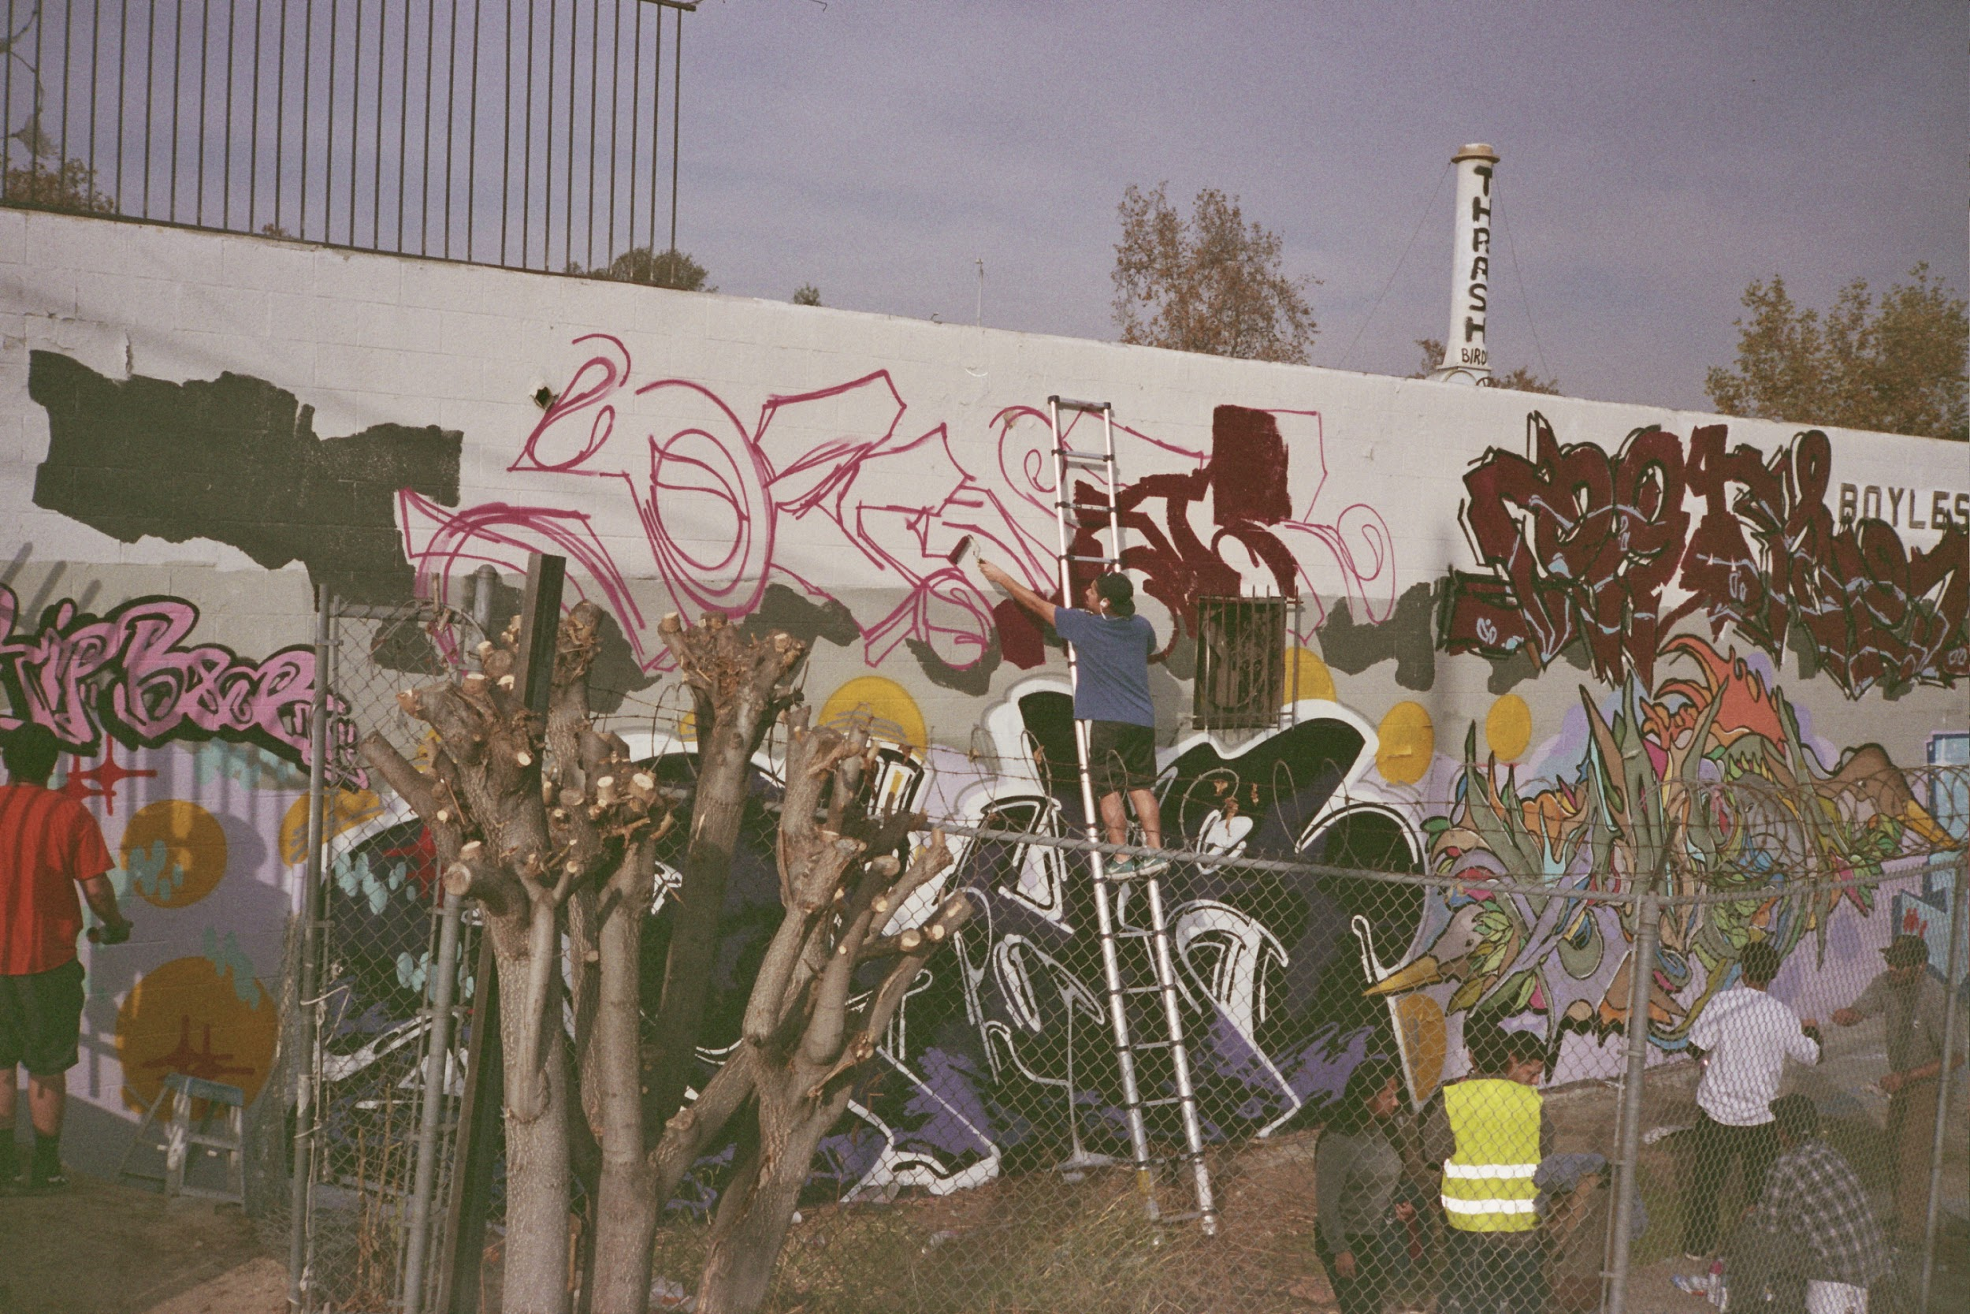
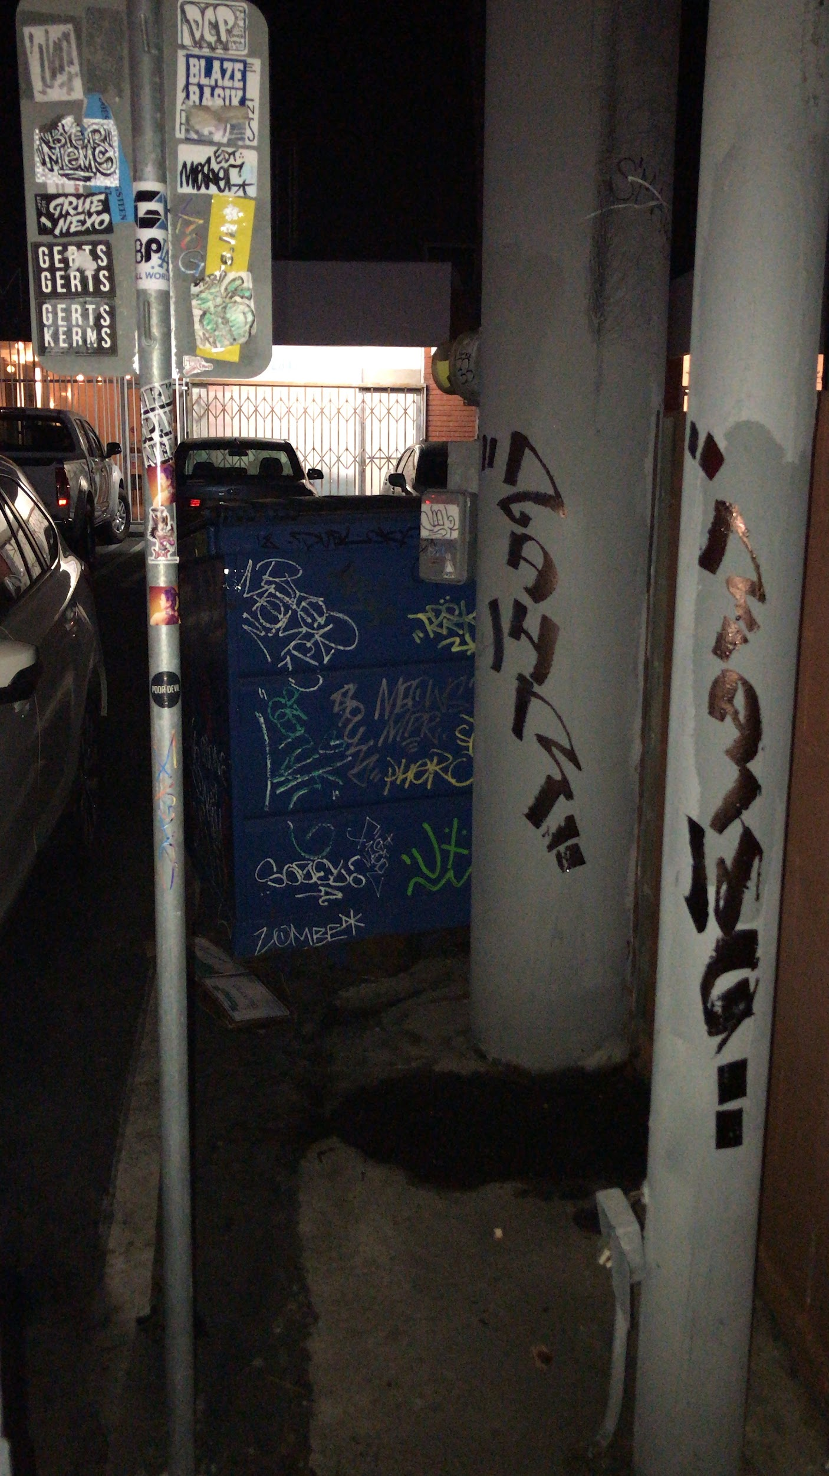
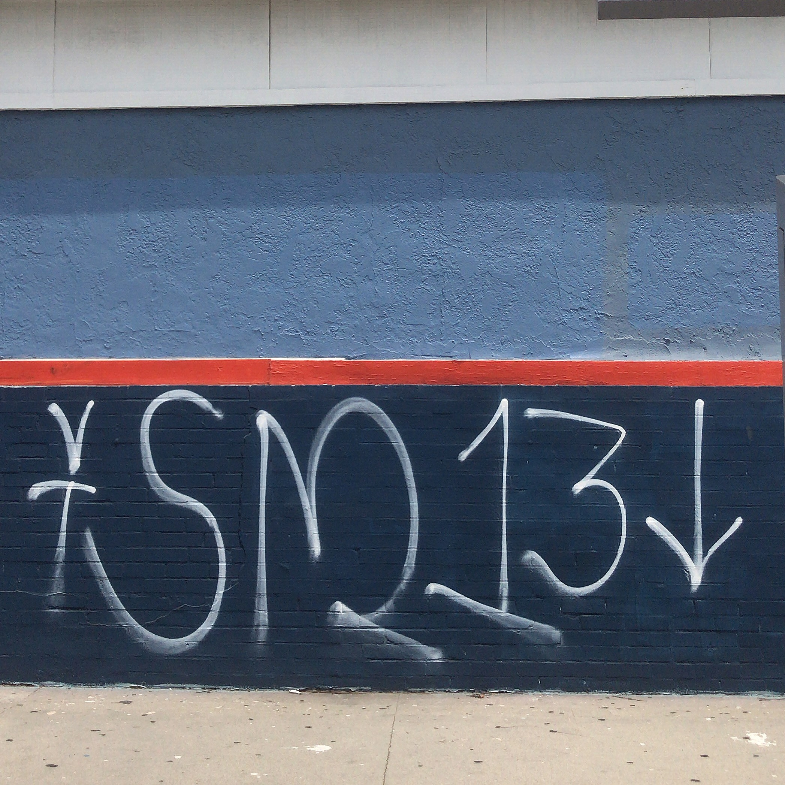

Slide 4
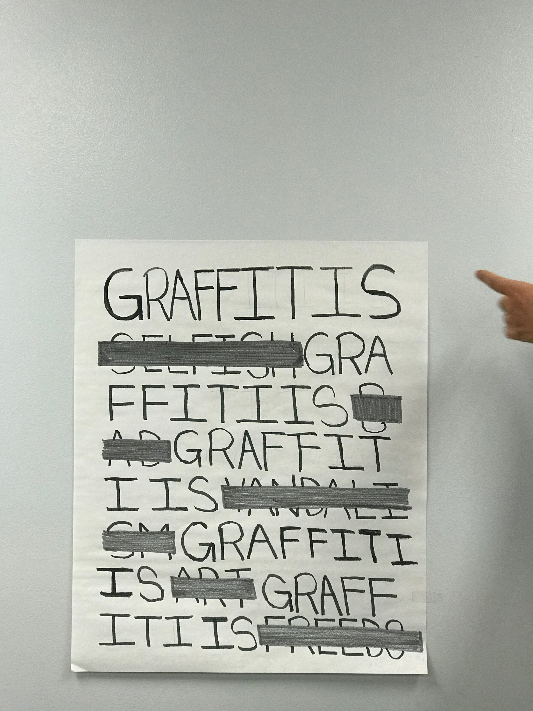
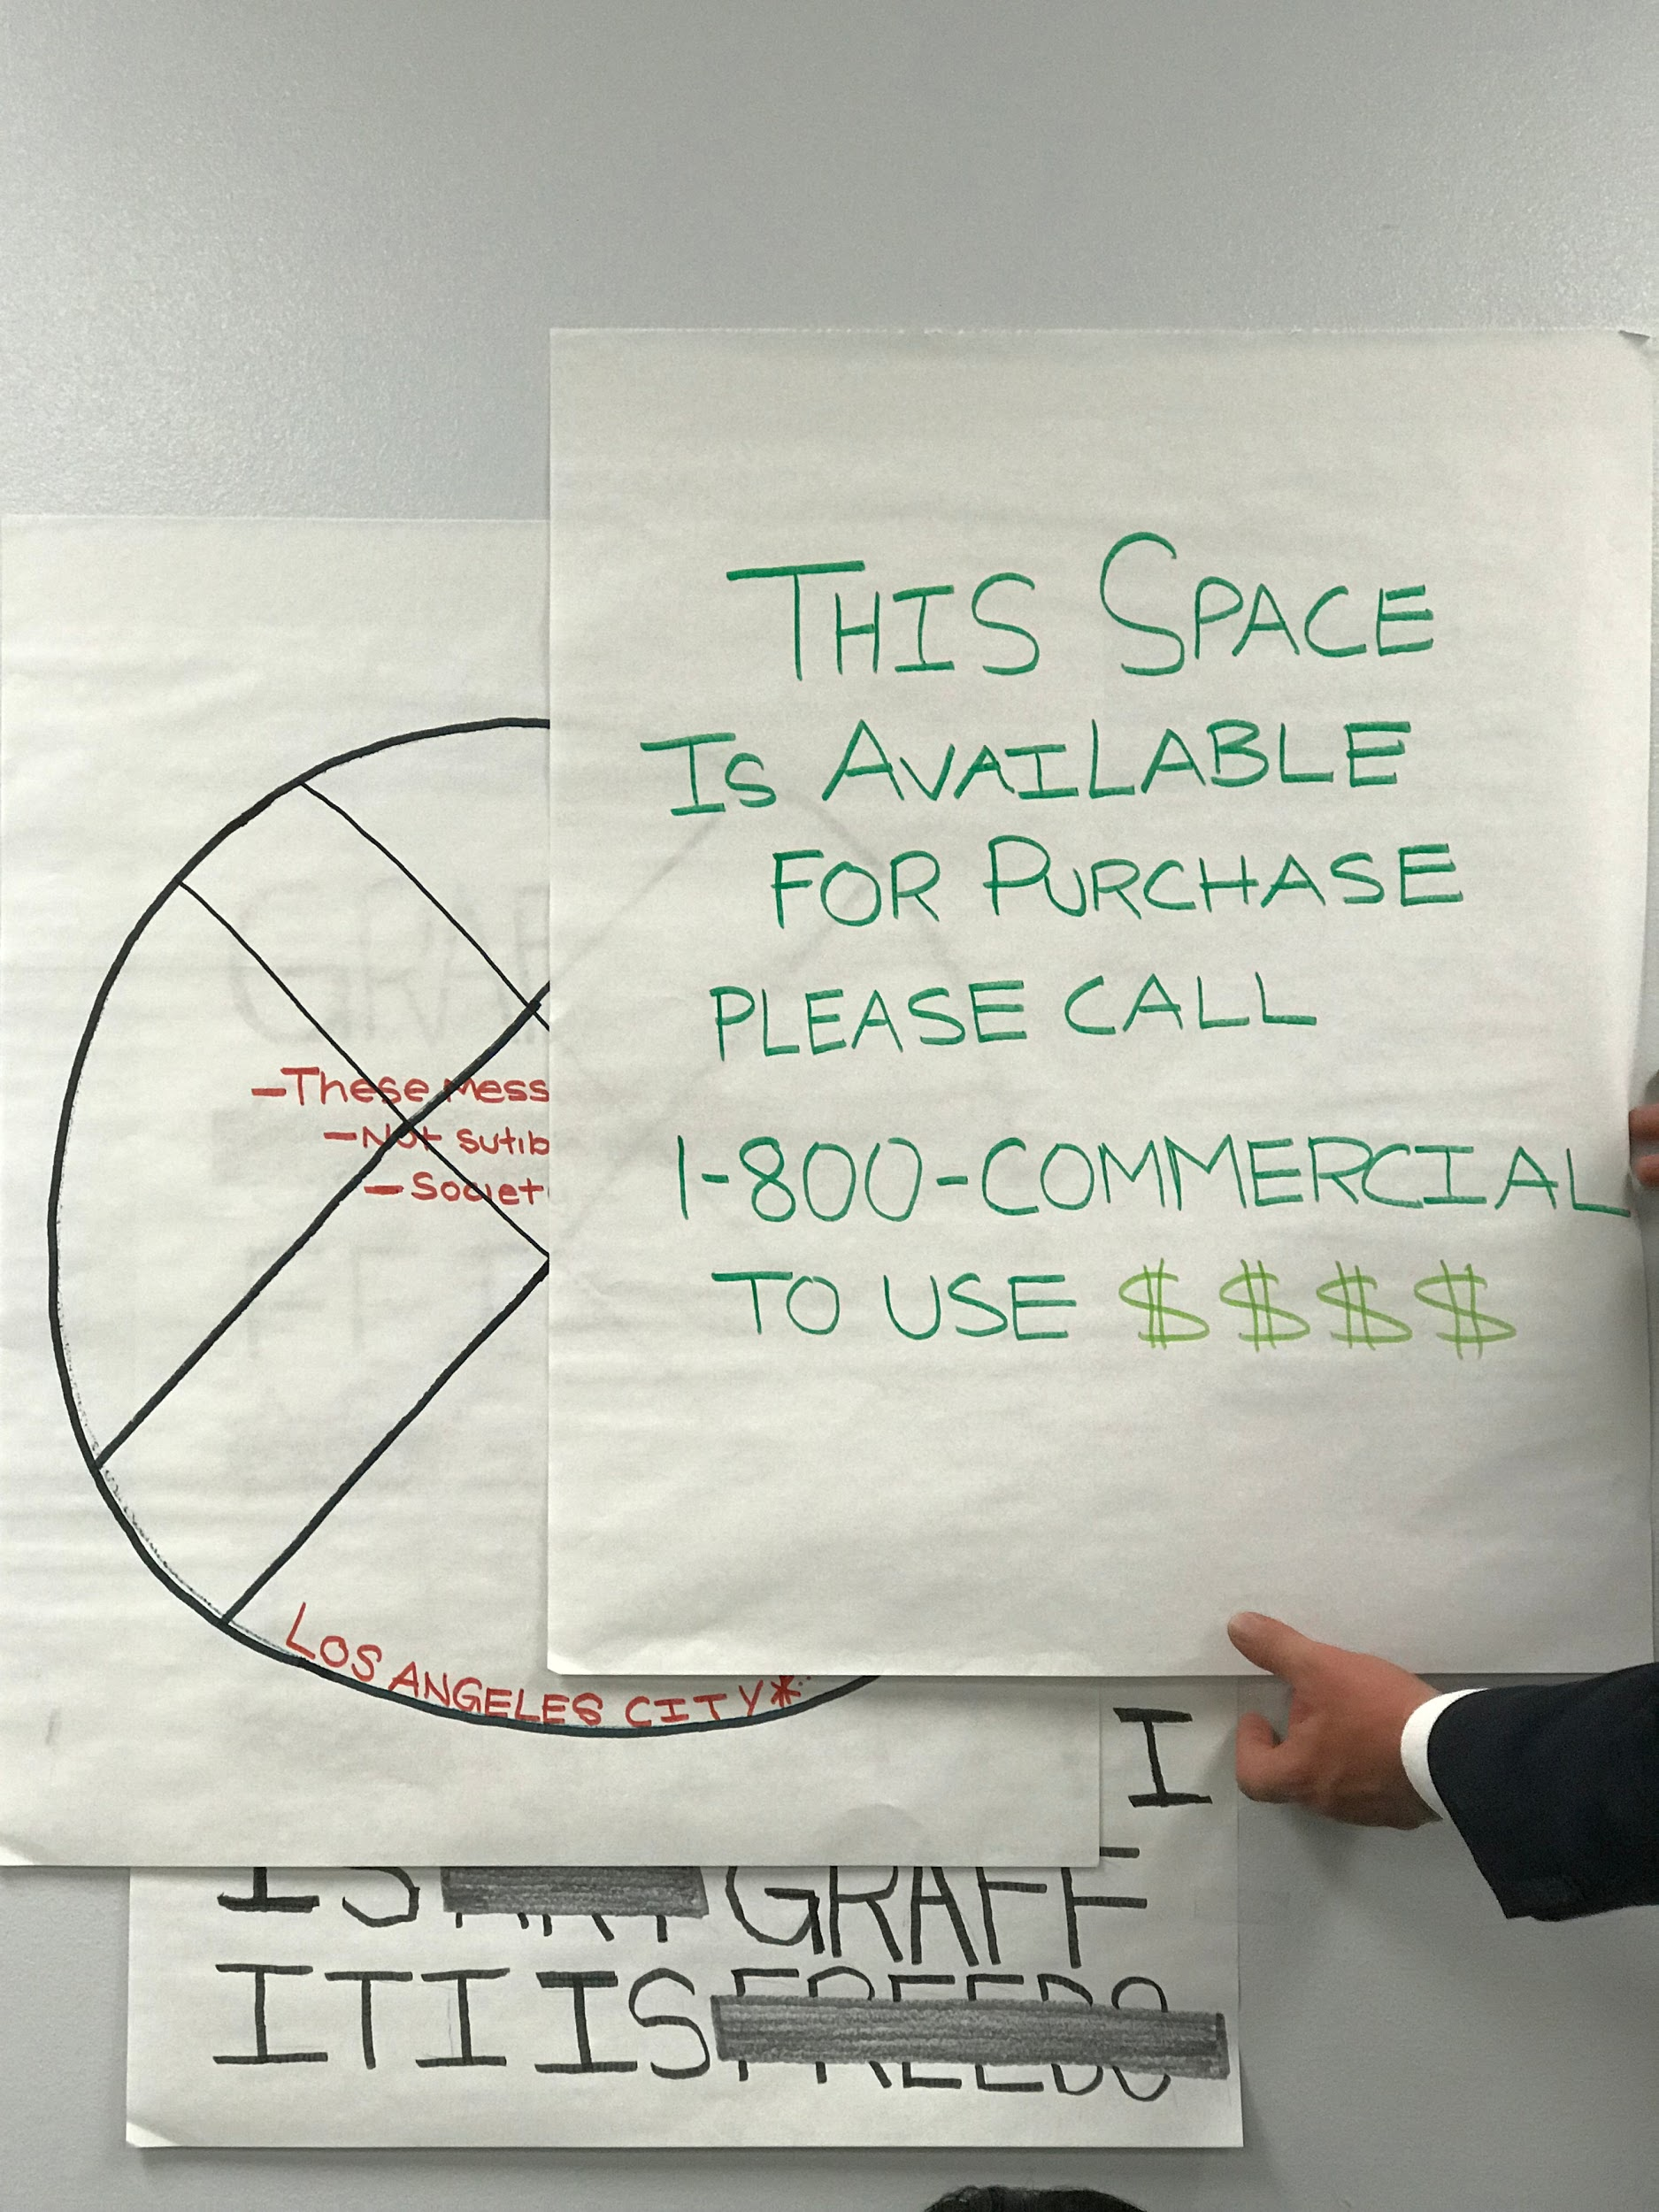
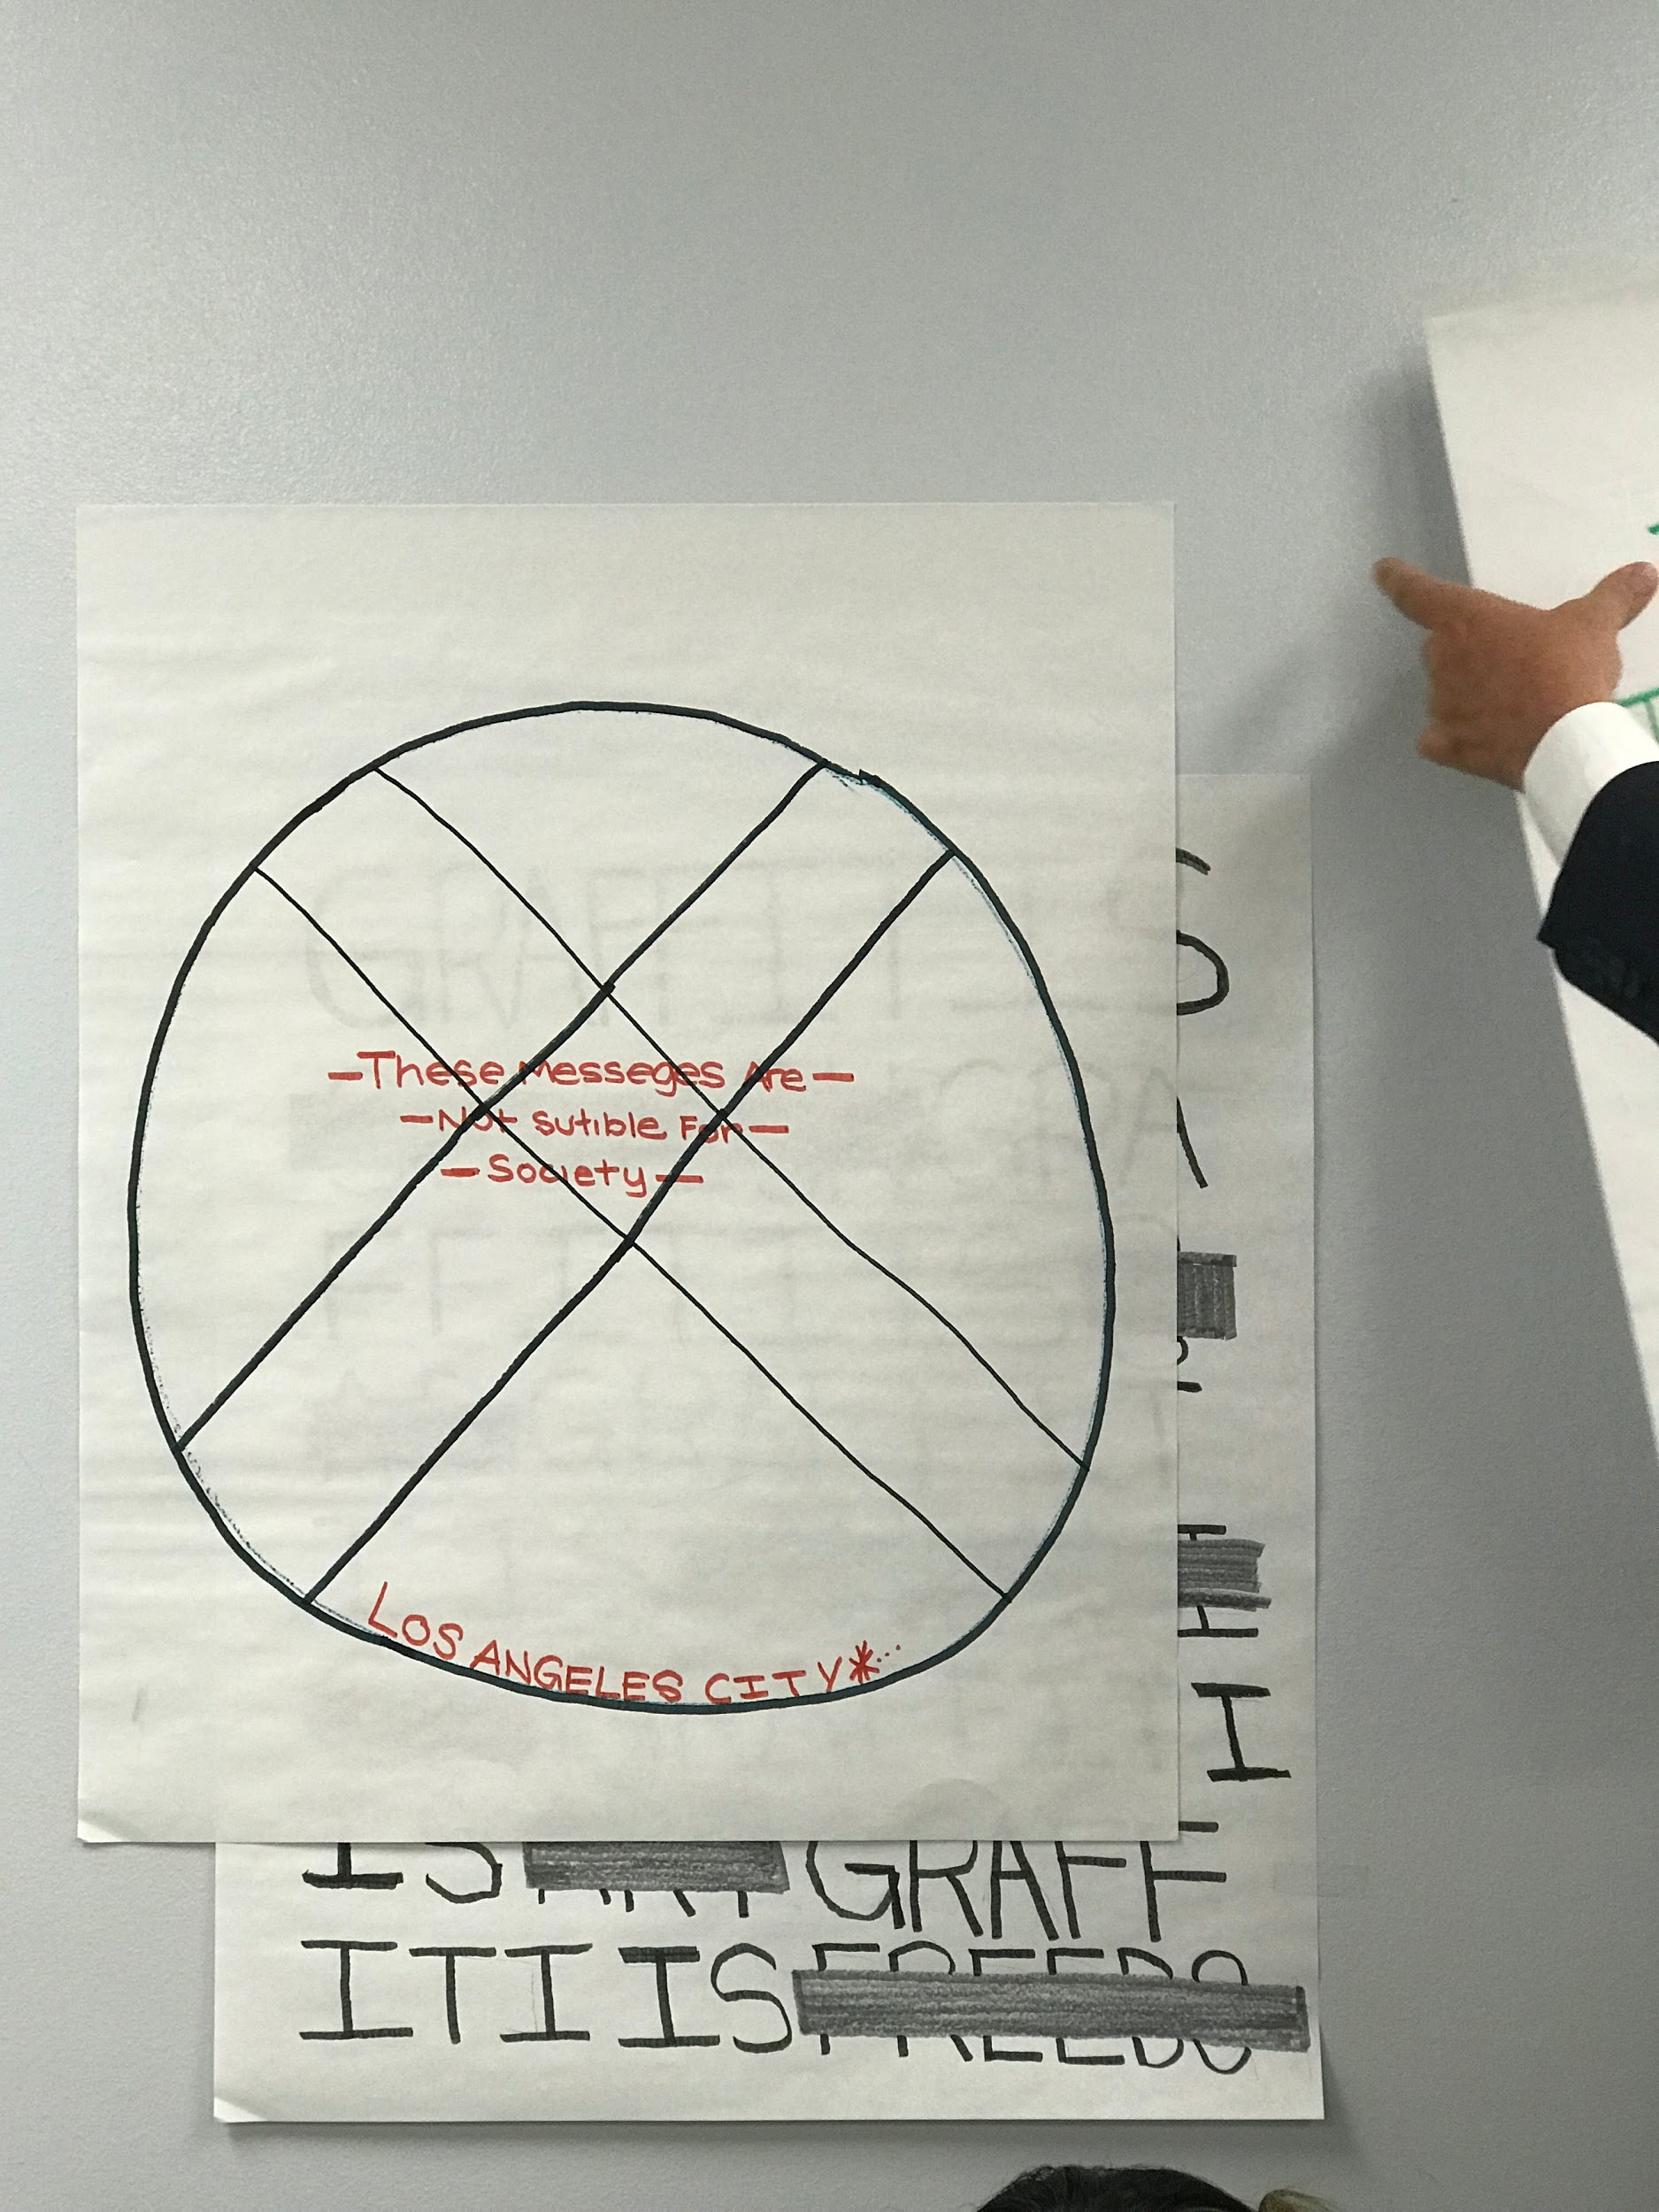

Slide 5
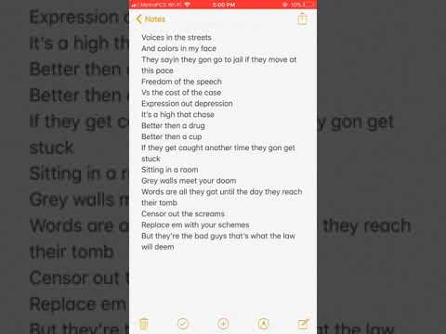

Slide 6
GRAFFITI
- writing or drawing scribbled, scratched, or sprayed illicitly on a wall or other surface in a public place.
Riccardo Messino

Slide 7
What might be the problem with that?
PAINT EVERYWHERE PAINTEVERYWEHRE PAIN TEVERY WHERE PAINT EVERY WHEREPAIN T EVER YWHERE PAI NTEVE RYWHER EPAINT EVE RYWHERE PAINT EVERYWHERE PAINTWPJWERFN FBPWERBVPWERIVERJN PEWHBVWEPV NPIEJNPIEWRJNEJV EWRV NEPWIVJNERW V PWEJVN WEJEWFNEWPIRFN WPIEU NWER DSNERFNEPQIWUDCNPIUNCIPNUC PAINNECPIERNERE PAINTWPJWERFN PAI NTEVE RYWHER EPAINT EVE RYWHERE PAINTEVE RYWEHRE PAINT EVERYWHERE PAINT EVERYWHERE
“IT’S ILLEGAL” “IT COSTS MONEY” “IT’S A VANADLISM” “IT BELONGS ON PAPER”

