Slide 1


Stop Means Stop
By Jordan Reed

Slide 2

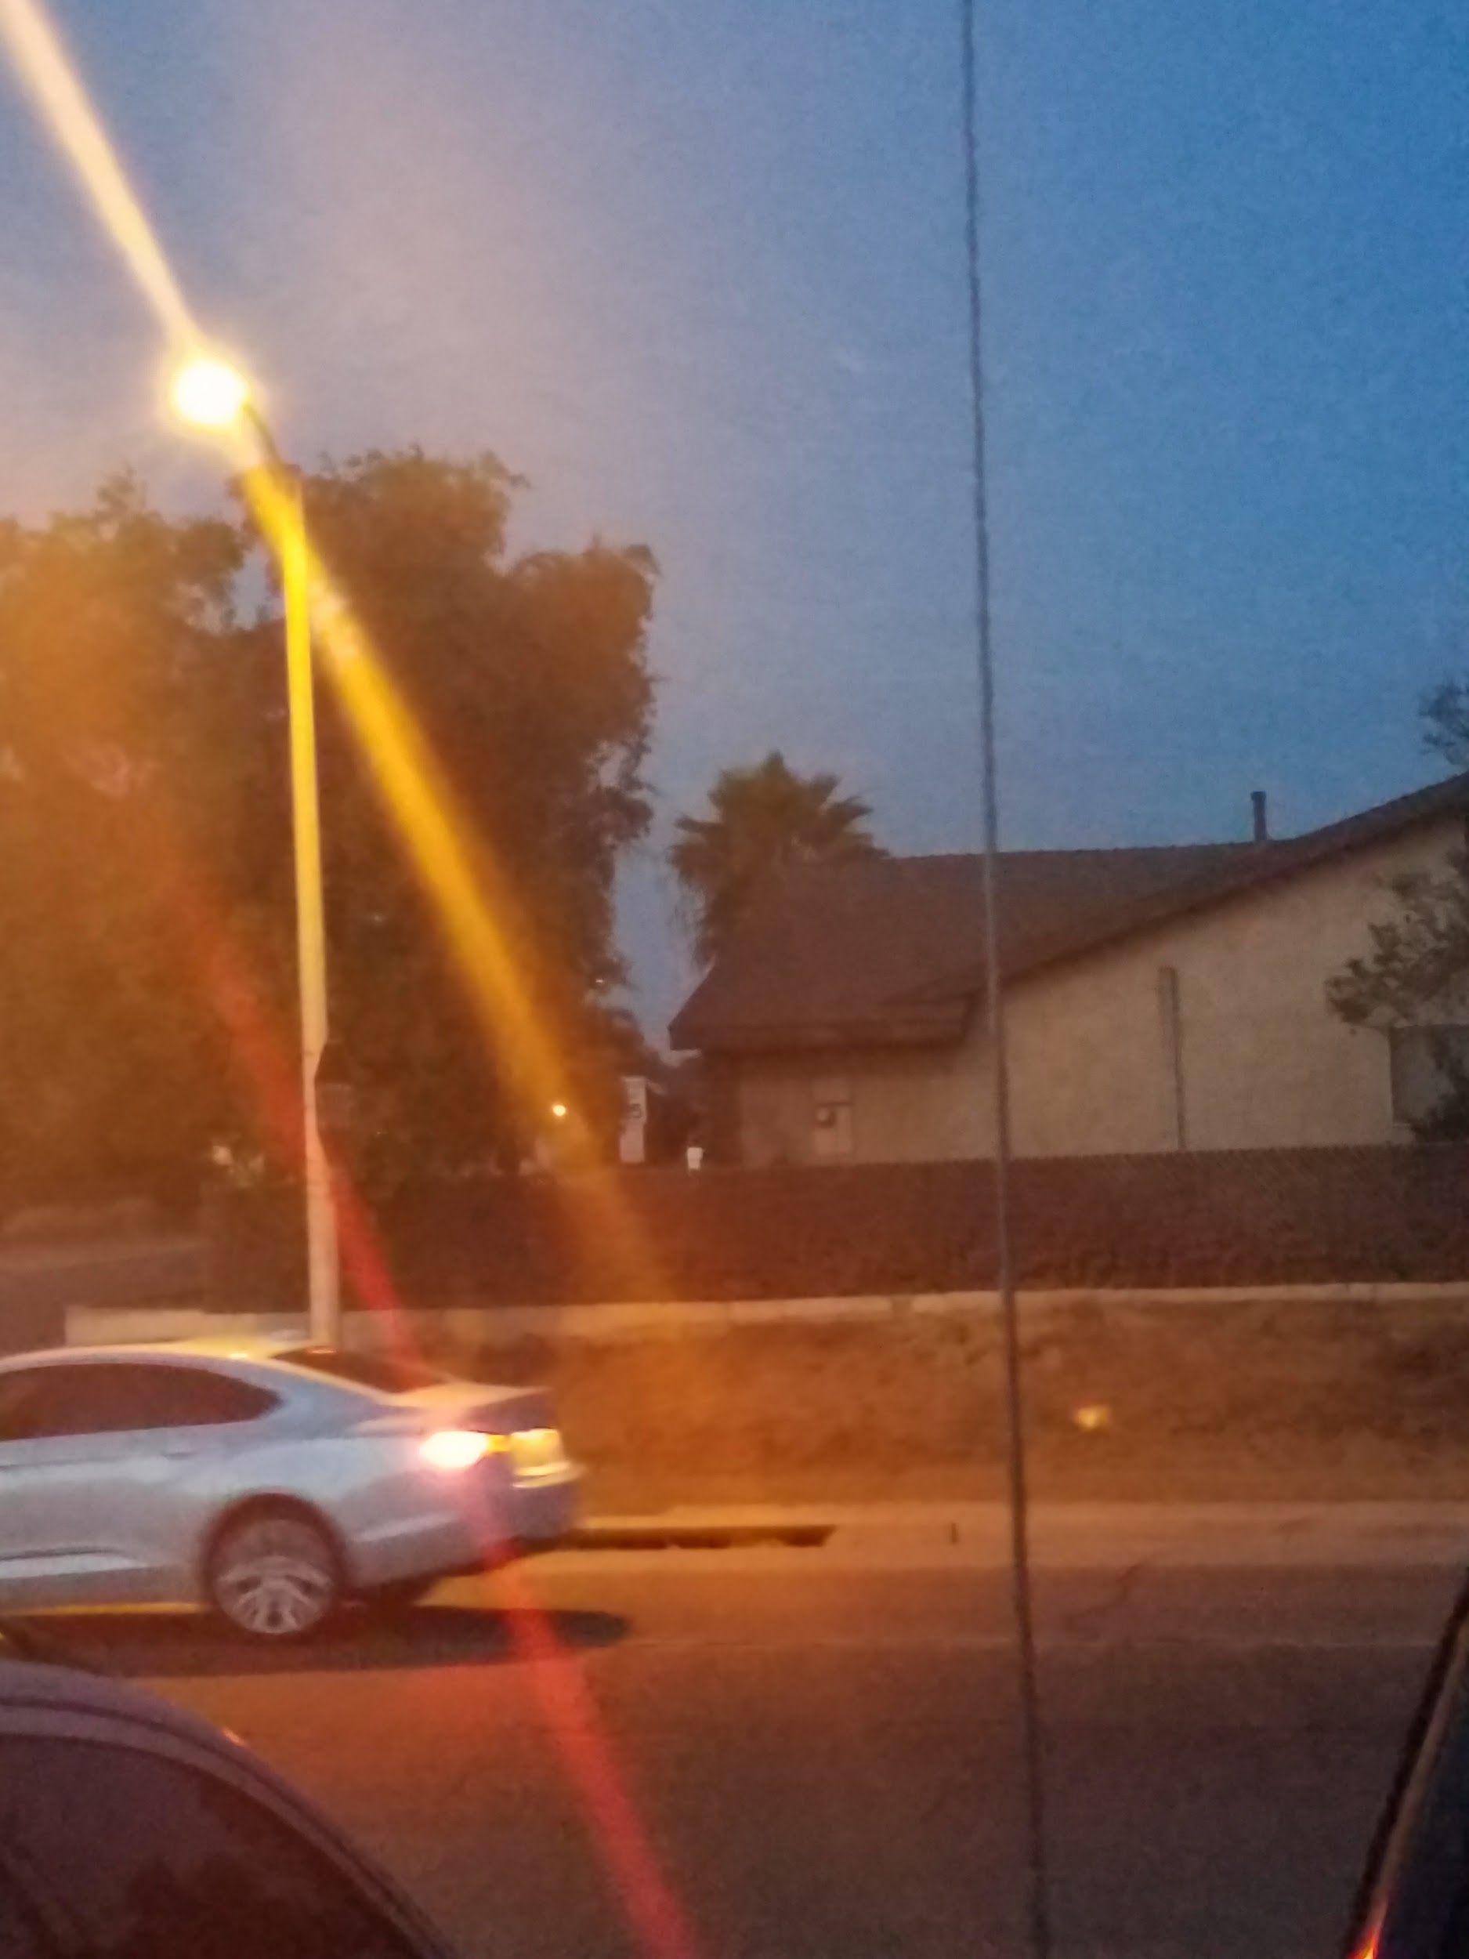
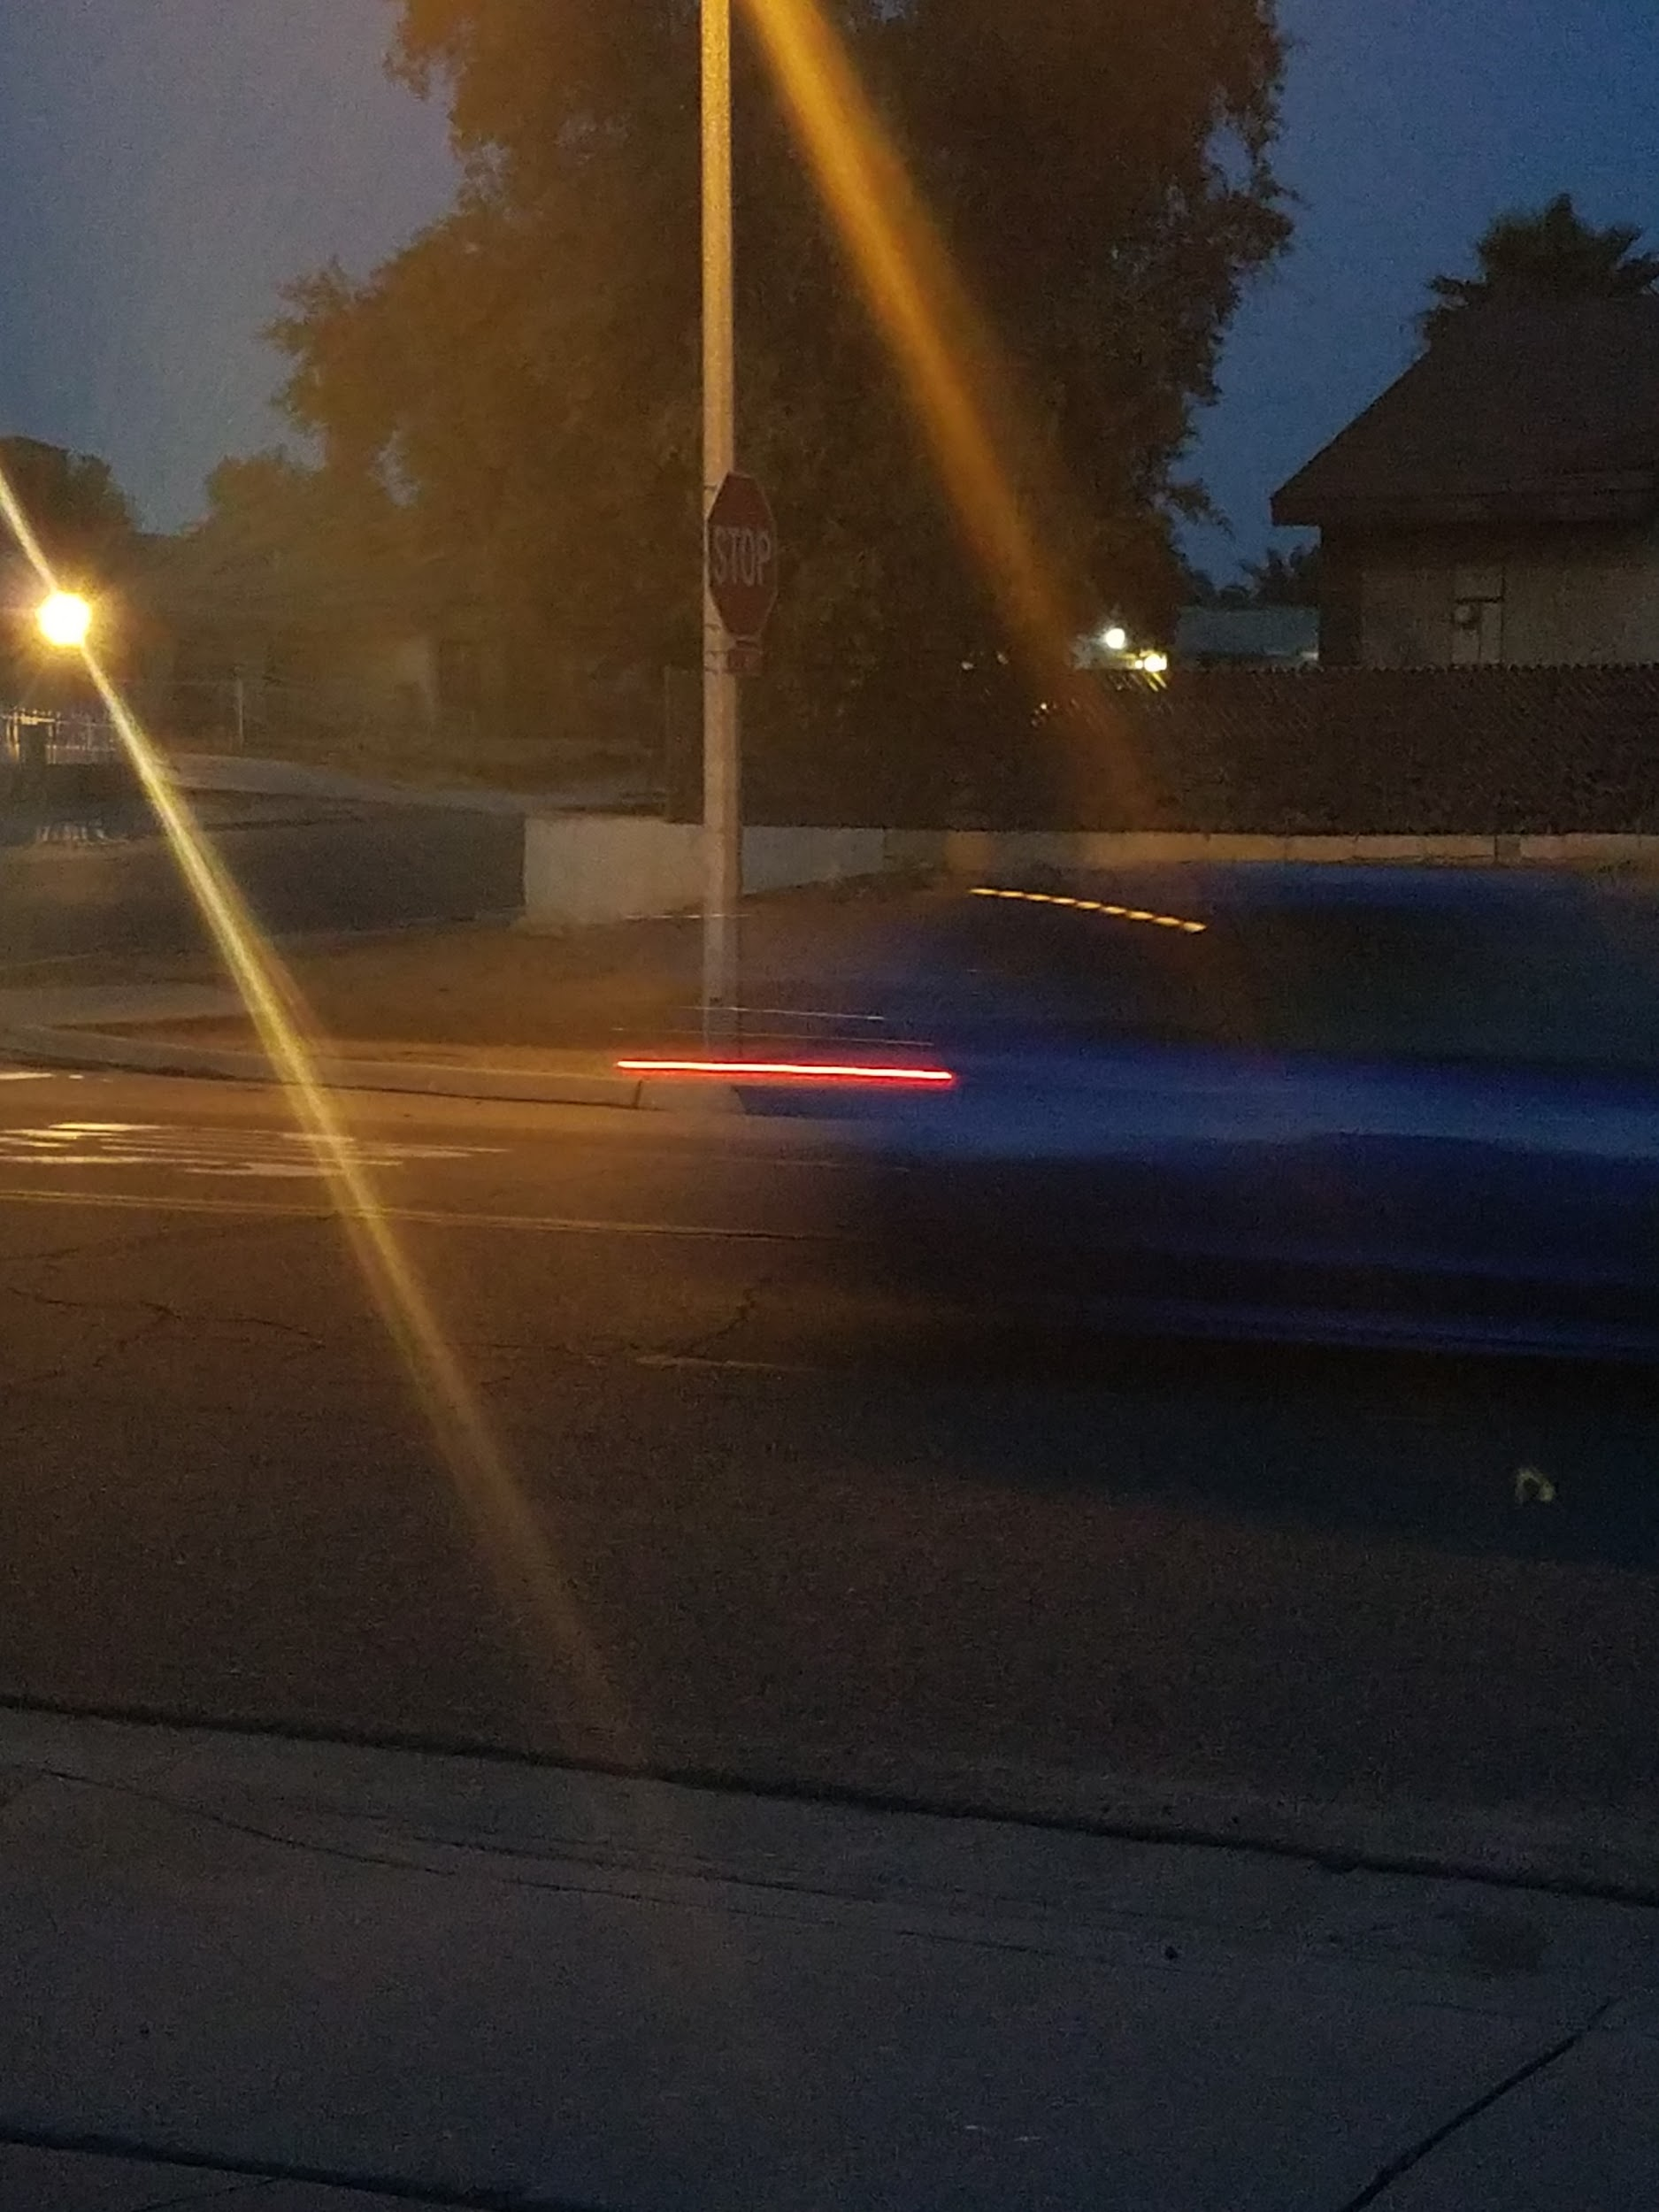

Slide 3

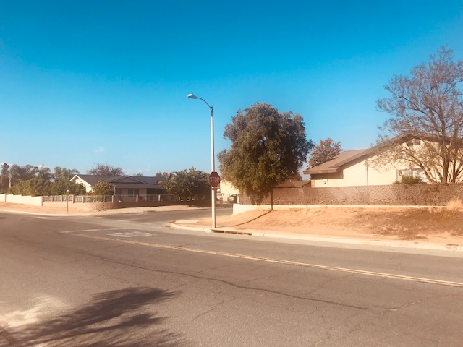


Slide 4
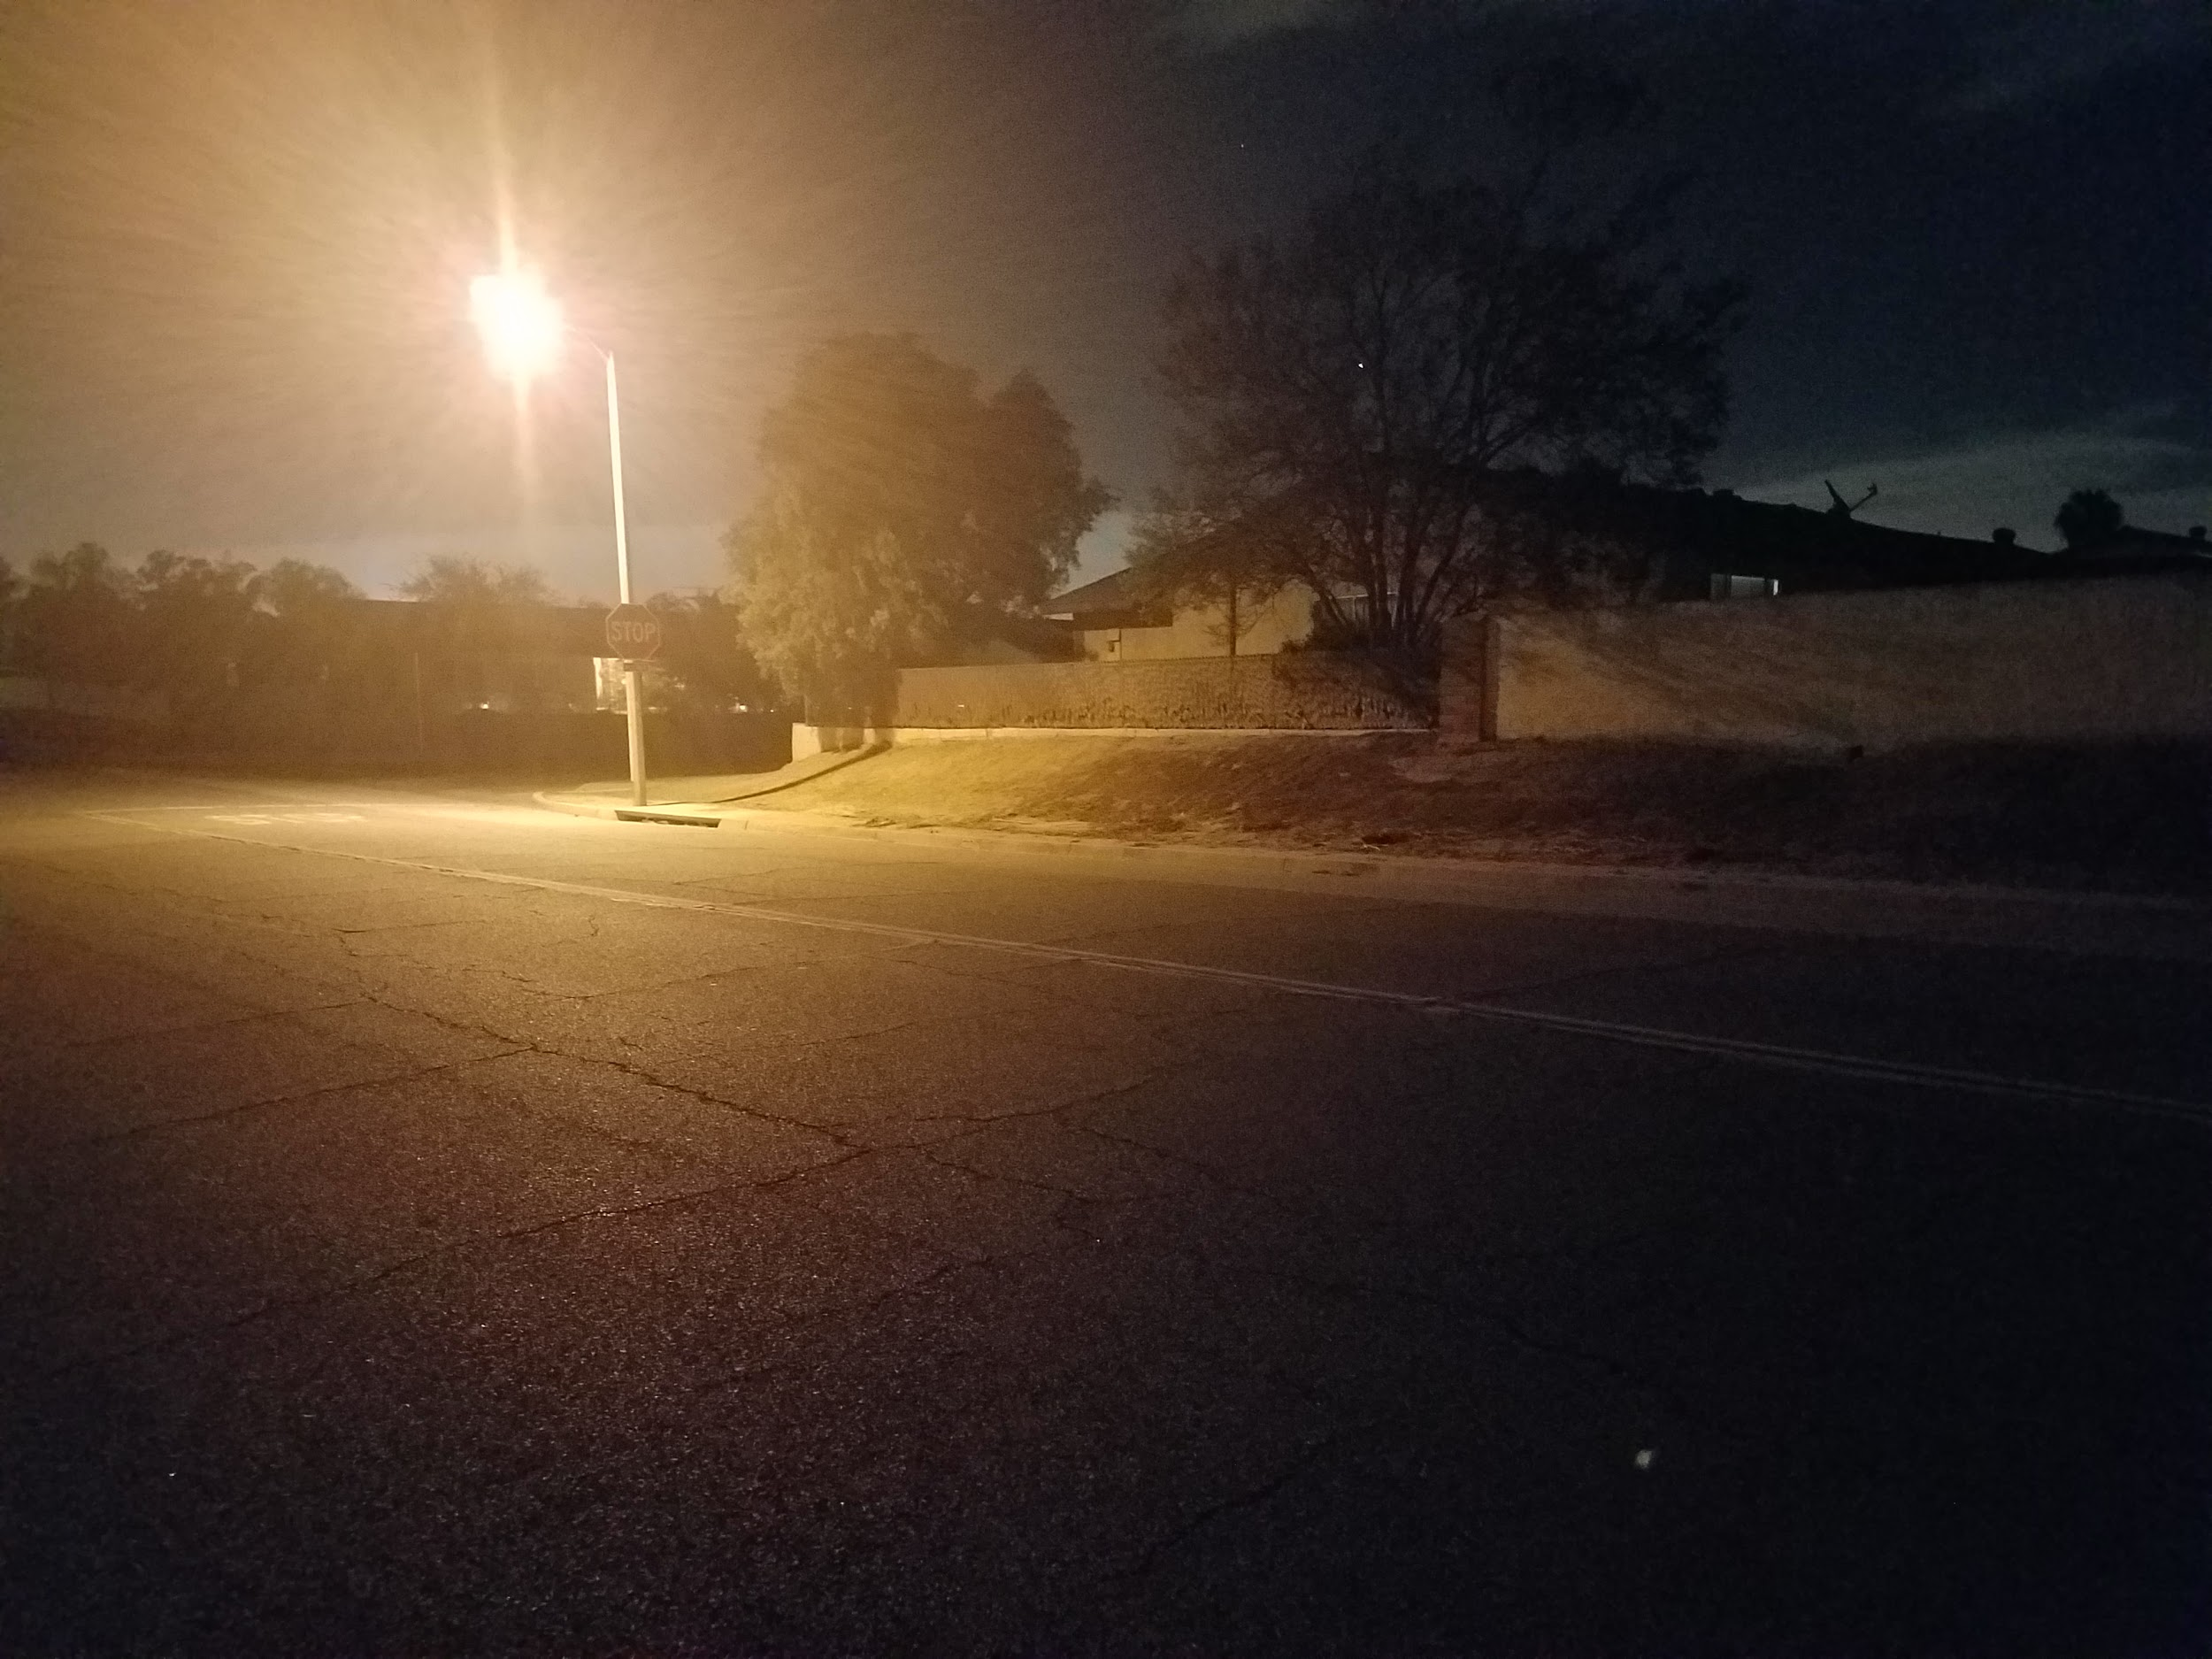


Slide 5
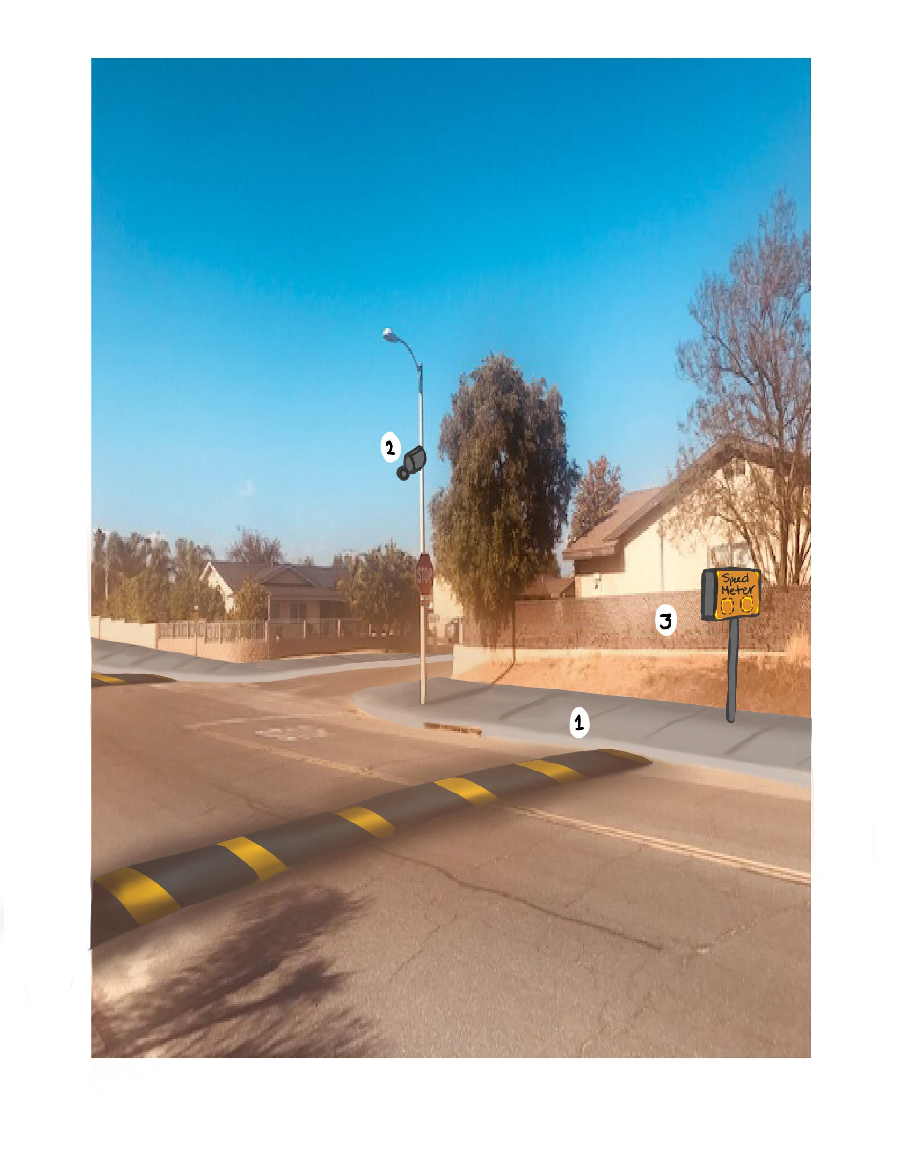
These are some of the changes that I hope to make to my neighborhood.

Slide 6
