Slide 1
High Impact Practices (HIP) Service Learning Internship Community Engagement (SLICE)with Spoken Word “Fix-It” Presentation
Javier Ray
The struggle of Gentrifications
English 350 Tues/Thru 8:30am-9:45am

Slide 2

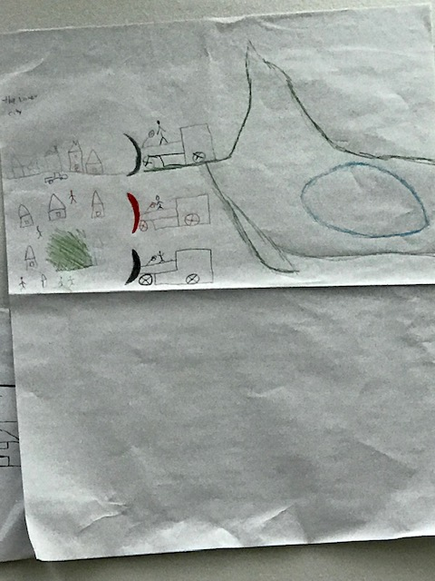
Under Construction

Slide 3
PHOTOGRAPH

Slide 4
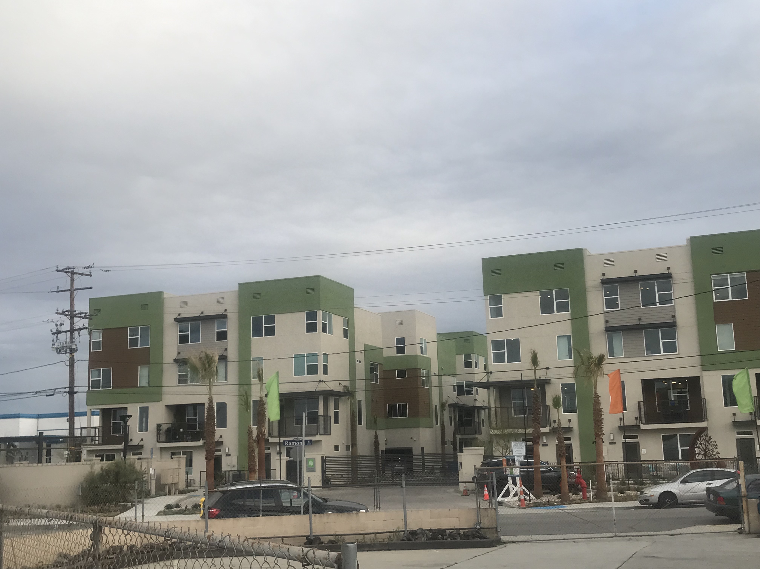
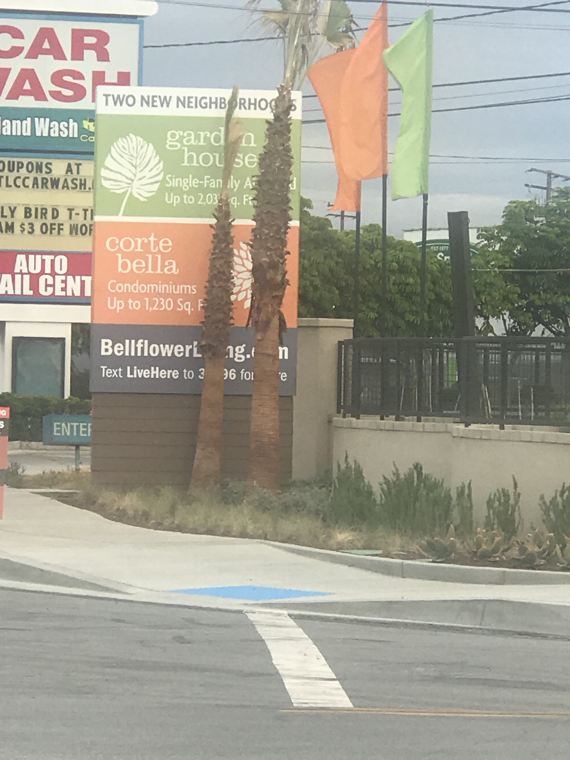
PHOTOGRAPH

Slide 5
photograph

Slide 6


Spoken words
At the beginning of time we were taken from are homes and placed in locations unfamiliar to us. Please don’t move us.
U take are homes without any regard. Please don’t move us.
U make are life`s a living hell, but please don’t move us.
U take are place of warmth and security and turn it into something of a memory. Please don't move us.
U make are life’s a vessel of lost hope. Please don’t move us.
U take are homes and dignity an yet you still move us.
U leave us unprepared for the future, yet you move us. but I tell you once again and again. Please don’t move us.
This Photo by Unknown Author is licensed under CC BY-SA

