Slide 1
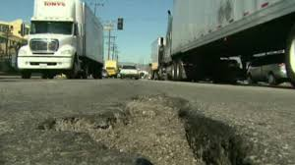
Potholes
Alyssa Maldonado
Eng 350
Professor Ramser
May 8 2019
HIP SLICE Fix It

Slide 2
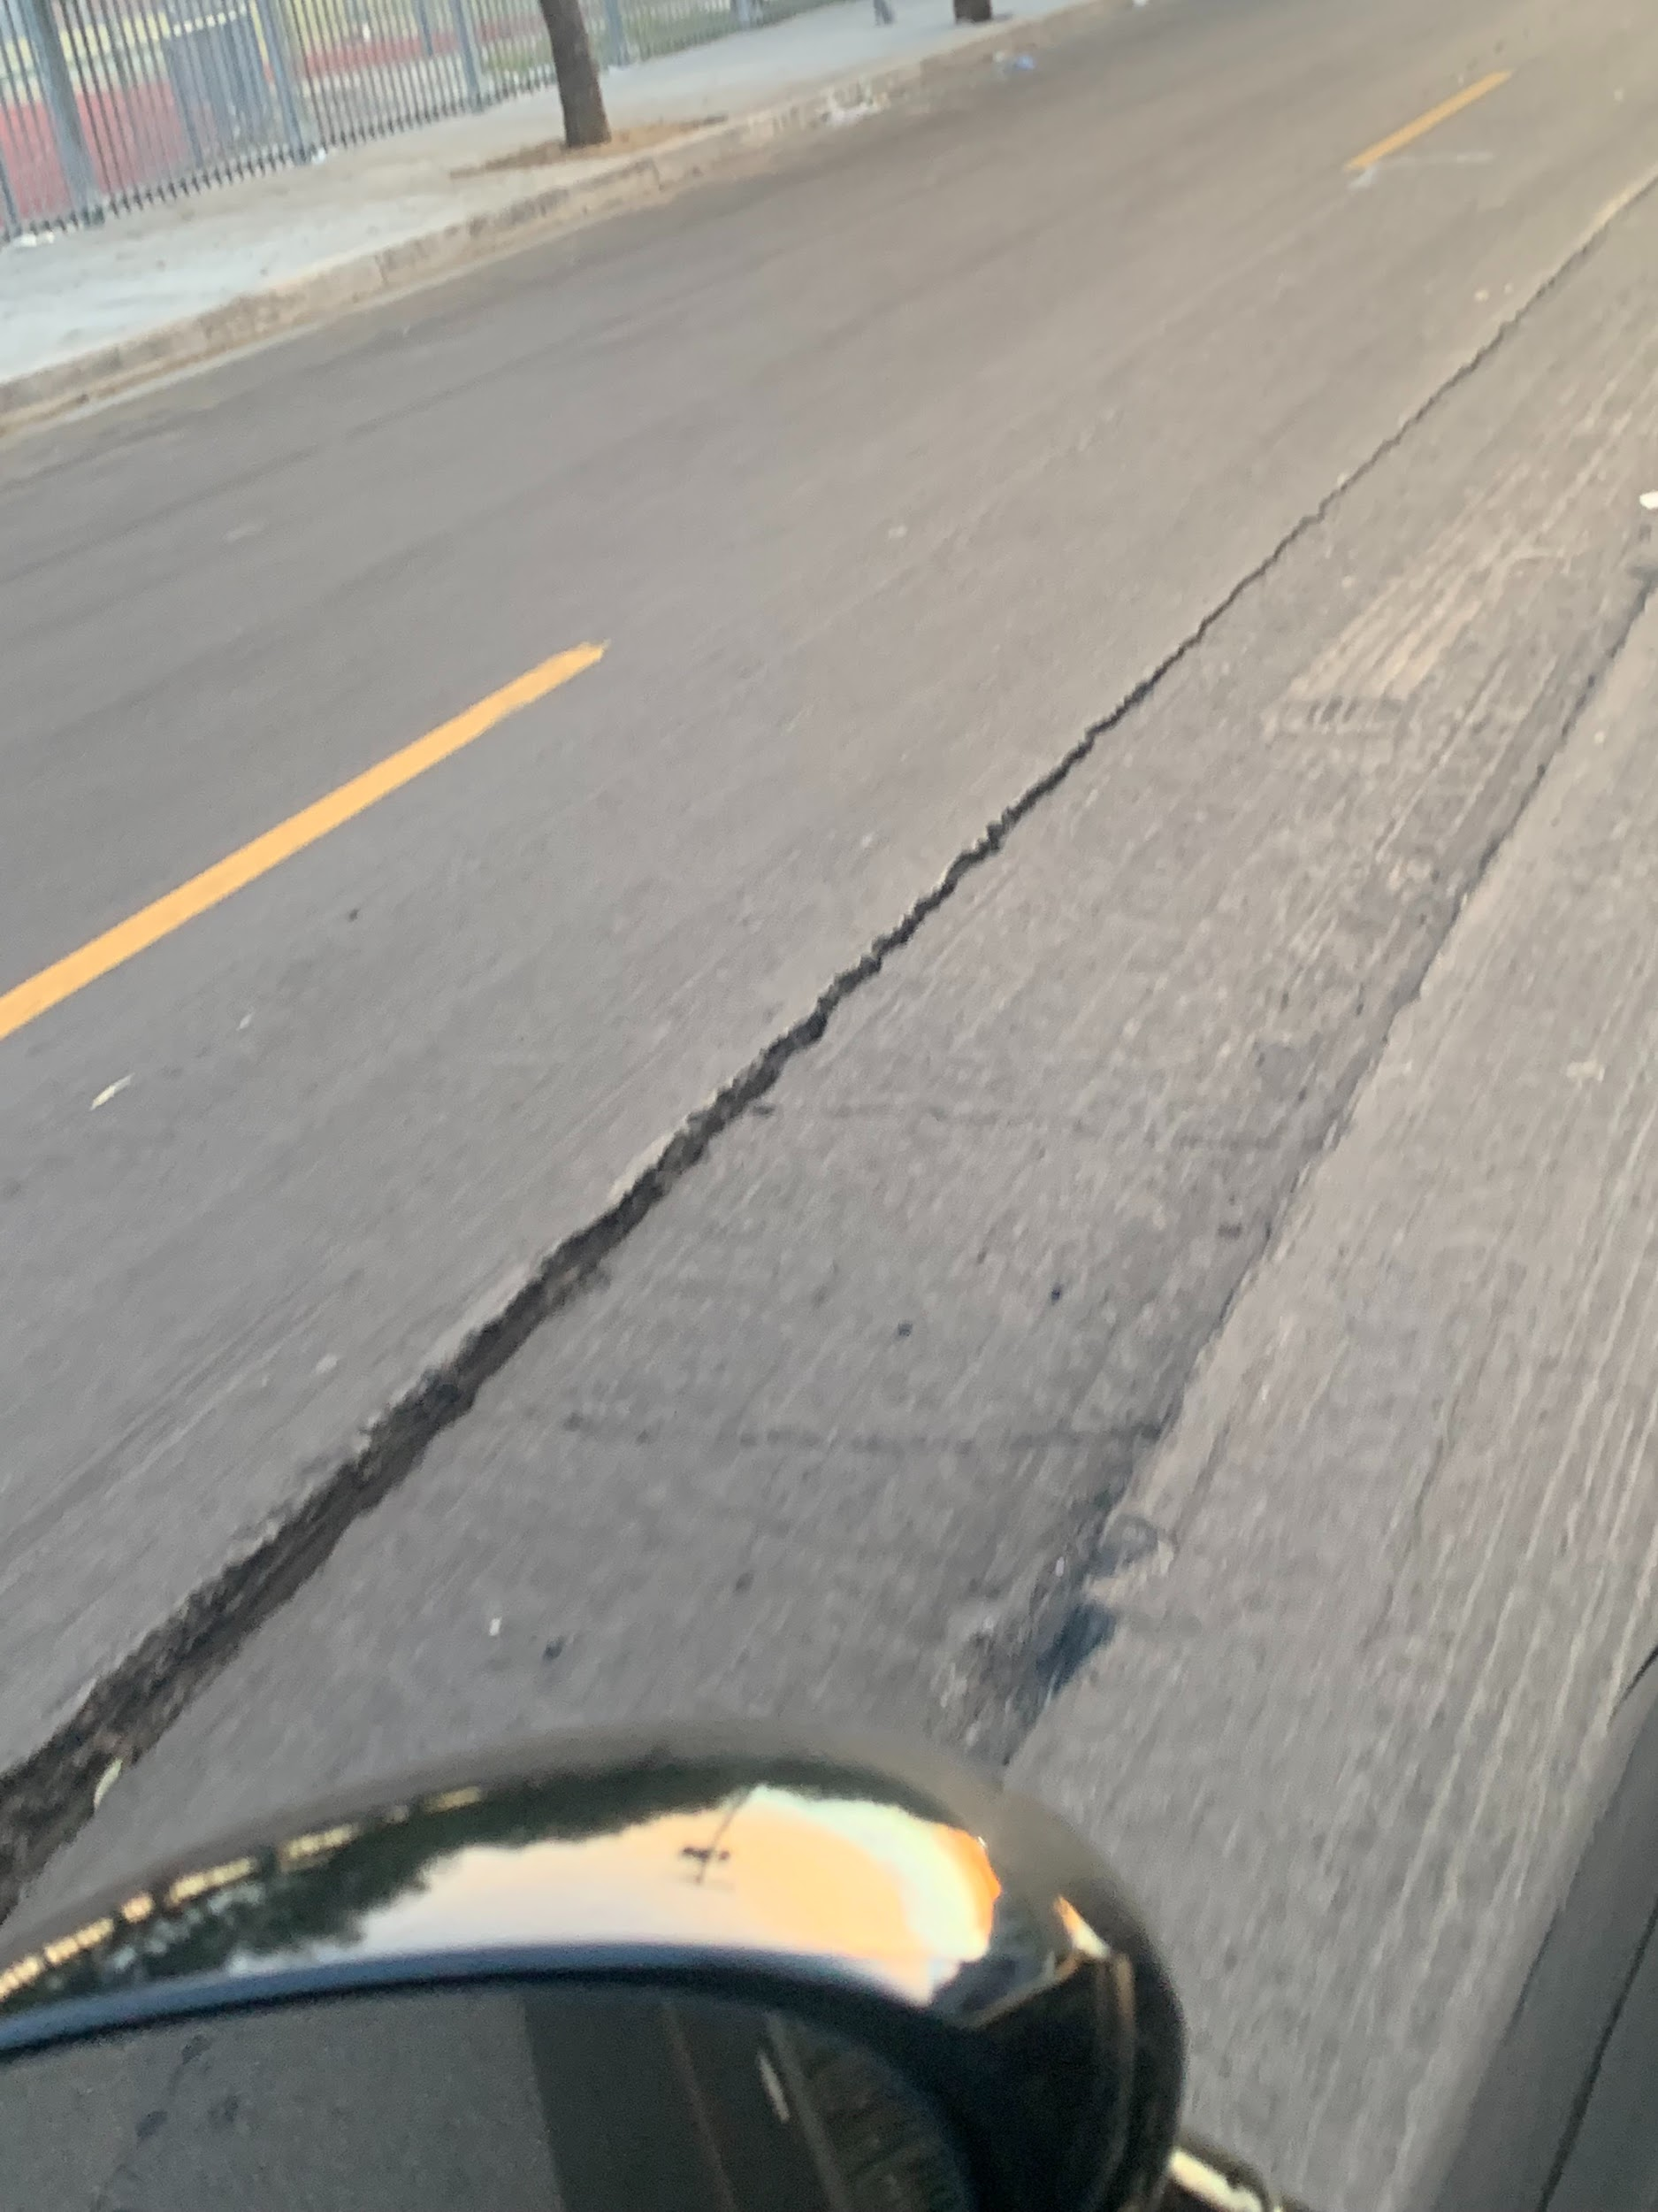

Constant transportation of vehicles on streets
The effect of automobiles in and out of cities has created a huge damage effect on the streets on LA mainly because LA is popular for jobs, tourists, and importing goods.
Three main factors are cars, trucks, and weather. This damages the concrete which then creates potholes that appear for months at a time.
The city of Los Angeles seems to have a difficult time maintaining their streets due to the overwhelming amount of potholes needing attention.

Slide 3
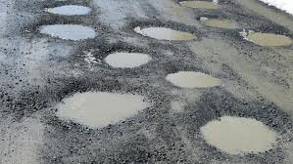
The weathers Impact on potholes
Although vehicles are mainly to blame for concrete destruction.
The weather also contributes negatively to potholes.
The rain creates broken concrete and effects potholes by creating bigger potholes and further concrete damage.
The streets are a pathway for everyone including cars, buses, trucks, and bikes.

Slide 4
Why the streets need more attention
These damaged streets require additional attention because it puts everyone’s safety at risk.
A quick dip, bump, hole, or twist on the road can hurt people as well as damage our property.
It is up to the city to maintain these streets properly or our tax money is basically being wasted.

Slide 5
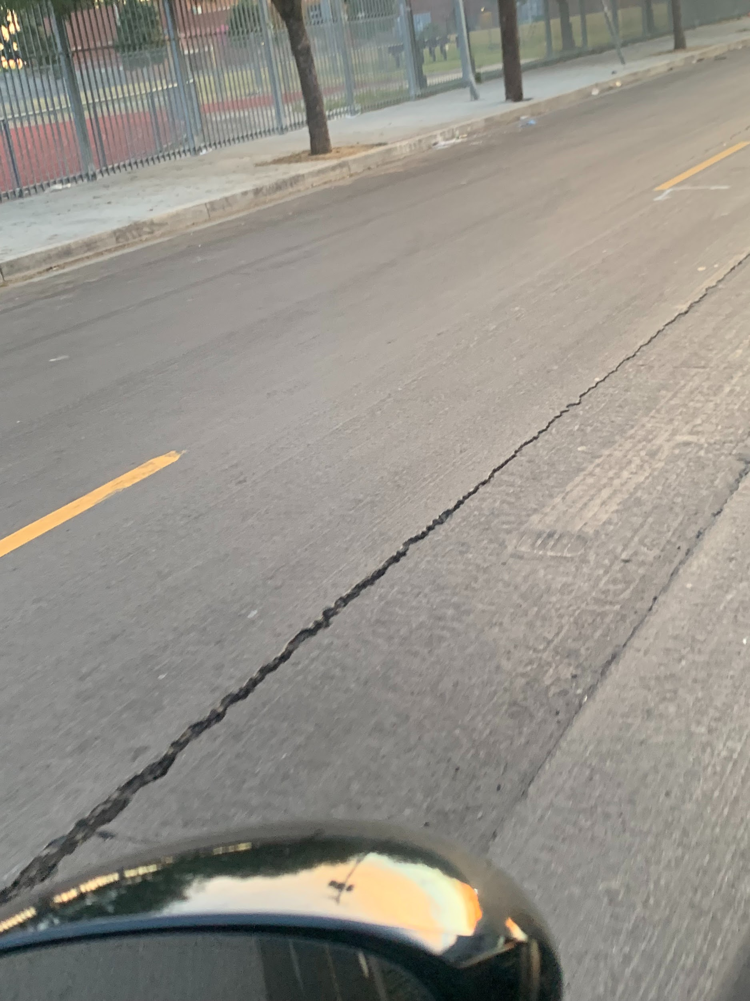
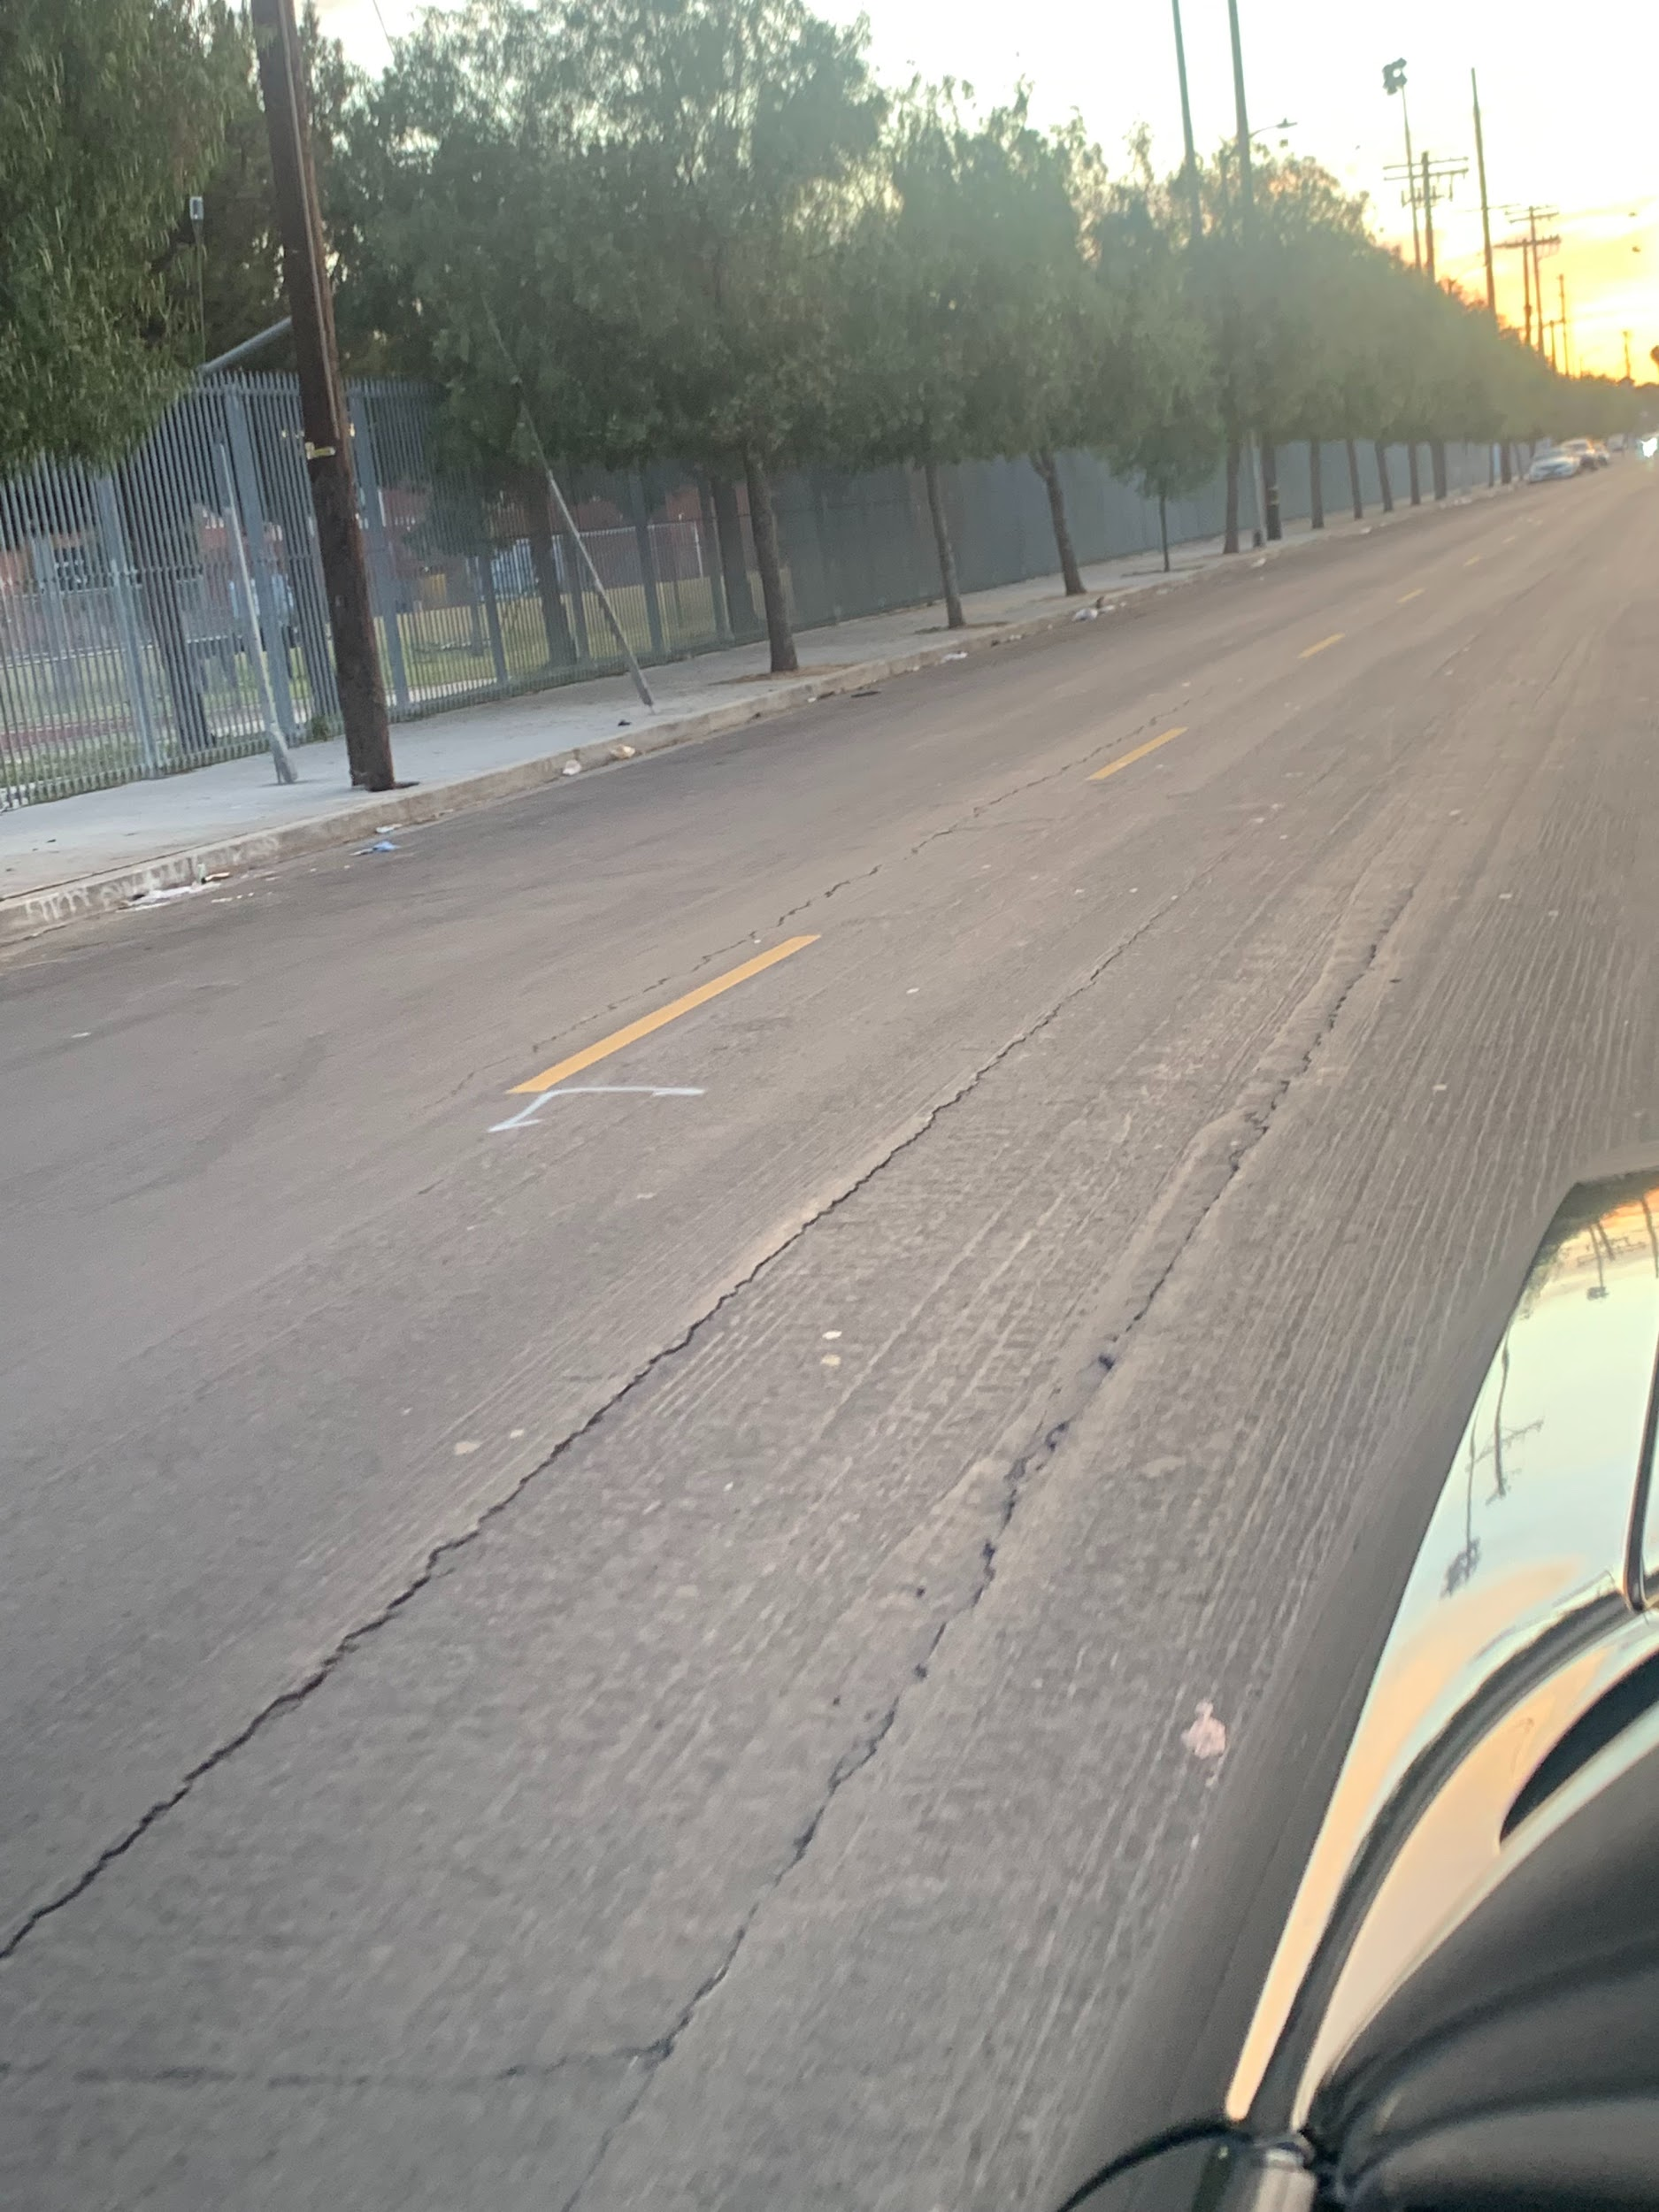
The damaged streets of LA

Slide 6
