Slide 1
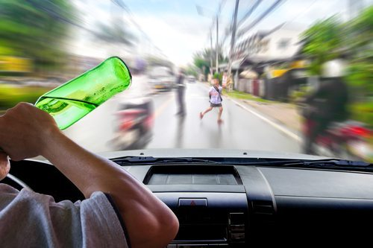
Reckless Driving
Sophia Popal
English 1B
May 19, 2019

Slide 2
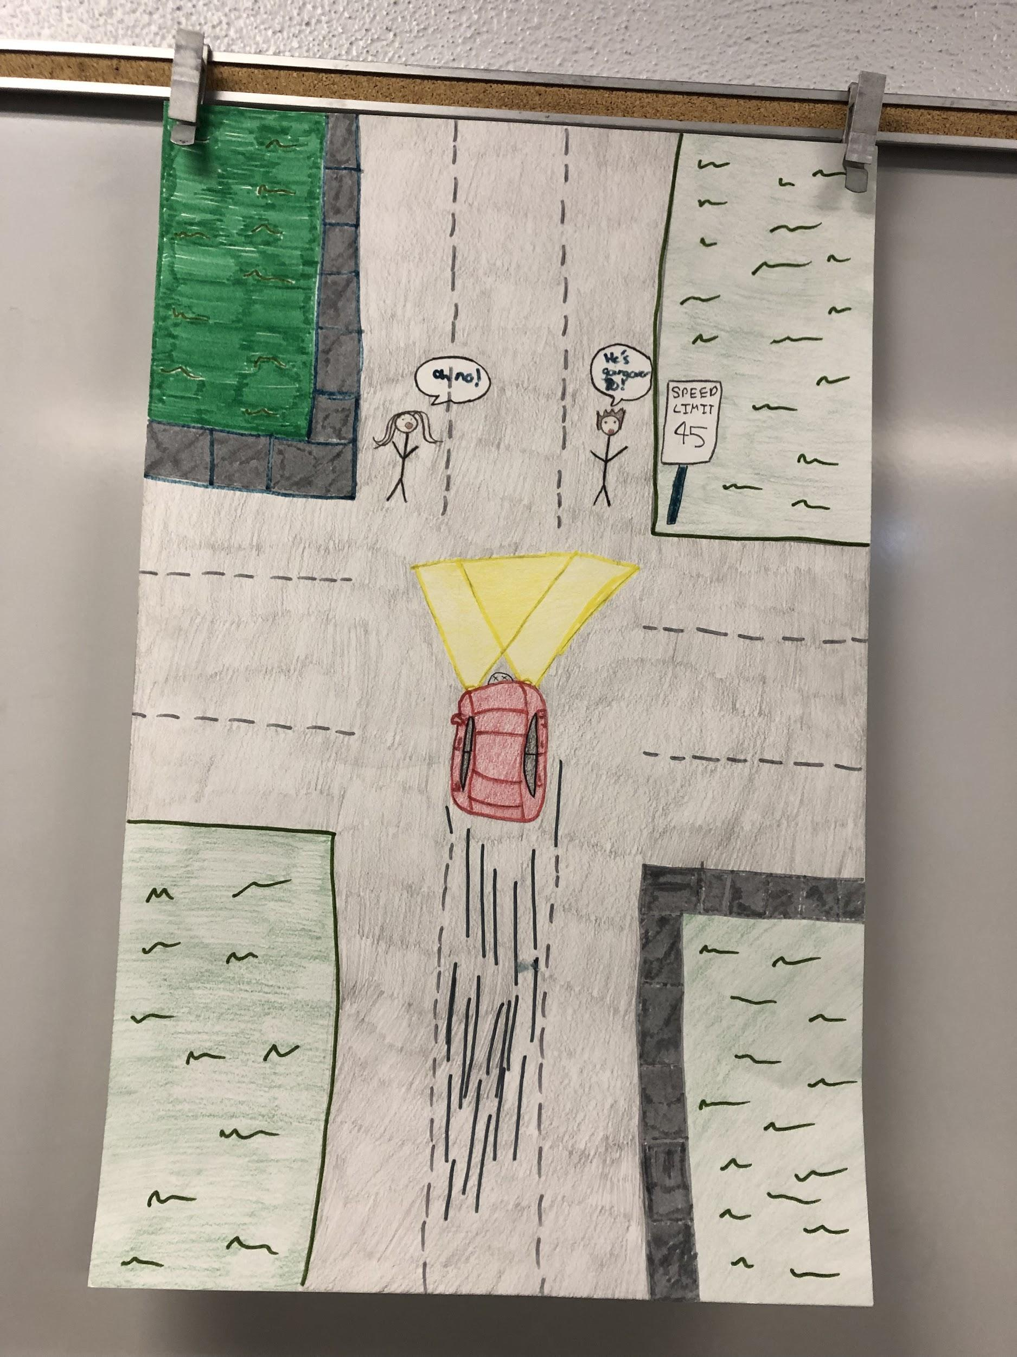

Slide 3
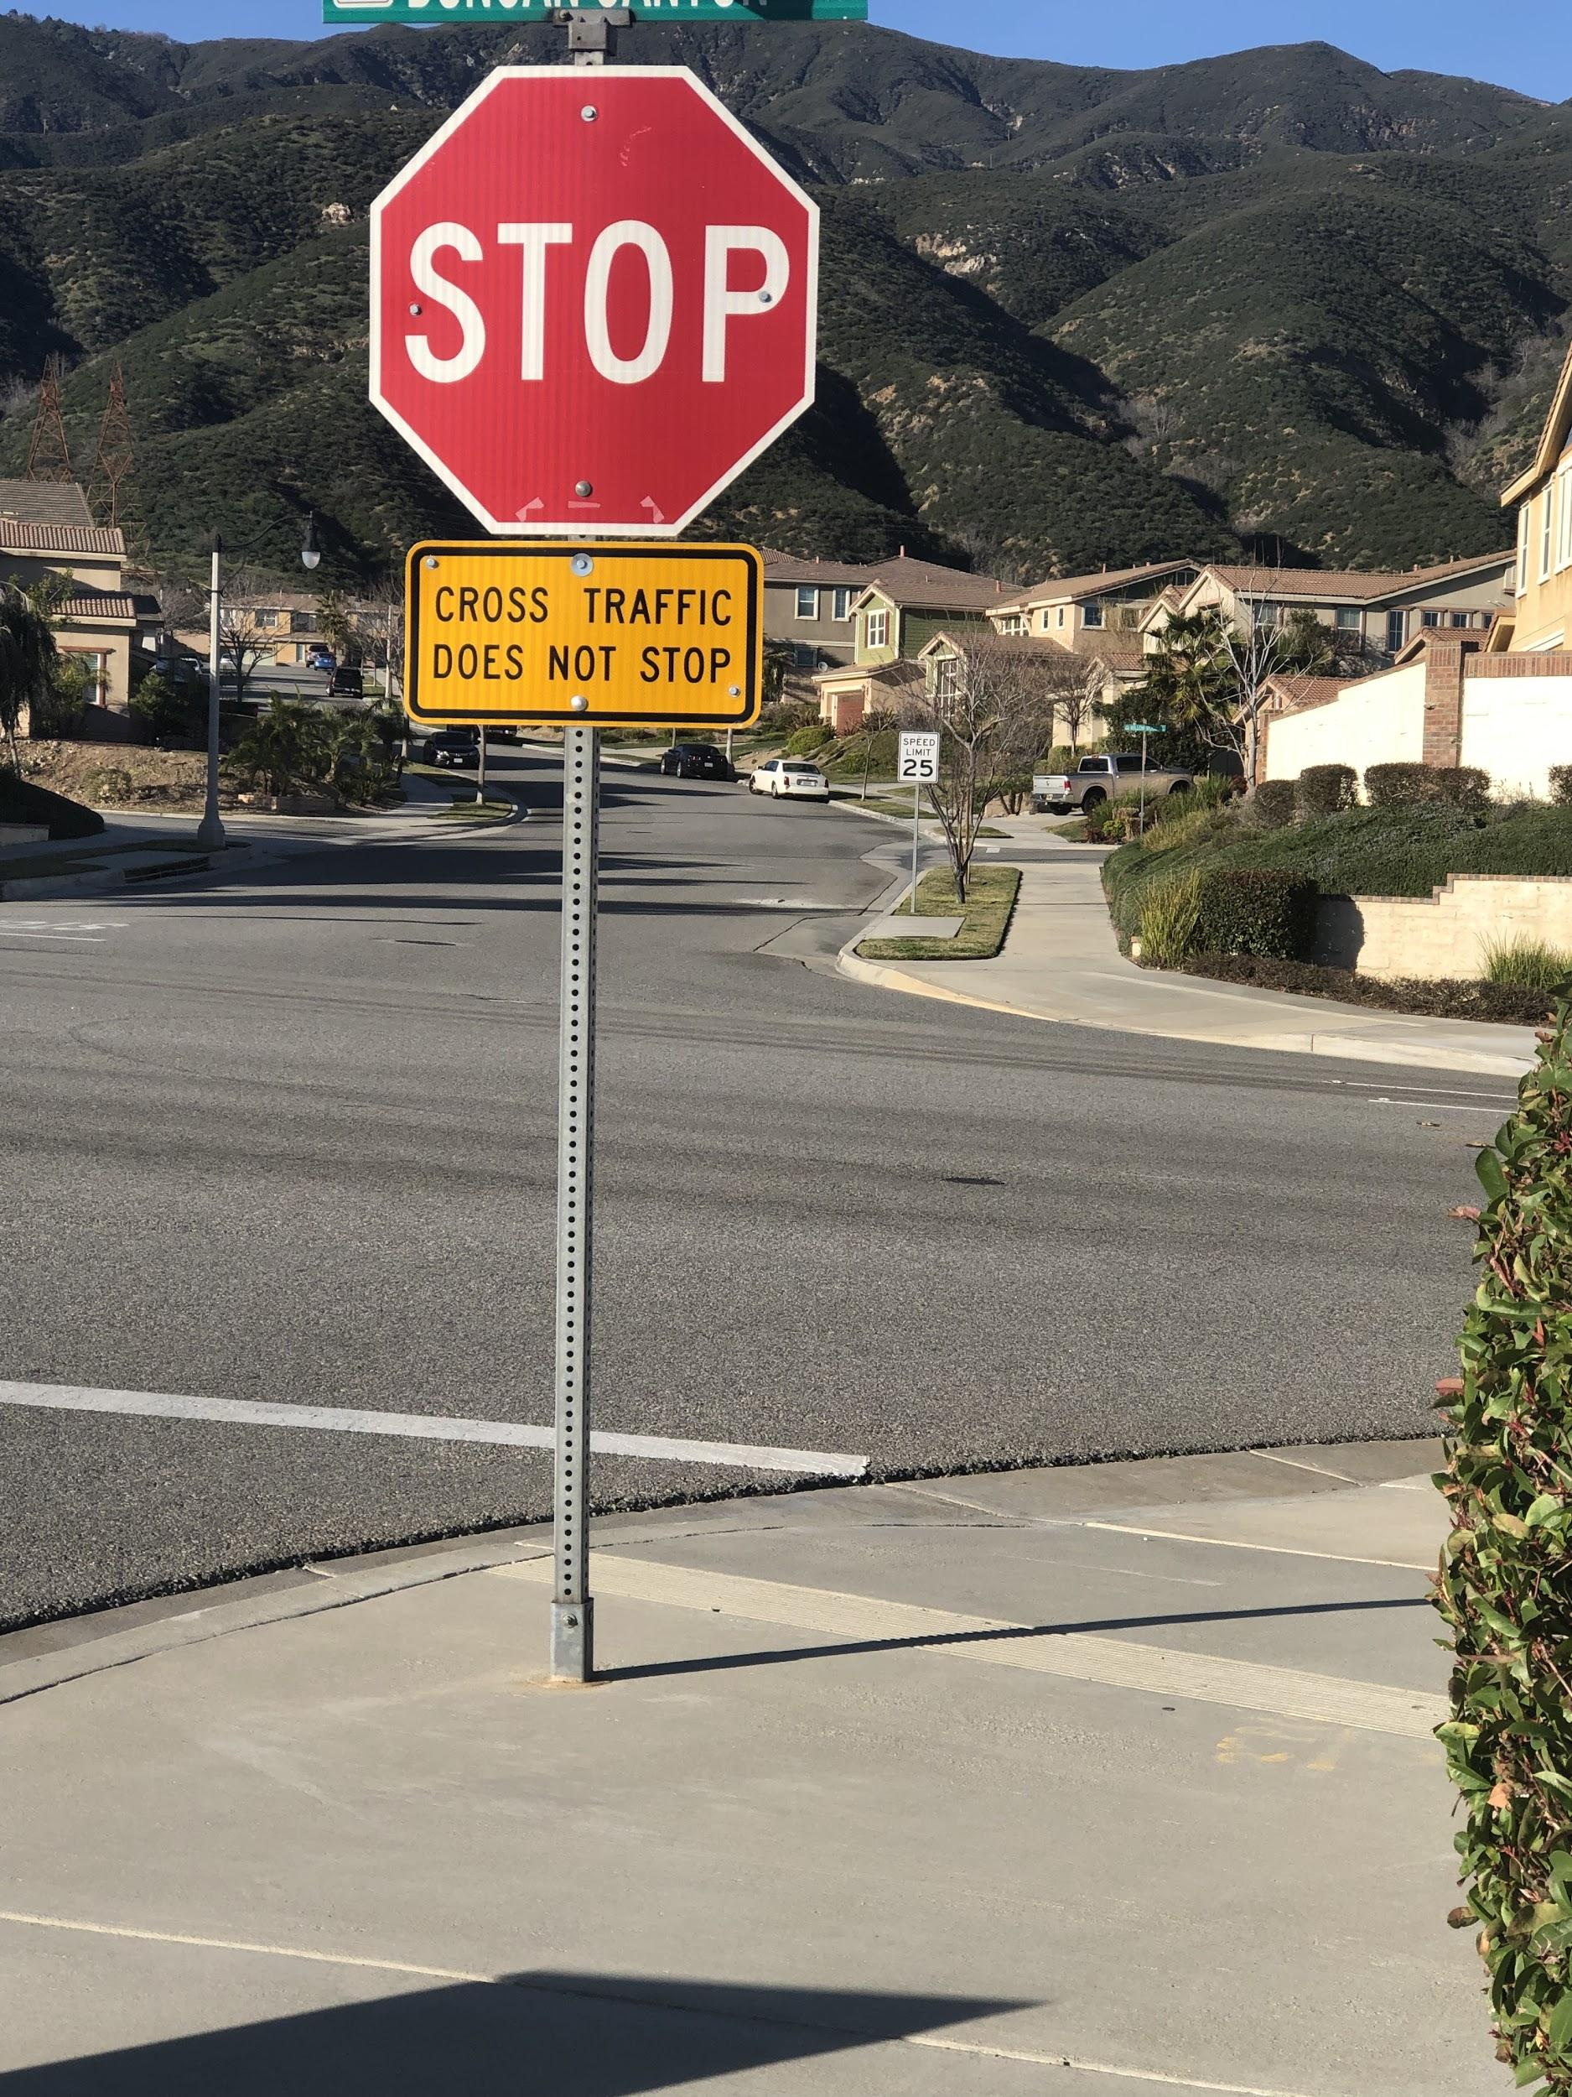

Slide 4
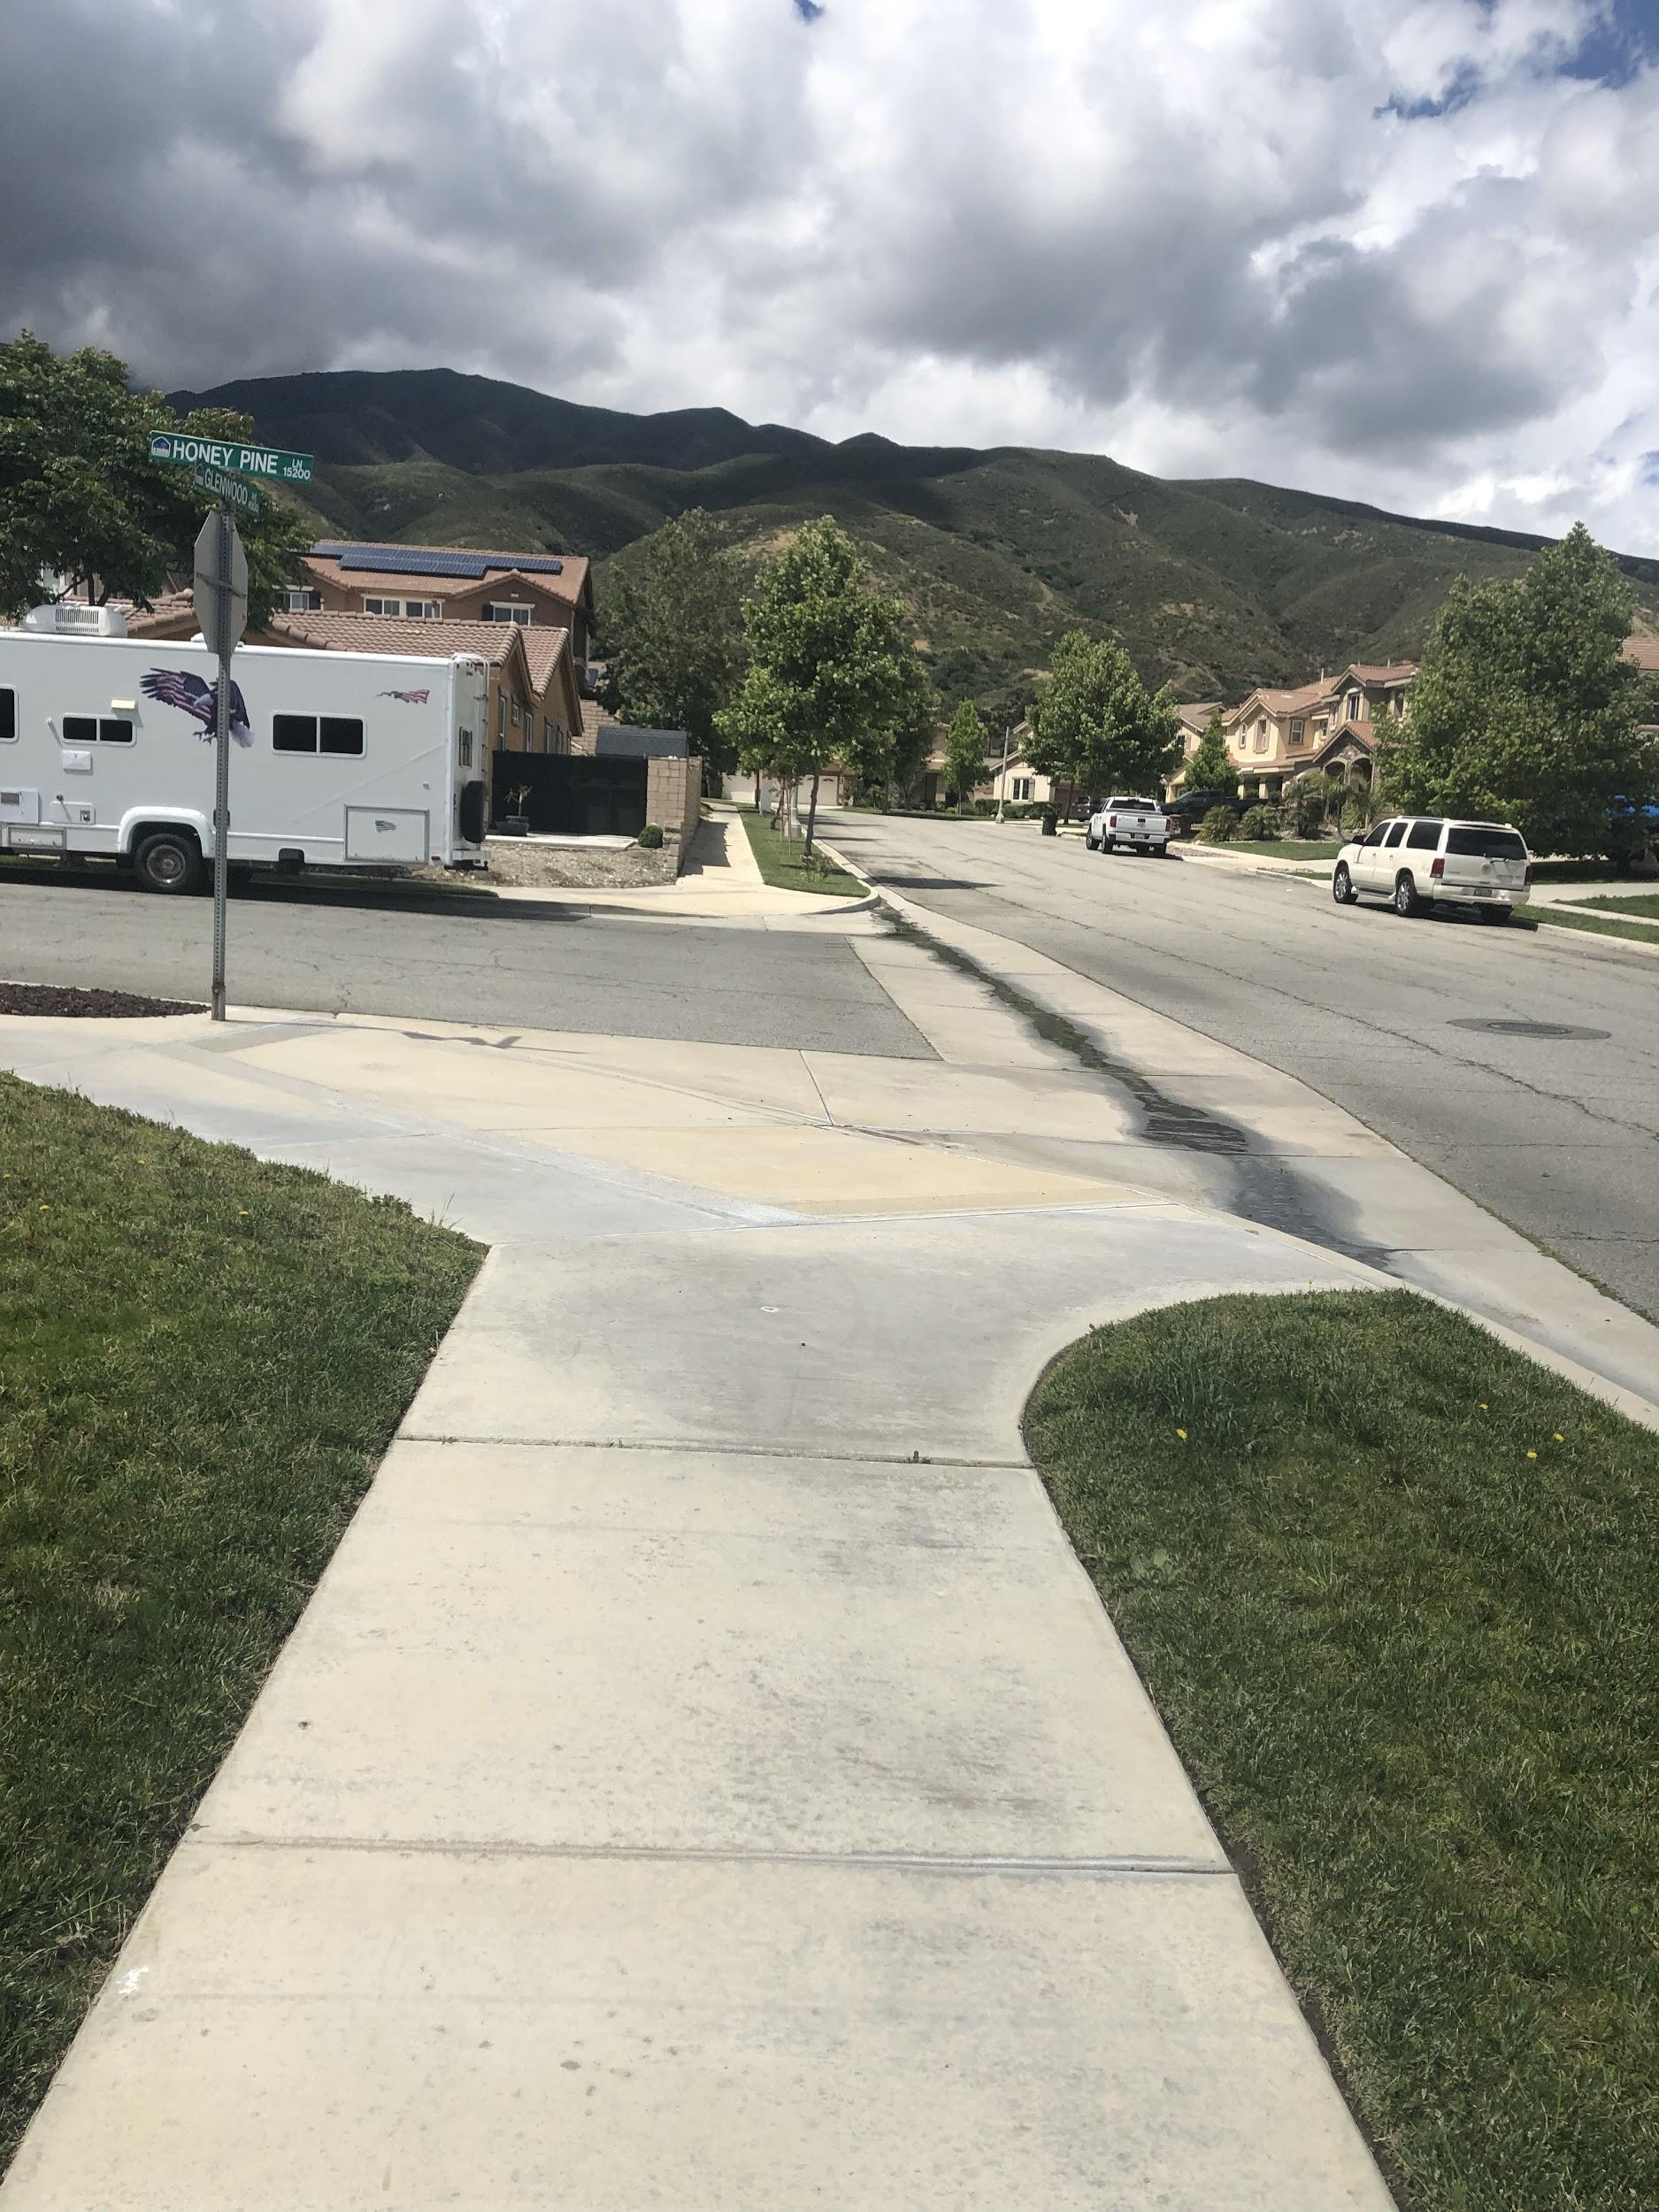

Slide 5
Reckless Driving
Love the feeling of danger,
Pressing on the gas pedal,
Letting out my feelings of anger
Going over eighty miles per hour.
I see a person walking over,
Pressing on the brake pedal
I can’t come to a stop.
Boom! I crash.
People gather up in front of my car.
I’ve costed a life, next it could be mine.
I
https://drive.google.com/file/d/1x6hRwA1gk3xDtrtYITgO4McPlMuA4zj6/view?usp=sharing

