Slide 1
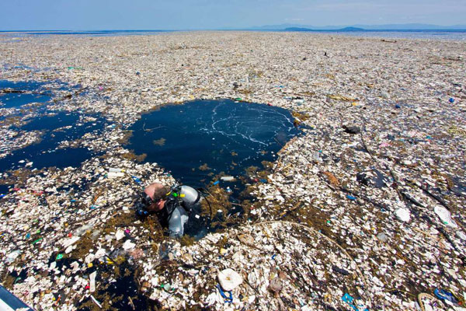

HIP SLICE “Fix-it”
Jared Ponzo
Litter is destructive
English 1B
22 May 2019

Slide 2
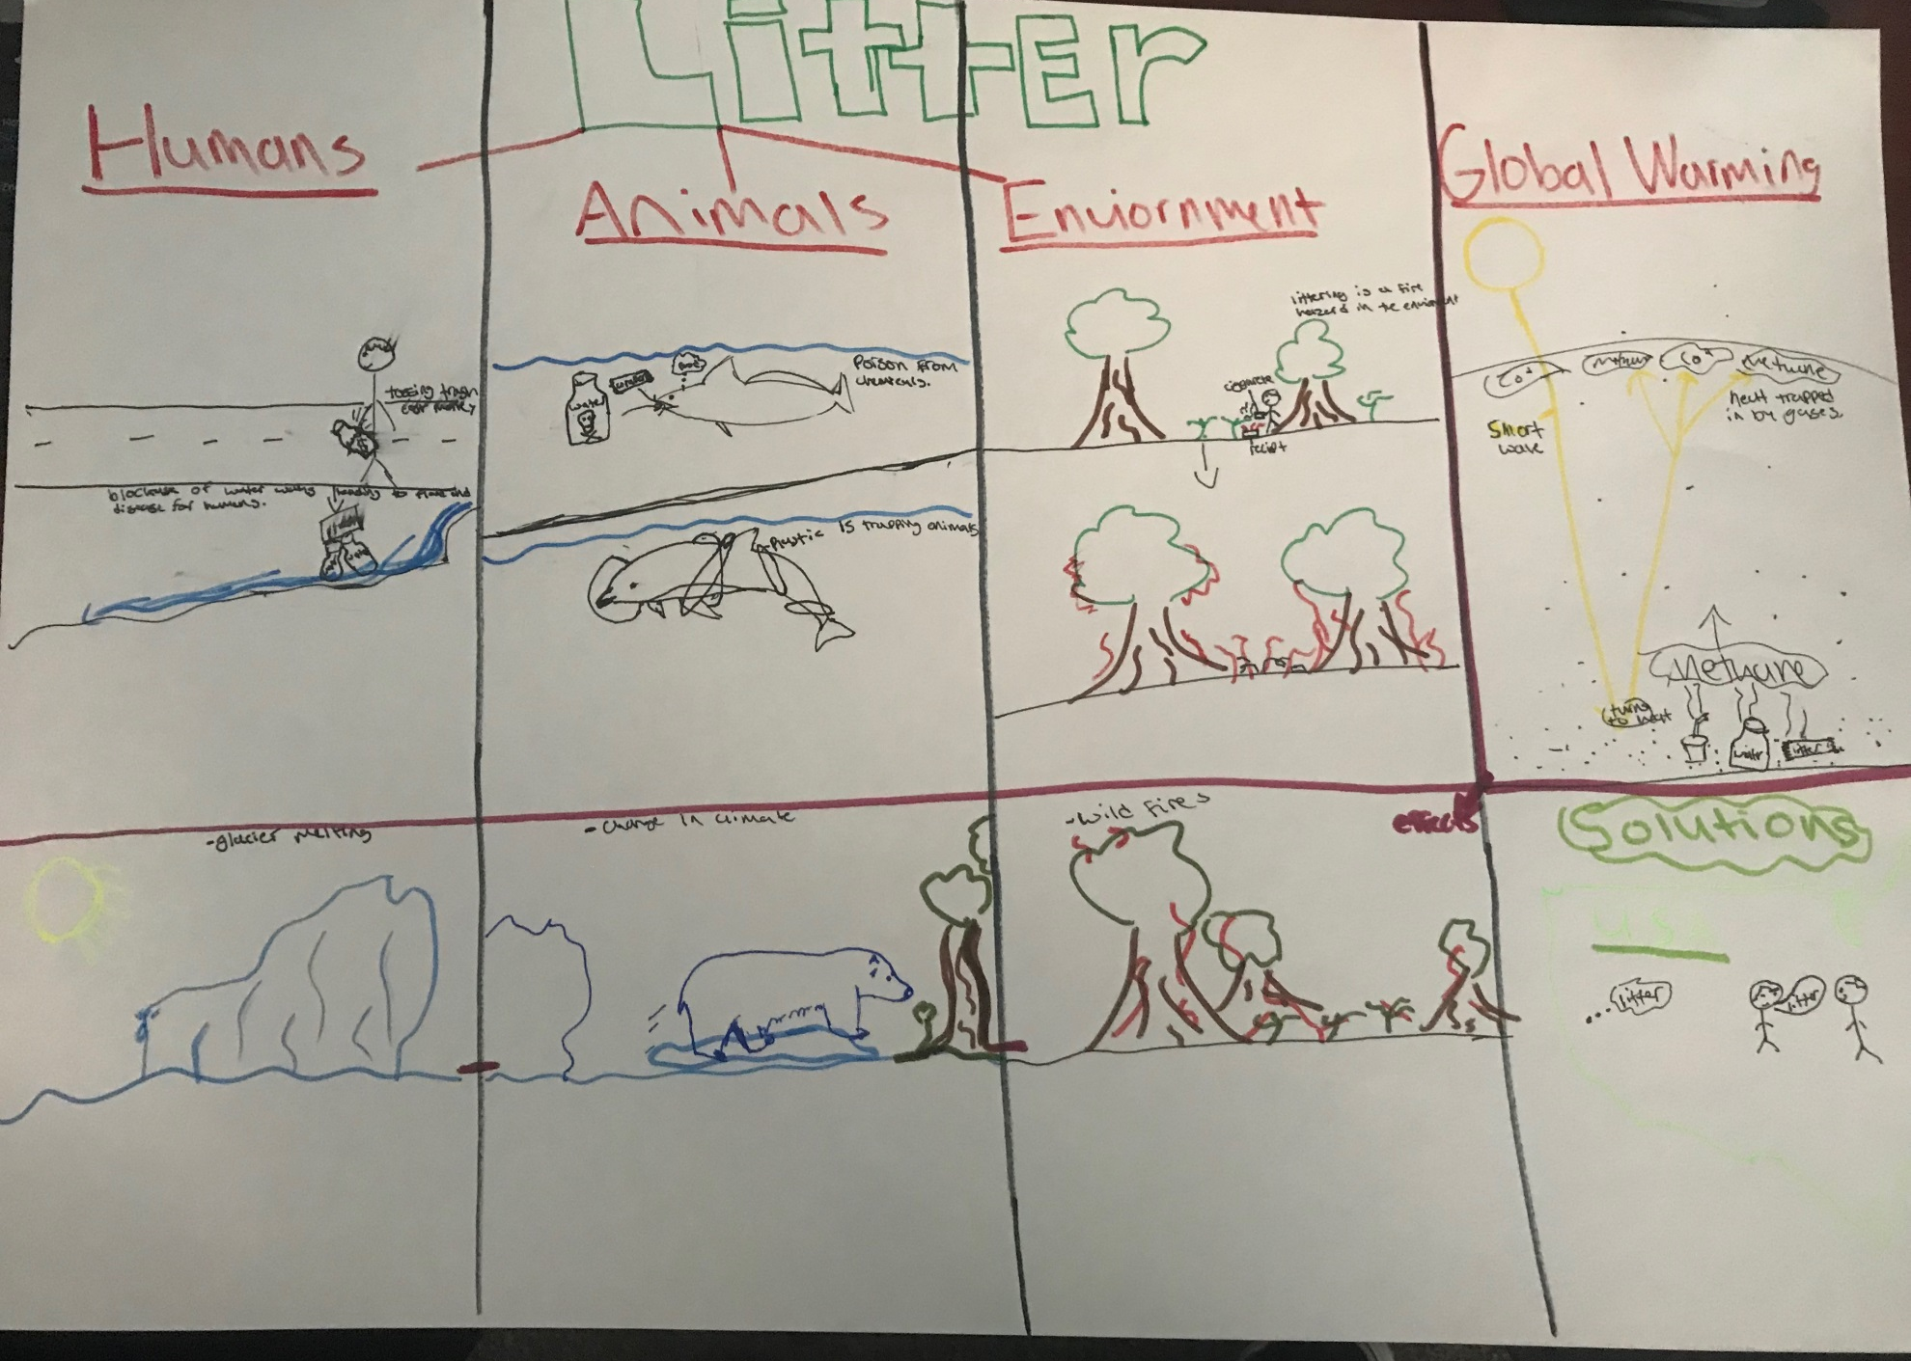
Poster

Slide 3
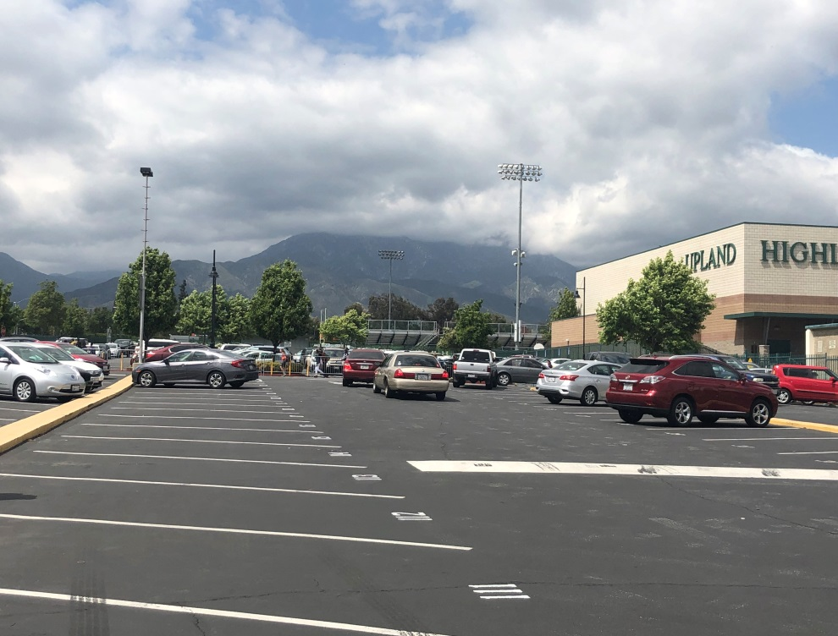
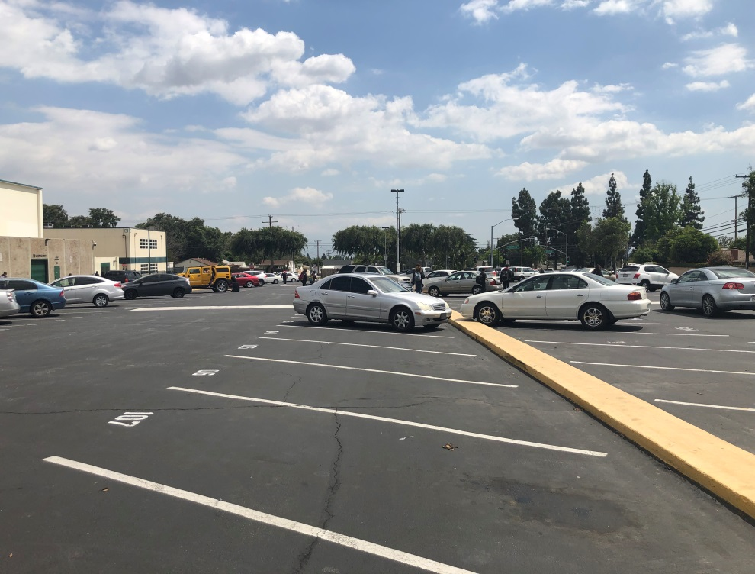
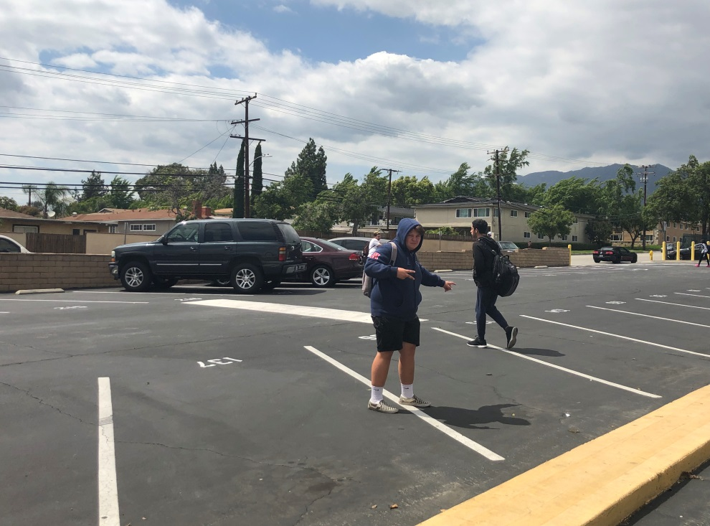

Slide 4
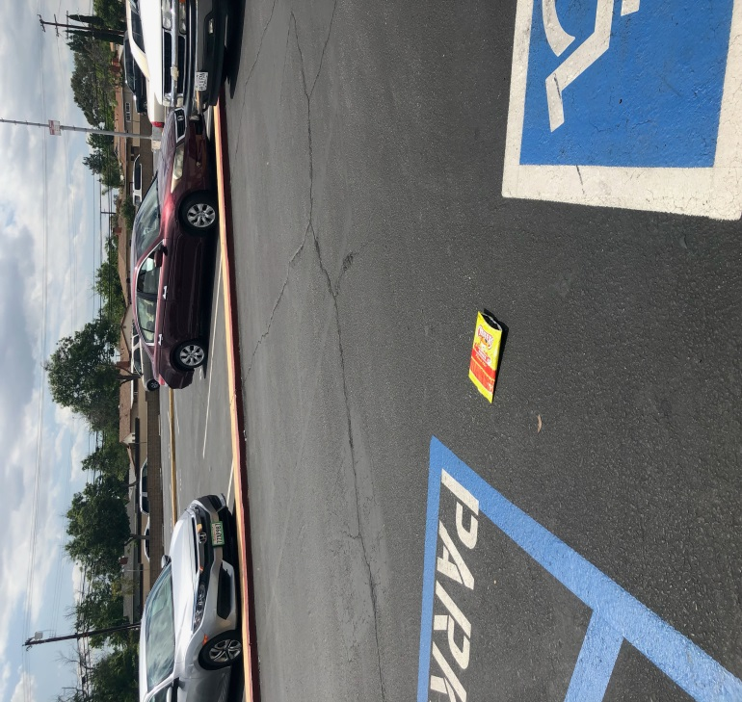
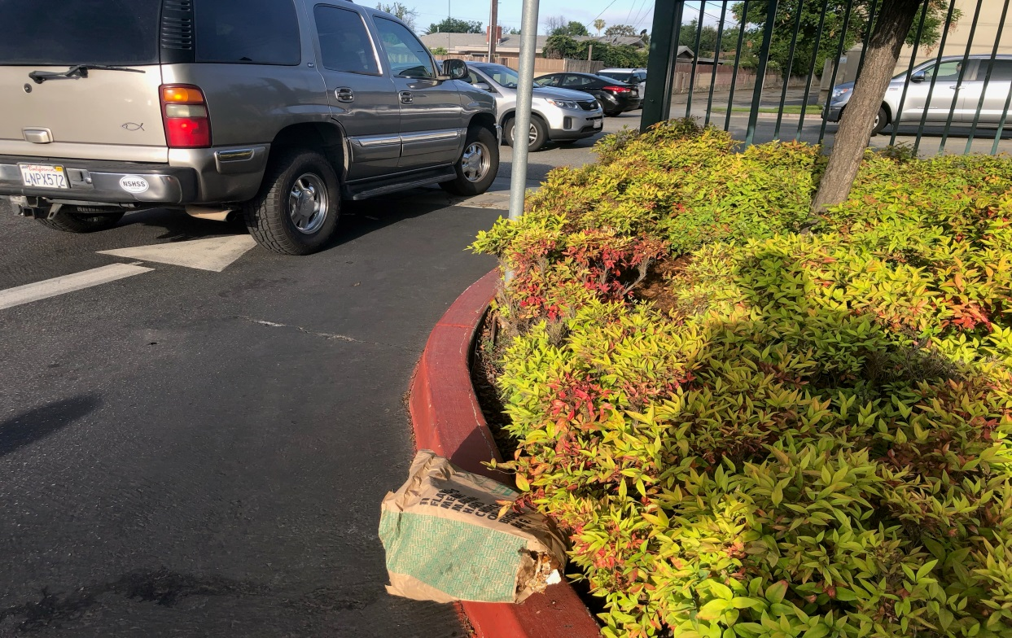
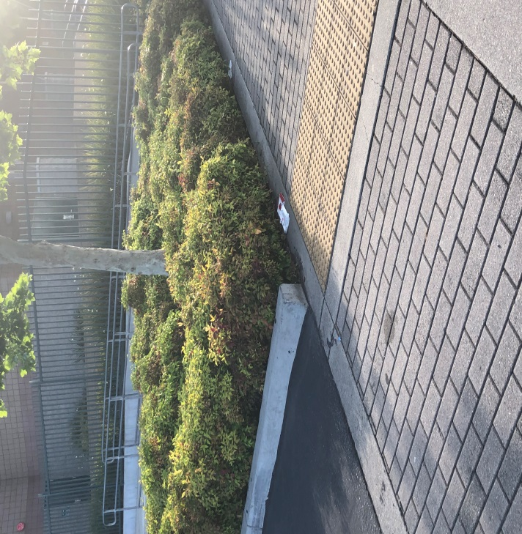

Slide 5
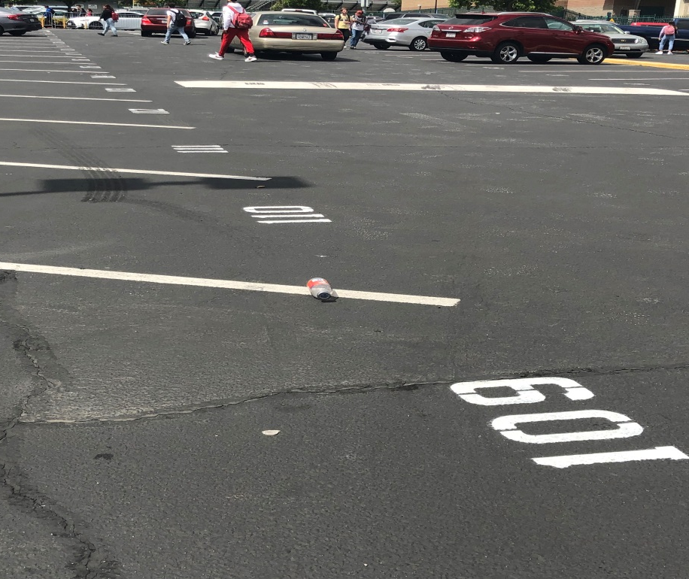
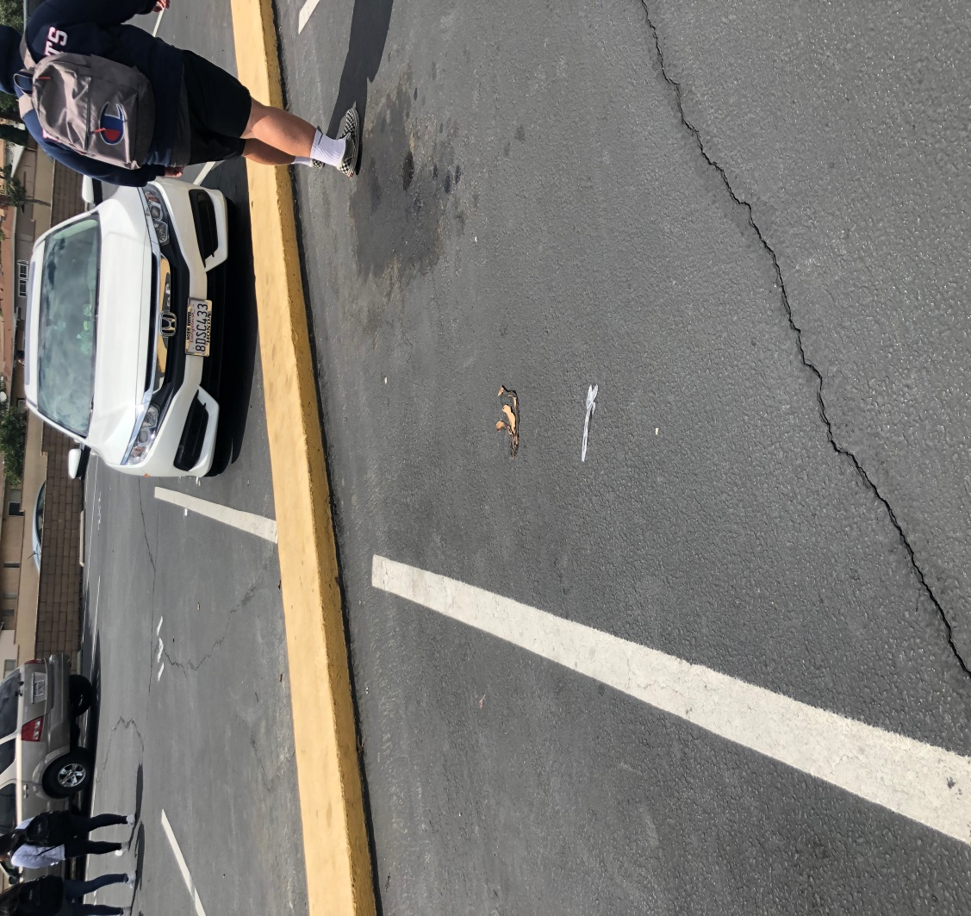


Slide 6


The silent killer
There is a silent killer roaming around the world
He is in small size and scads of shapes
But do not be mistaken by his size
Because his size does not kill his pride
He may be small but he feels just as tall
His voice is silent but his actions speak louder than words
He cost money in humans pockets
While blockades waterways with diseases
He can be ingested by animals constructing contamination
While trapping animals in the ocean to die
He is causing hazard to the environment
While forging furious fires
He indirectly initiates global warming woes with:
Glacier melting making monstrous floods for humans
Climate change coercing animals to die and migrate
Intense heat causing large wild fires
He, who is the silent killer is litter
Law enforcement needs to take action
The community needs to take action
It needs to be heard and discussed
Because that is the only way it will stop affecting us.

