Slide 1
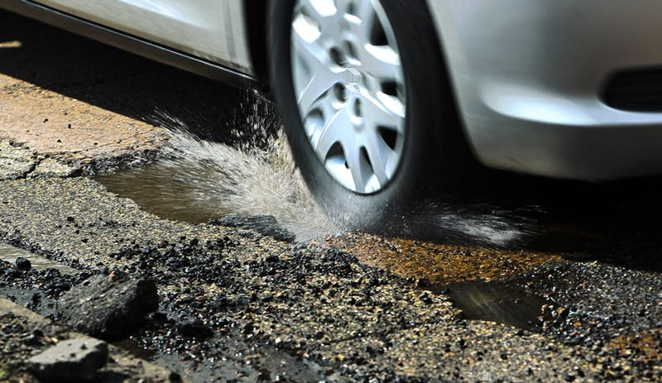
Potholes In The community
By: Ricardo Ortiz

Slide 2
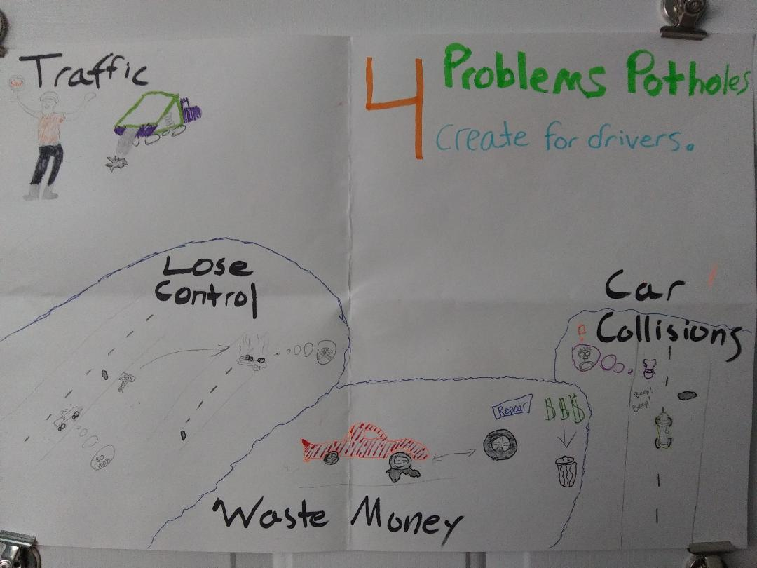

Slide 3
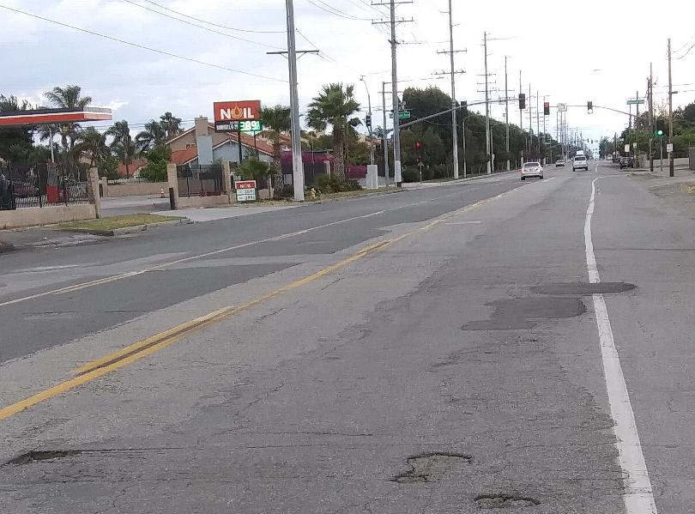
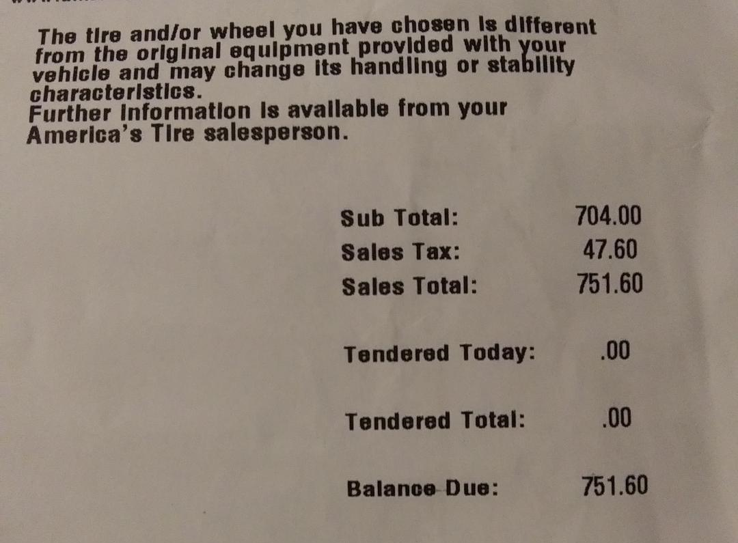
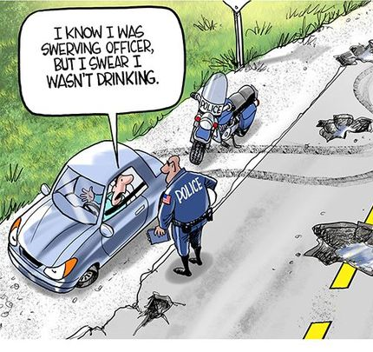
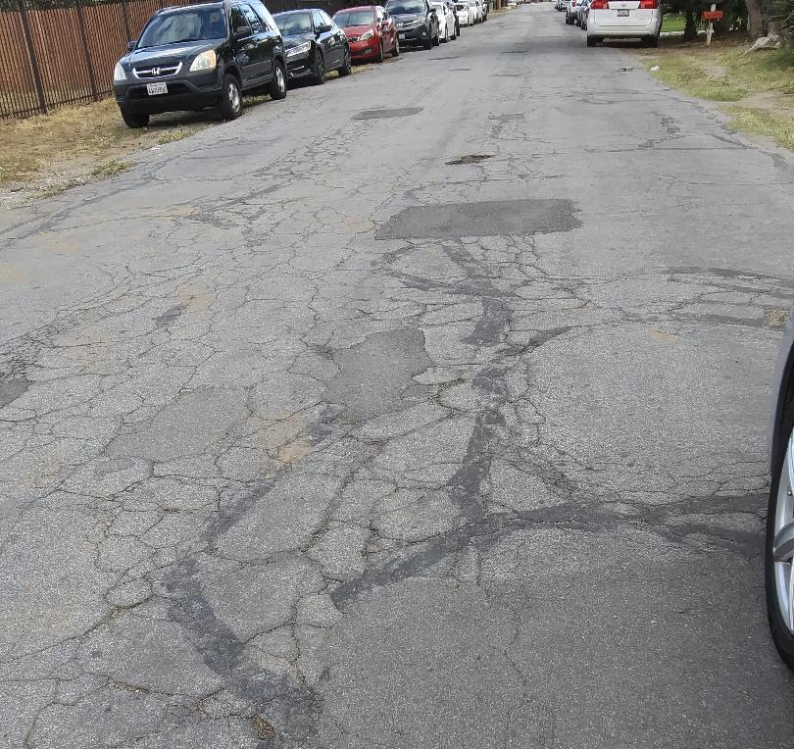
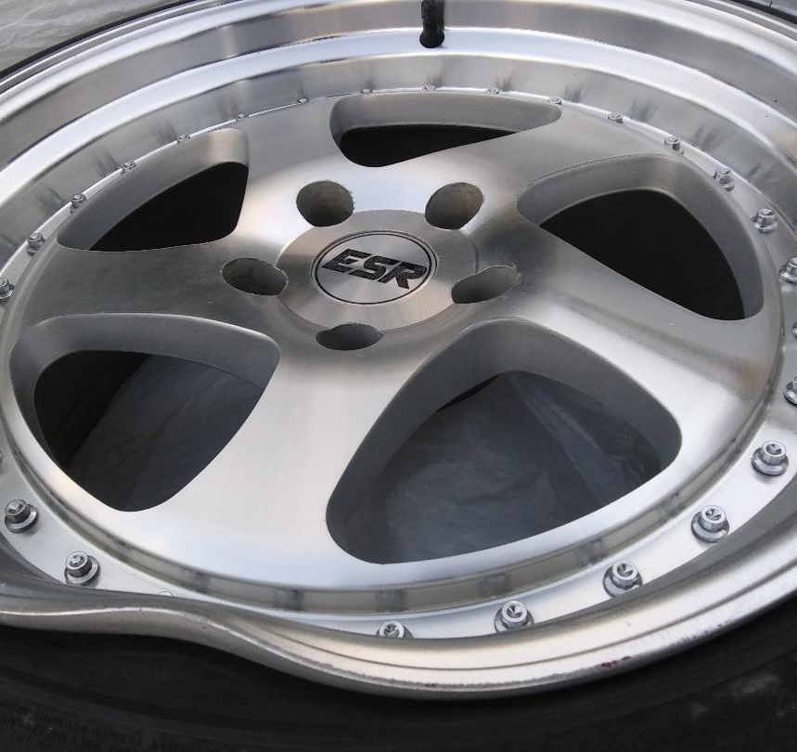
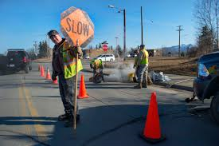

Slide 4
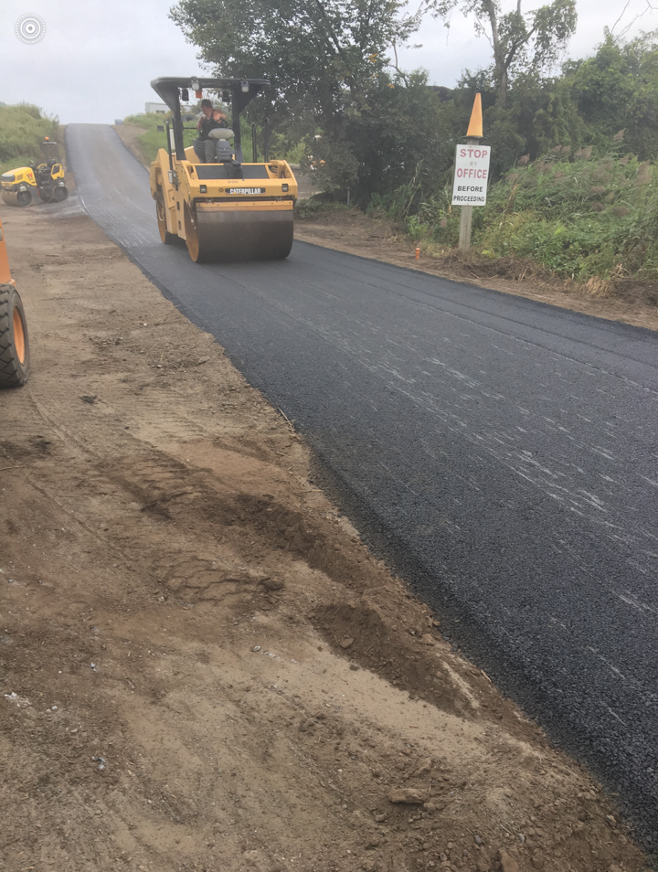

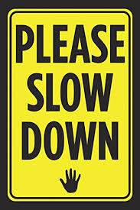
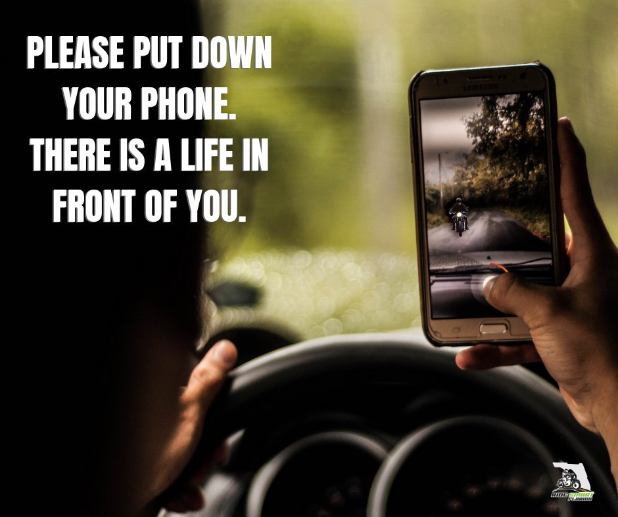
Possible Solutions To Pothole Issues
By building more roads or having some type of emergency route that helps drivers to move around the work cite, can help reduce traffic. Working on certain times throughout the day, when drivers aren’t as active on roads can make a difference (night time). Making some type of new machine that helps make the asphalt faster and sturdier would be nice.
The city officials in every community should pay for every major car damage for drivers who were victims of poor road maintenance while driving. Having detectives on every city’s management team for city road funds should help keep thieves away.
Driving slower and following the proper speed limits on the roads will help avoid losing control of the vehicle while driving over a abysmal pothole.
Keeping eyes on the road and the car in front of you, having a good distance from the car in front, will allow you to predict or see upcoming troubles (potholes), which gives you time to make a safer turn while dodging a pothole.

Slide 5

Pothole Poem
Growing up seeing so many changes throughout time, living in this city I wouldn’t be able to recognize it 20 years ago. Believing that things overall in life would be fine, staying in a safe, organized and clean city I must go. Trying to avoid all the deep and bad potholes is a hassle, not just that but the barbaric drivers who I call immature jackals. While on the road keep in mind of other lives on the line, since there are fools who misuse the tools of their bodies, who intertwine the bad. Road rage, accidental collisions and loss of control can lead someone to death, as the one holding the scythe with a black hoodie can also be called a creature of life theft. Driving recklessly can scare others, don’t cause pain to the caring loving mothers. Watch out for the unexpected turn, or else the innocent will crash and burn. Wait there is something else to learn, but who will it be to define the word stern. Create new roads to guide the drivers, please stop posting sad tragic flyers. Unite as proliferated community, not as the group of anti-human insecurity.

