Slide 1
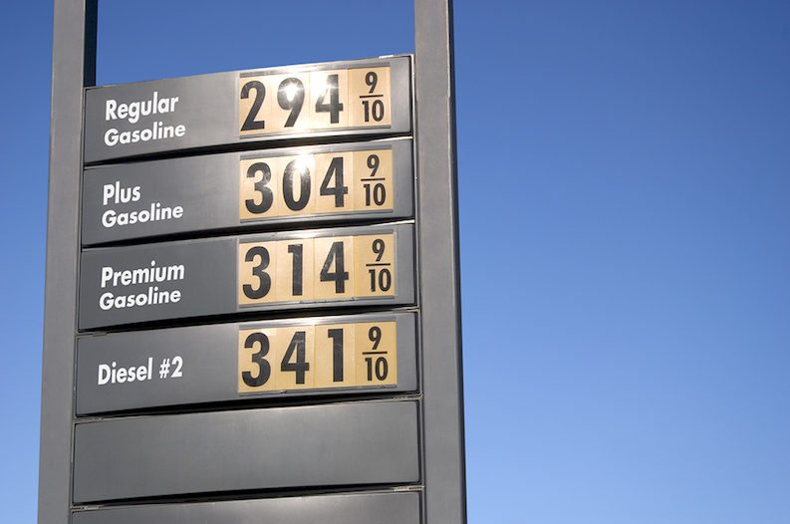
Gas Prices
By Chelsea Nuss
Professor Ramser
May 18th, 2019

Slide 2
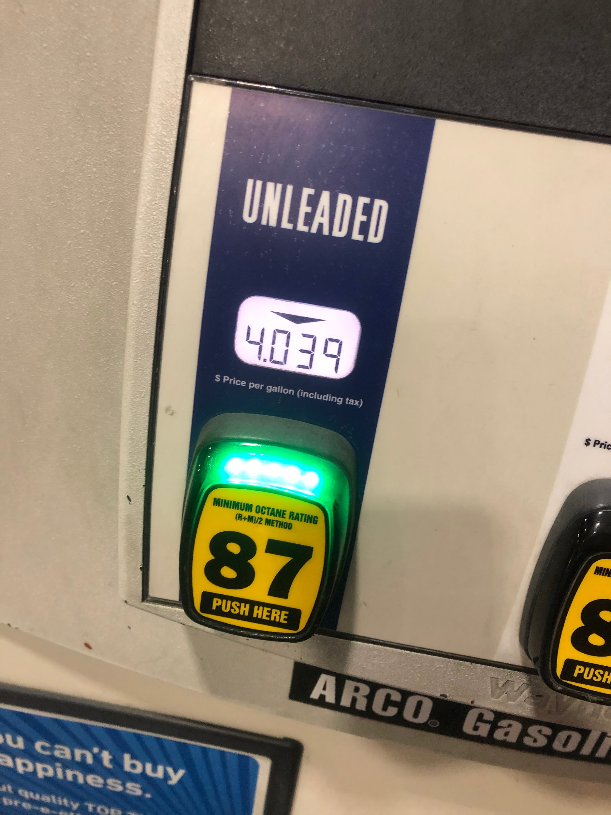
Gas Prices in Anaheim, California
For Unleaded Gas
Aka Cheapest Gas

Slide 3
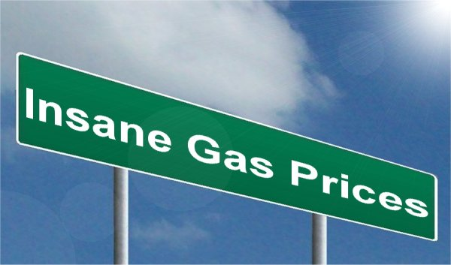
Gas Prices In Chino Hills
$ 3.89- $3.90

Slide 4
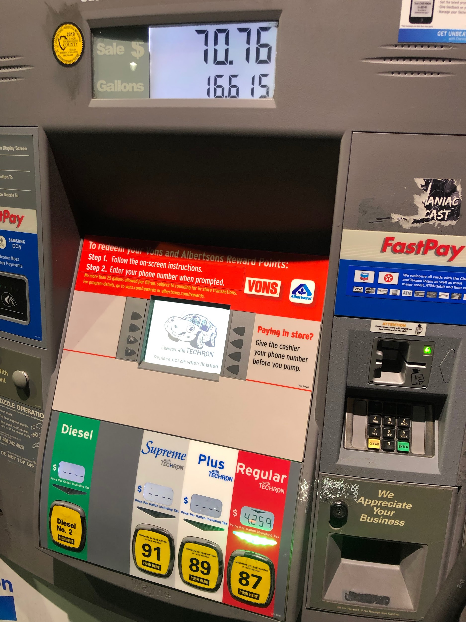
Gas Price In Rancho Cucamonga, California
Near Victoria Gardens
The Price Above is after filling my tank up

Slide 5

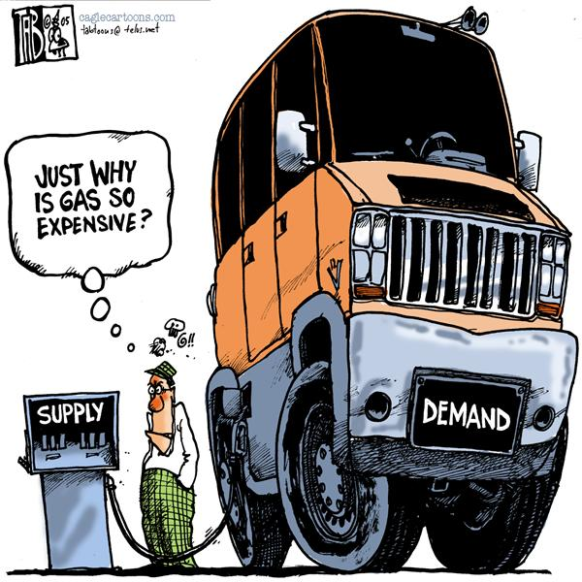
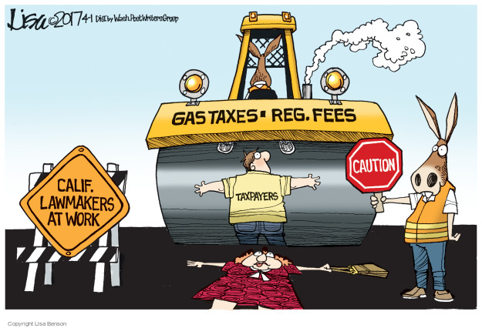
Contributors to High Gas Prices

Slide 6

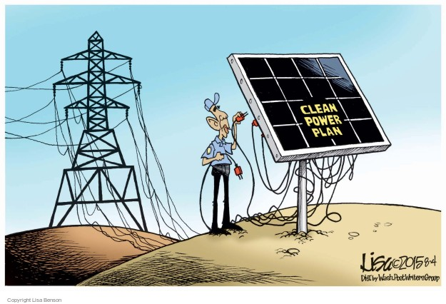
Solution

Slide 7

Spoken Word
Gas Prices have become a need
Forget to get food , Forget to take Vacations
To see the high tides and rising suns
Instead I will make sure my gas tank is full
Full for $3.89 a gallon.
I will stay home and enjoy the last episode, I won’t experience my summer
You ask why
My car is full, therefore I can’t let it go empty. I can't throw the money I poured into my tank
My life has been revolved around the amount of gas goes in.
Well happy summer, I’ll imagine the smell of the sea, the sun hitting my skin and the drinks touching my lips.
Well that's all a dream now, Back to reality.

