Slide 1
Essay IV-Hip Slice
Ethan Mathews

Slide 2
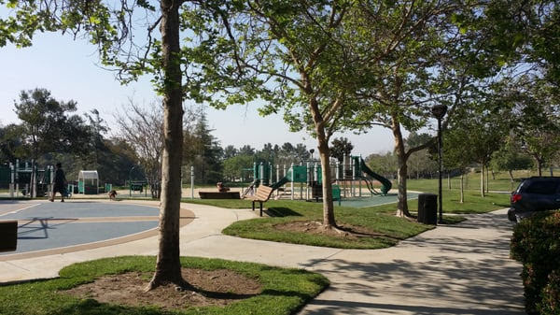
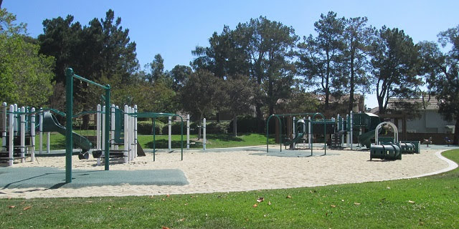
Vintage Park

Slide 3
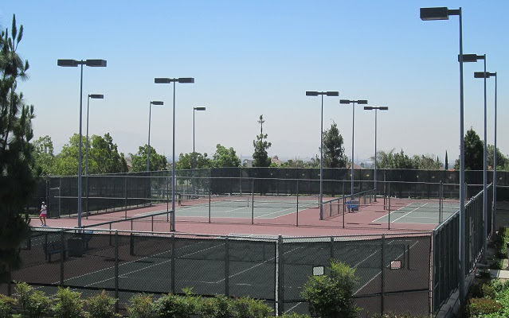
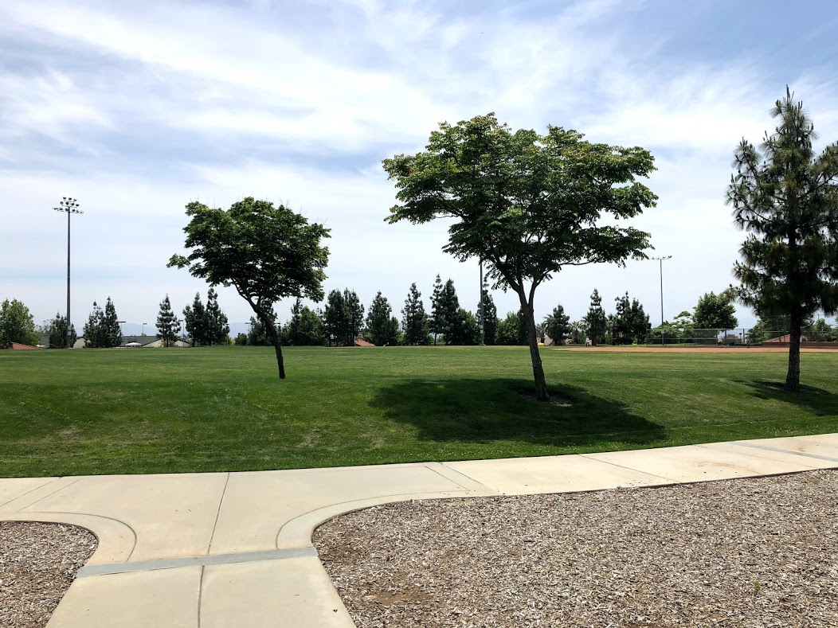
Day Creek Park

Slide 4
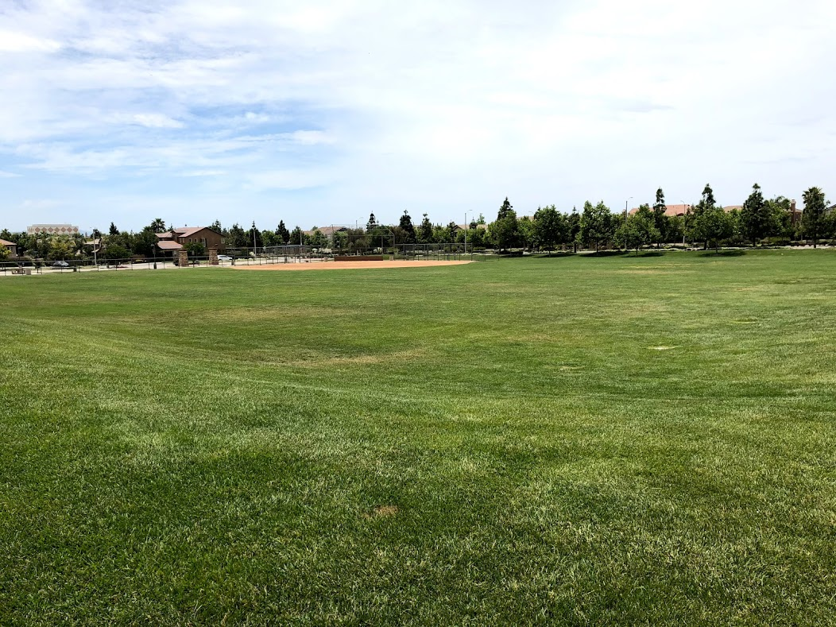
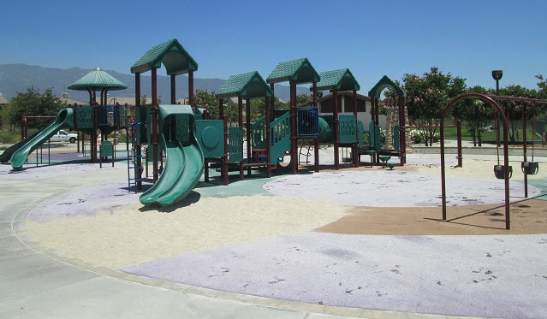
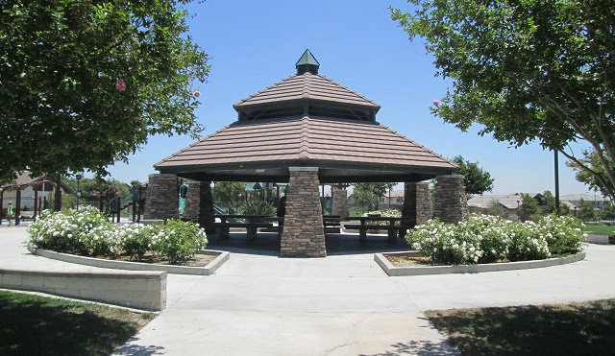
Victoria Arbors Park

Slide 5

Audio Slide
https://drive.google.com/file/d/1NT60PX2Z41ApcltqgoWXE8fp9lGxAs3M/view

