Slide 1
Student Parking
By: Lyle Loc

Slide 2
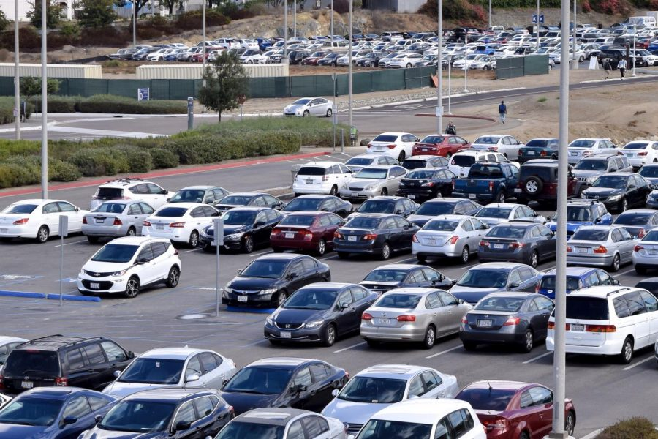
First Week
Filled up

Slide 3
Second Week
Still filled up

Slide 4
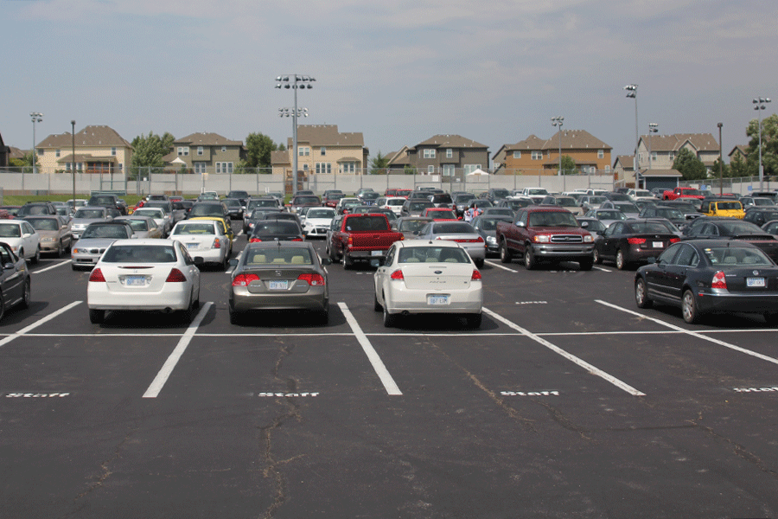
Staff Parking
Staff parking takes up student parking causing limited space

Slide 5
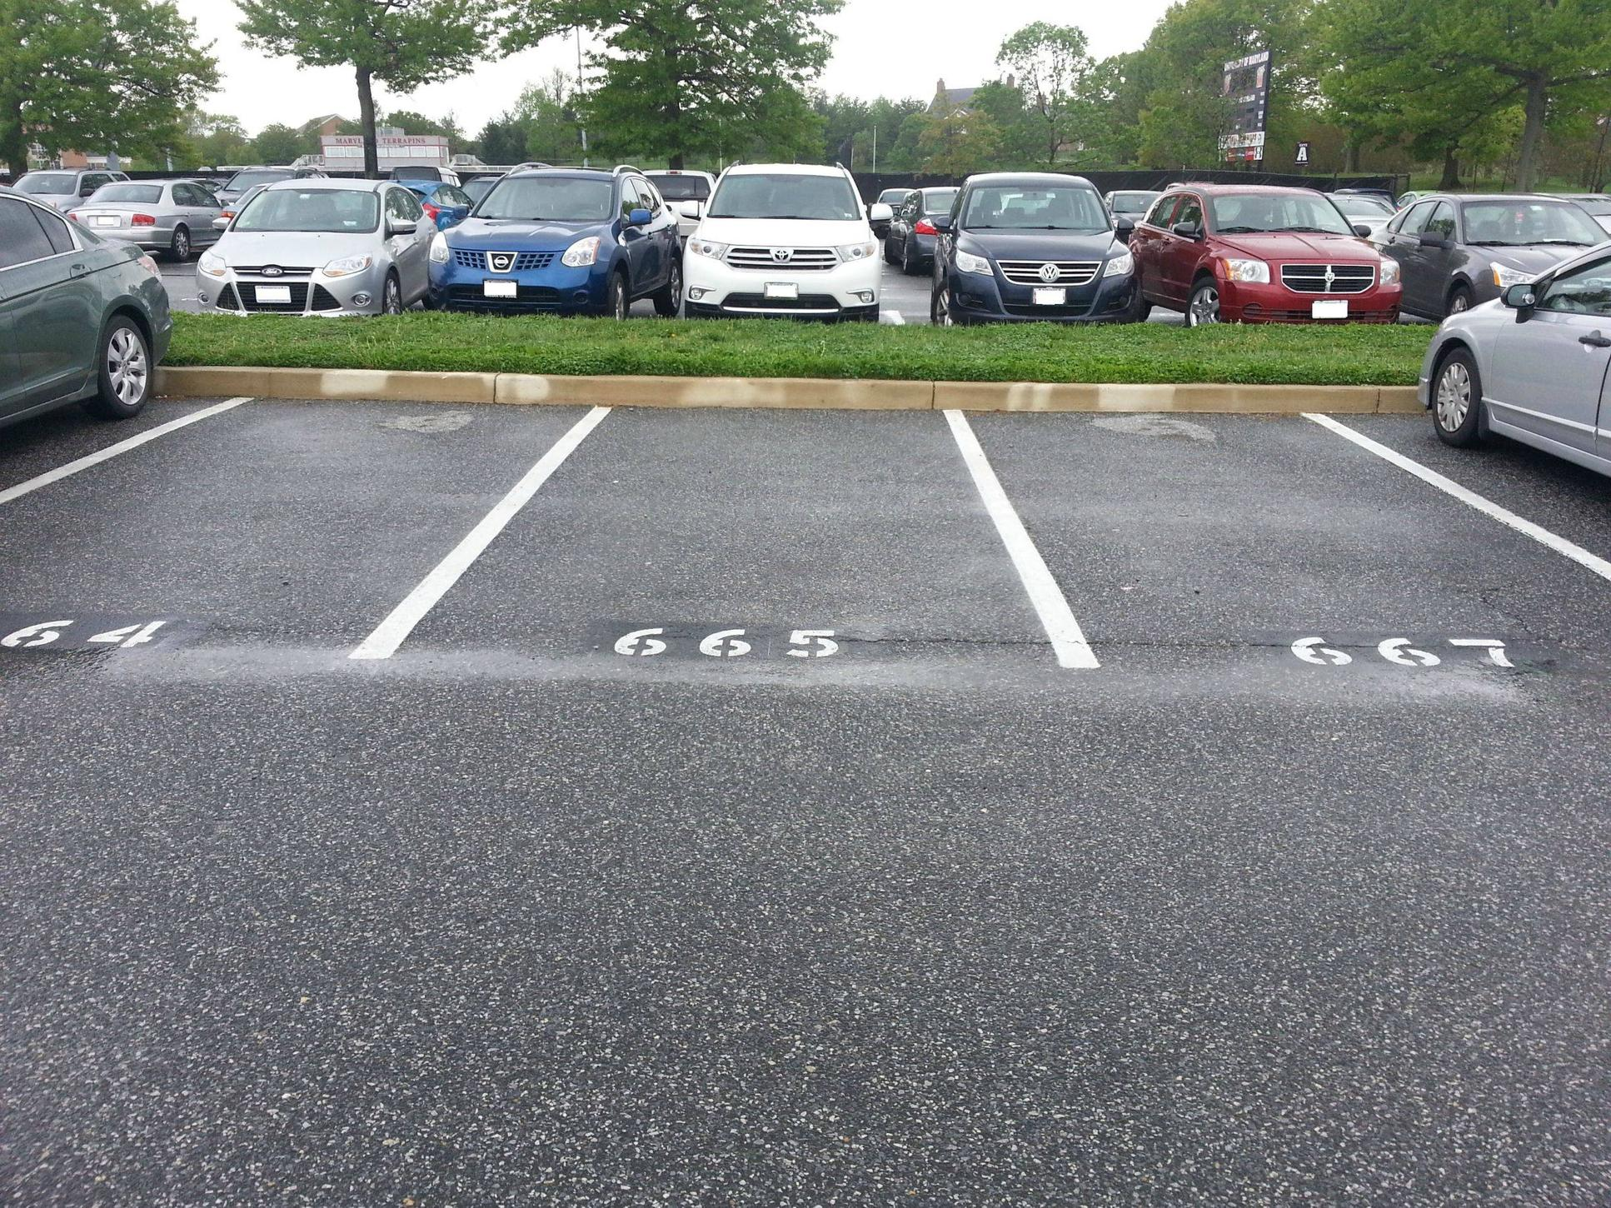
Mid week
More parking spaces available
Students dropping?

Slide 6
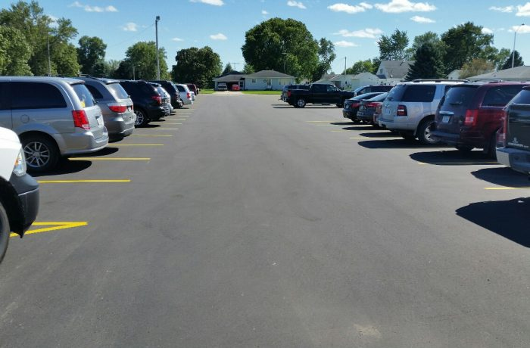
Solution
I feel to get a parking spot, you would need to show up earlier
Staff parking should be separated from student parking to have more student parking spaces
There should be more student parking on campus

