Slide 1
Peer pressure
By nasim khodadadi
English 1B
Prof. Dean Ramser

Slide 2
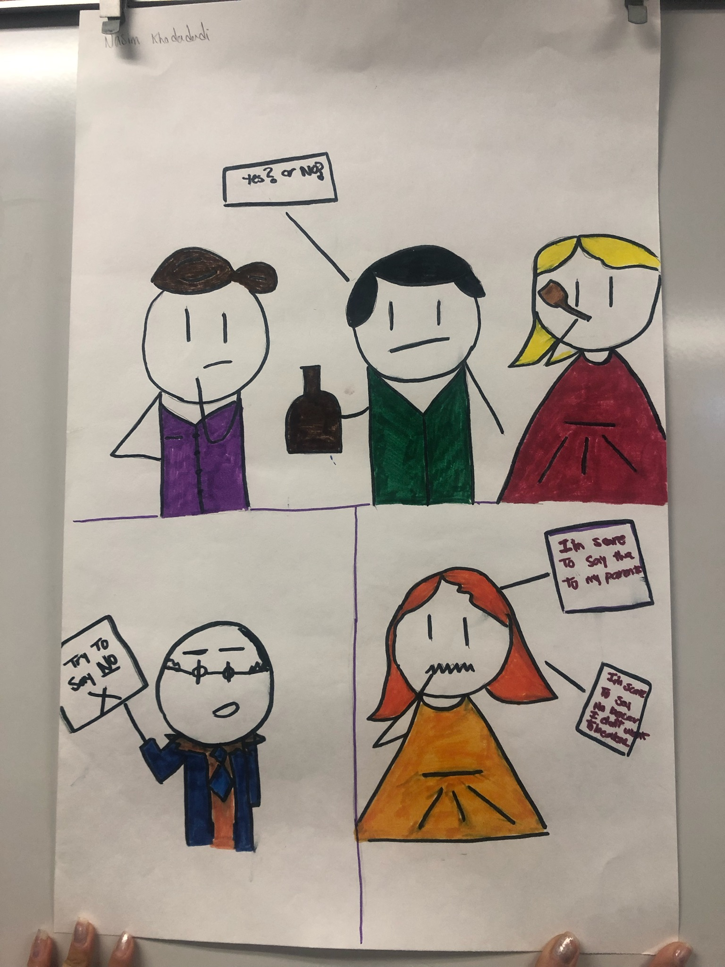
What’s peer pressure?
Peer pressure is the influence on people by peers
or the effects of individuals by encouraging other
peers in different situations of
Friendship( Meshram).

Slide 3
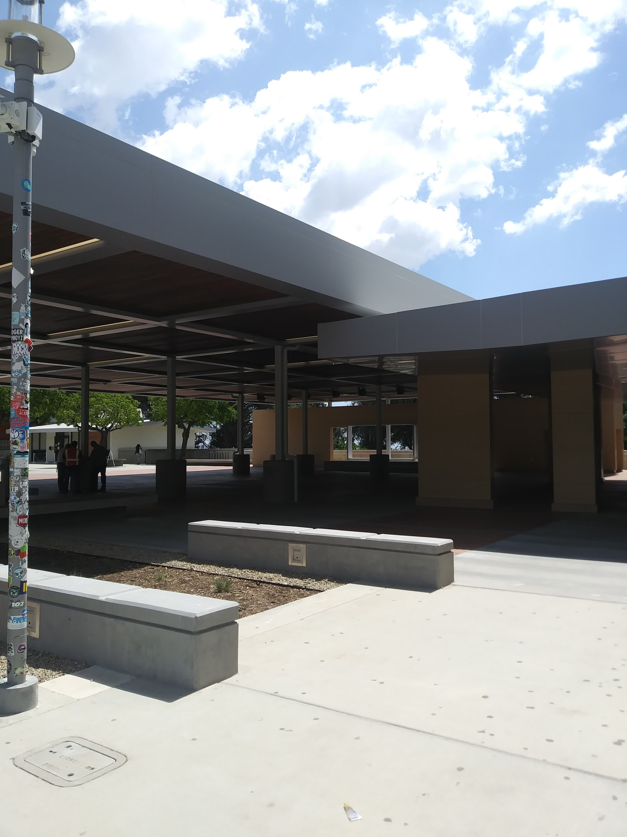
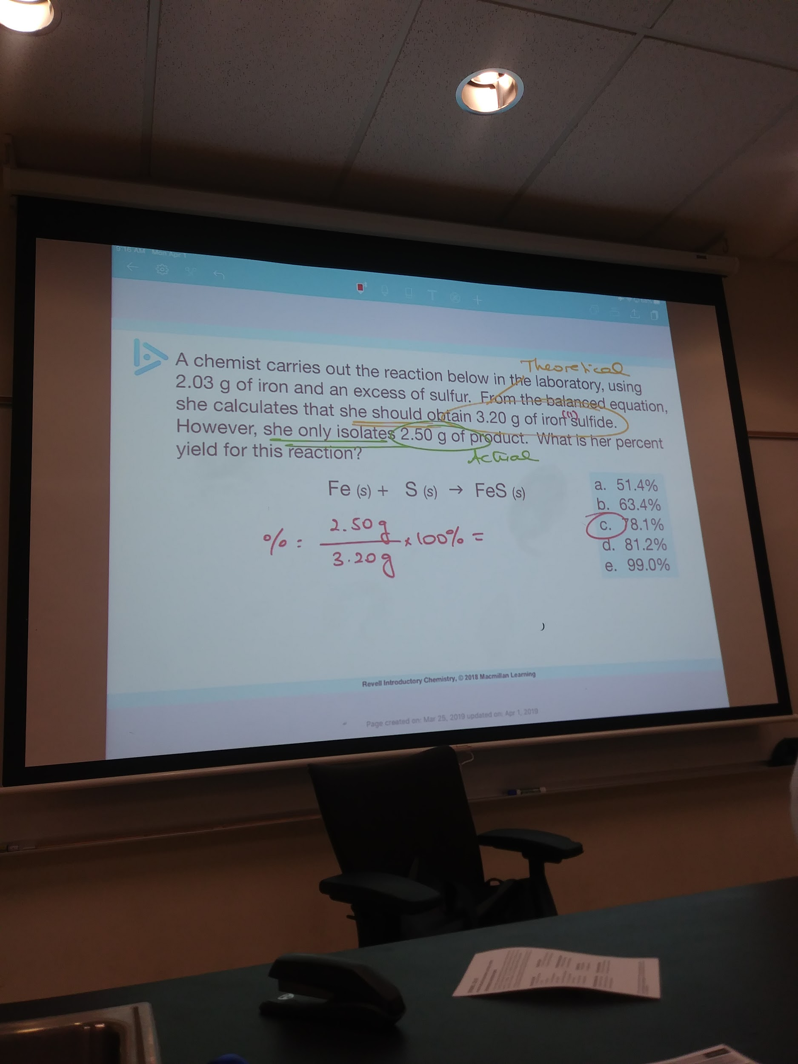
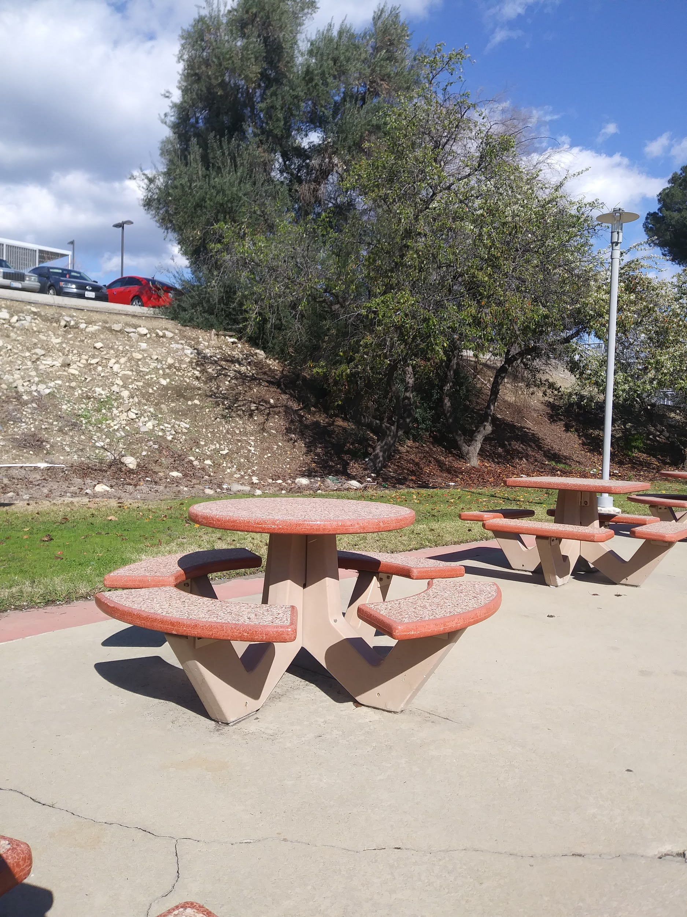
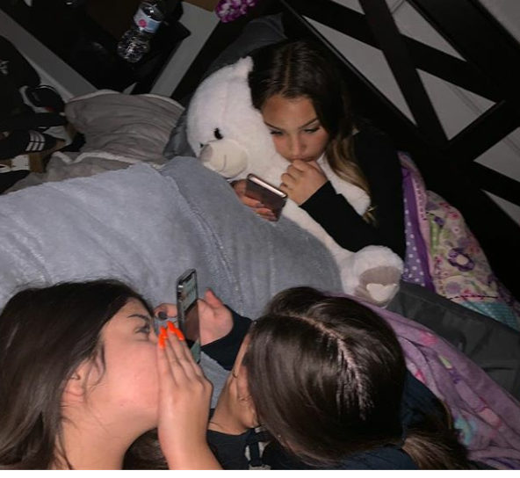
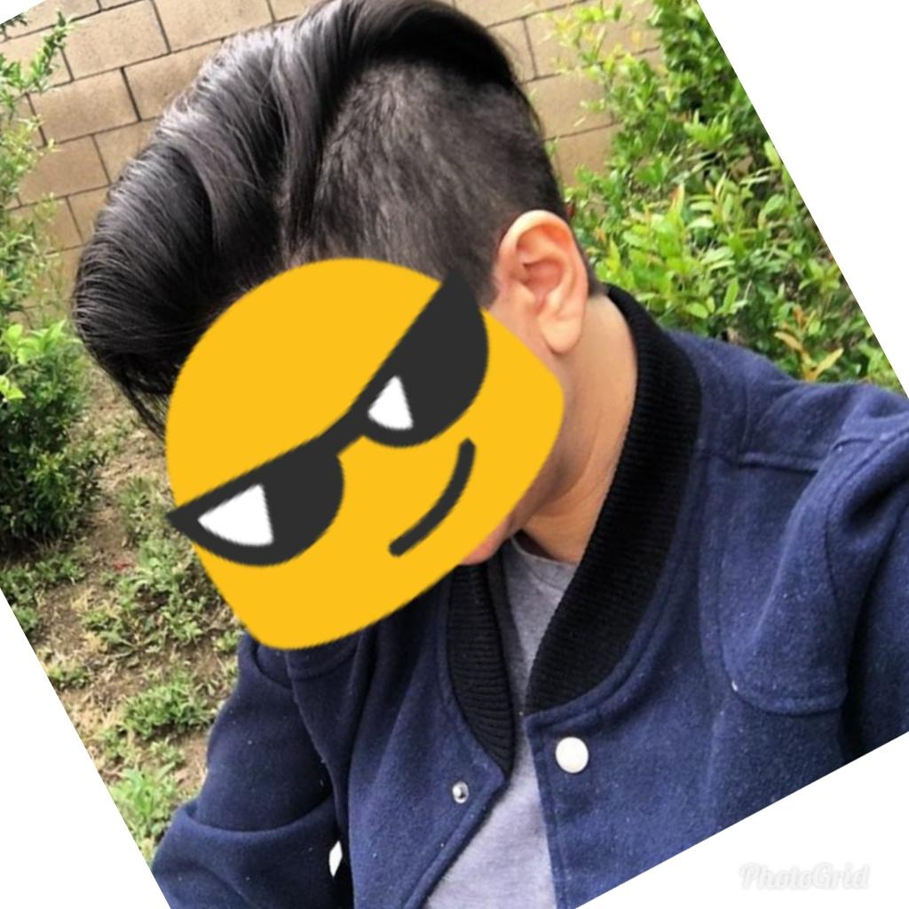
Peer pressure effectiveness

Slide 4
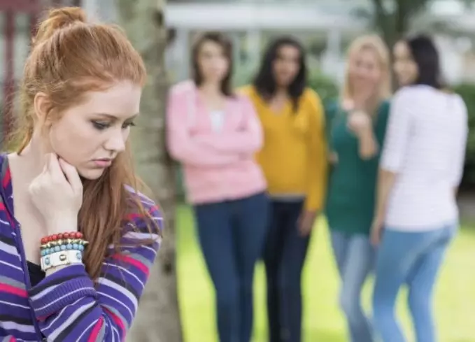

What we can do?

Slide 5
Spoken Word
https://youtu.be/dc9DVPjzZlo
Someone in life is hard to tell / move you down hard to tell / break your heart hard to tell /peers are everywhere / should I say yes or no to them? / am I be alone hard to tell ? / what I can do? hard to say/ stop following them / be brave and aware hard to tell

