Slide 1
Poor Parenting and how it Affects the Public
By Kenyon Johnson

Slide 2
What defines a bad parent?
Same parenting style passed down from their own parents.
A lack of supervision.
Being persmissve or neglectful towards their child.
No quality time.

Slide 3

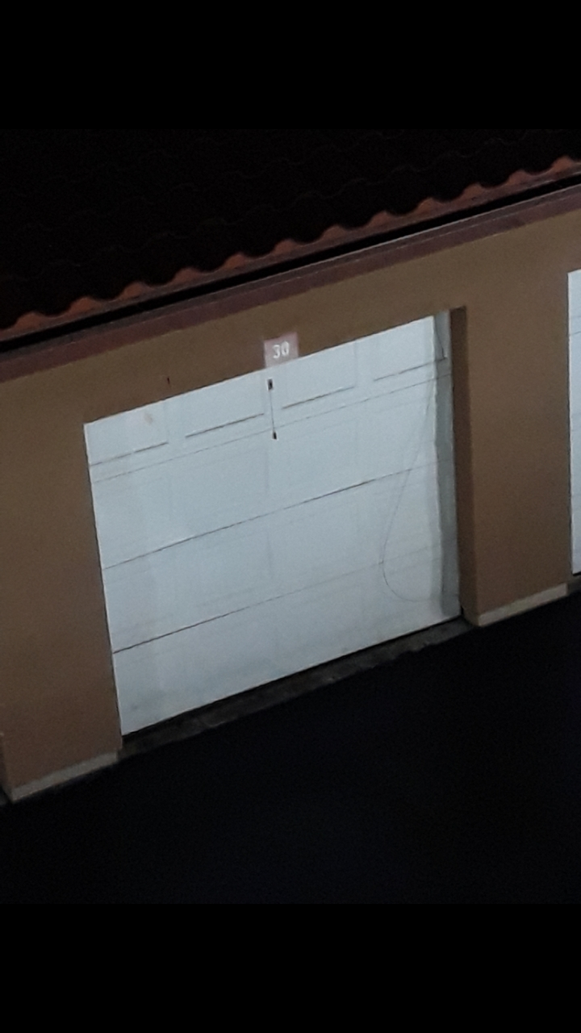

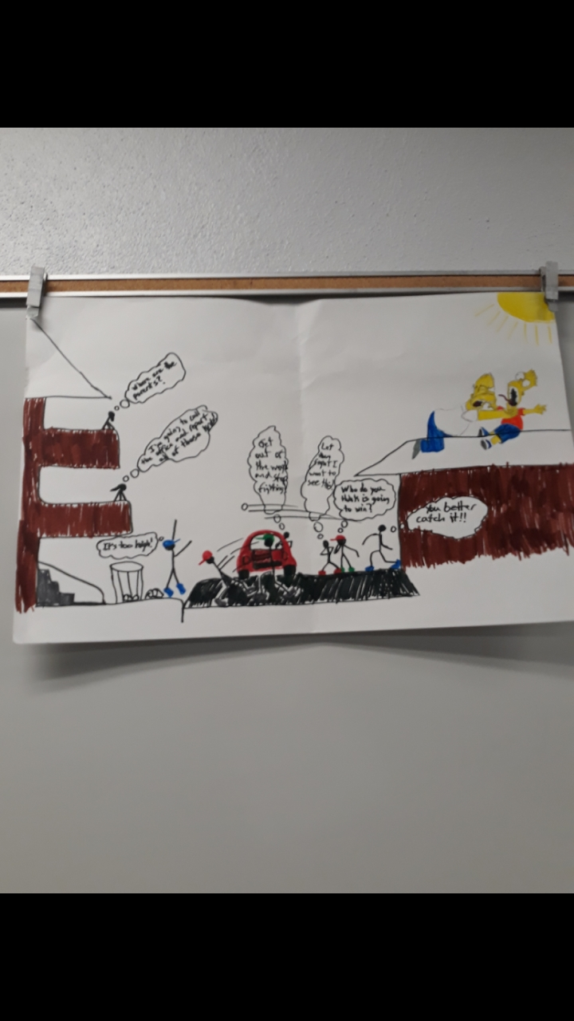

How does this issue involves the public?
Irrational behavior from the child.
Create depression in their child’s mind.
Creating Disturbance in Neighborhoods/Apartment Complexs’
Leaving trash around the Neighborhoods/Apartment Complexs’

Slide 4
Possible Solutions
Take a parenting class
  Online Course.
  In Class sessions
  Authorative or Authoritarian Parenting Style

Slide 5

Limitations to the Solutions
Online class is more restricted
In Class is usually more expensive

