Slide 1
The Dangerous Intersection
Maria Guzman
May 8, 2019

Slide 2
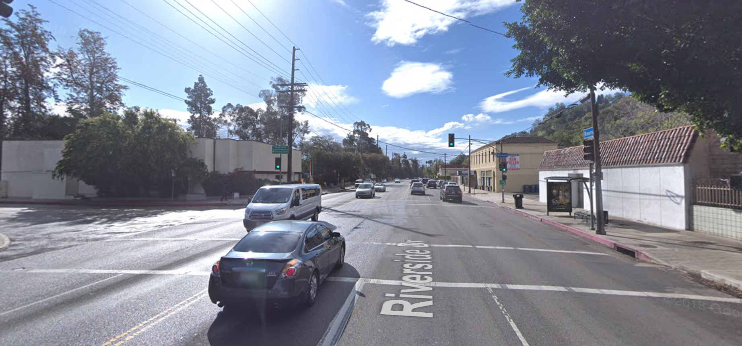
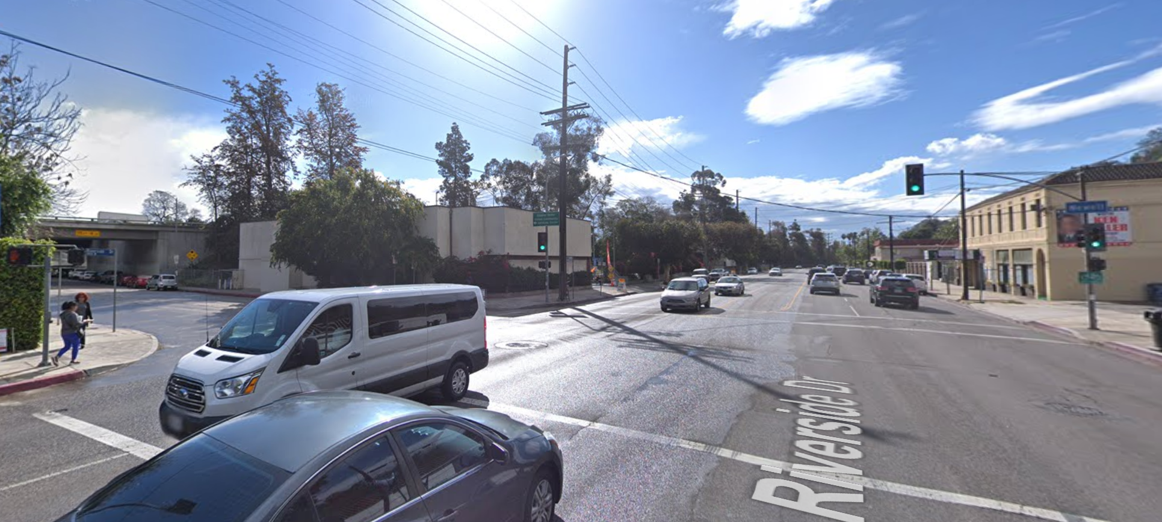
Before

Slide 3
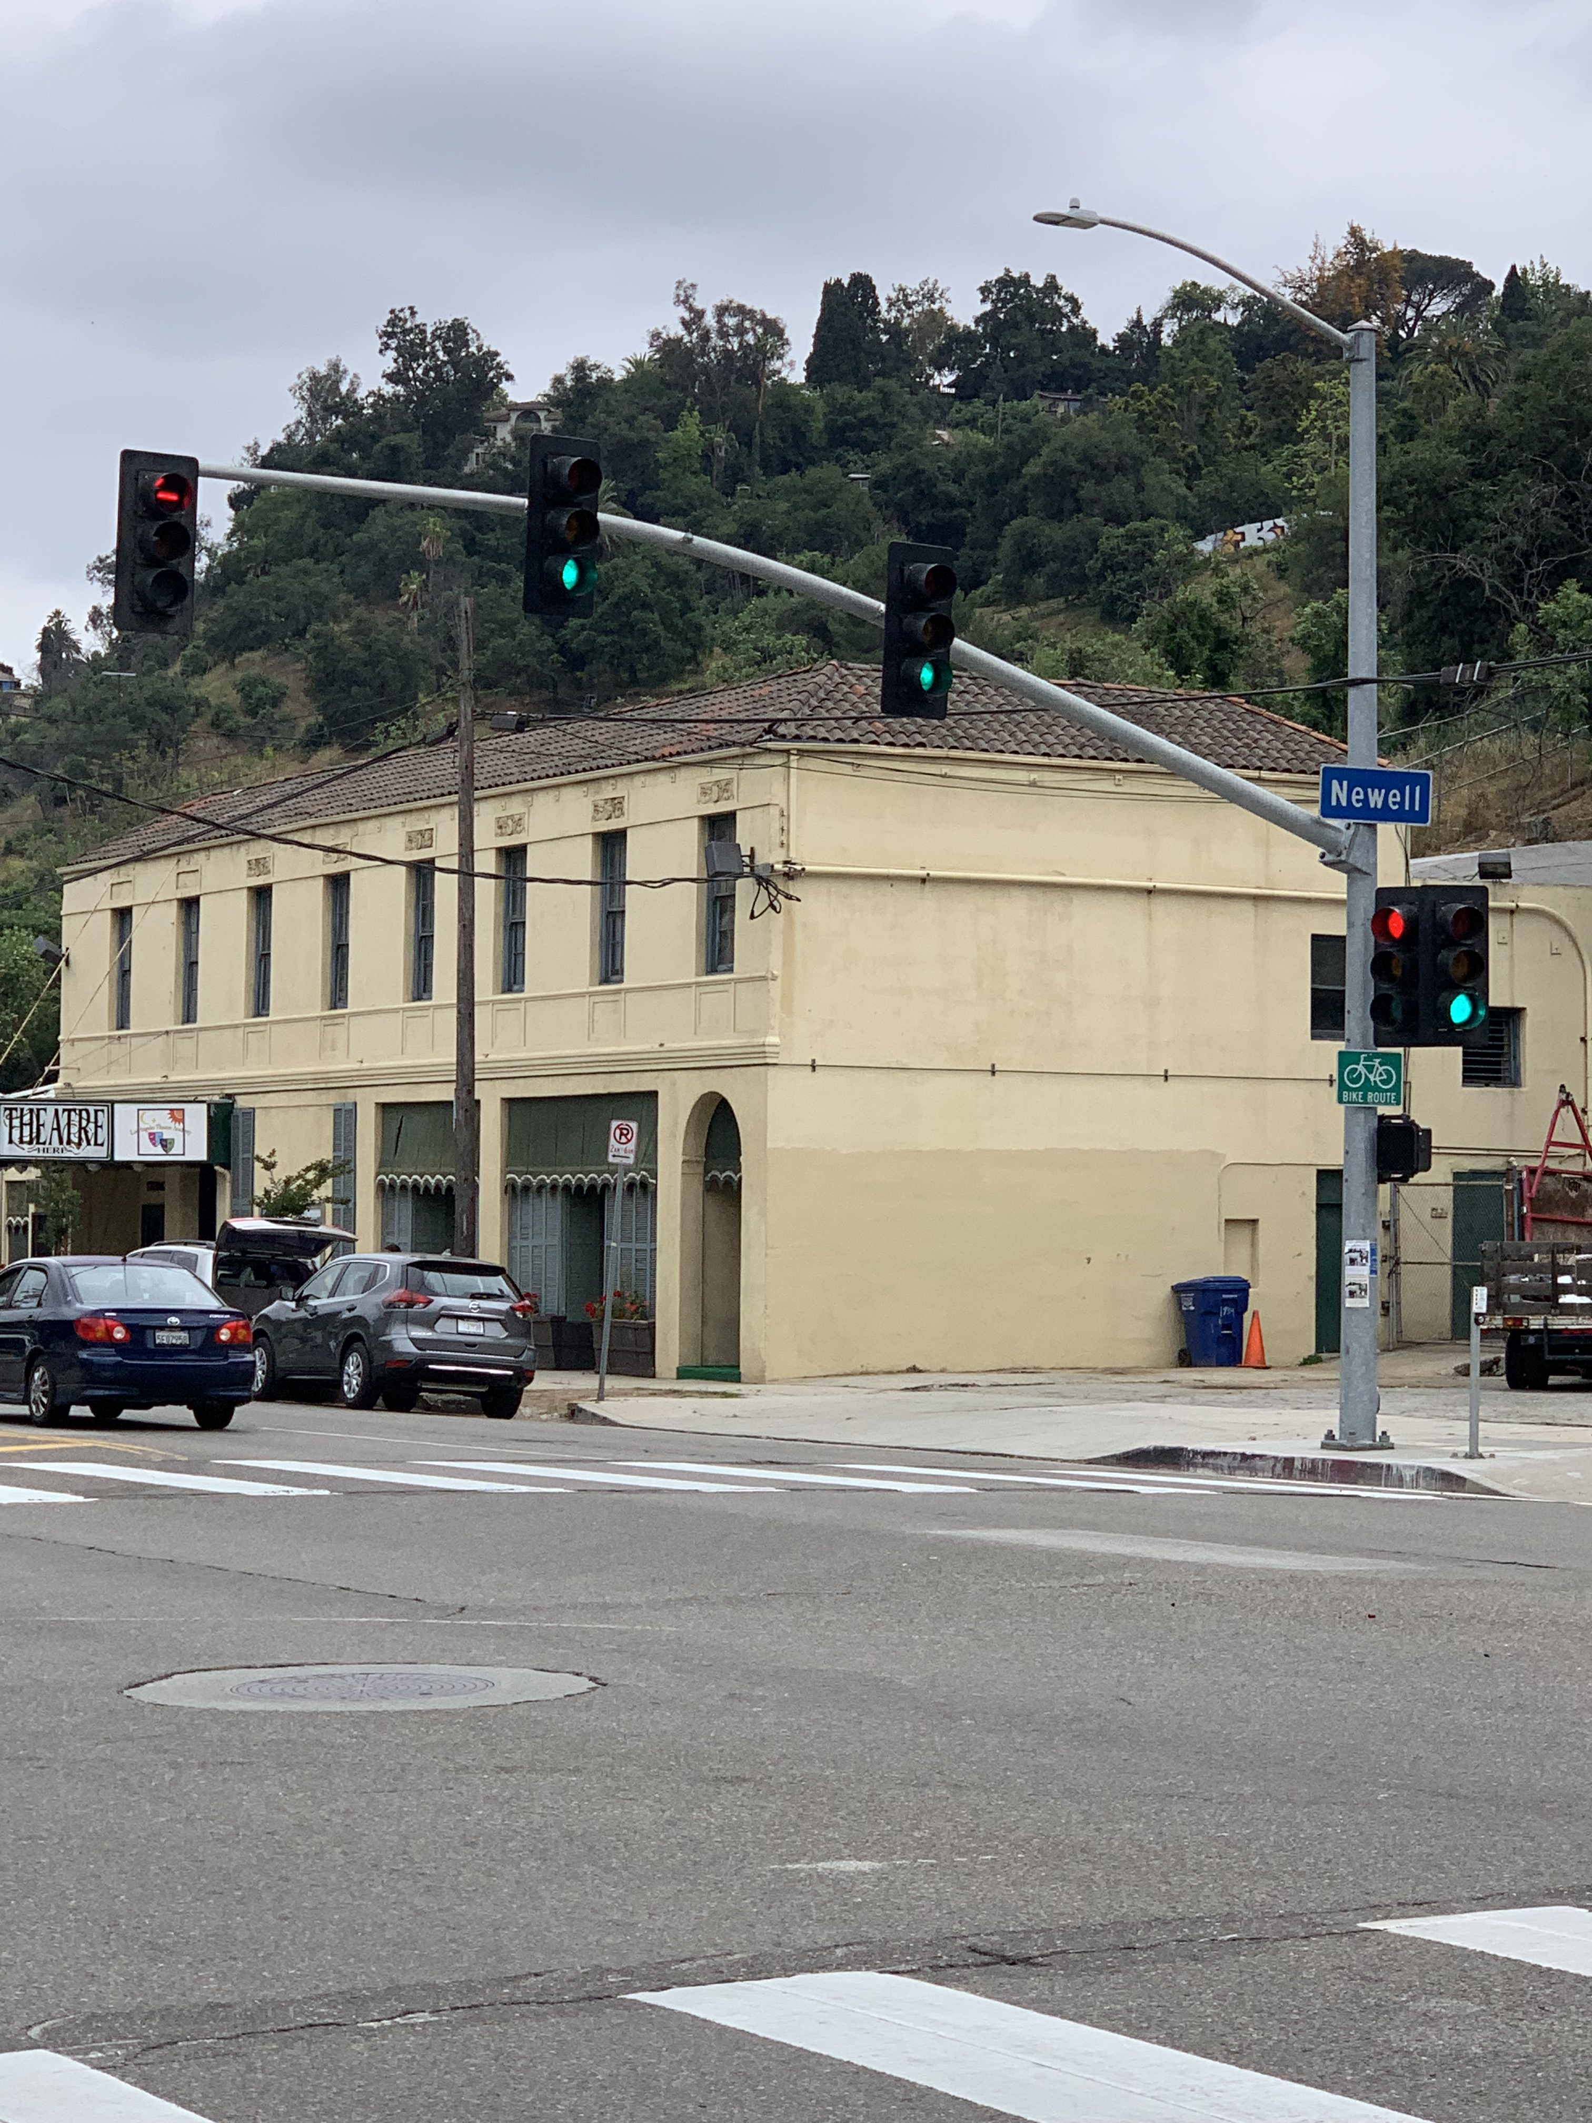
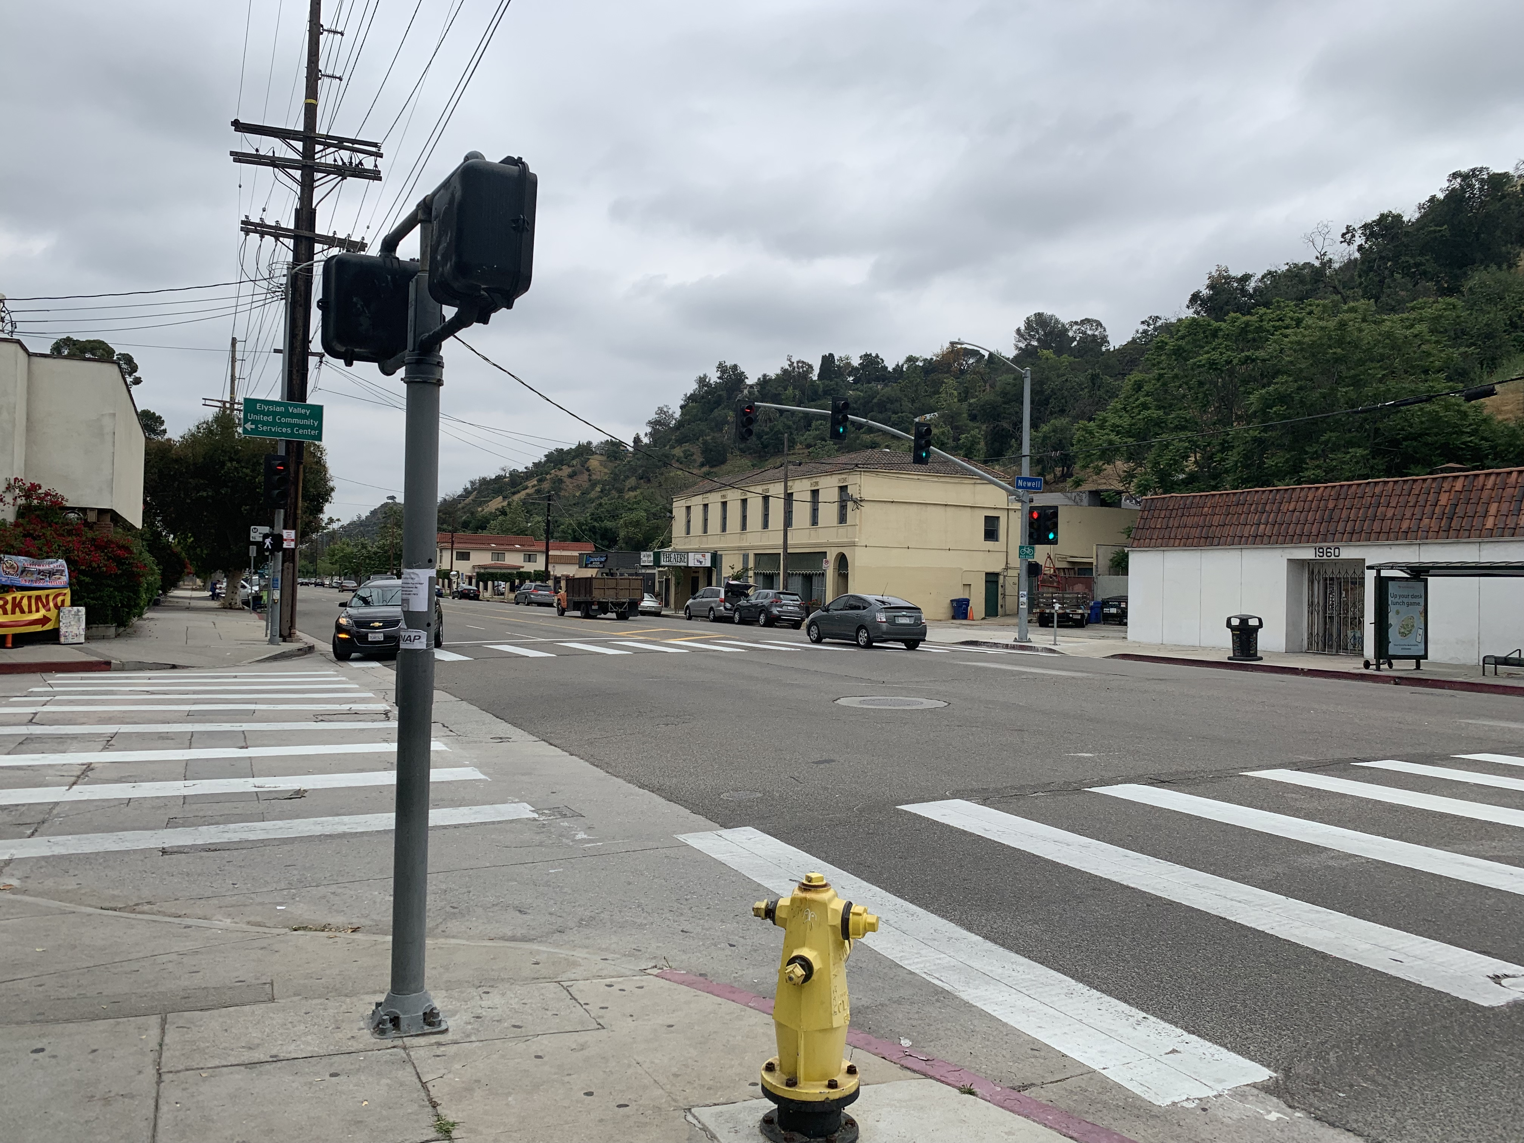
after

Slide 4
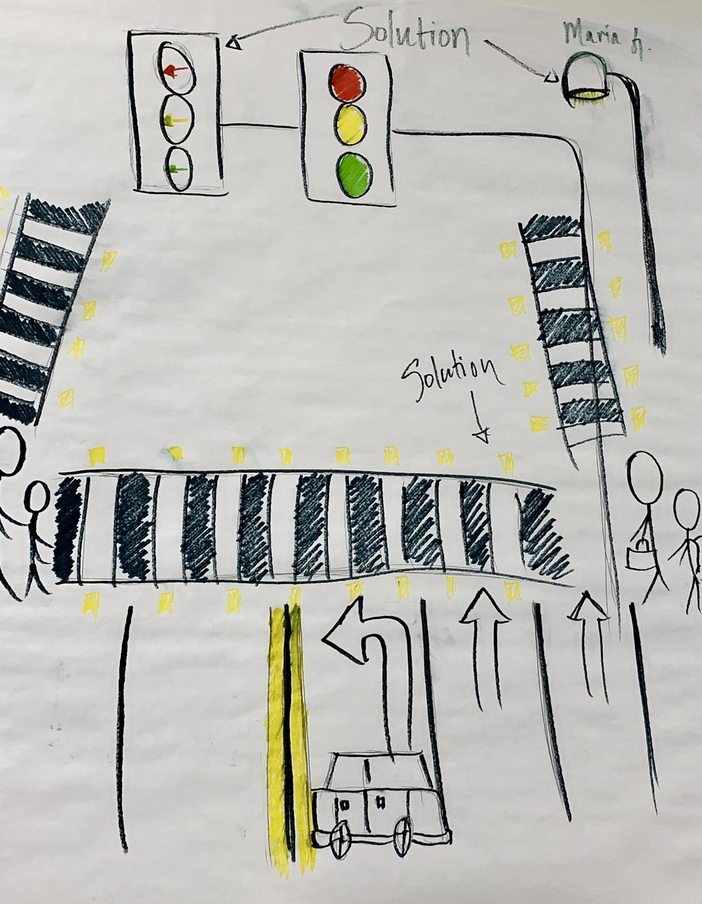
Poster

Slide 5

Driving in your car, approaching the intersection green Light. It’s Okay to go
I SEE YOU perpendicular to me. a red light illuminating your face you seemed to be stopping, a vision of safety but you are not stopping. neither of us are stopping
We are hurling towards each other, becoming closer and closer together almost inches from each other. MY LIFE is flashing before my eyes preparing for the inescapable collision, and we crash
Debris flying everywhere, fire igniting over our engines metal scraping upon metal, our cars dragging across the cold hard cement sirens blasting from afar. I feel blood running down my body i’m gasping for air, unable to move a single limb but I search over the scene looking for you
I need to make sure you are okay. I see you come out of your car
I call out for you, but only murmurs come out of my mouth
I try to reach out asking for your attention you look at me with a cold stare, and then you turned around starting to walk away from me and leave the scene of your crime you were just a reckless driver

