Slide 1
Planned Night Time Disturbances
Miranda Hutson
ENGL - 1B
5/21/2019

Slide 2
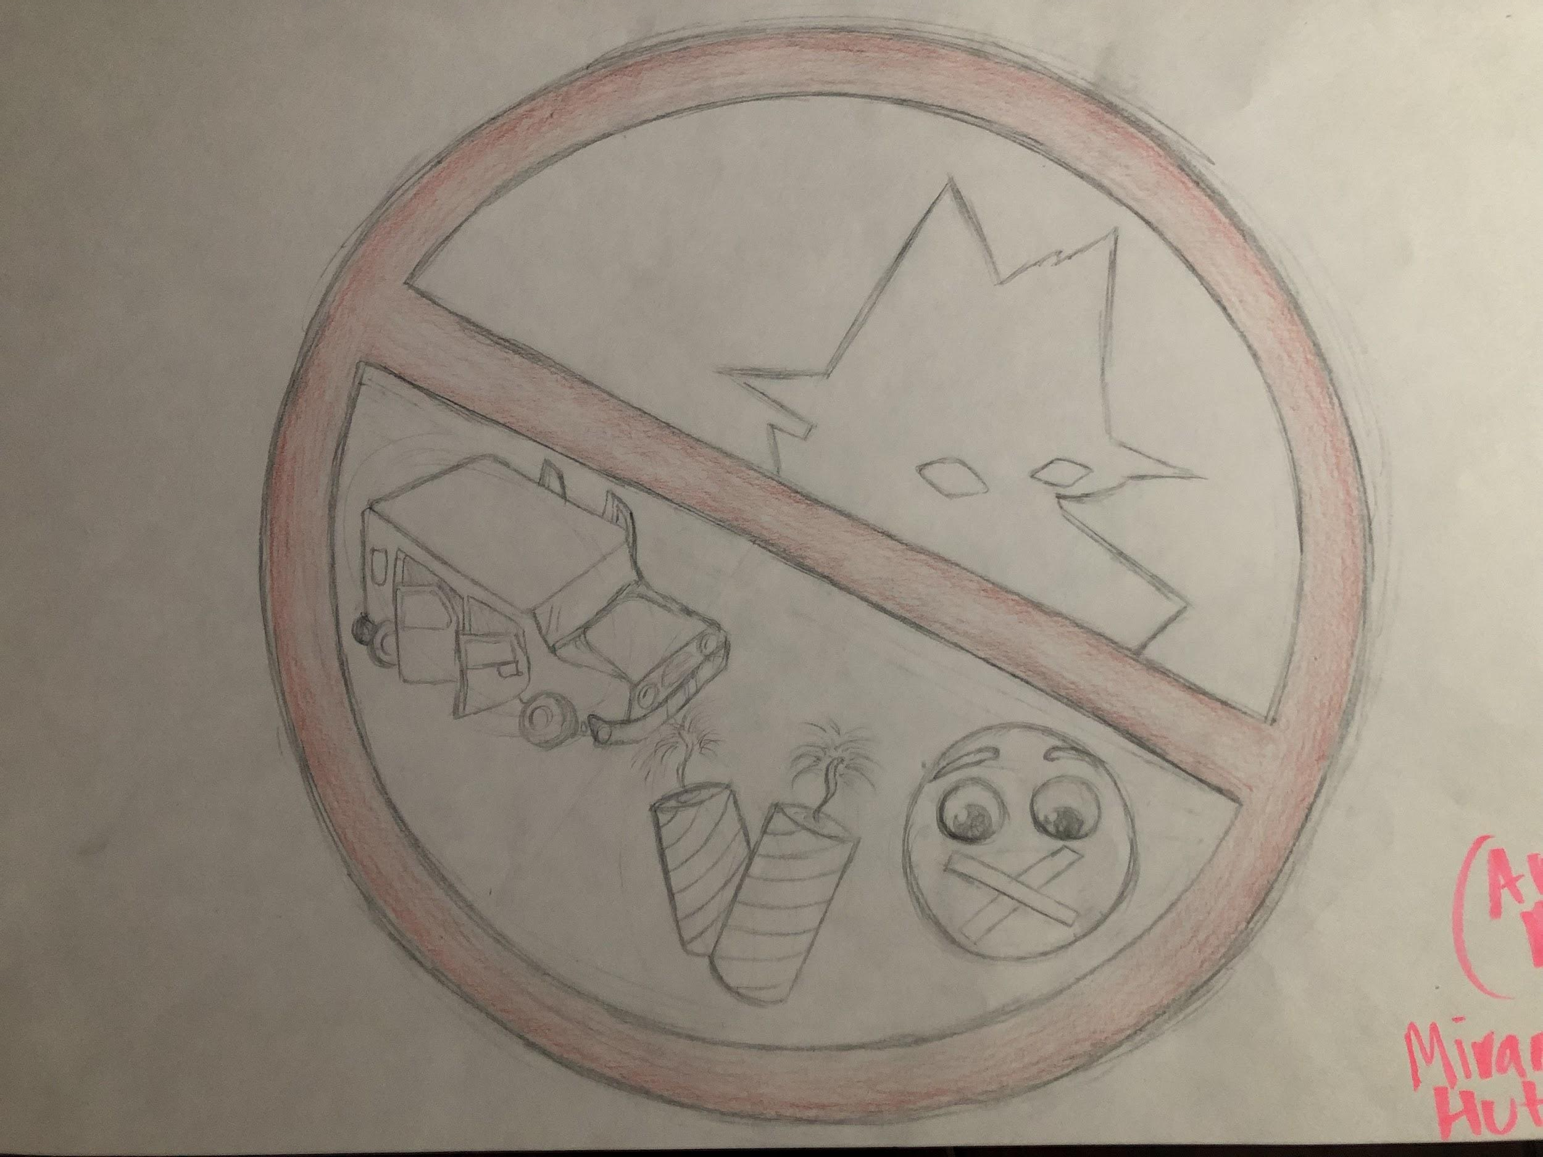
Poster

Slide 3
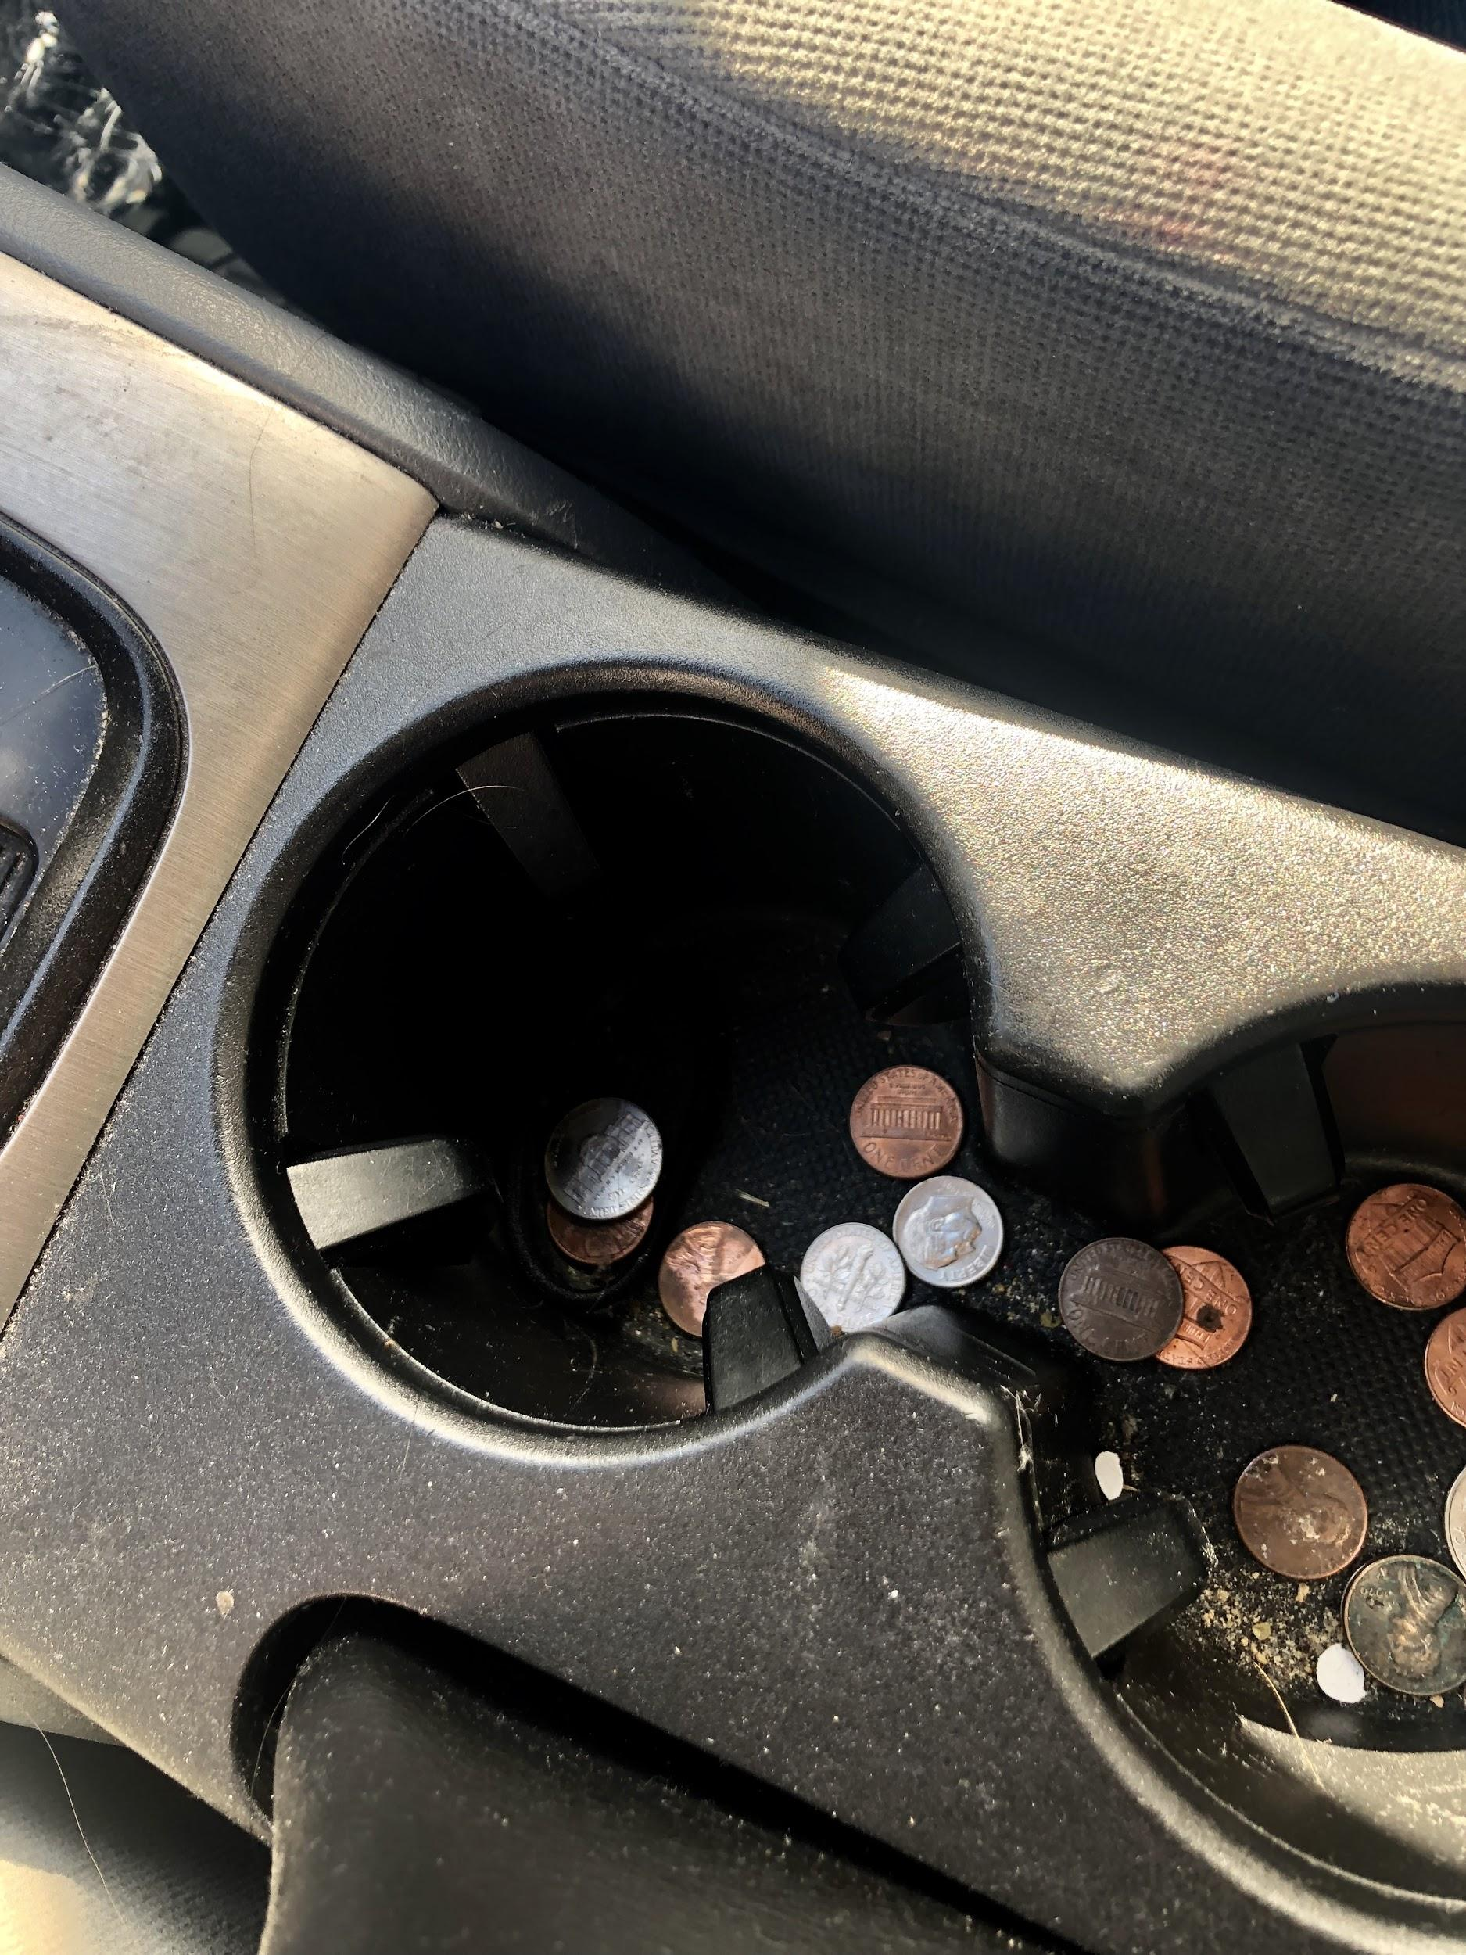
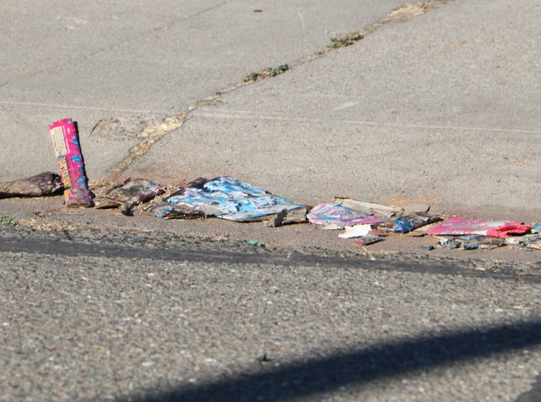
Photographs: The Problem

Slide 4
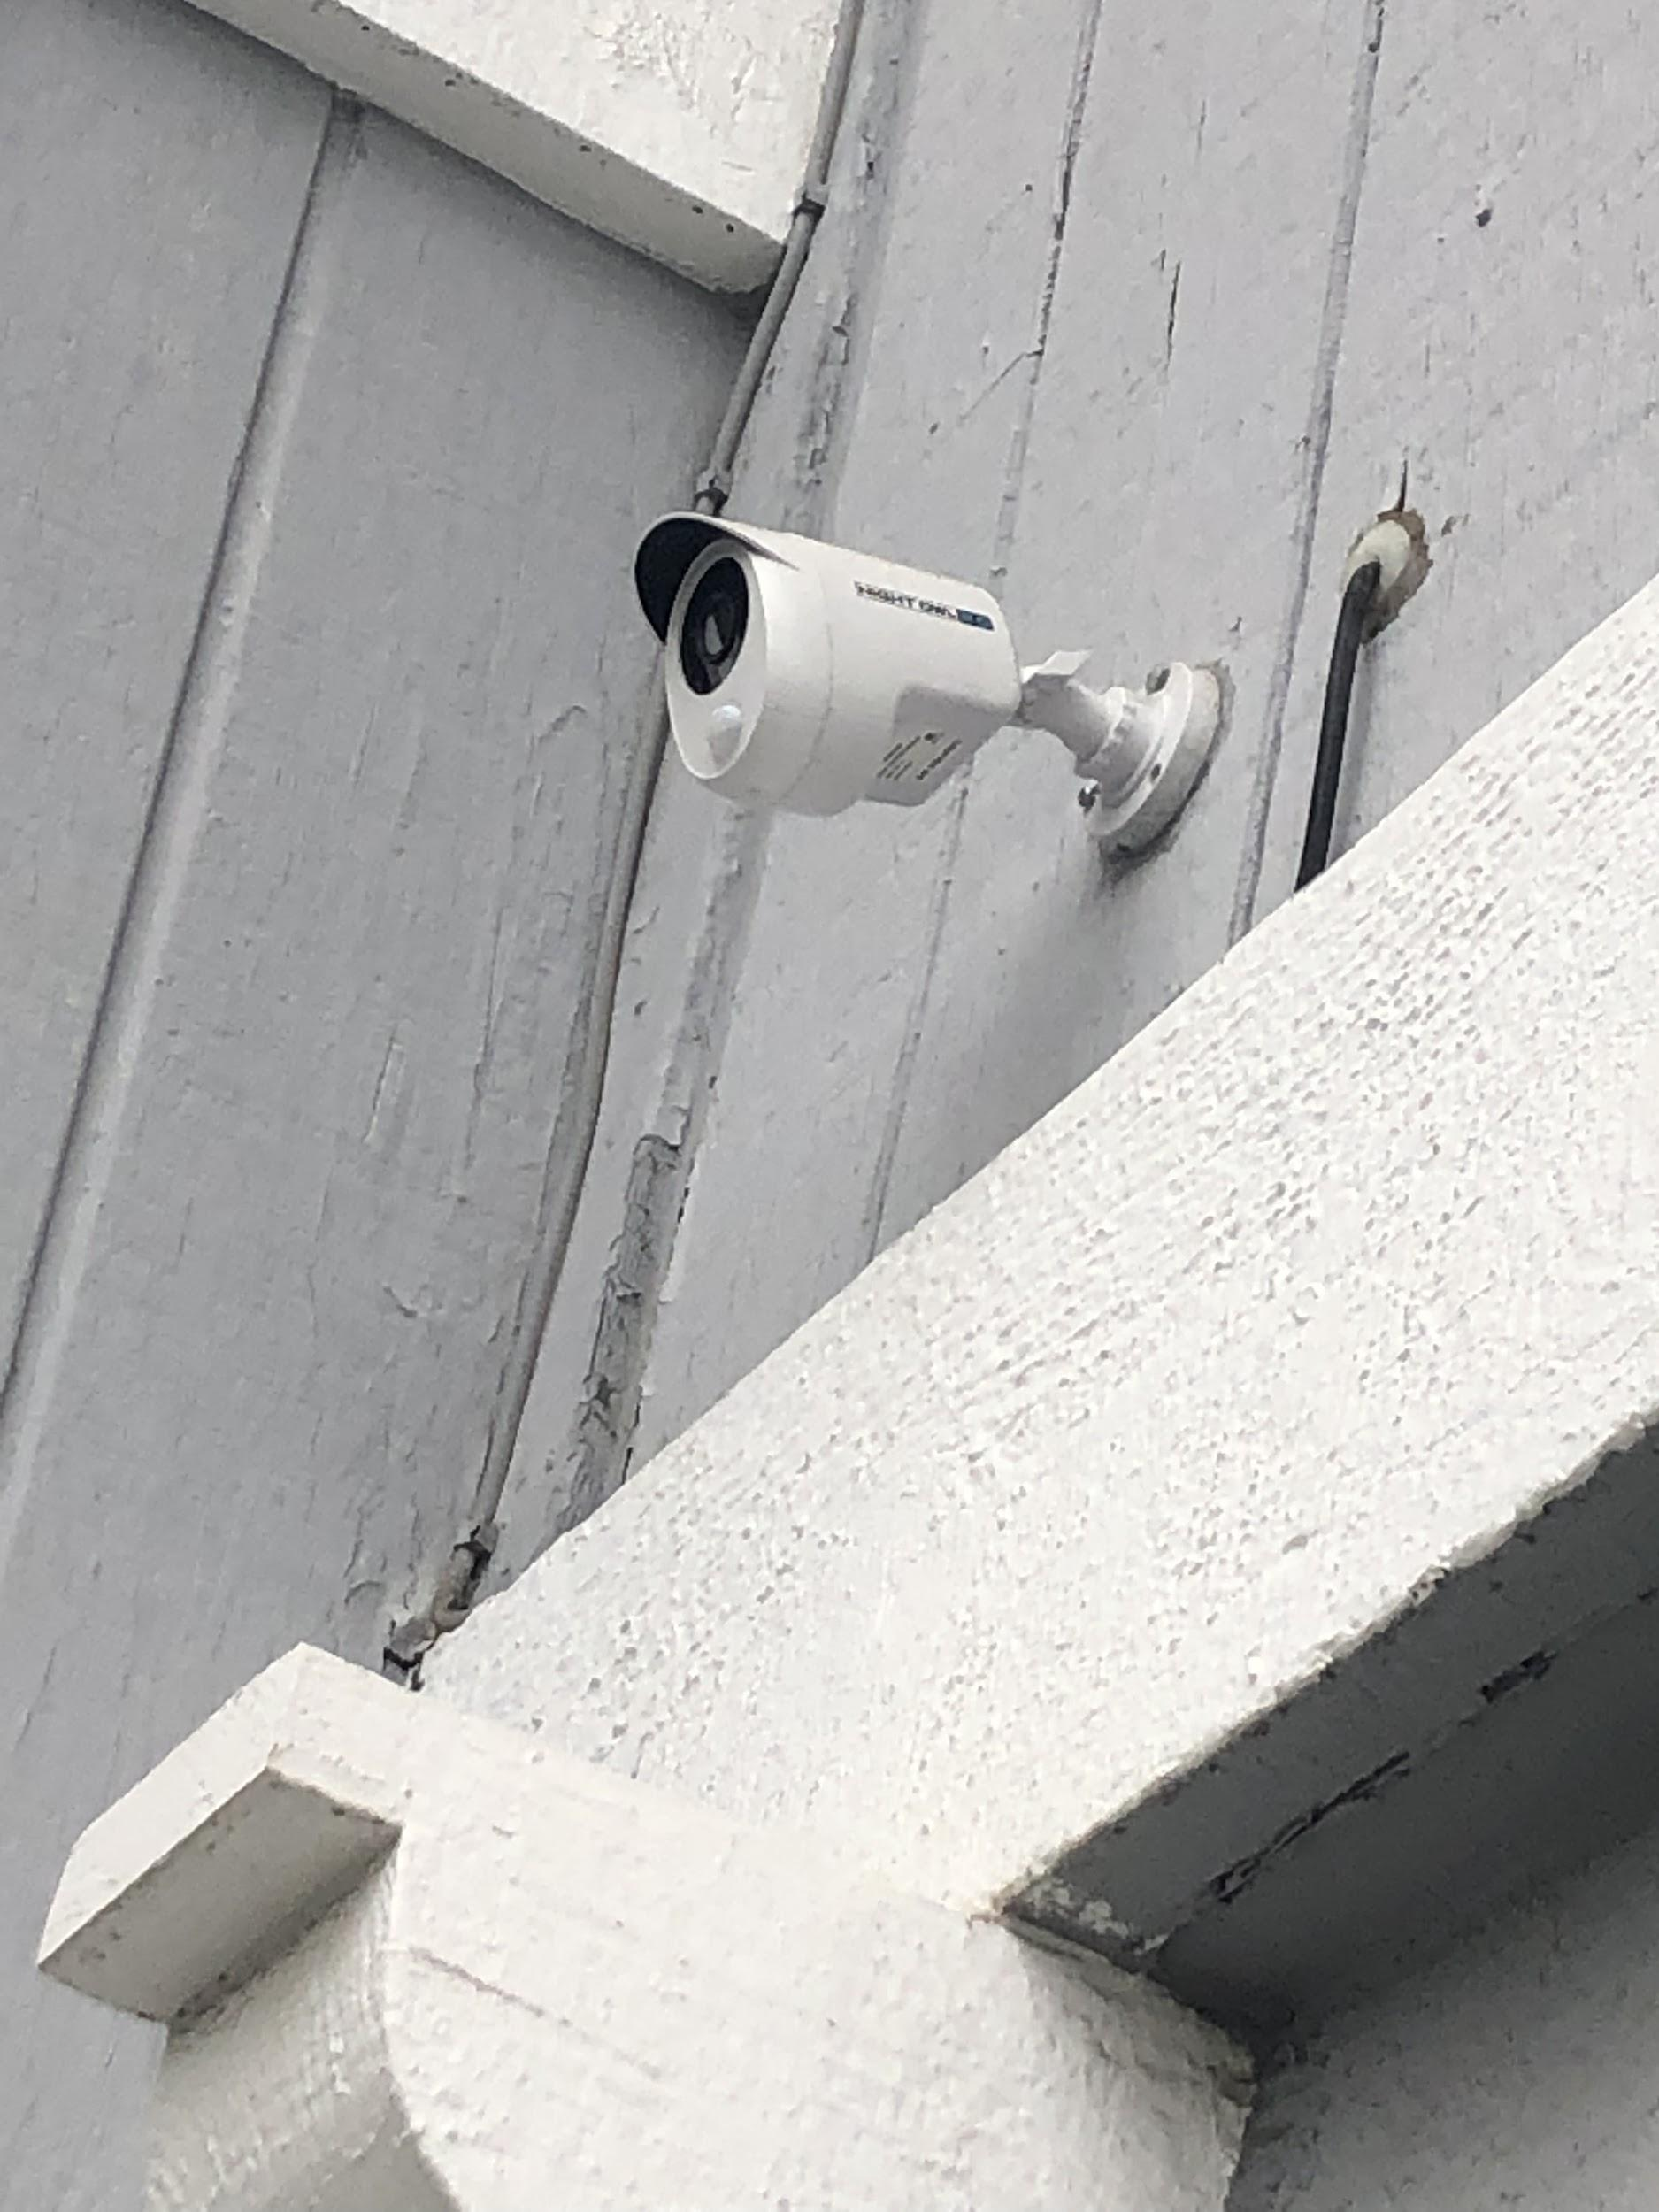
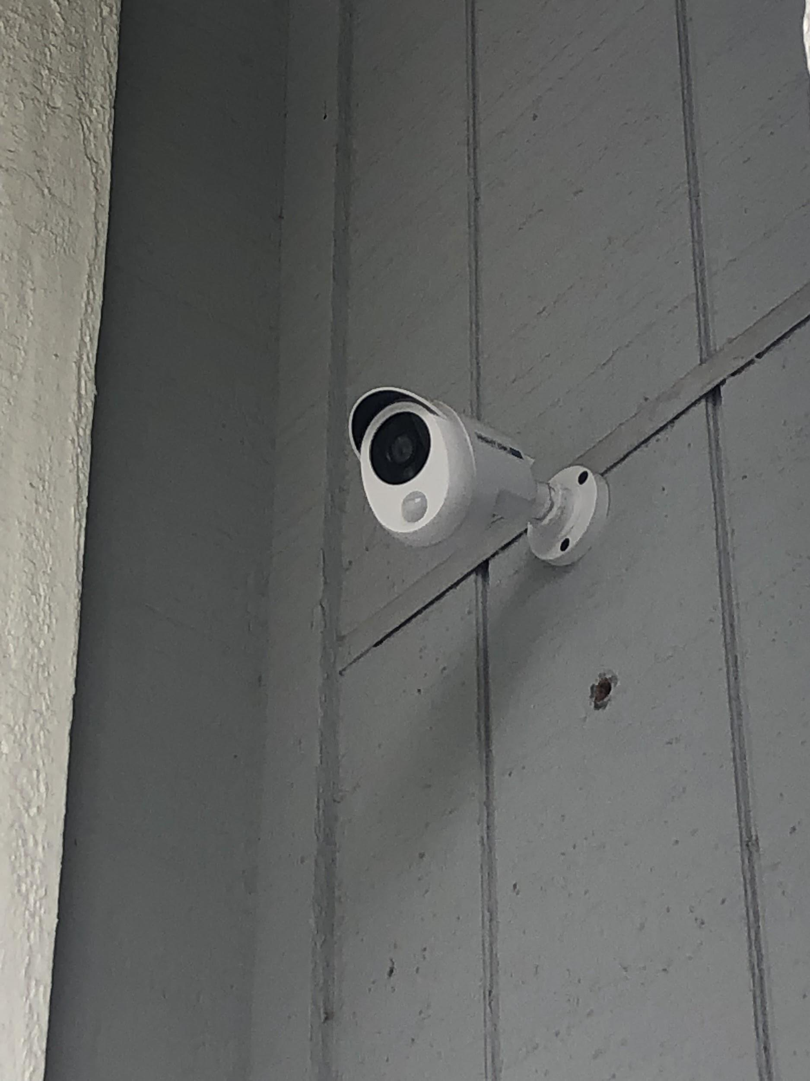
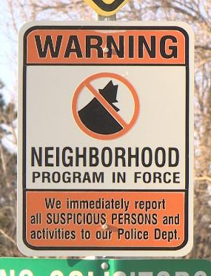
Photographs: The Solution

Slide 5

Poem

