Slide 1

Homelessness in Paramount
Ivon Gomez
English 350-07

Slide 2
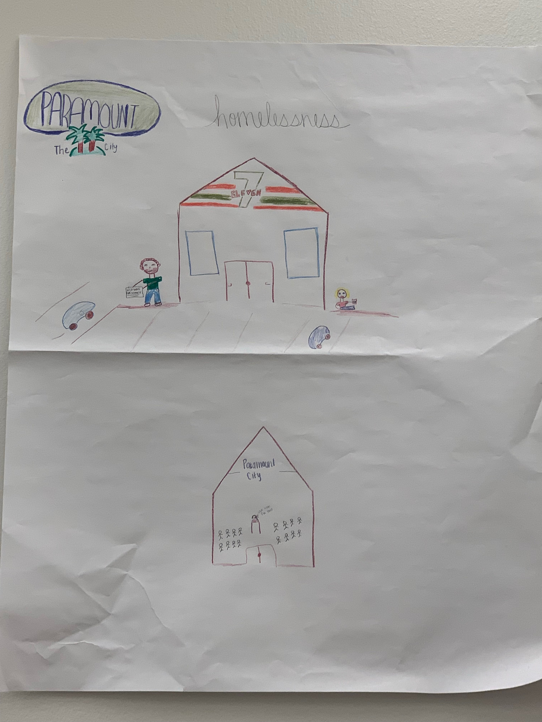

Slide 3
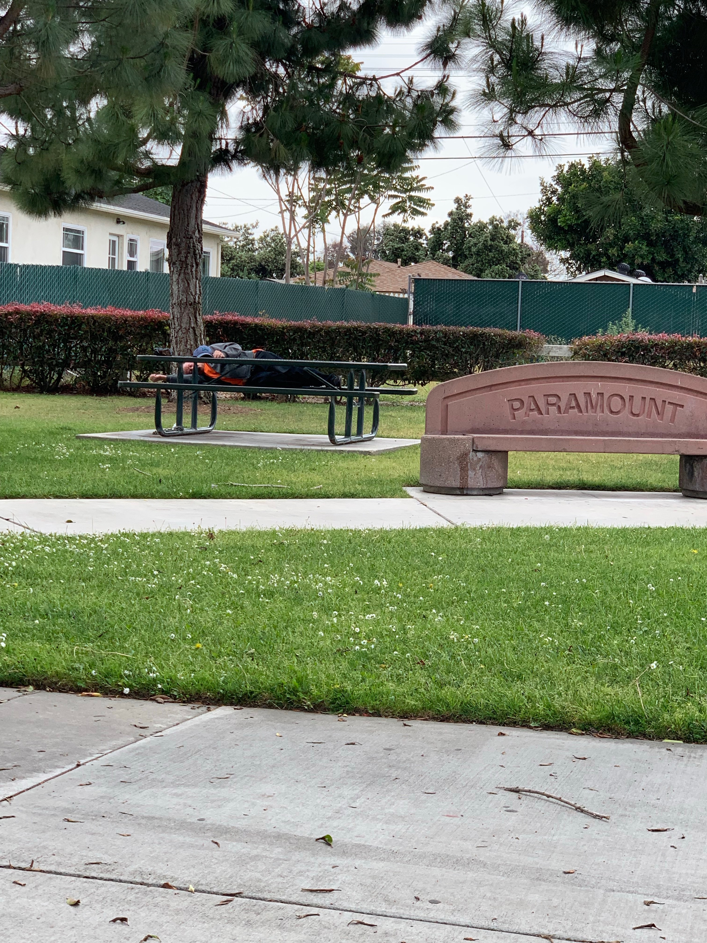

Slide 4
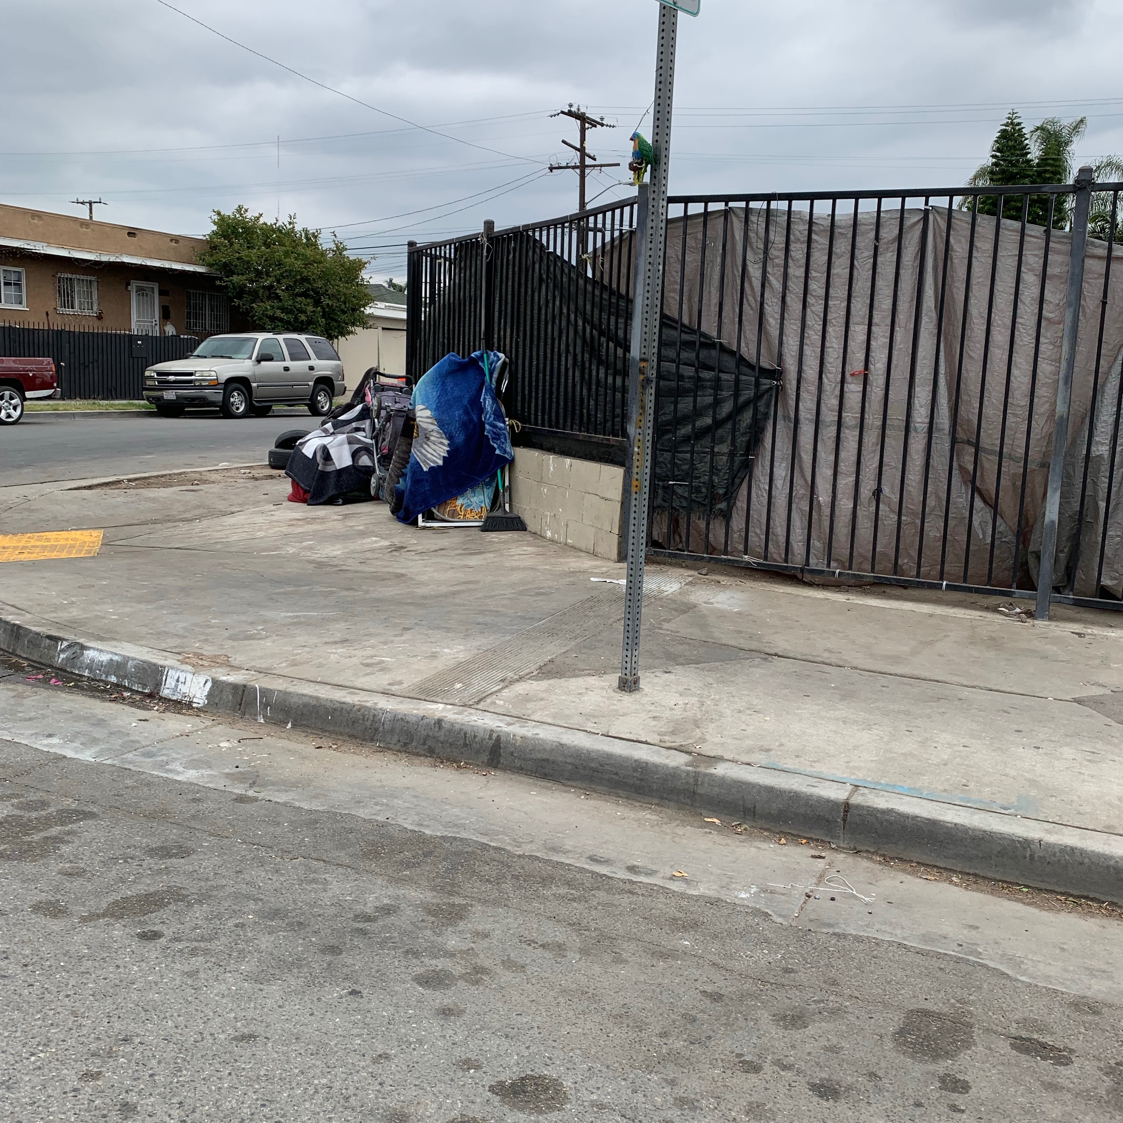

Slide 5
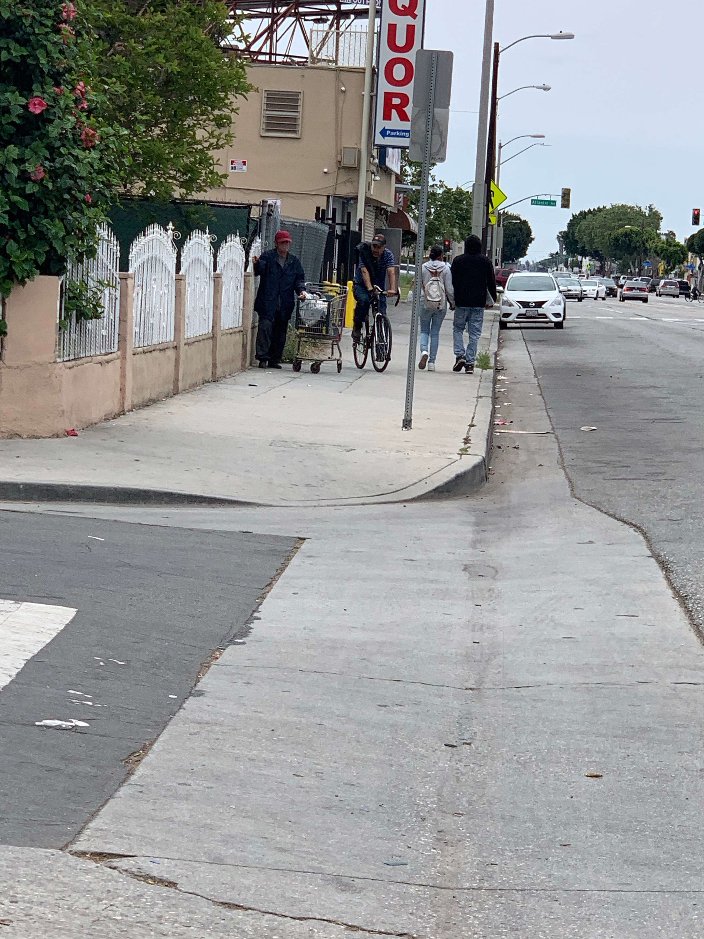

Slide 6
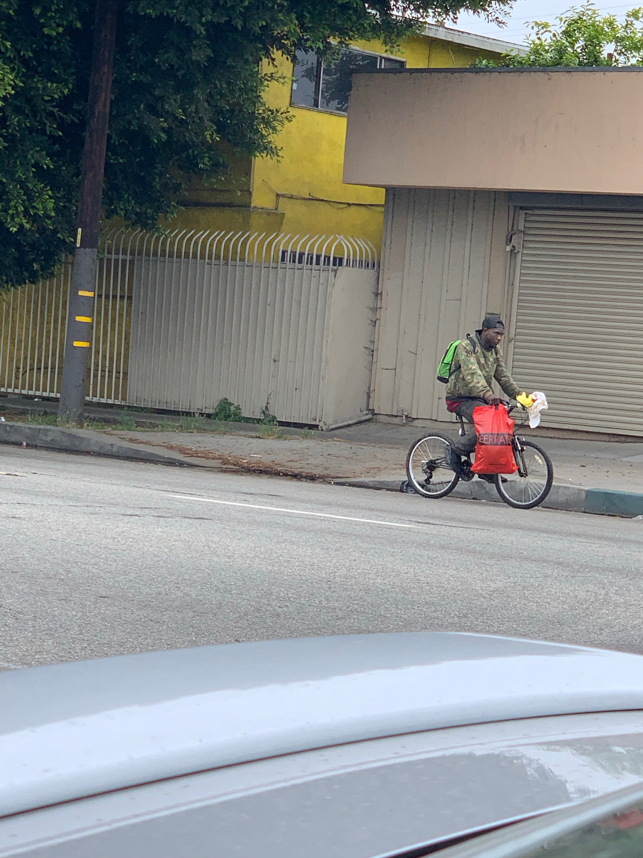

Slide 7

Its sad watching him out by the freeway sit
While in my car I sit and eat
He probably hasn’t had a decent meal
1, 2, 3, 4, 5, days, weeks, months maybe
Why do I complain I contemplate
I have food, clothes, and shelter
He has none
He begs and begs for spare change
While our community can’t grab a pen and paper
To sit and plan to make a change
I sit and observe and plan a change
Shelters, support anything would be good
Lets come together as one and respect our community

