Slide 1
Experiencing Homelessness
By Filoi Ahsiu

Slide 2
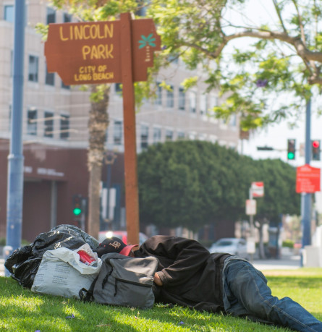
Homelessness can be experienced by families and individuals

Slide 3
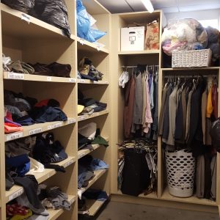
At my internship, Harbor Interfaith Services. They provide services such as a food bank, hygiene and clothing closet to clients.

Slide 4
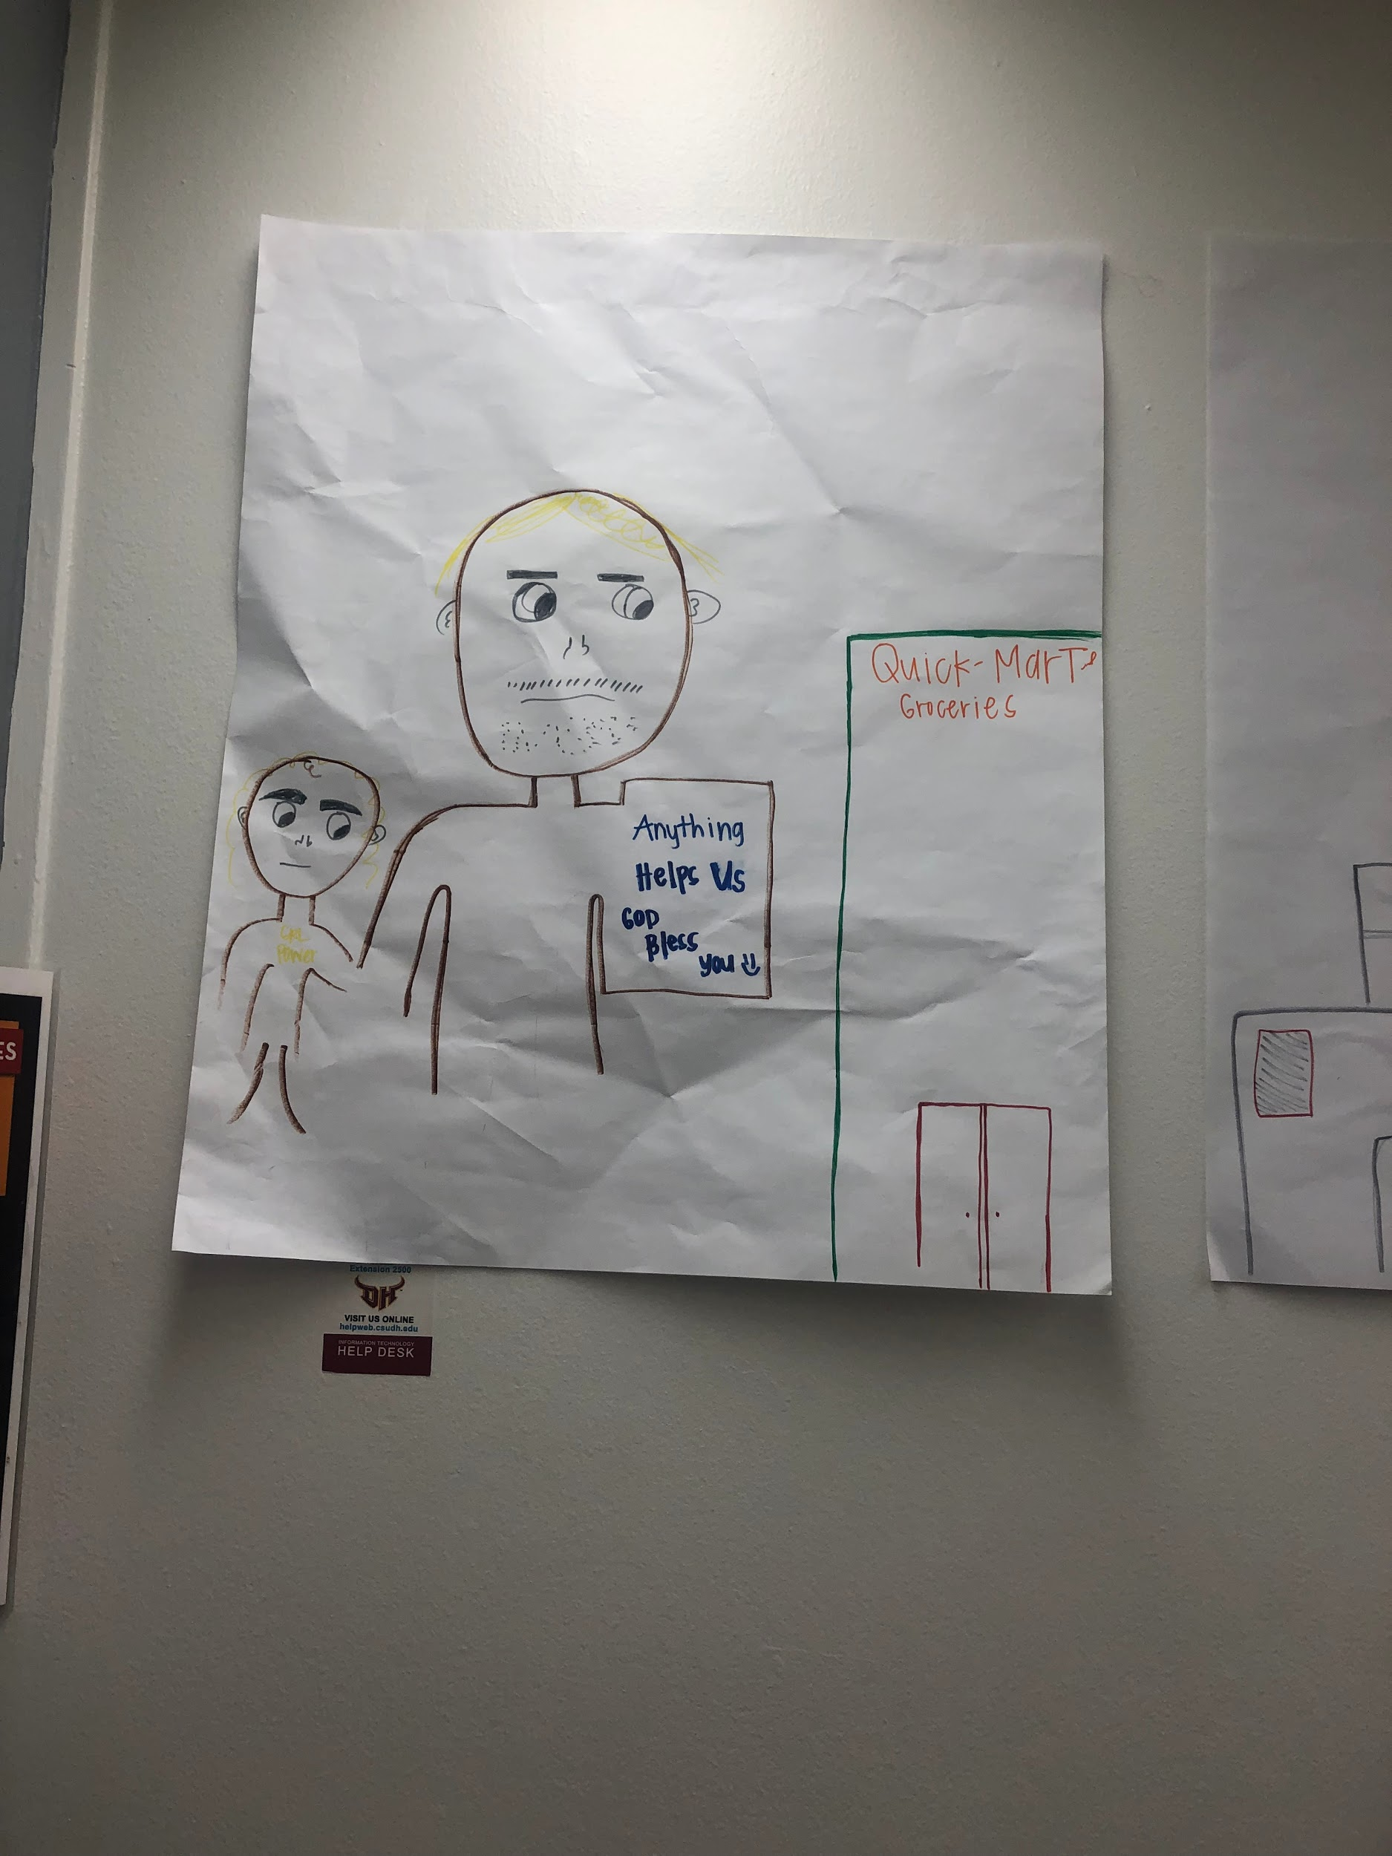

Slide 5

Spoken Word / Poem
Without a Home -Filoi Ahsiu

