Slide 1
High Impact Practices (HIP) Service Learning Internship Community Engagement (SLICE)with Spoken Word “Fix-It” Presentation
Isabel Mariscal
Dumping Grounds
English 350-07
May 4, 2019

Slide 2
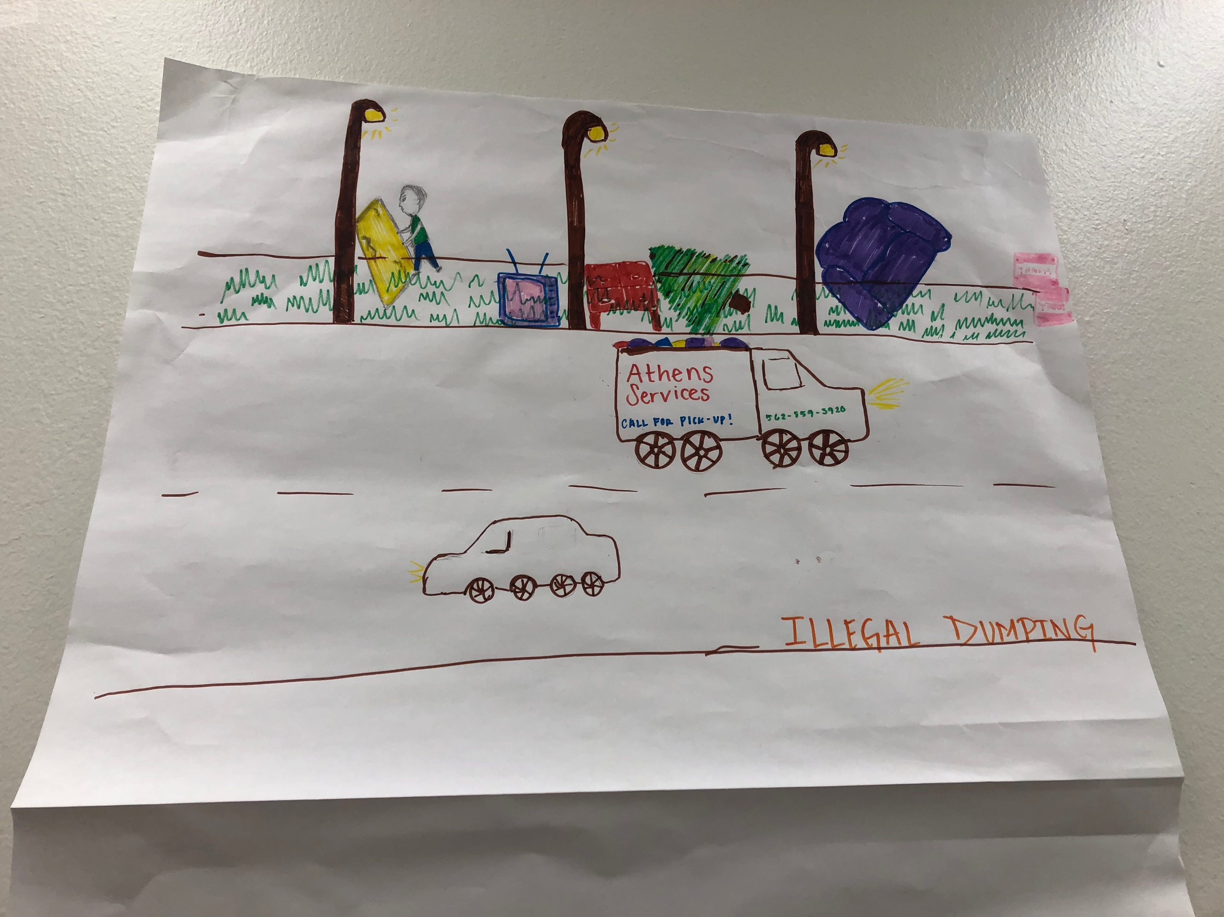
POSTER

Slide 3
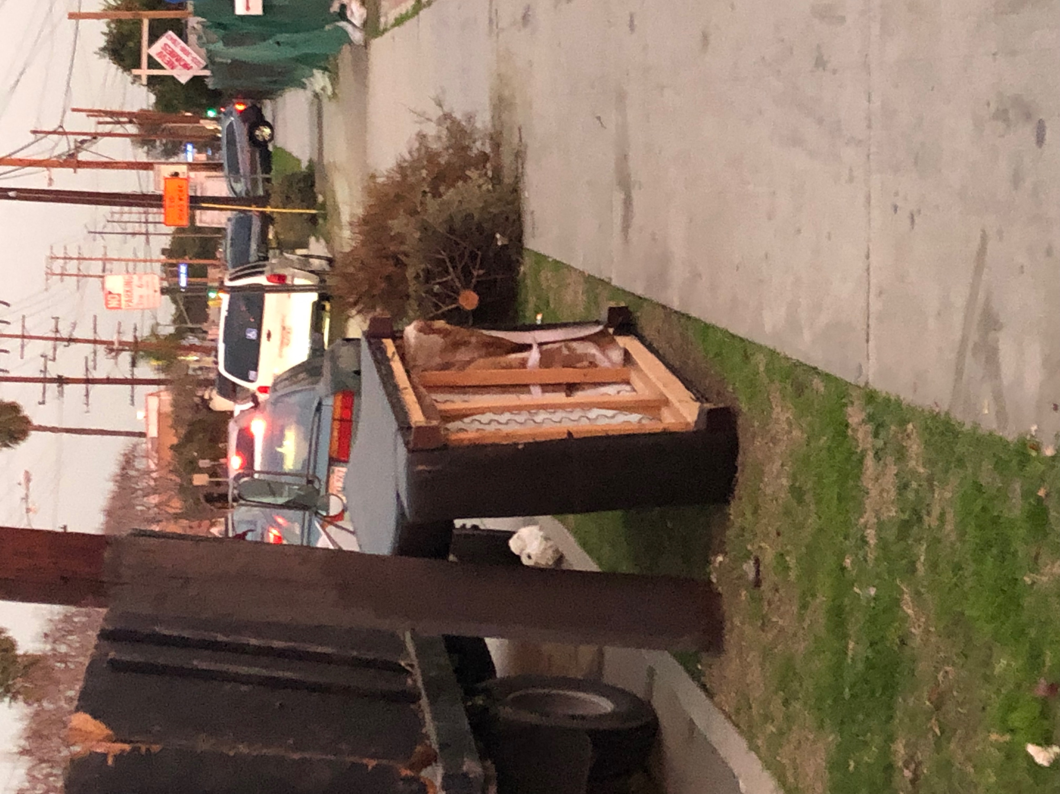
PHOTOGRAPH

Slide 4
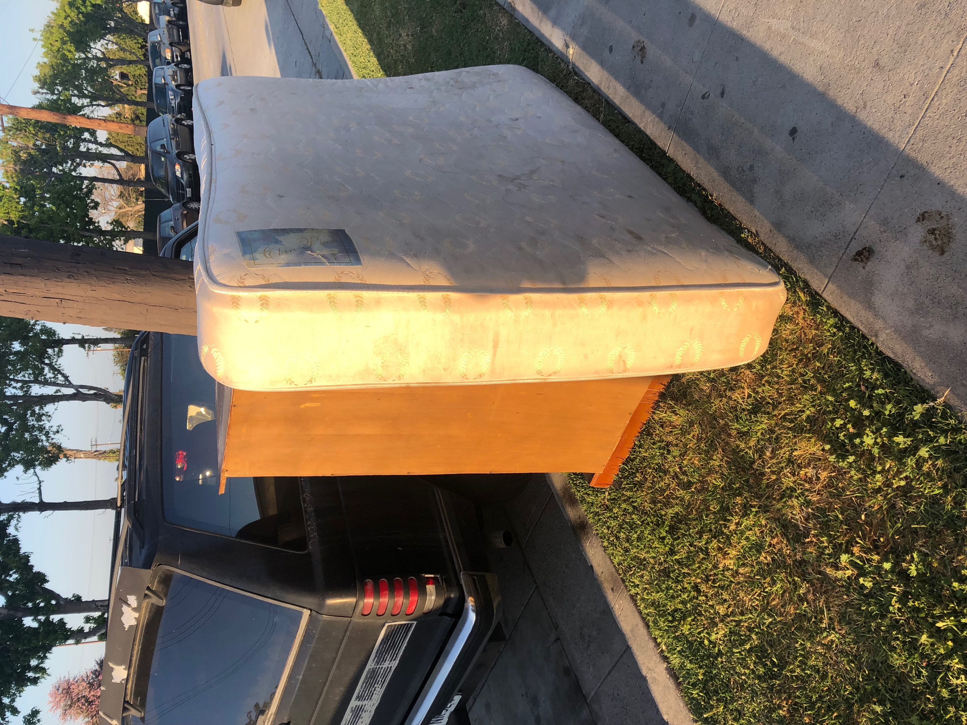
PHOTOGRAPH

Slide 5
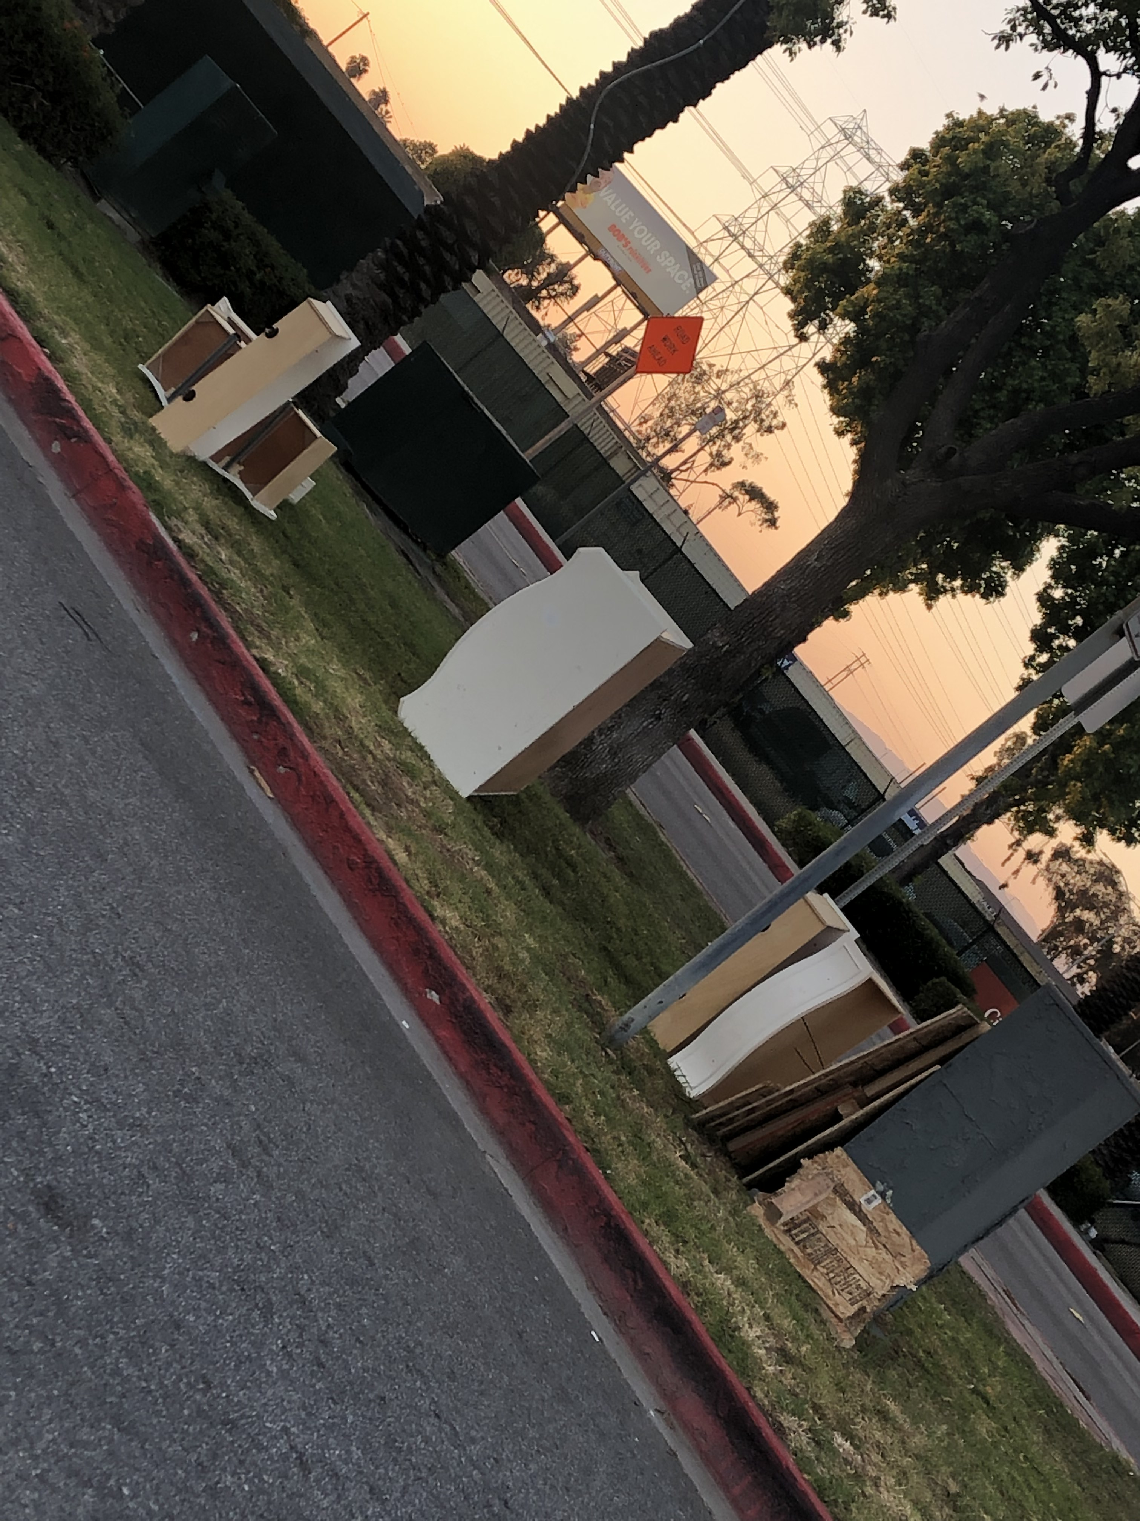
PHOTOGRAPH

Slide 6
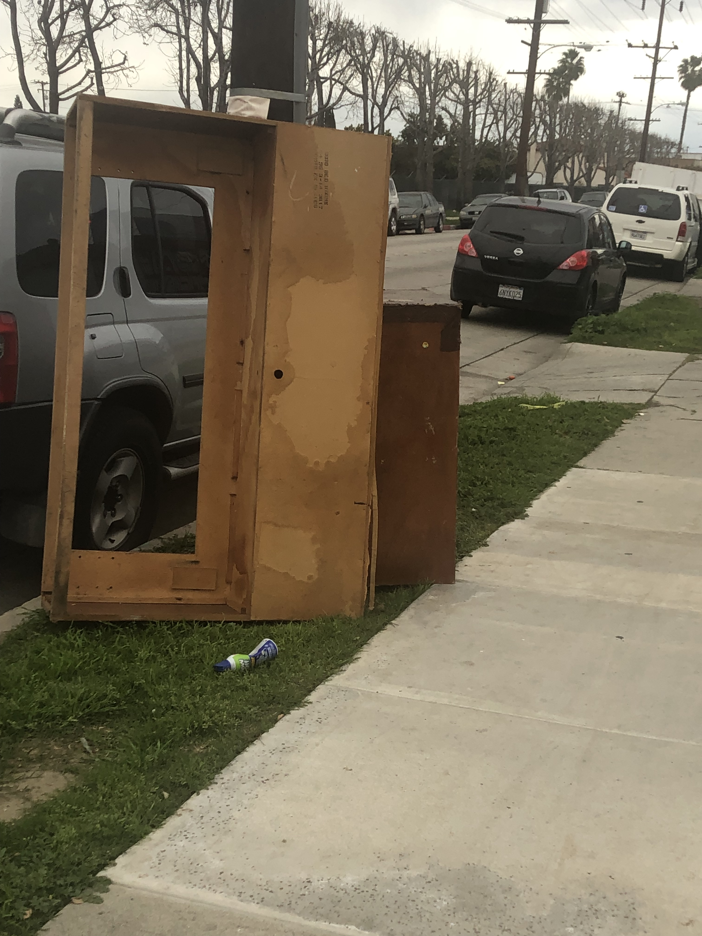

Dumping Grounds
The streets become a dumping ground
Furniture and appliances found all around
Why don’t you call?
Why not report it?
This is an issue please don’t ignore it
Debris and chemicals pollute our air
For our future generations this is not fair
Why don’t you call?
Why not report it?
I only ask you don’t ignore it
You say you can’t afford the fee
But if you notice the service’s free
So make the call and report it
You no longer have the choice to ignore it

