Slide 1
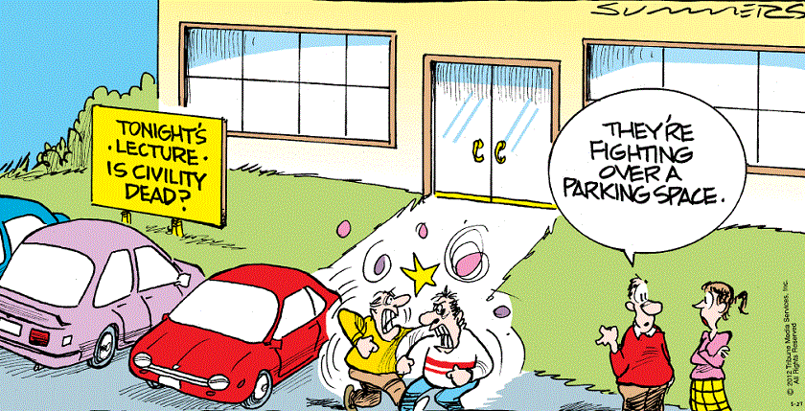
LOW PARKING
NO PARKING

Slide 2
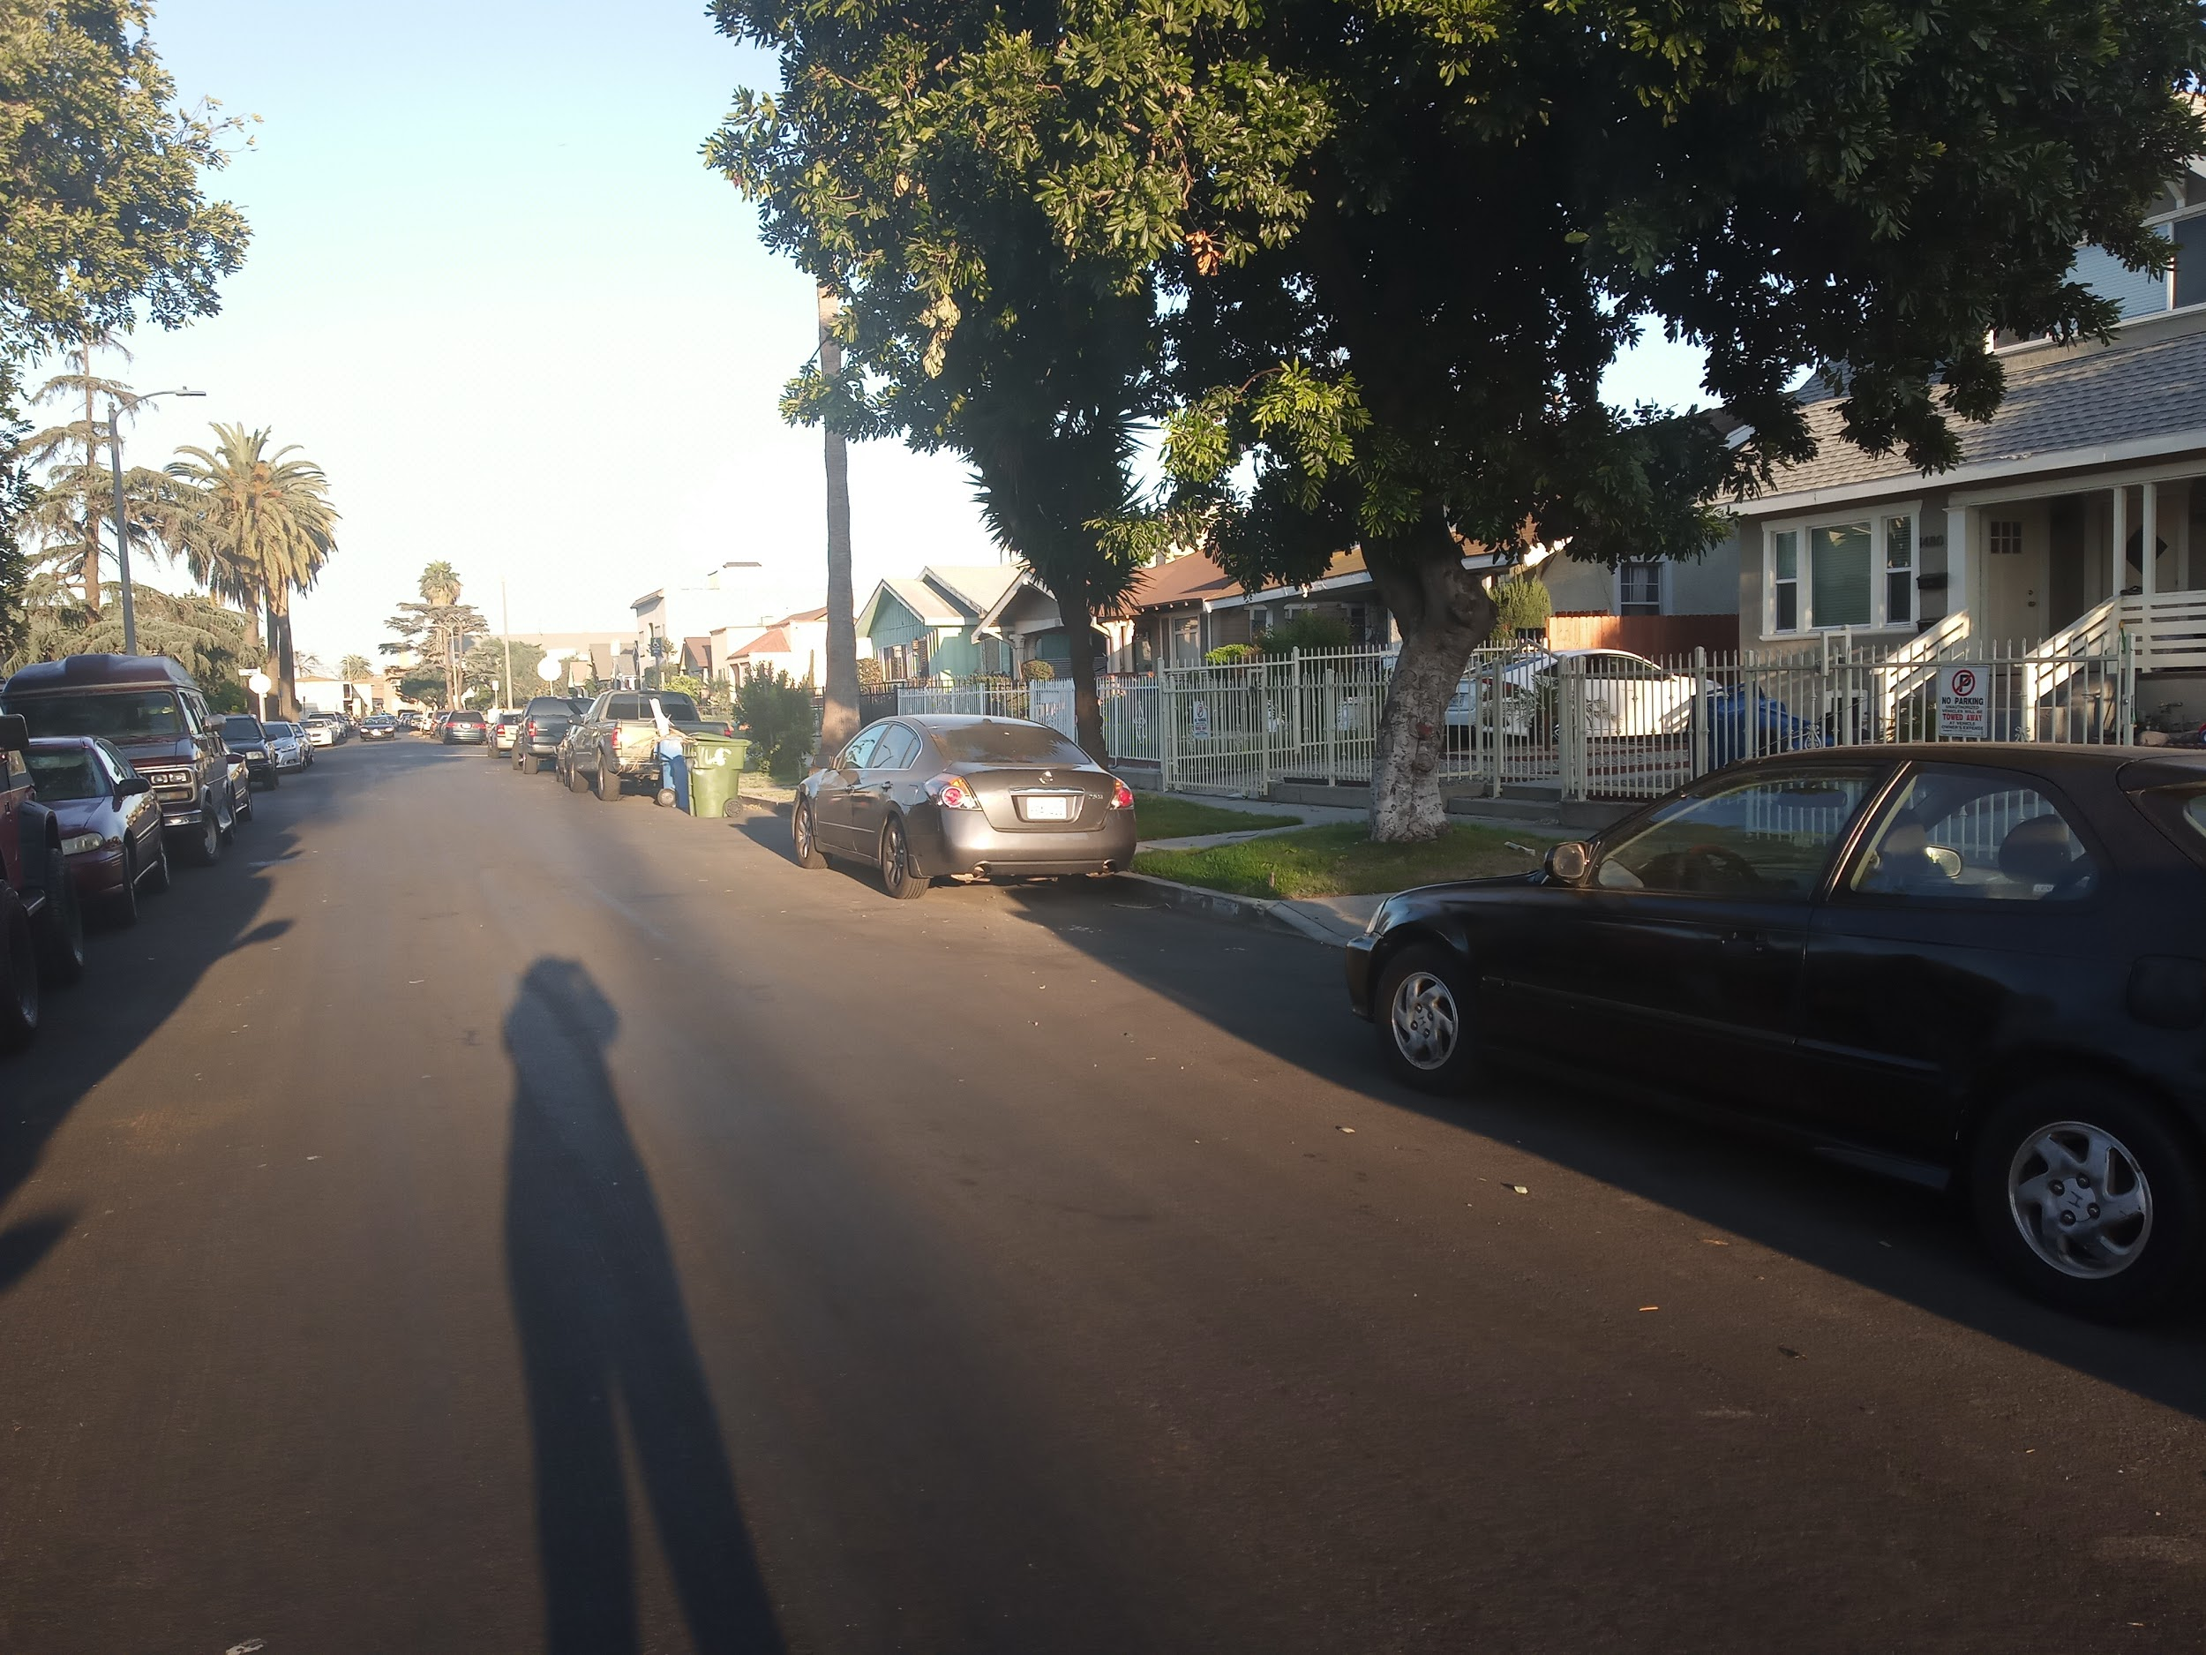
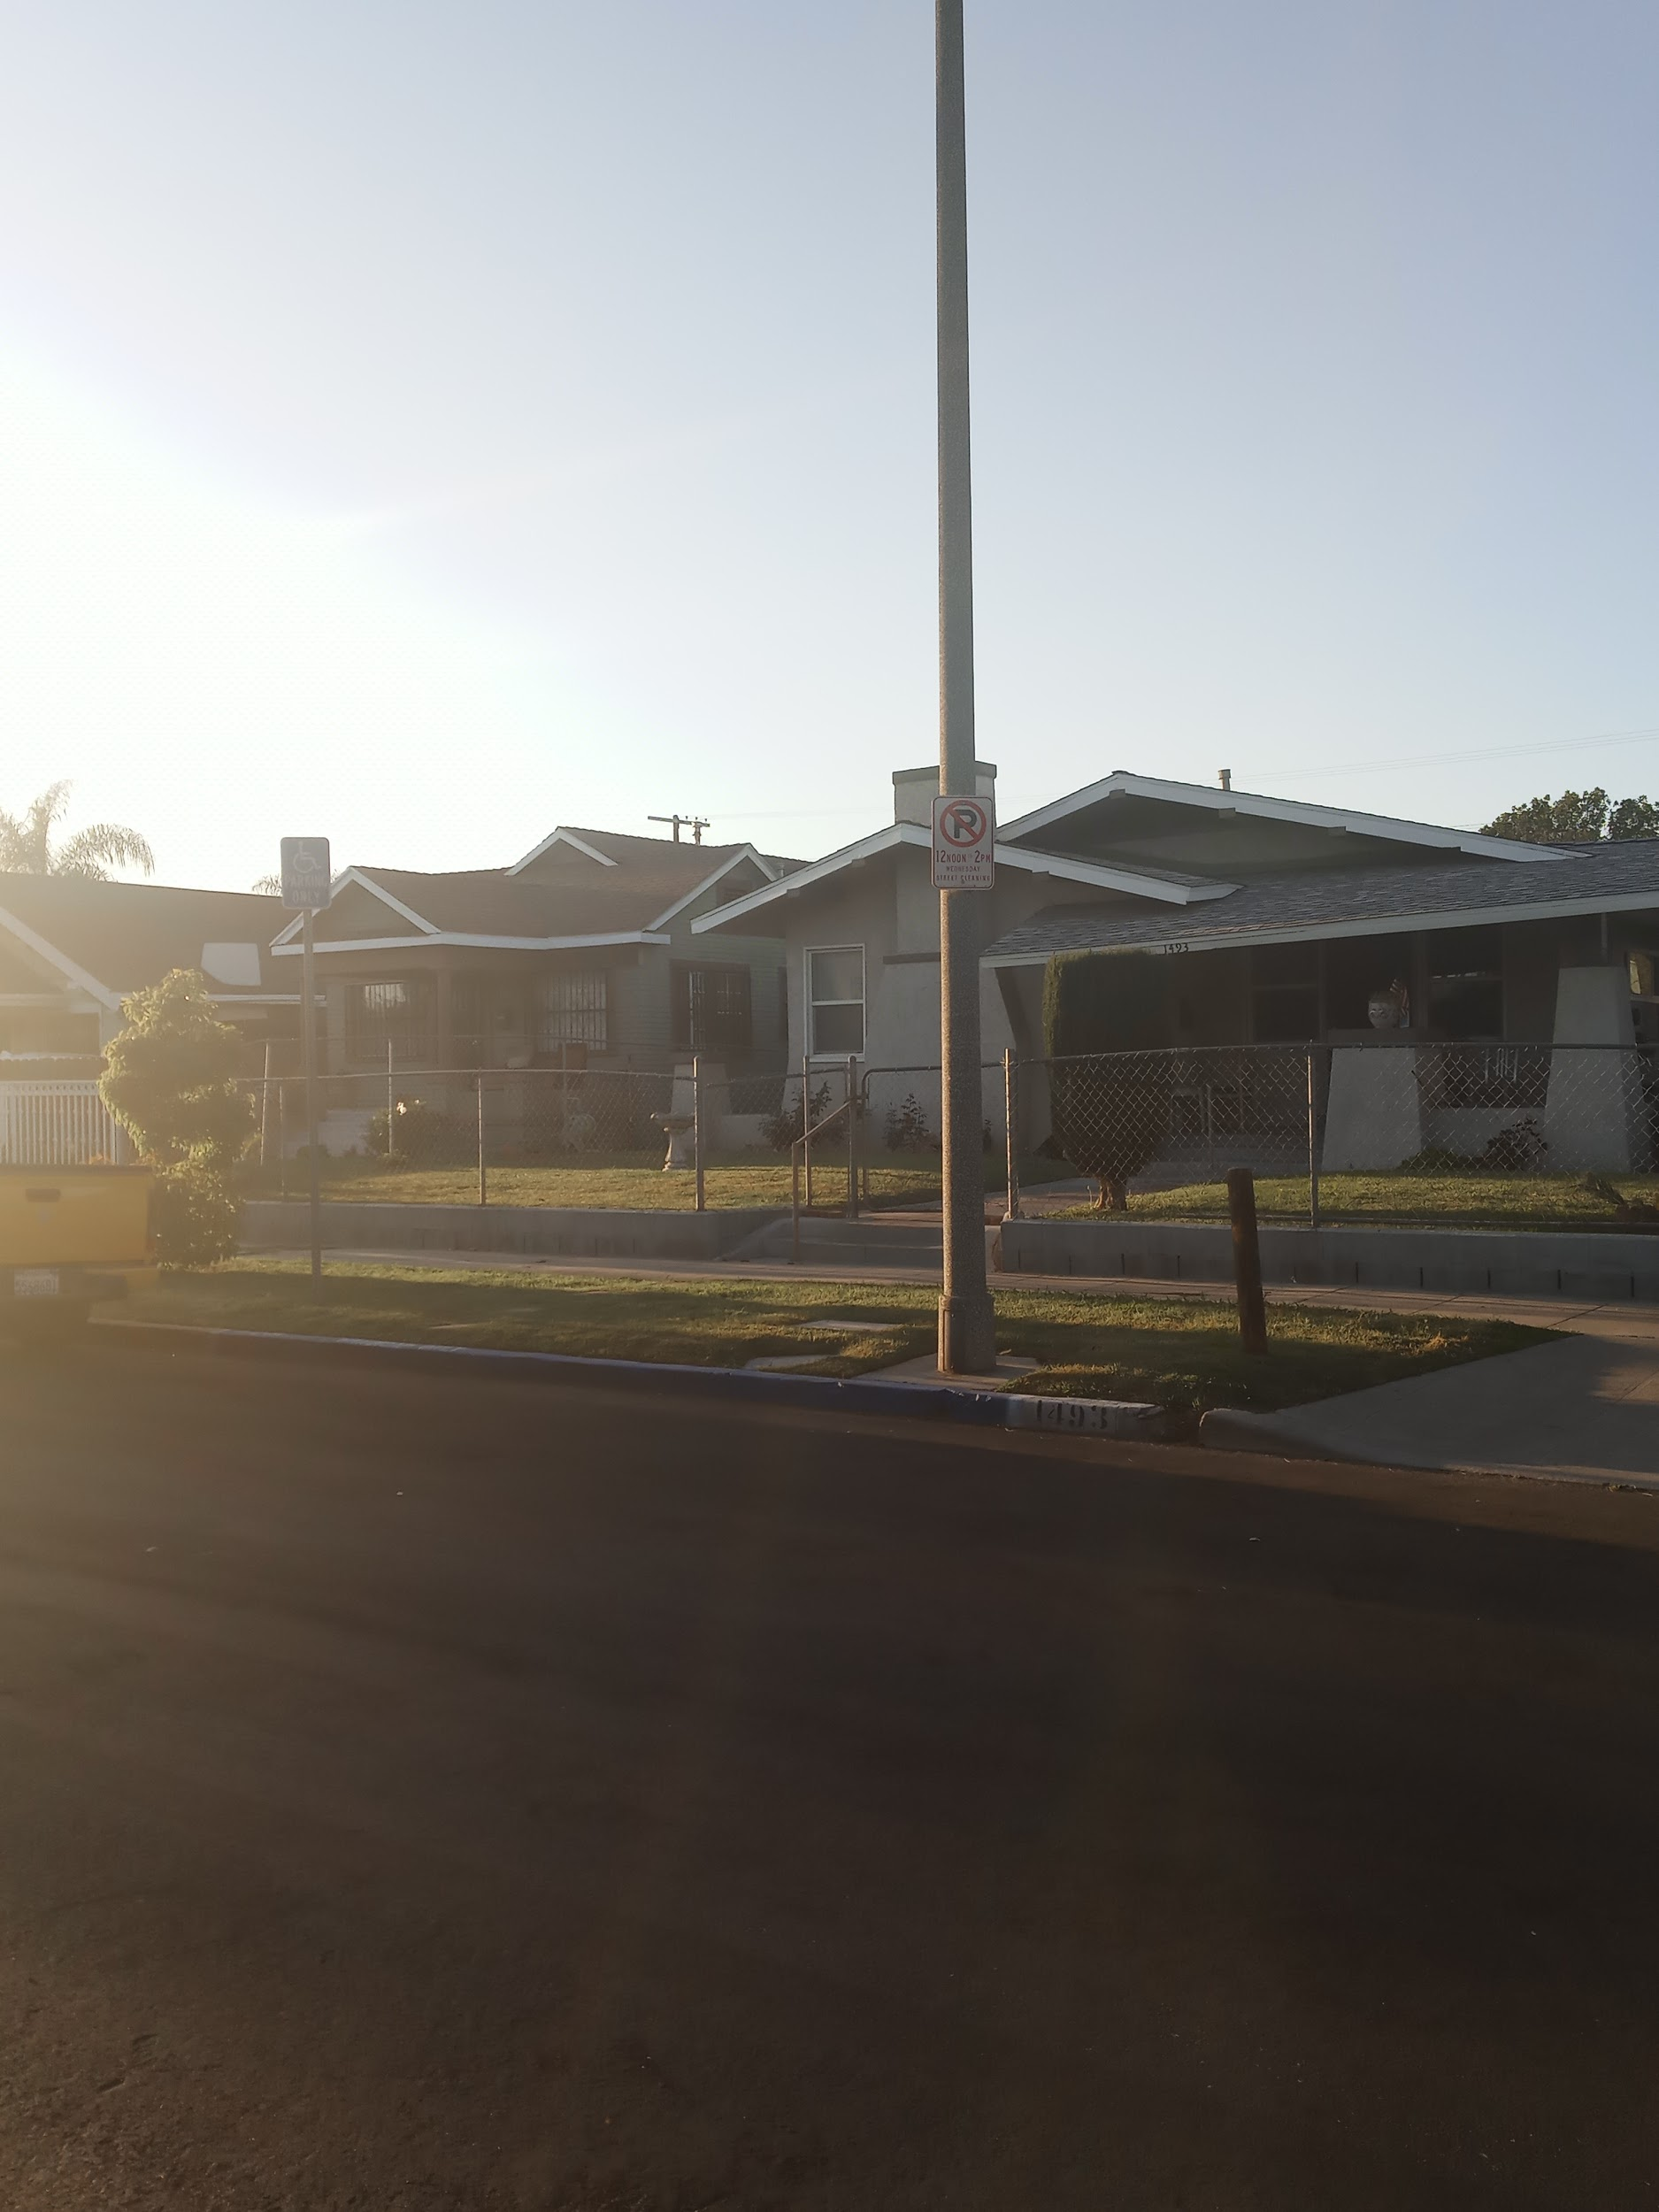

Slide 3
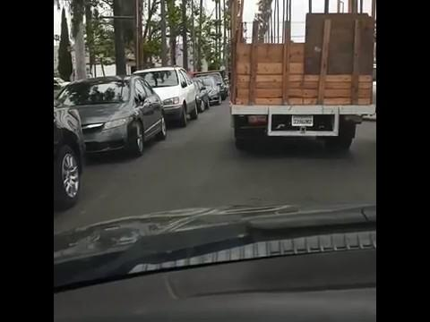
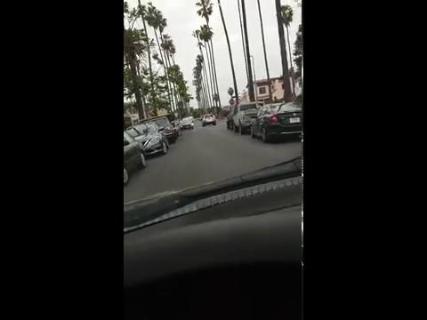

Slide 4
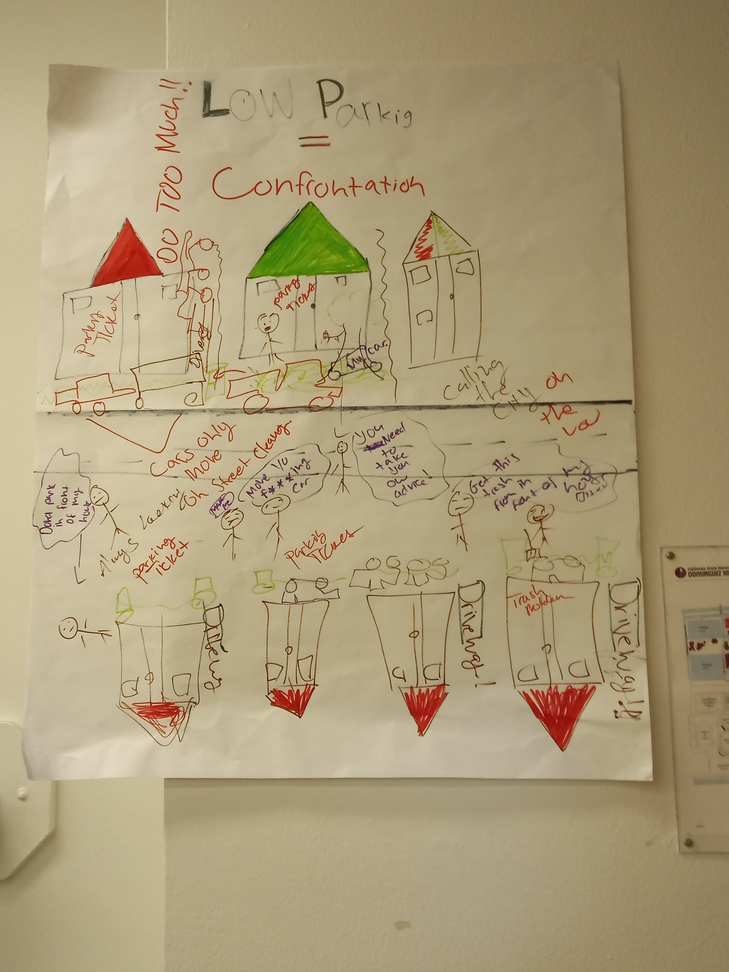
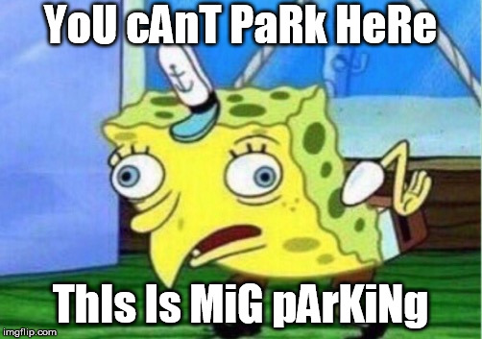
STOP BEING IGNORANT!!
HOW TO SOLVE THIS PROBLEM?

Slide 5
Dear People On The Block
Preview attachment dear pp2.m4a
dear pp2.m4a
791 KB

