Slide 1
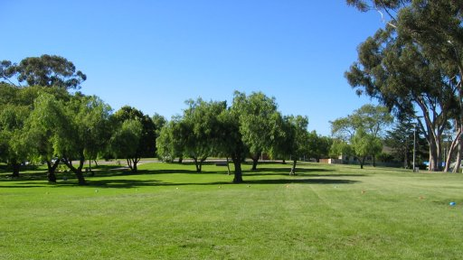
Parks Located In Different Socioeconomic Cities
Carlos Garcia
English 350
May 6, 2019

Slide 2
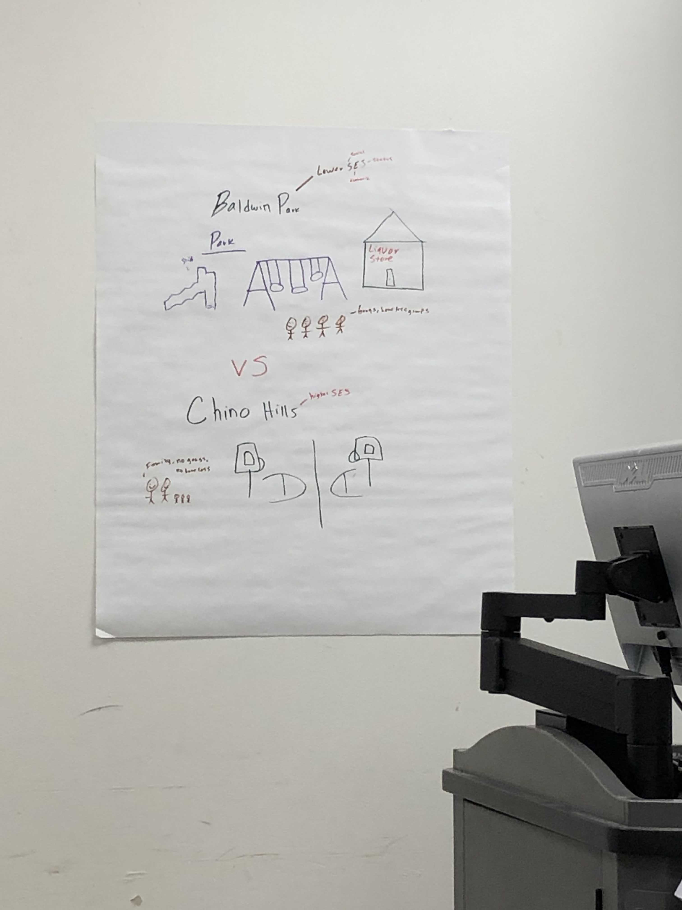
Poster

Slide 3
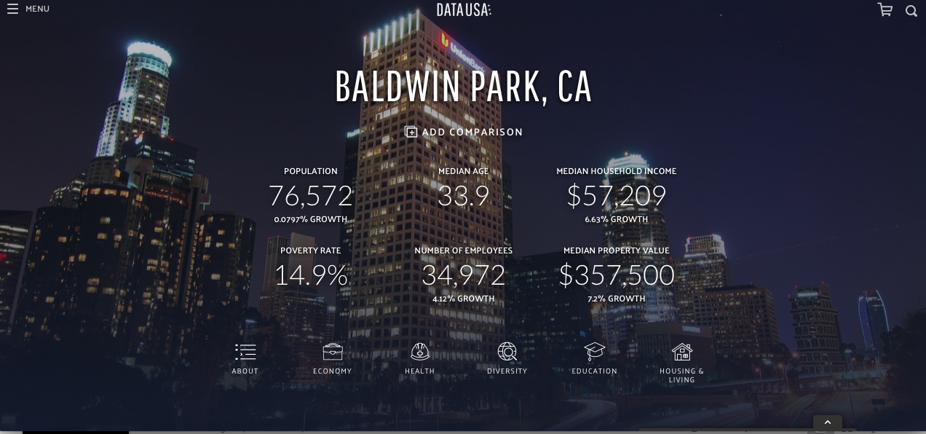
Baldwin Park

Slide 4

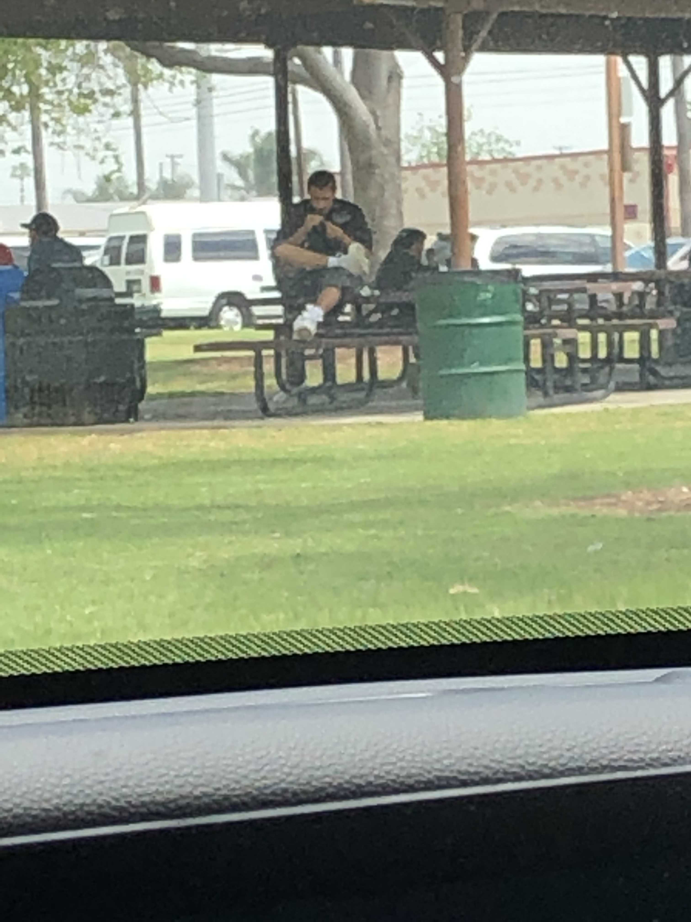
Deviance- Smoking at The Park

Slide 5
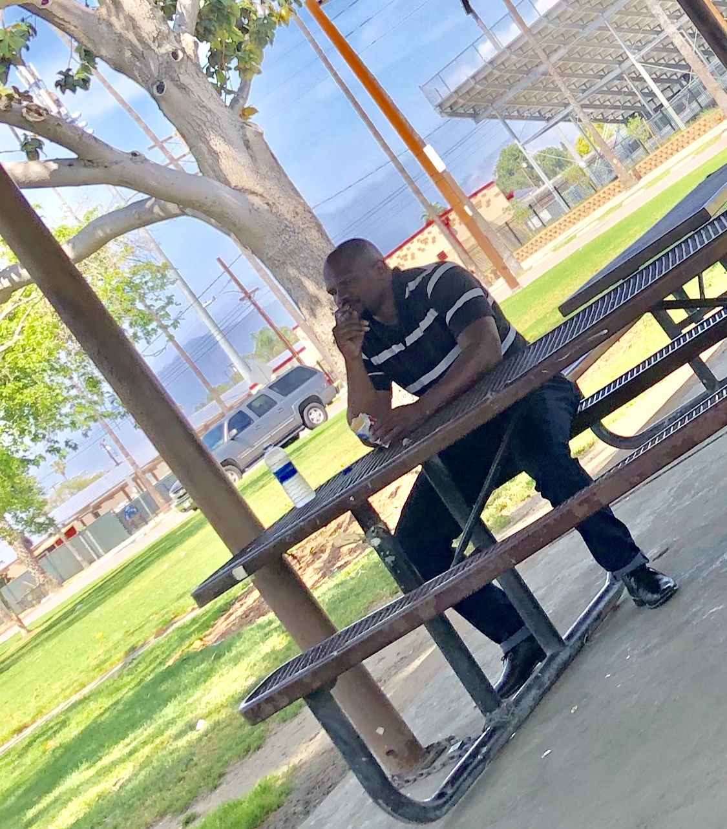
Deviance- Smoking at The Park

Slide 6
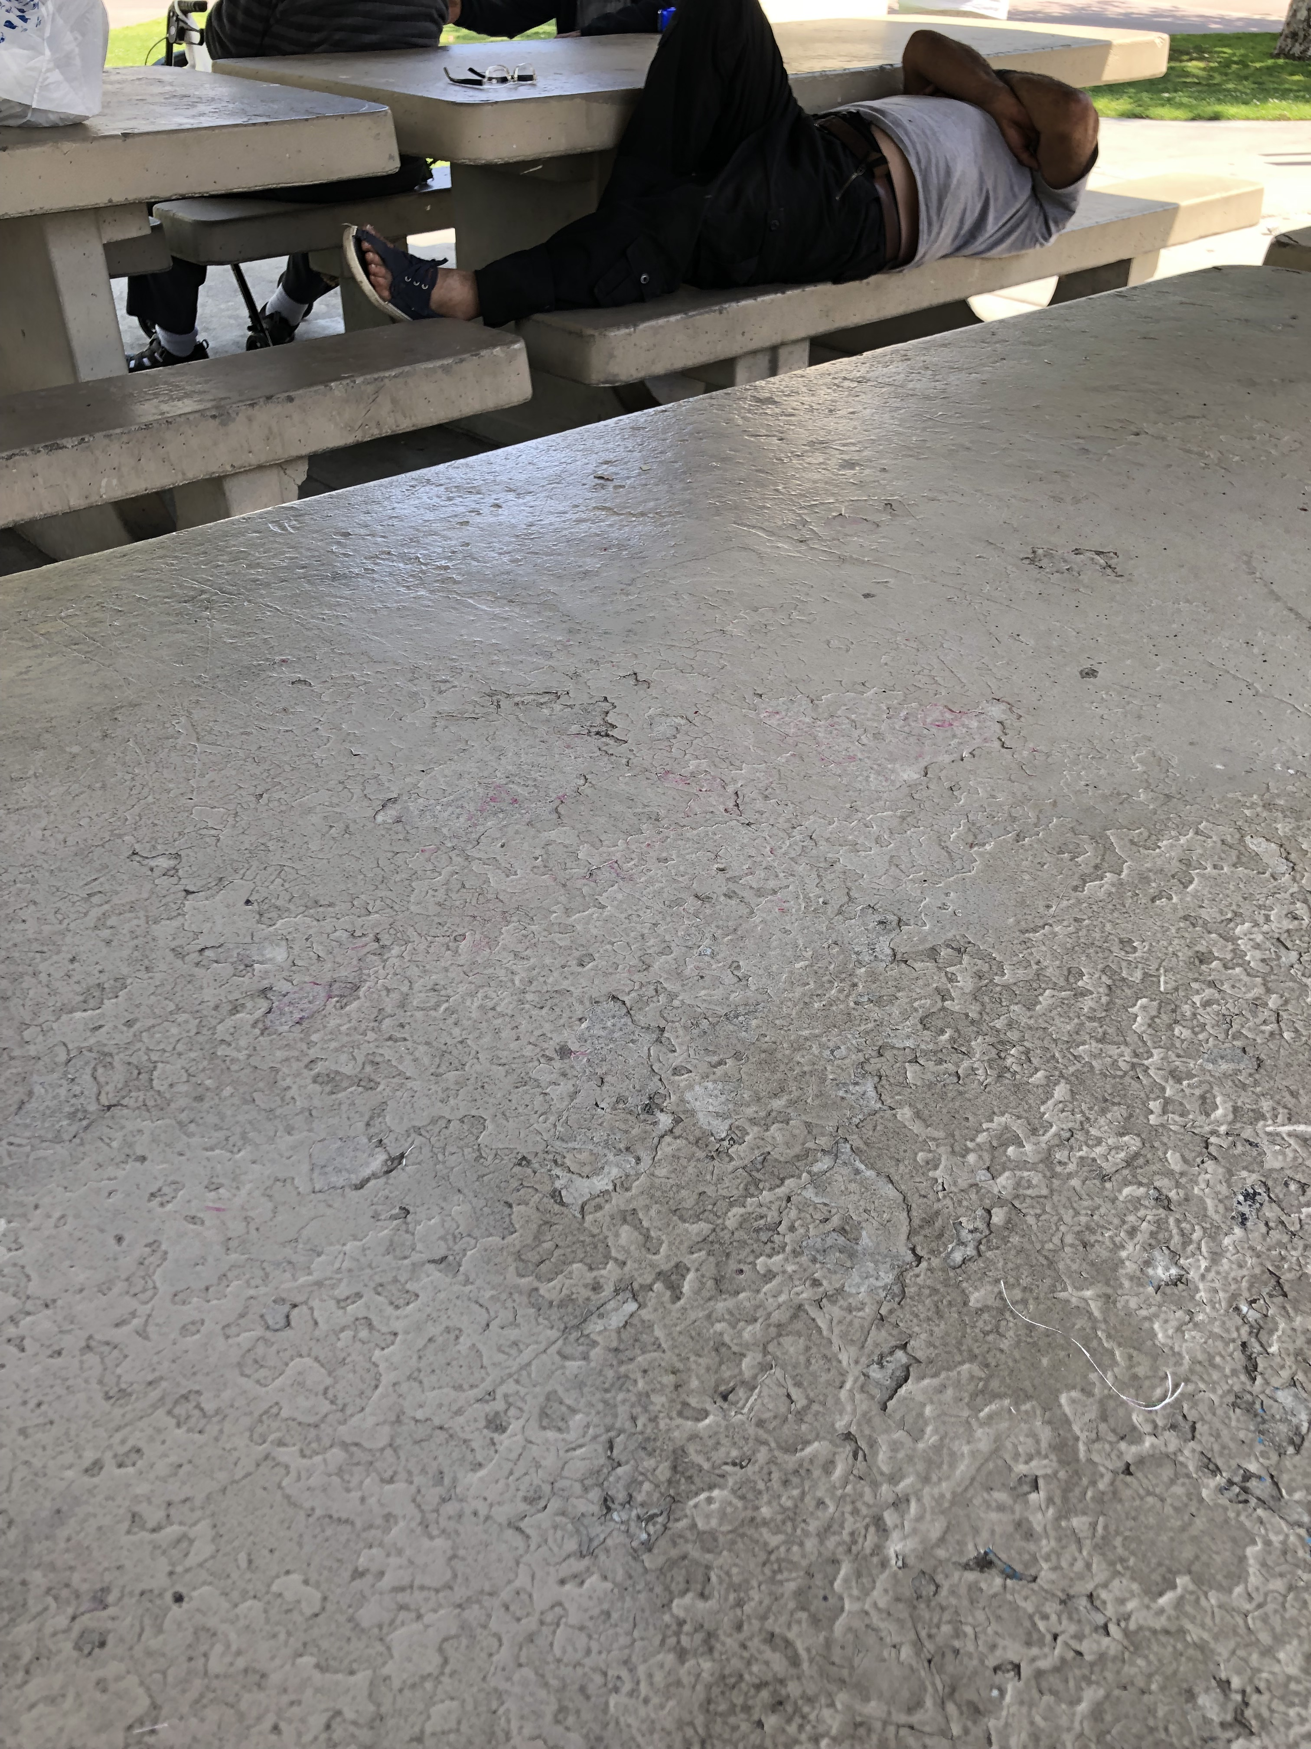
Homeless

Slide 7
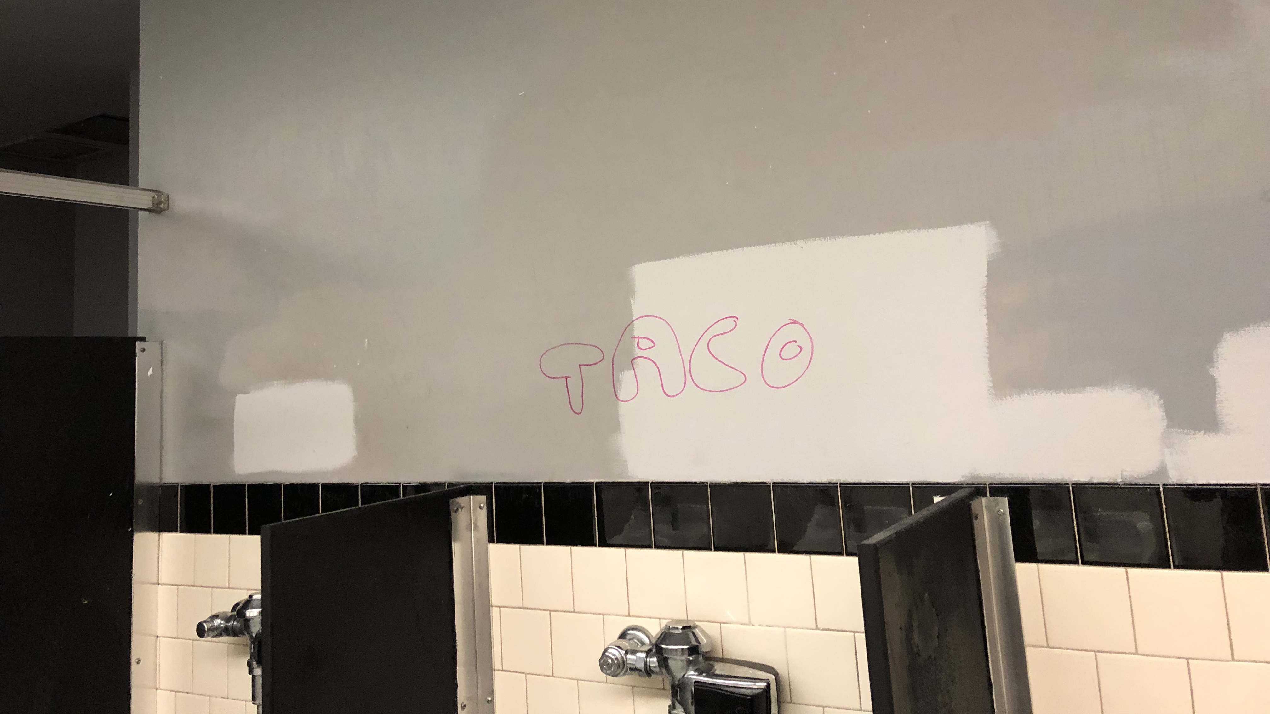
Graffiti

Slide 8
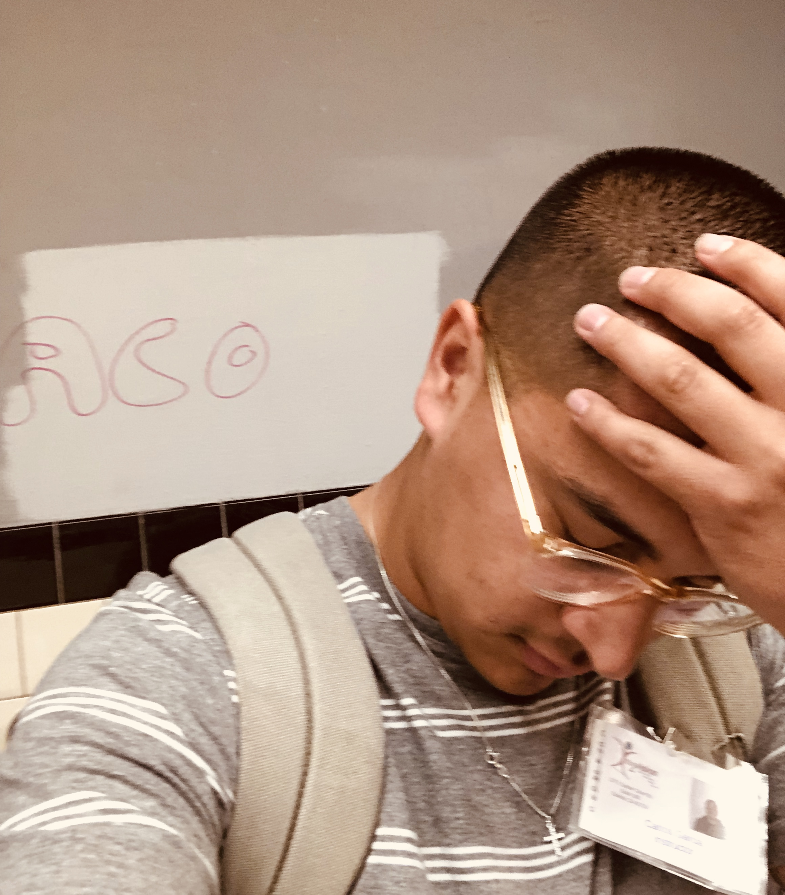
Graffiti

Slide 9
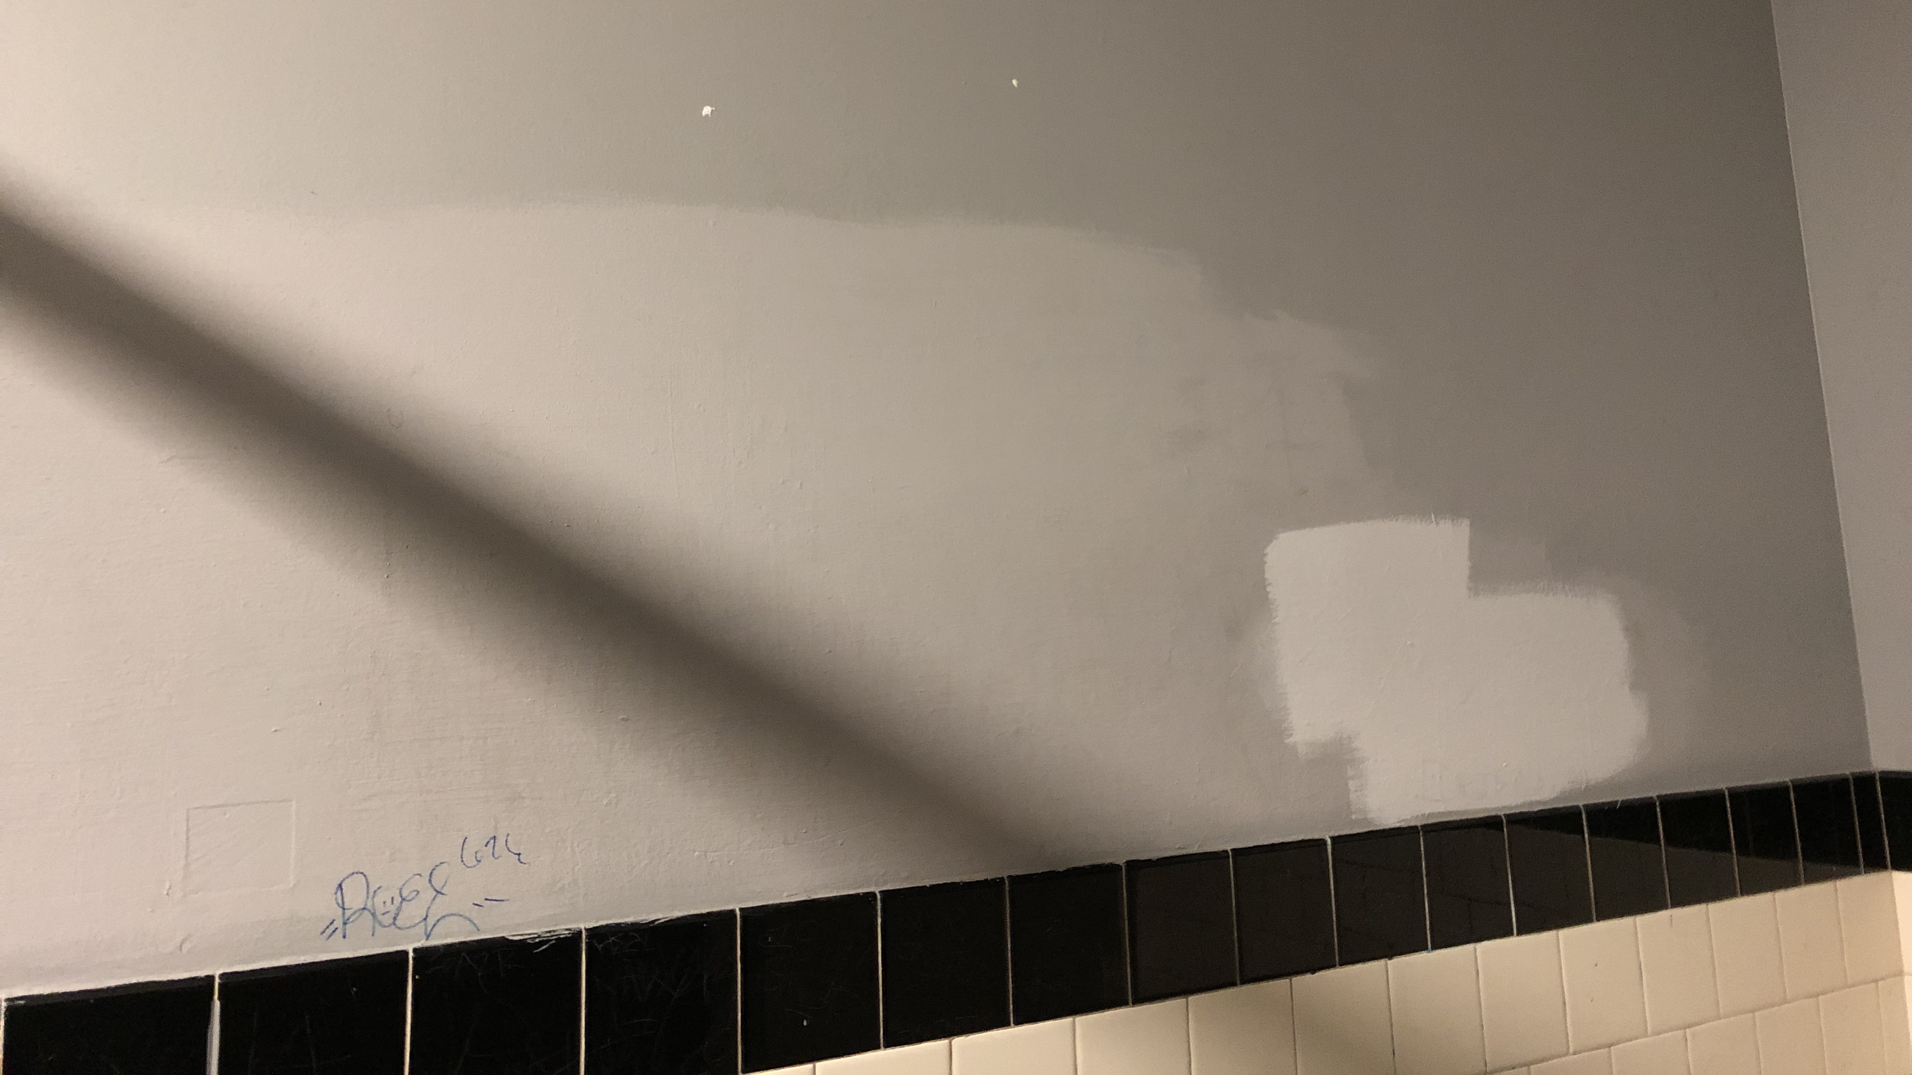
Graffiti Cover Ups

Slide 10
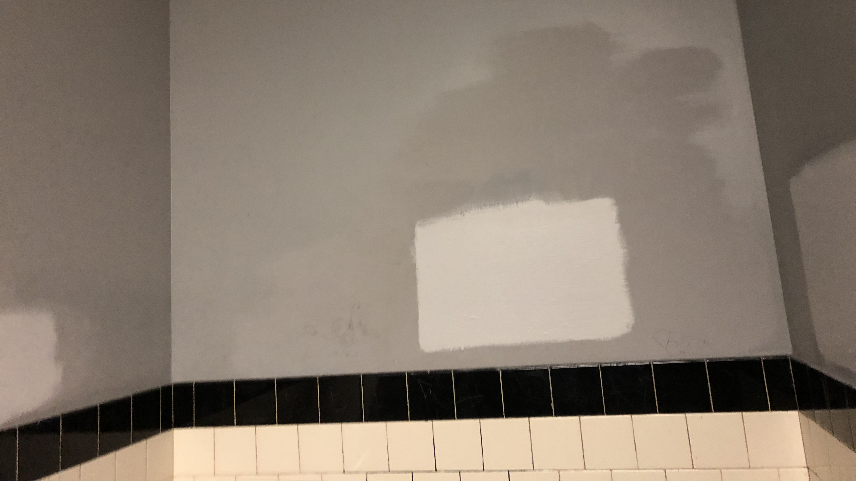
Graffiti Cover Ups

Slide 11
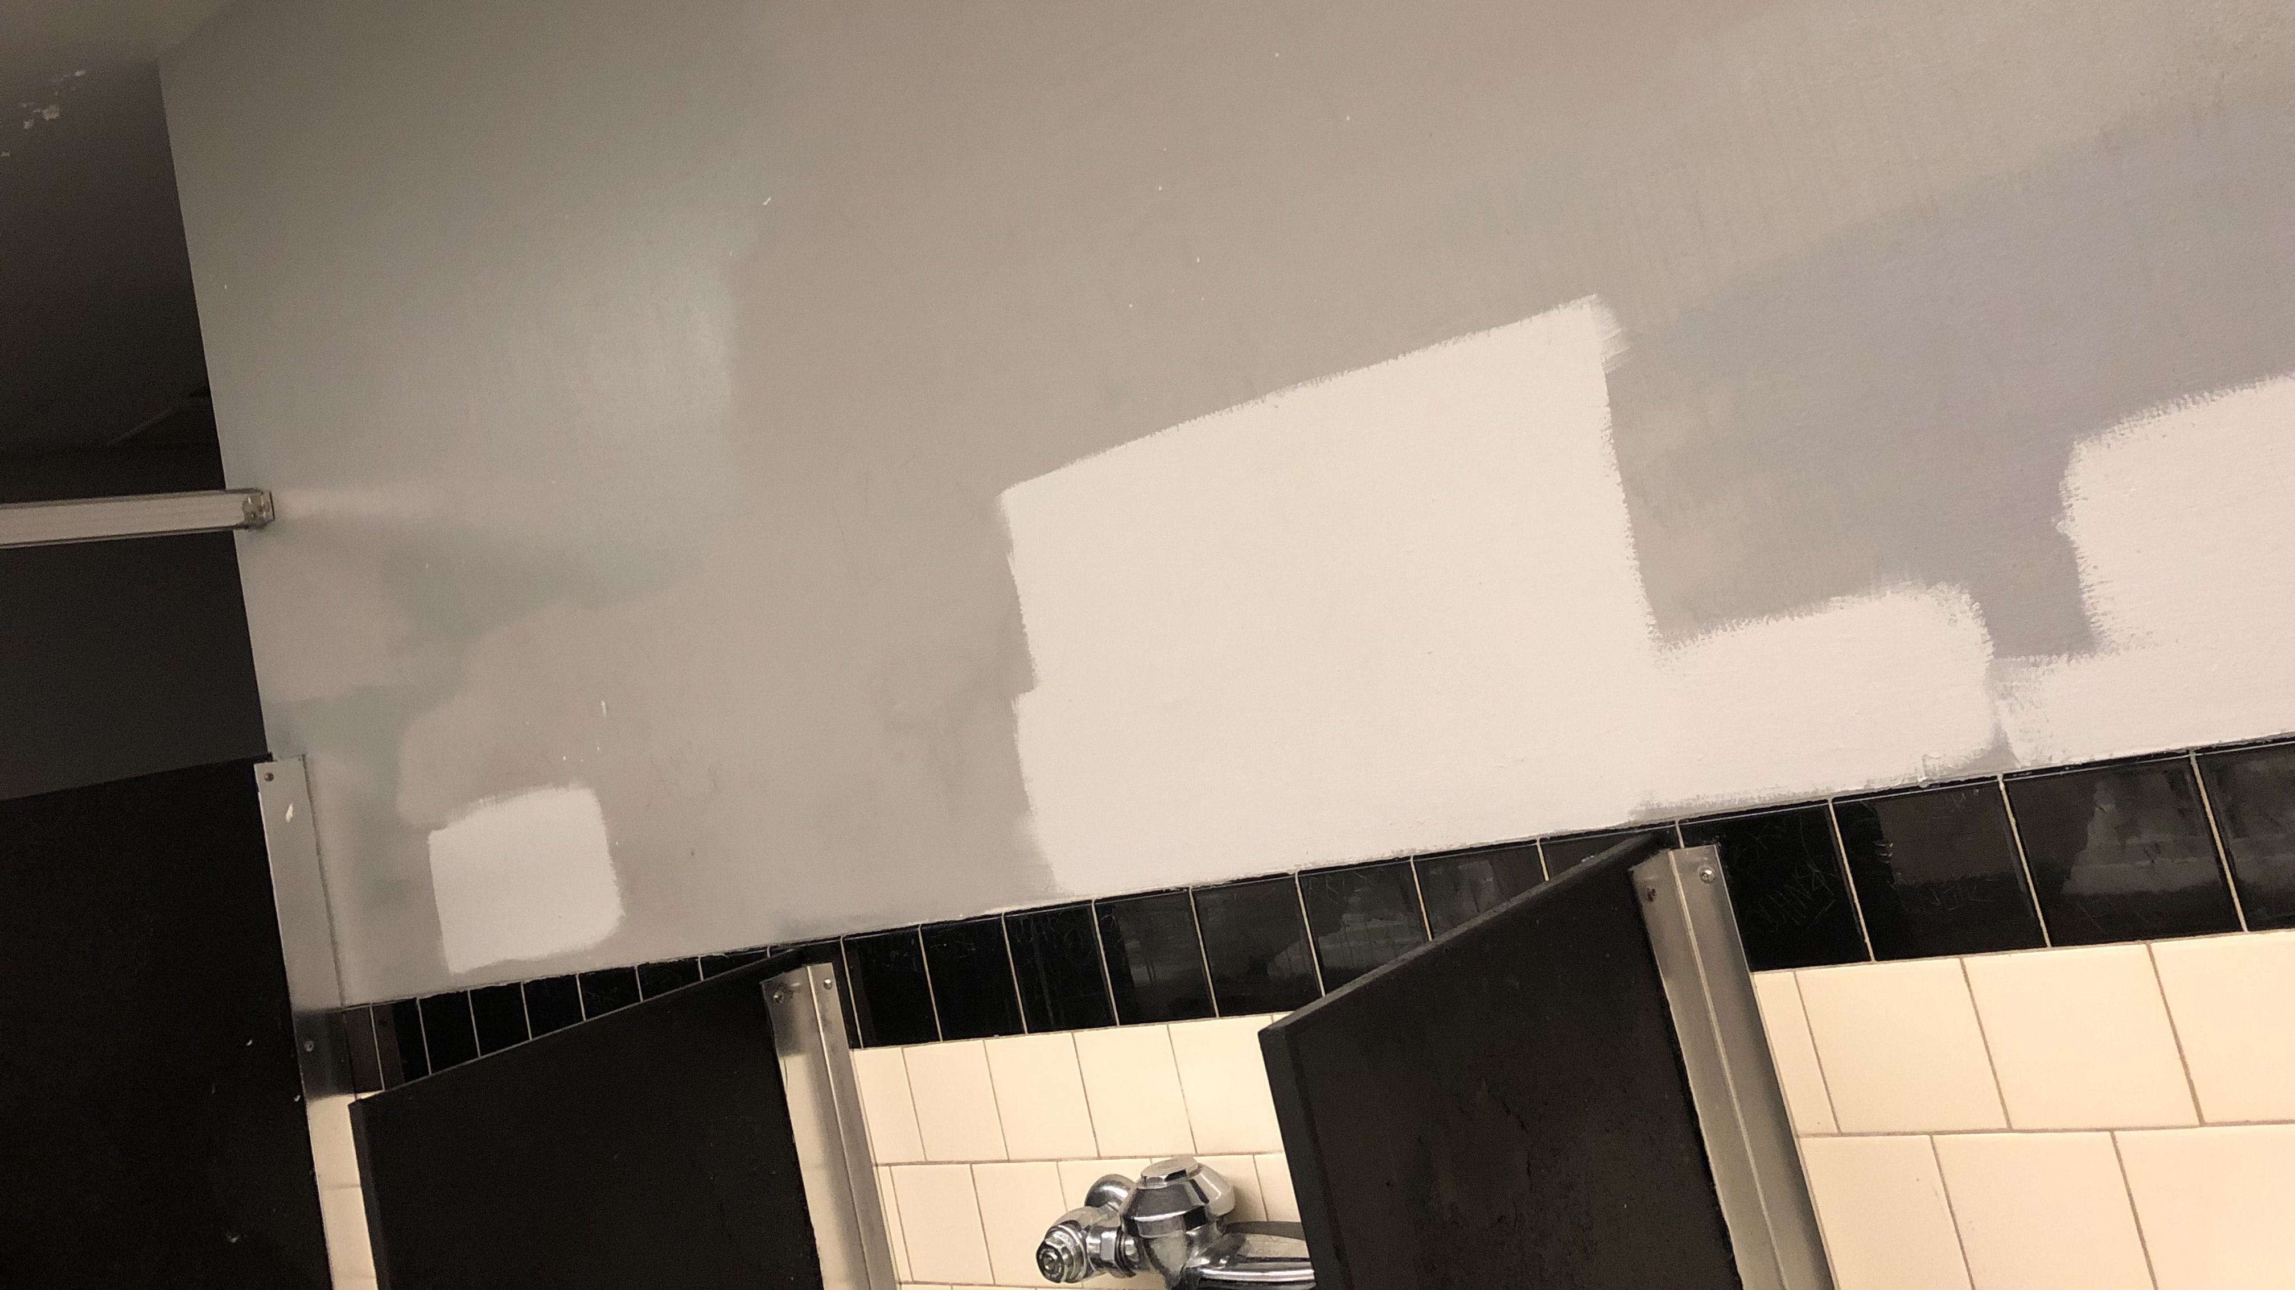
Graffiti Cover Ups

Slide 12
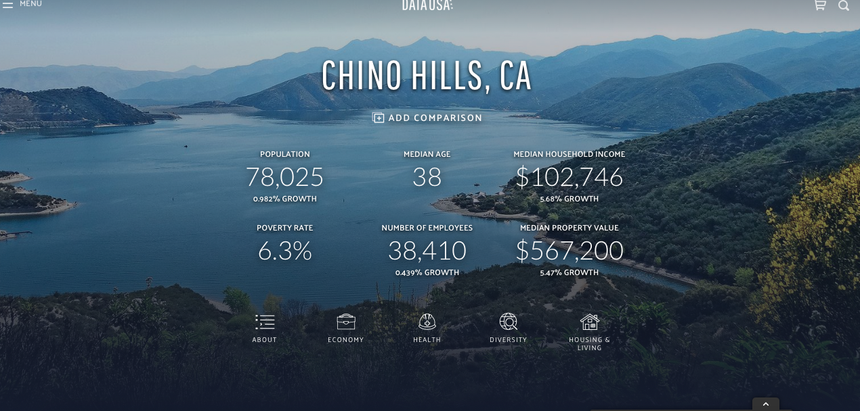

Slide 13
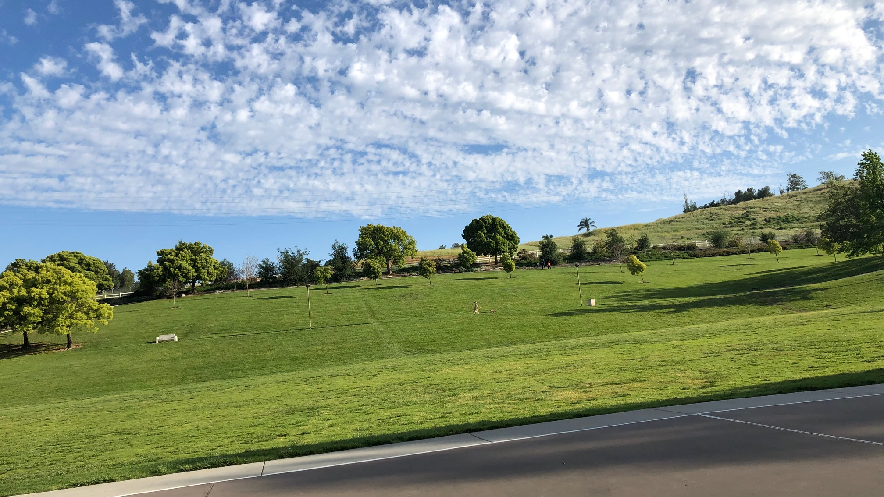
Contrasting Views

Slide 14
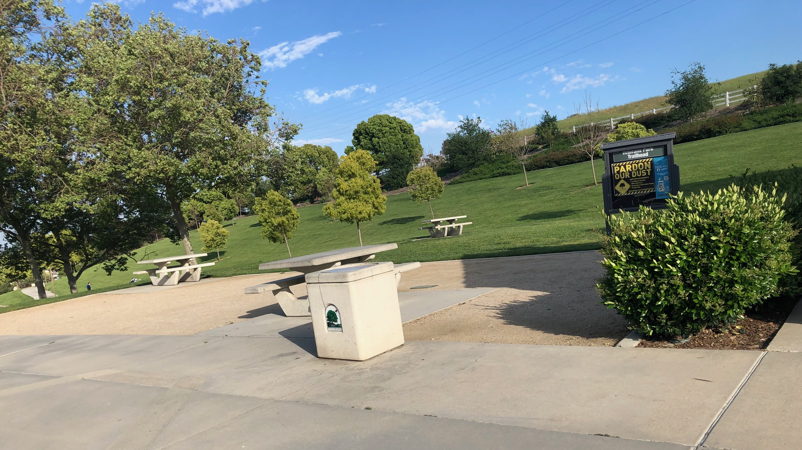
Clean Park

Slide 15
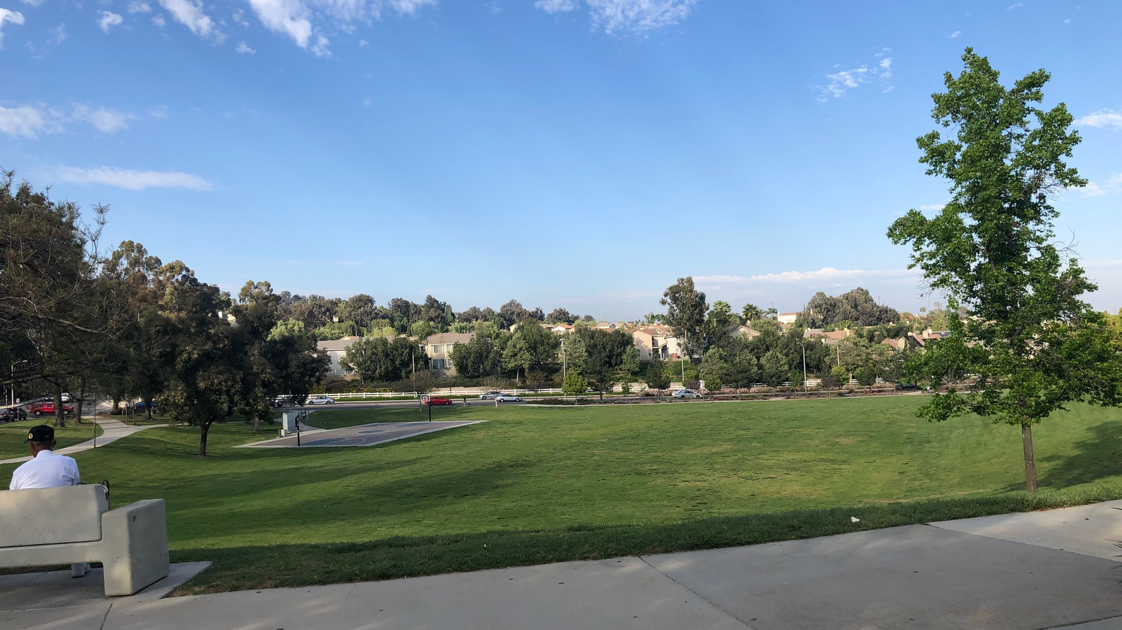
Clean

Slide 16
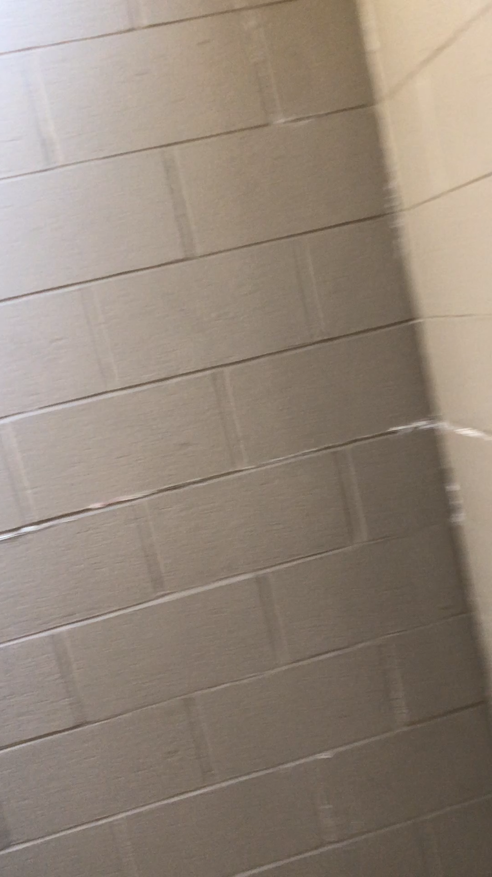
Clean Restroom

Slide 17
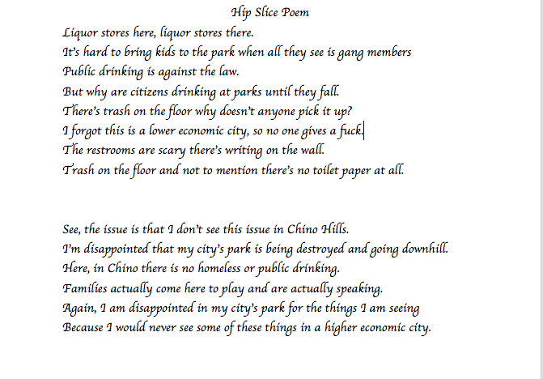
Poem

