Slide 1
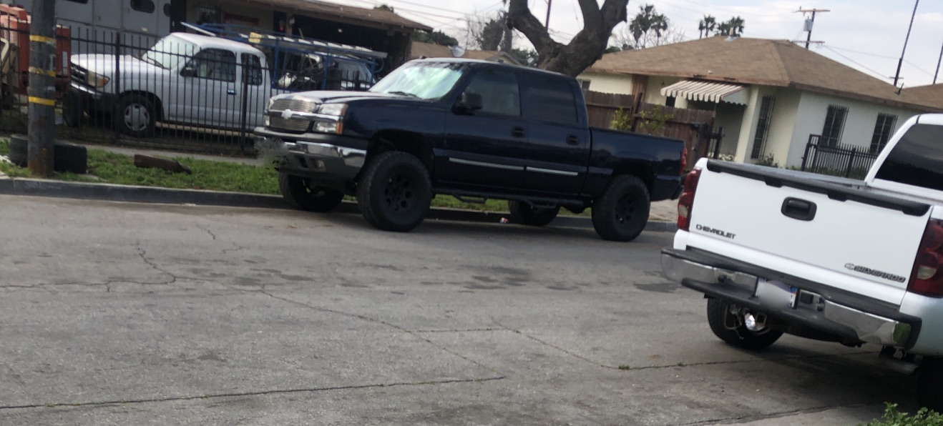
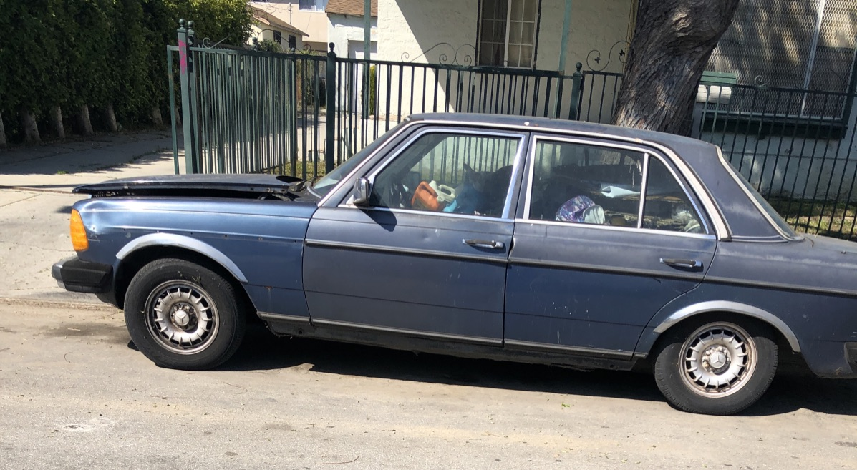
Hogging two parking spaces & Storing Vehicles In a Residential street of South Los Angeles
Leticia Santiago
Eng 350-029
Professor Ramser

Slide 2
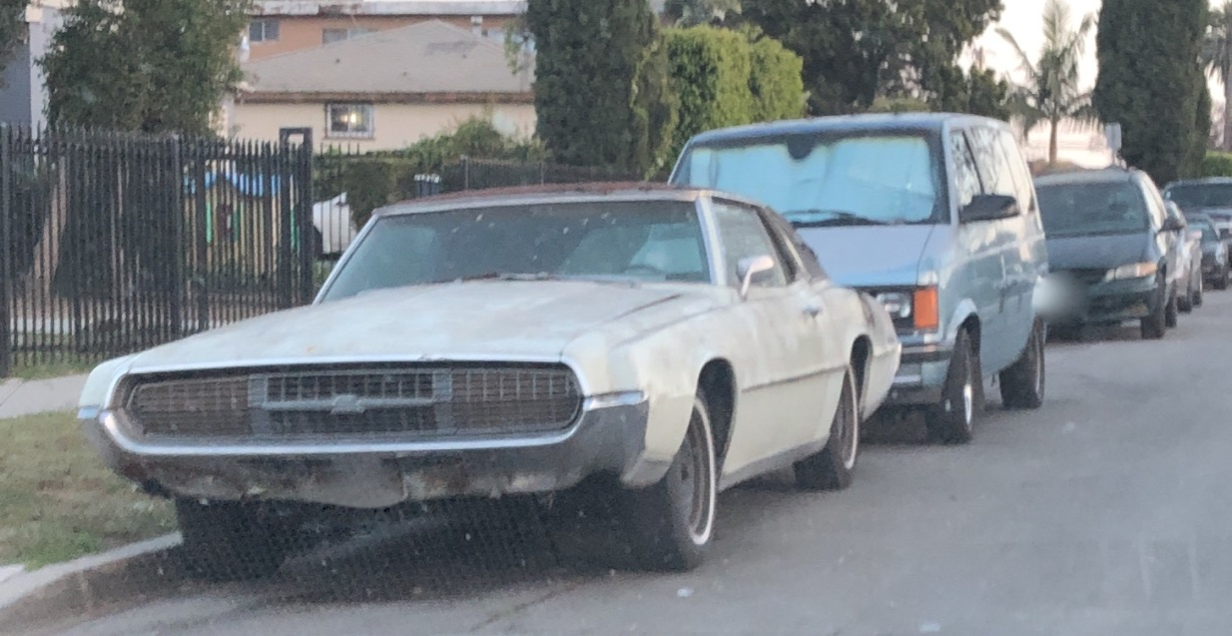
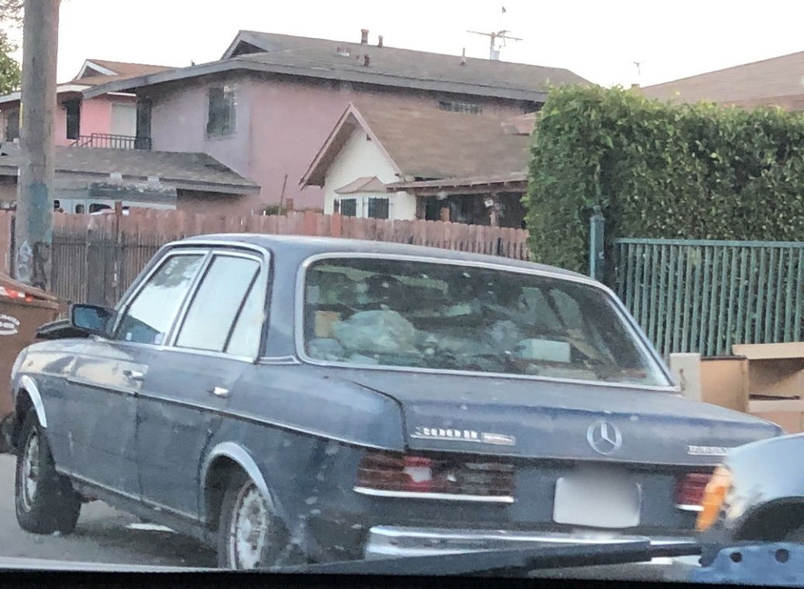
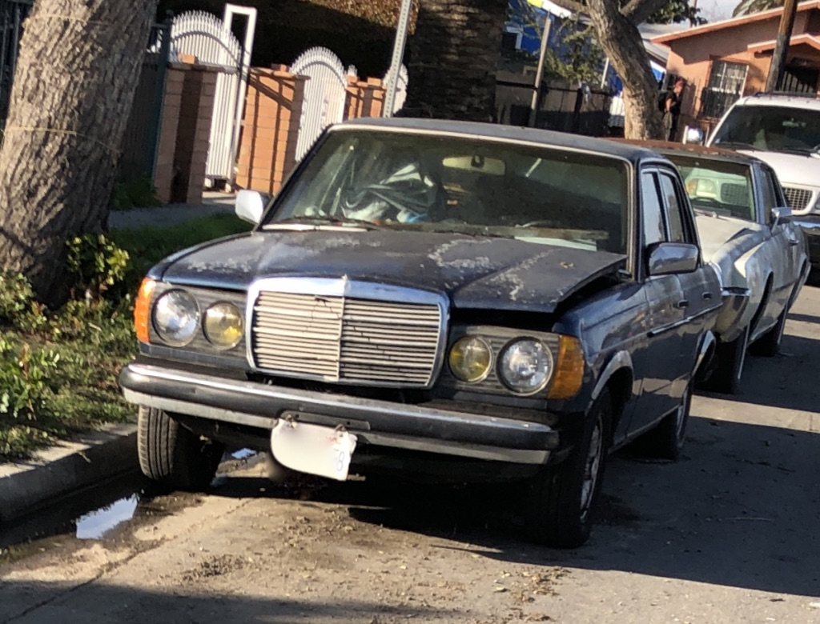
Storing Non-Driveable vehicles

Slide 3
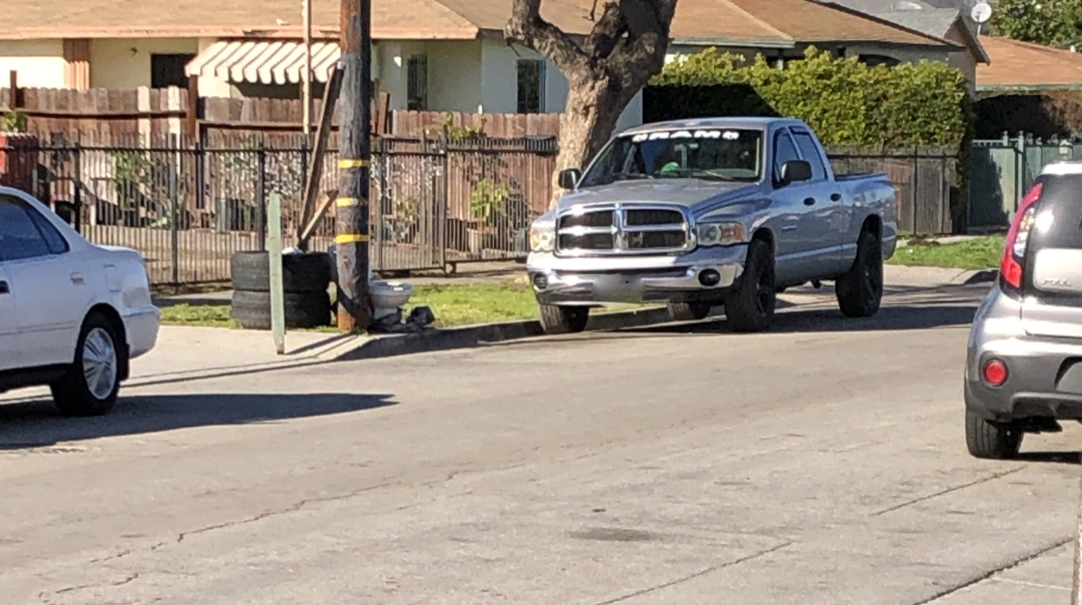
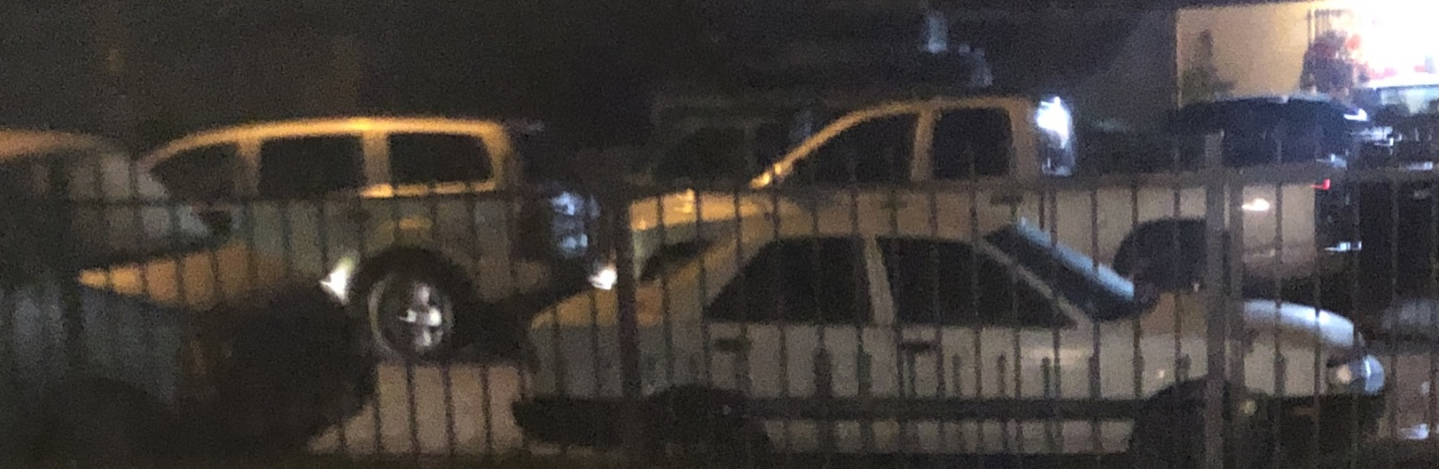
HOGGING TWO PARKING SPACES

Slide 4
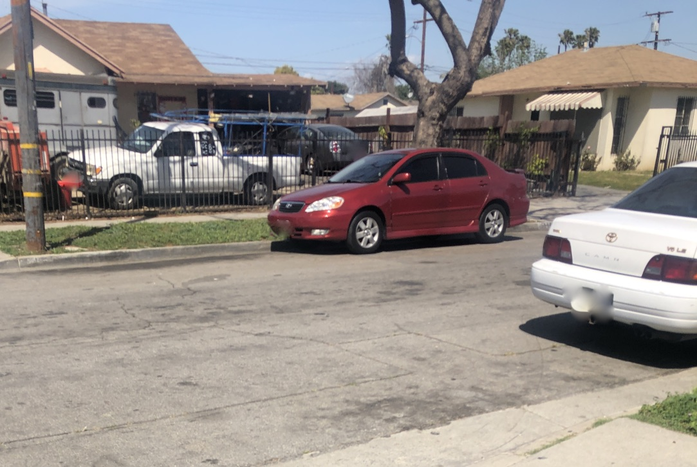
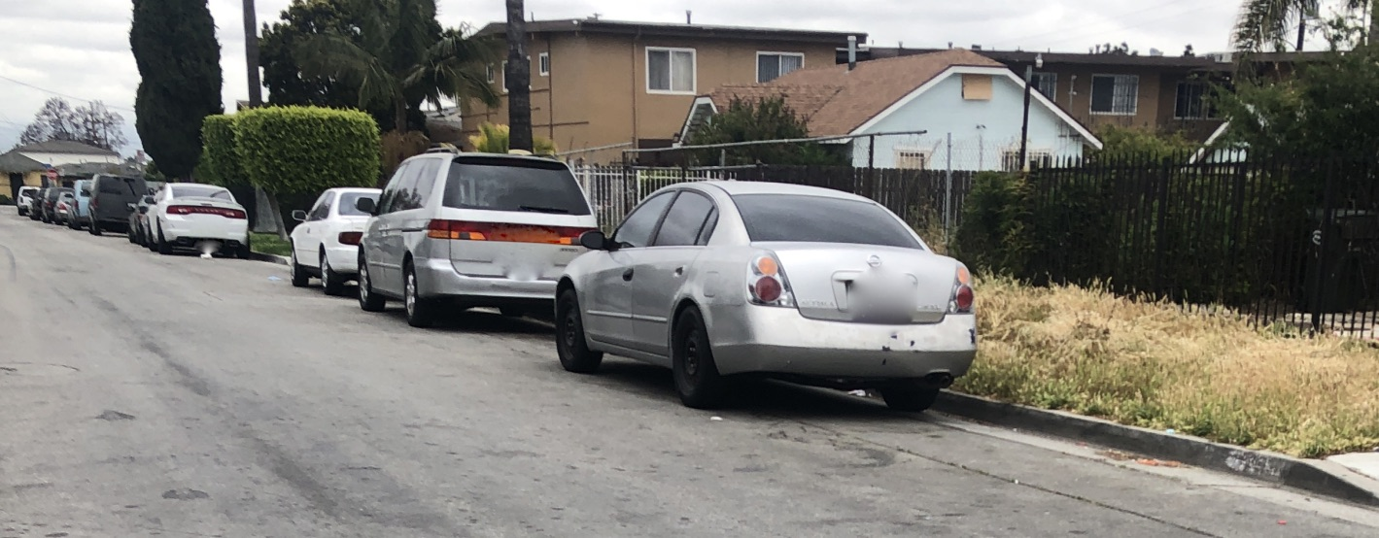
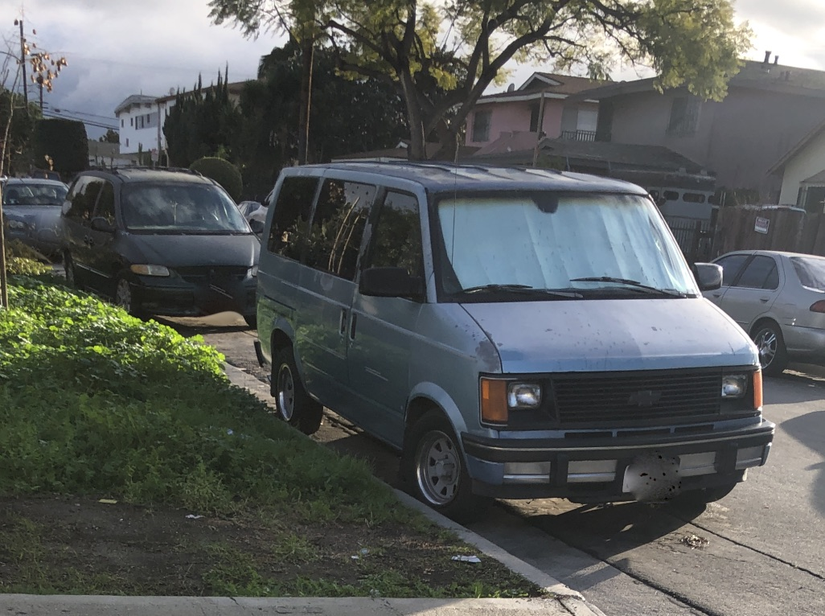
HOGGING TWO PARKING SPACES

Slide 5
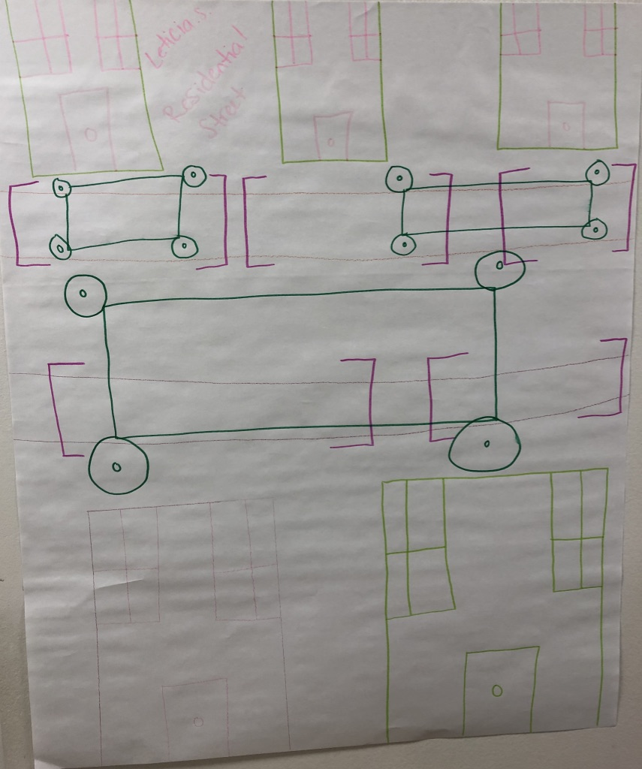
POSTER

Slide 6
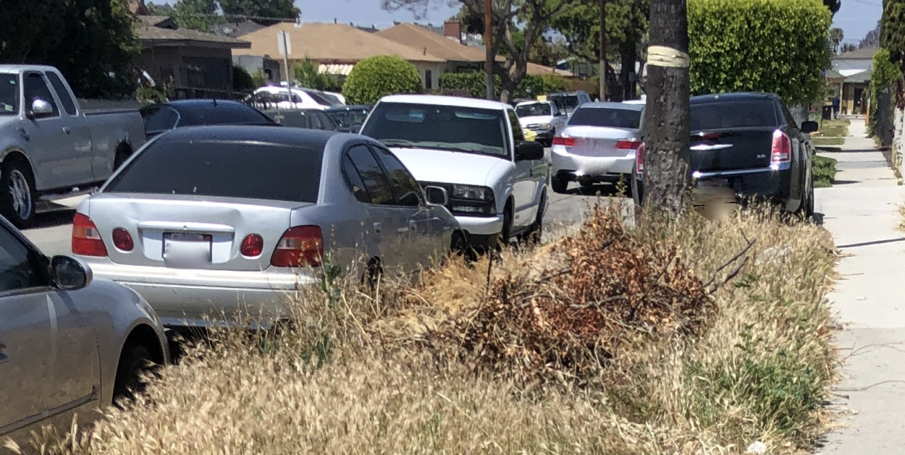
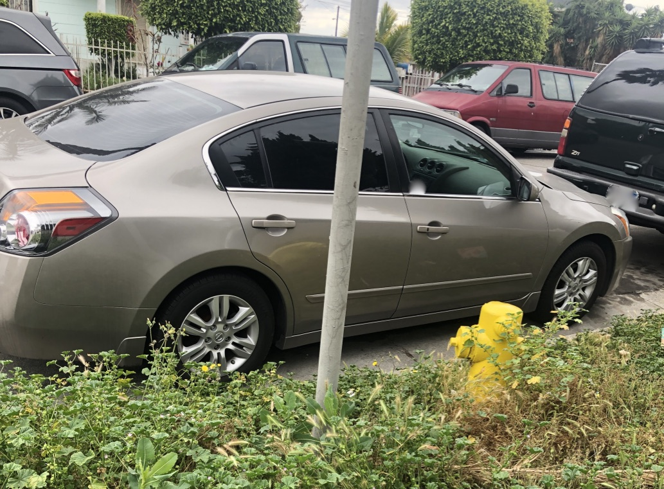
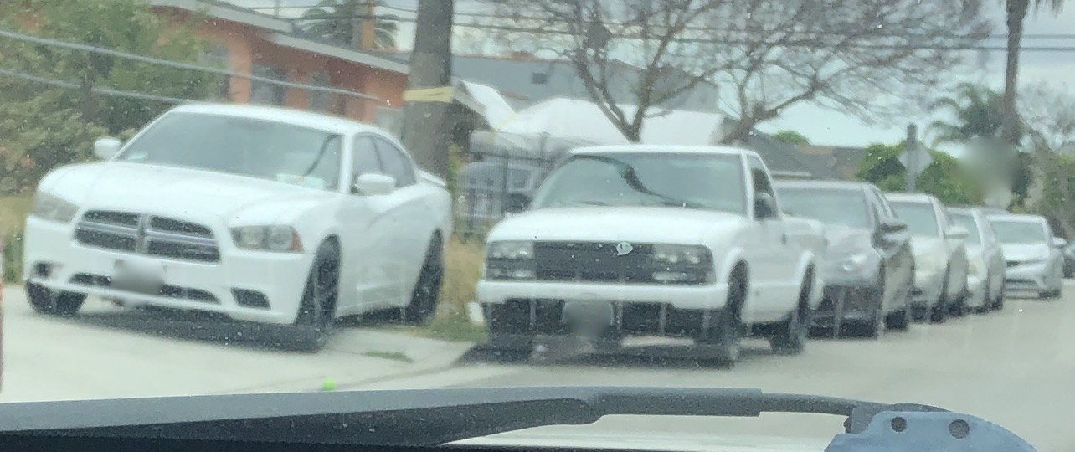
TAKING THE RISK OF
GETTING A PARKING CITATION DUE TO LACK OF PARKING

Slide 7

SPOKEN WORD
Those hogging two parking spaces do not realize the struggles that they may cause to other people.
Those who store their vehicles and will not move them until the day before street sweeping may not have empathy for others.
If you ask me?
I will let you know about the struggles that I encounter every time after 3 pm.
I am the one who experiences driving in circles to find parking.
I am the one who kills time in trying to find parking.
I am the one who experiences blocking traffic while waiting for my daughter to get inside my car because the road is too narrow.
I am the one who has experienced getting cursed at because of waiting in front of a driveway to prevent myself from blocking the road.
And I am the one who calls my mother 5 minutes before arriving, so she can be outside with my daughter when I arrive.
While you, have no struggles.

