Slide 1
Potholes, unsafe neighborhoods, and homelessness
Jaylan Toney
ENG 350-07

Slide 3
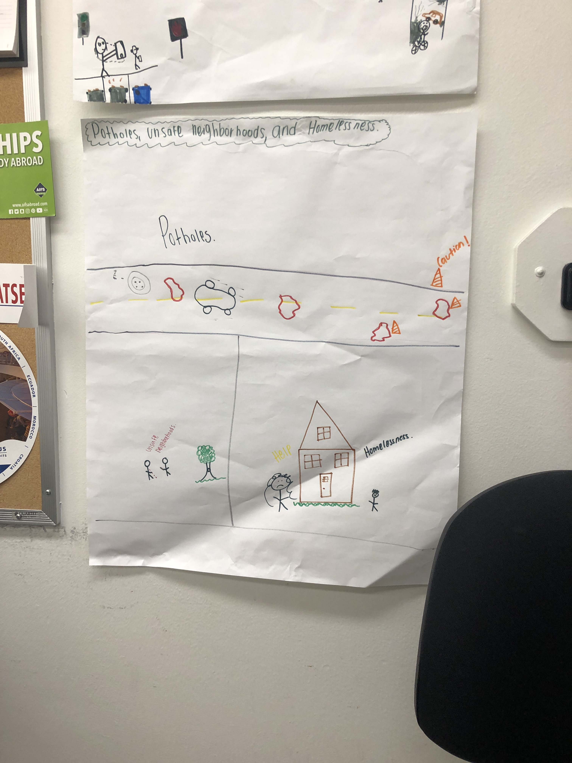
Hip-Slice
Fix it

Slide 6

Spoken word
The deep holes in the ground, Create a muddle for the driver, The drivers day becomes ruined, Due to the hole in the ground, Let us fix the holes in the ground, Please let us fix the holes in the ground, Let us fix the poor living on the streets, The same grounds the holes live on, Except those poor people are angry at the world, We must fix the world we live on filled with blood, The blood that sheds on the grounds the holes and poor lives on, The violence must stop, let the violence stop, We need to create peace for the drivers, the poor, and violent creatures. Let us stand together to overcome the battle!

