Slide 1
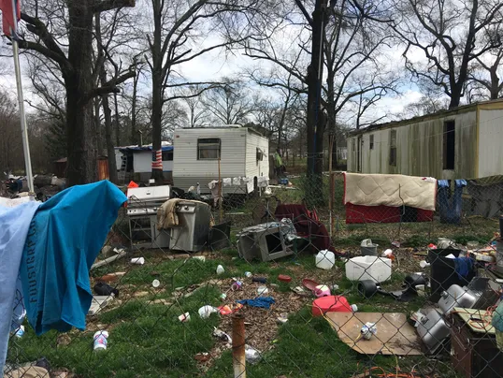
RVS PARKED IN LOS ANGELES STREETS
YOLANDA RENDON
RVs PARK IN OUR COMMUNTIES
ENGLISH 350
APRIL 4, 2019

Slide 2
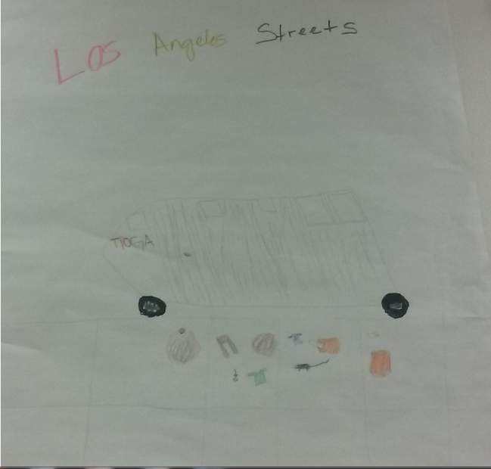
POSTER MADE IN CLASS

Slide 3
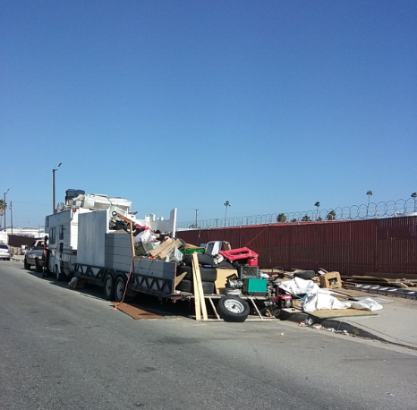
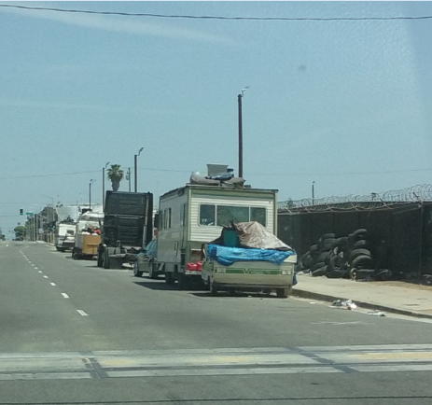
135TH STREET AND BROADWAY

Slide 4
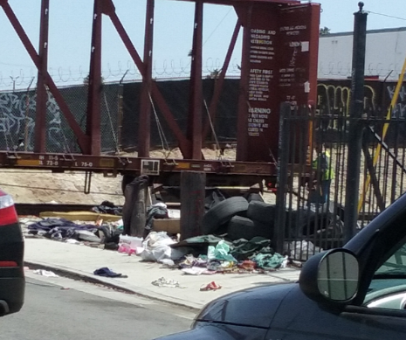
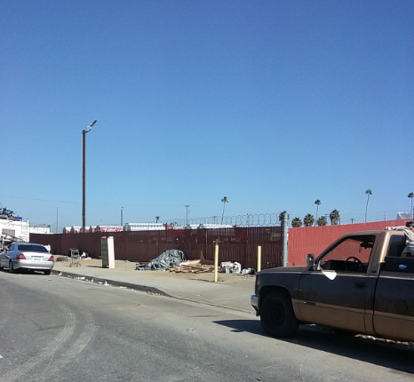
135TH STREET AND MAIN

Slide 5
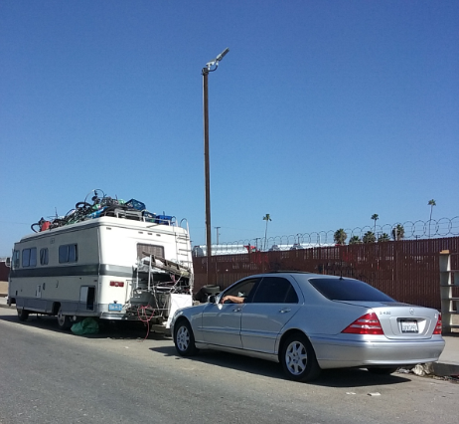
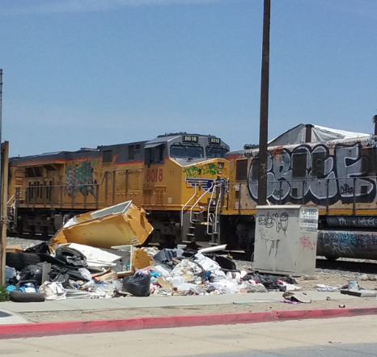
Train TRACKS

Slide 6
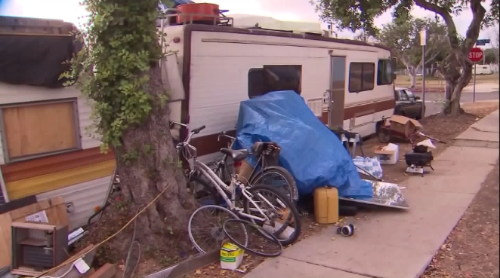

City of los aneles, is it really a city of angels? People living on the streets are they really angels? Are they just fallen angel that need a hand to fix their wings. Sometimes they are messy angels, they throw trash on the streets. It is our job to show them where trash goes, these angels need our helping hand. You might asked me, How? Well, I asked you how? We need to put our heads together and think what is the right solution. Remember we are city of angels….we are their angels

