Slide 1
Homelessness in Norwalk,ca
BY: MEGAN SALCIDO
ENG 350-07

Slide 2
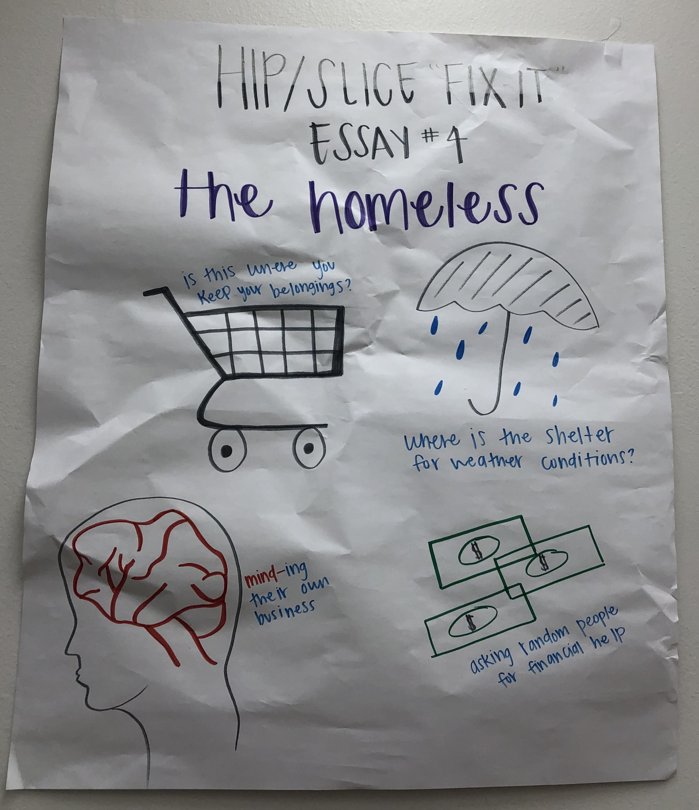
Poster

Slide 3
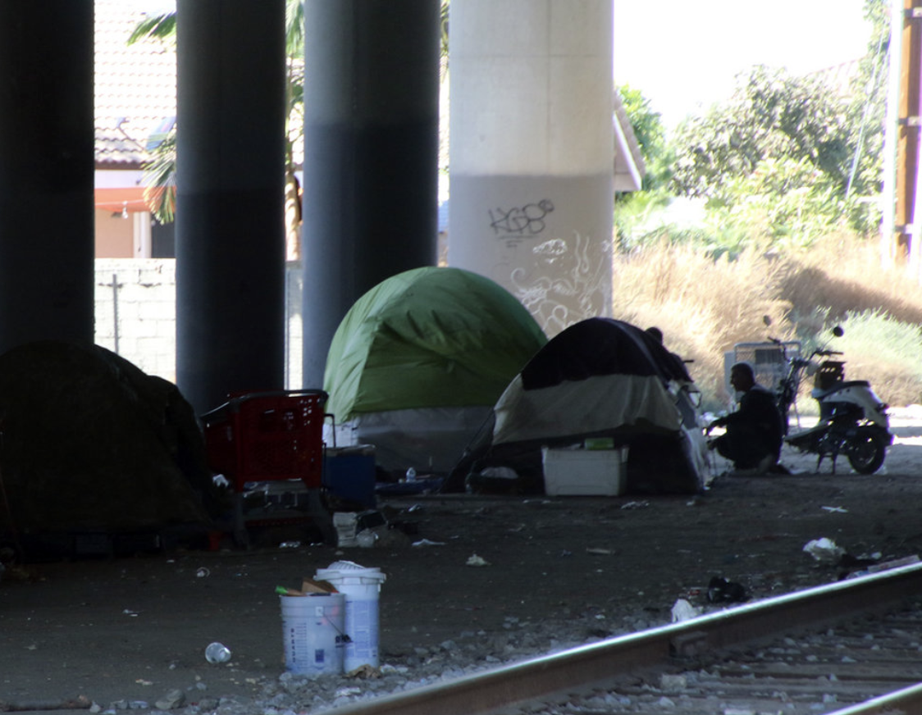
photograph

Slide 4
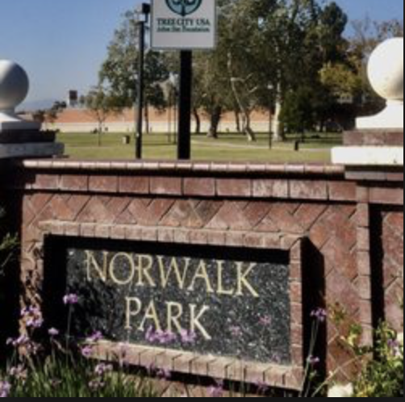
Photograph

Slide 5

Spoken word
Walking down the street
You see people that you never thought you’d see
The ones who have no place to go to
The ones who have no home to go to
They carry all their belongings with them as they travel from place to place
But where do they go to sleep at night?
They find a place that looks inviting
A place that they can call home for the night
But what happens when it rains?
They search for a place to keep themselves and their belongings dry
But who can they go to when they are in need?
People refuse to help as they hold up their signs crying for help
But why do people seem scared as they walk by?
He is only minding his own business
At the end of the night
Where do they call home?

