Slide 1
High Impact Practices (HIP) Service Learning Internship Community Engagement (SLICE) with Spoken Word “fix-It” Presentation
Jessica Real
New Inglewood Stadium
English 350
9 May 2019

Slide 2
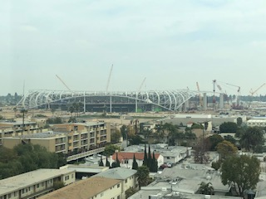
Stadium Construction

Slide 3
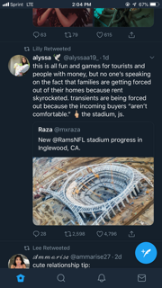
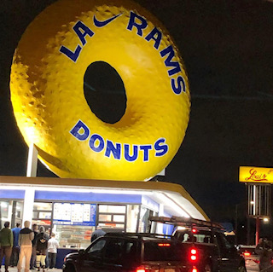
Tweet in regards to the stadium that says: “This is all fun and games for tourists and people with money, but no one’s speaking on the fact that families are getting forced out of their homes because rent skyrocketed. Transients are being forced out because the incoming buyers “aren’t comfortable.” F the stadium, js.”
Local donut shop in Inglewood “Randy’s Donuts” changed their name during the Superbowl to gain some publicity and bring more attraction to Inglewood’s new stadium.

Slide 4
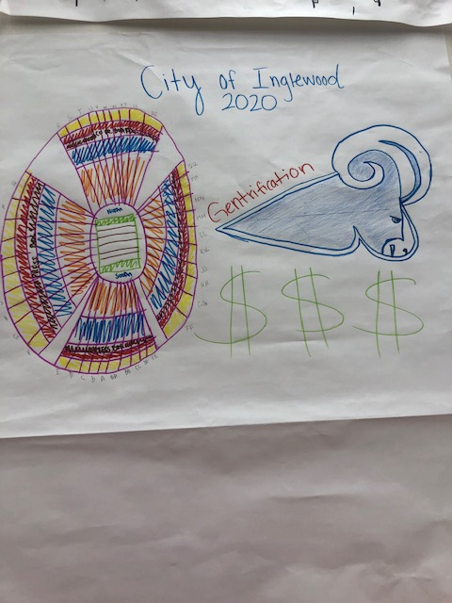

Slide 5

Stadium. Money. Power
Who is being affected?
Low-income minorities,
Blacks, Latinos, Los Niños.
Stadium. Money. Power.
5 billion dollars while people are struggling to pay rent
5 billion dollars that couldn’t fix potholes
5 billion dollars pushing out minorities
History repeating itself
Los Angeles Dodgers stadium pushed minorities out
Welcoming the wealthy to “the ghetto”
Stadium. Money. Power.
Good-bye Inglewood.

