Slide 1
High Impact Practices (HIP) Service Learning Internship Community Engagement (SLICE)with Spoken Word “Fix-It” Presentation
Kimberly Goopar Juarez
Danger in School Zone Areas
English 350

Slide 2
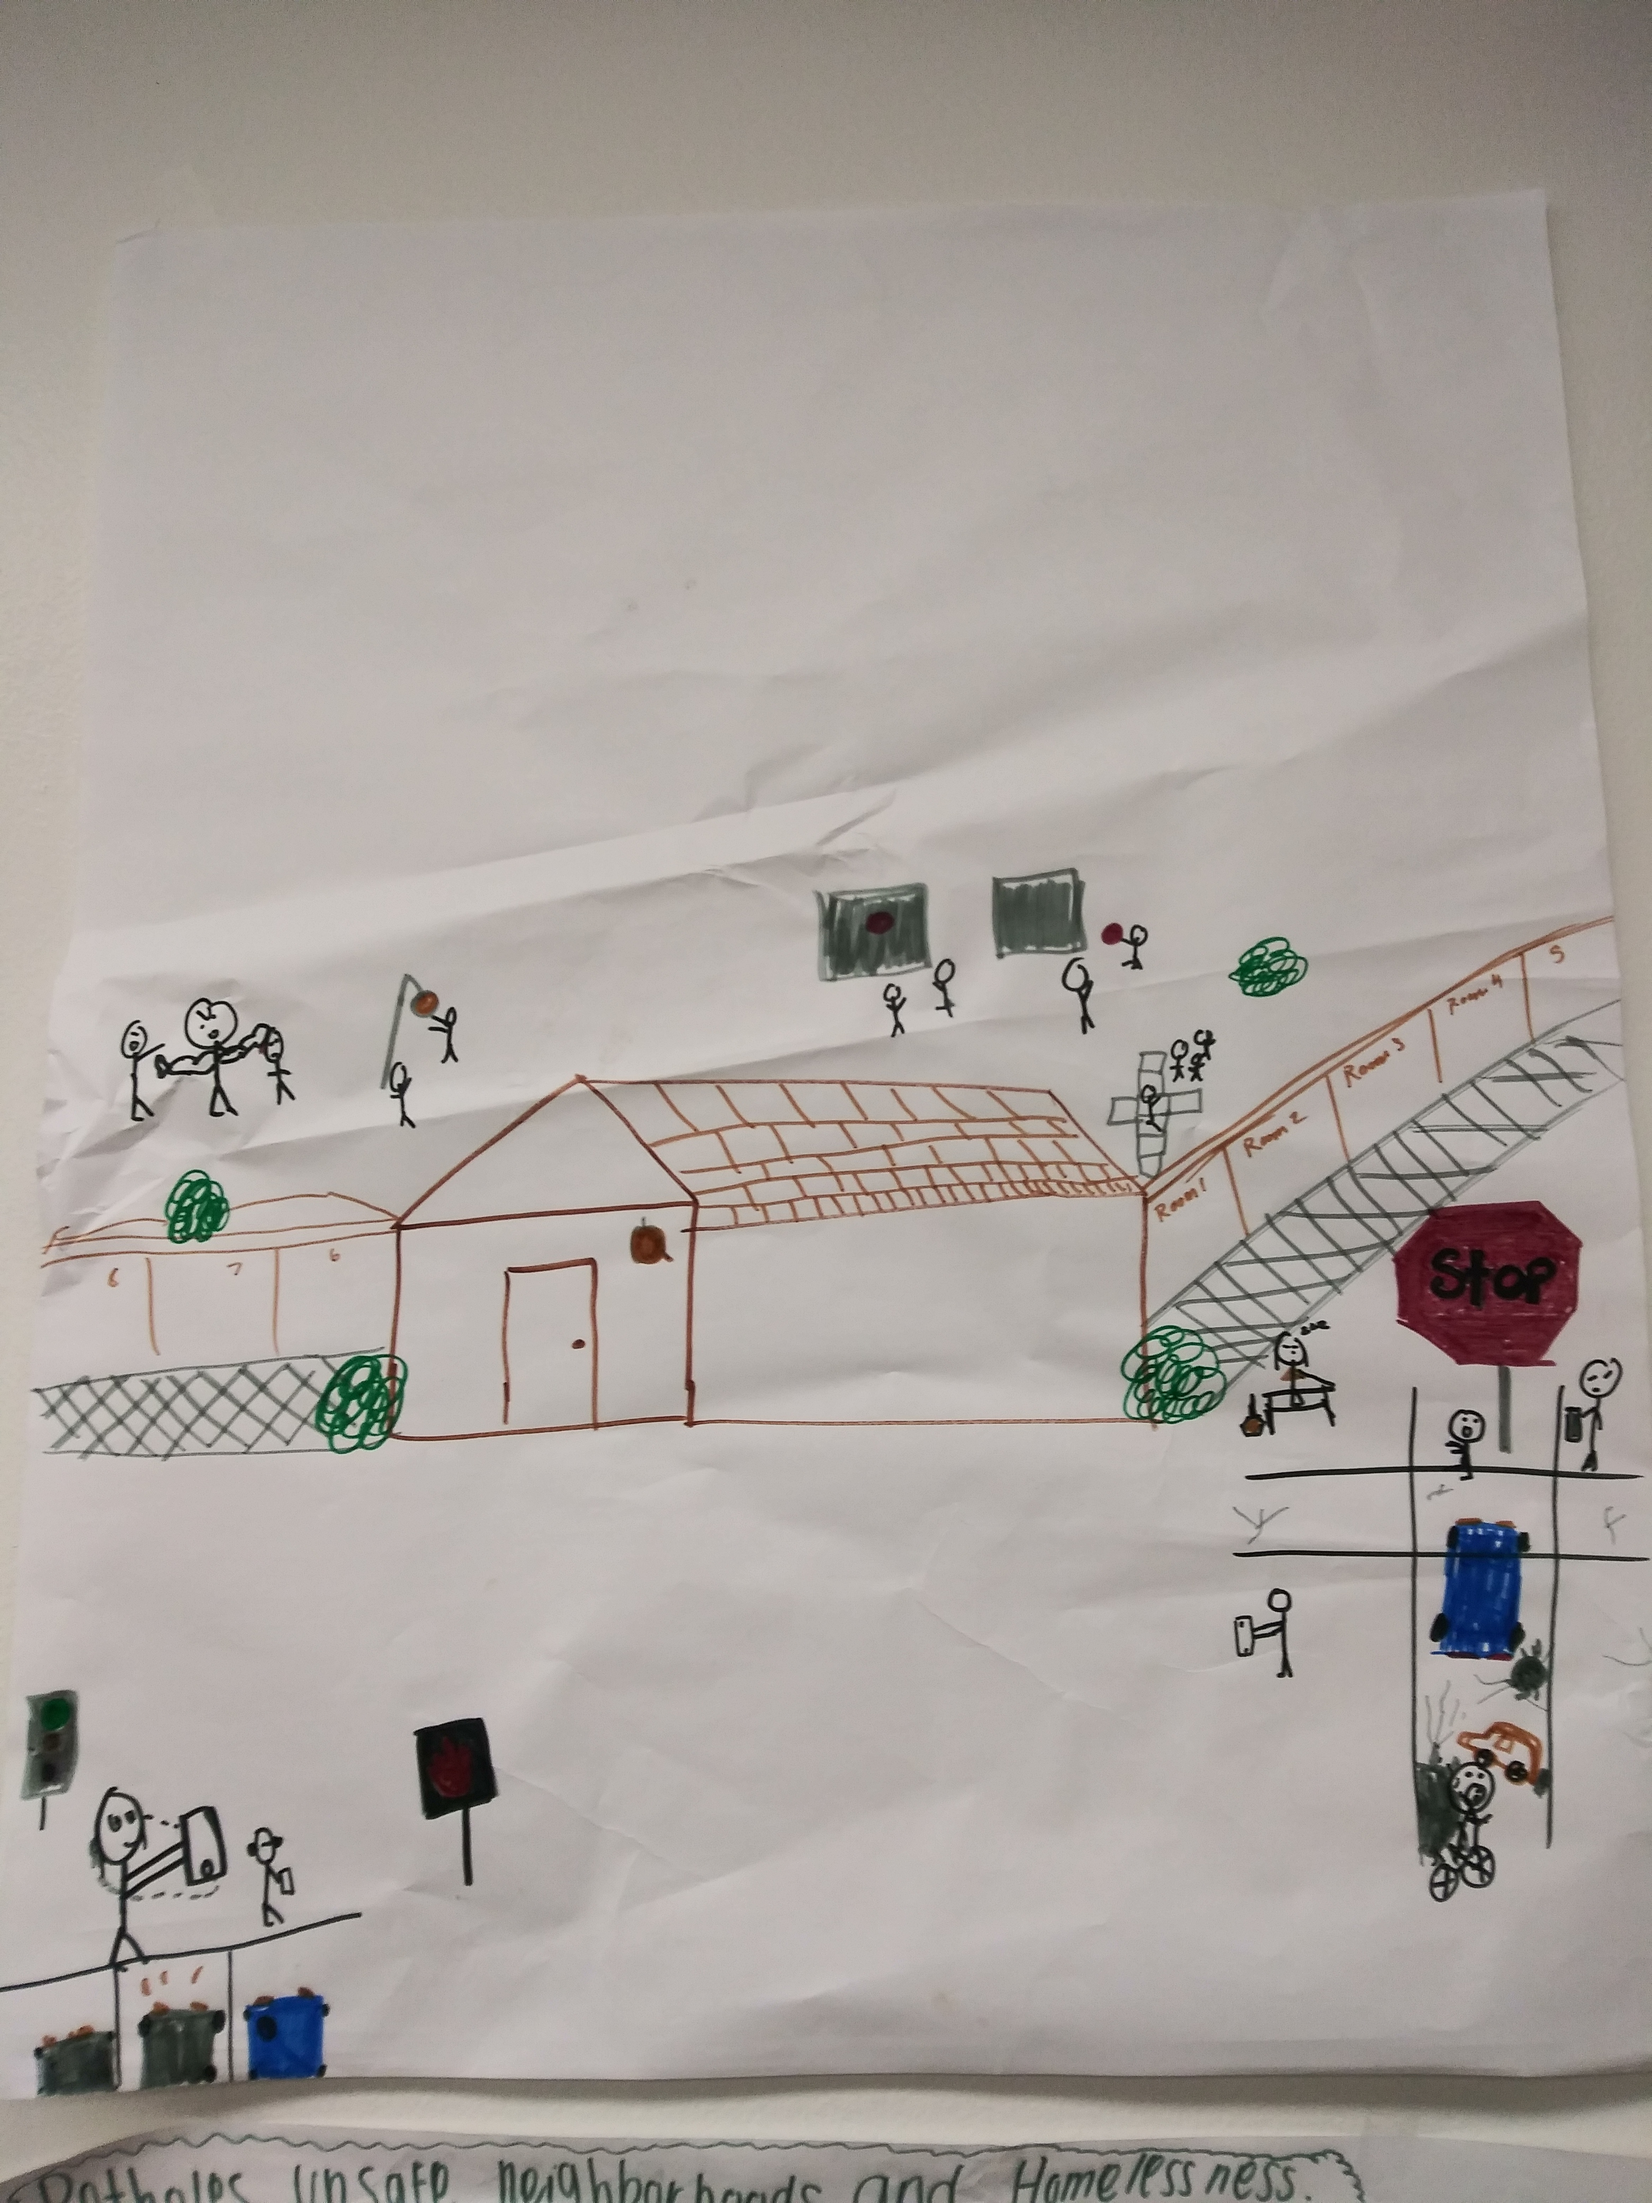
Poster

Slide 3
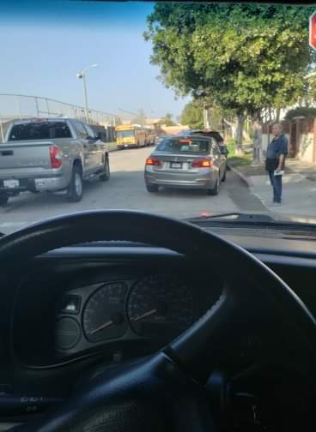
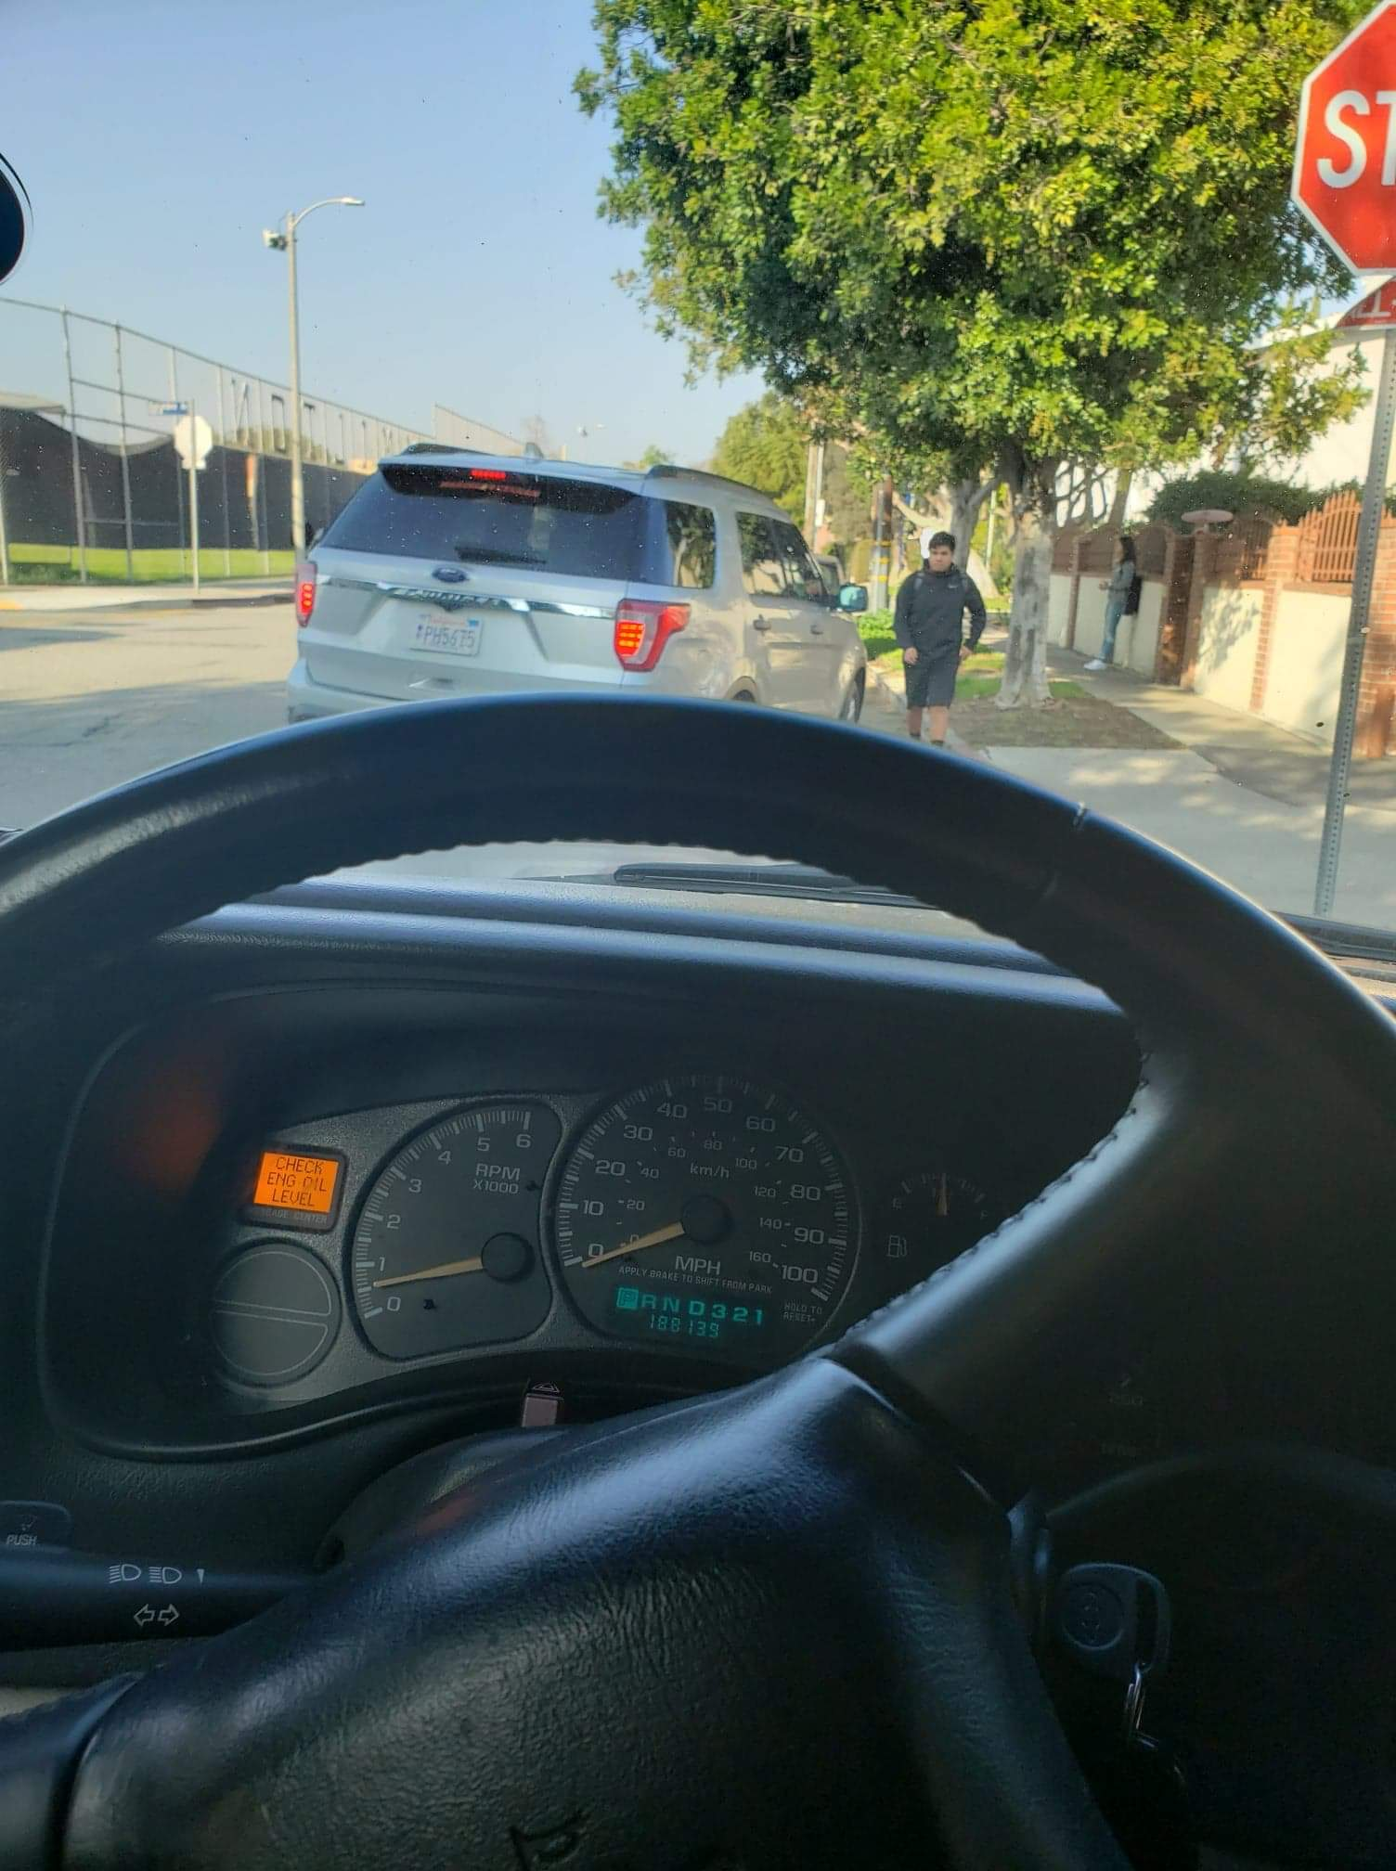
Photographs
This Photo by Unknown Author is licensed under CC BY-NC-ND

Slide 4
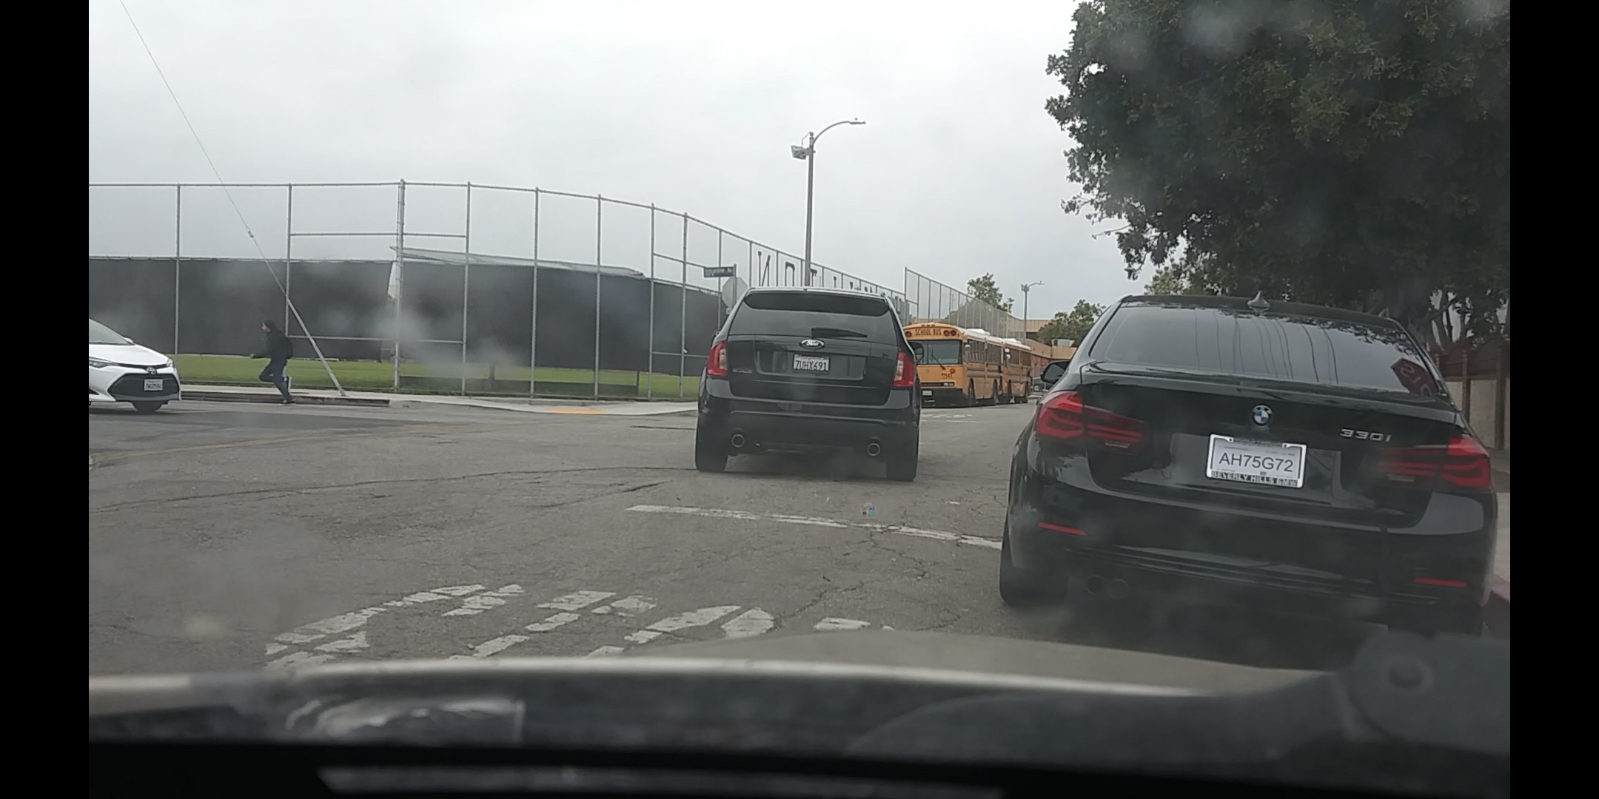
Photographs

Slide 5
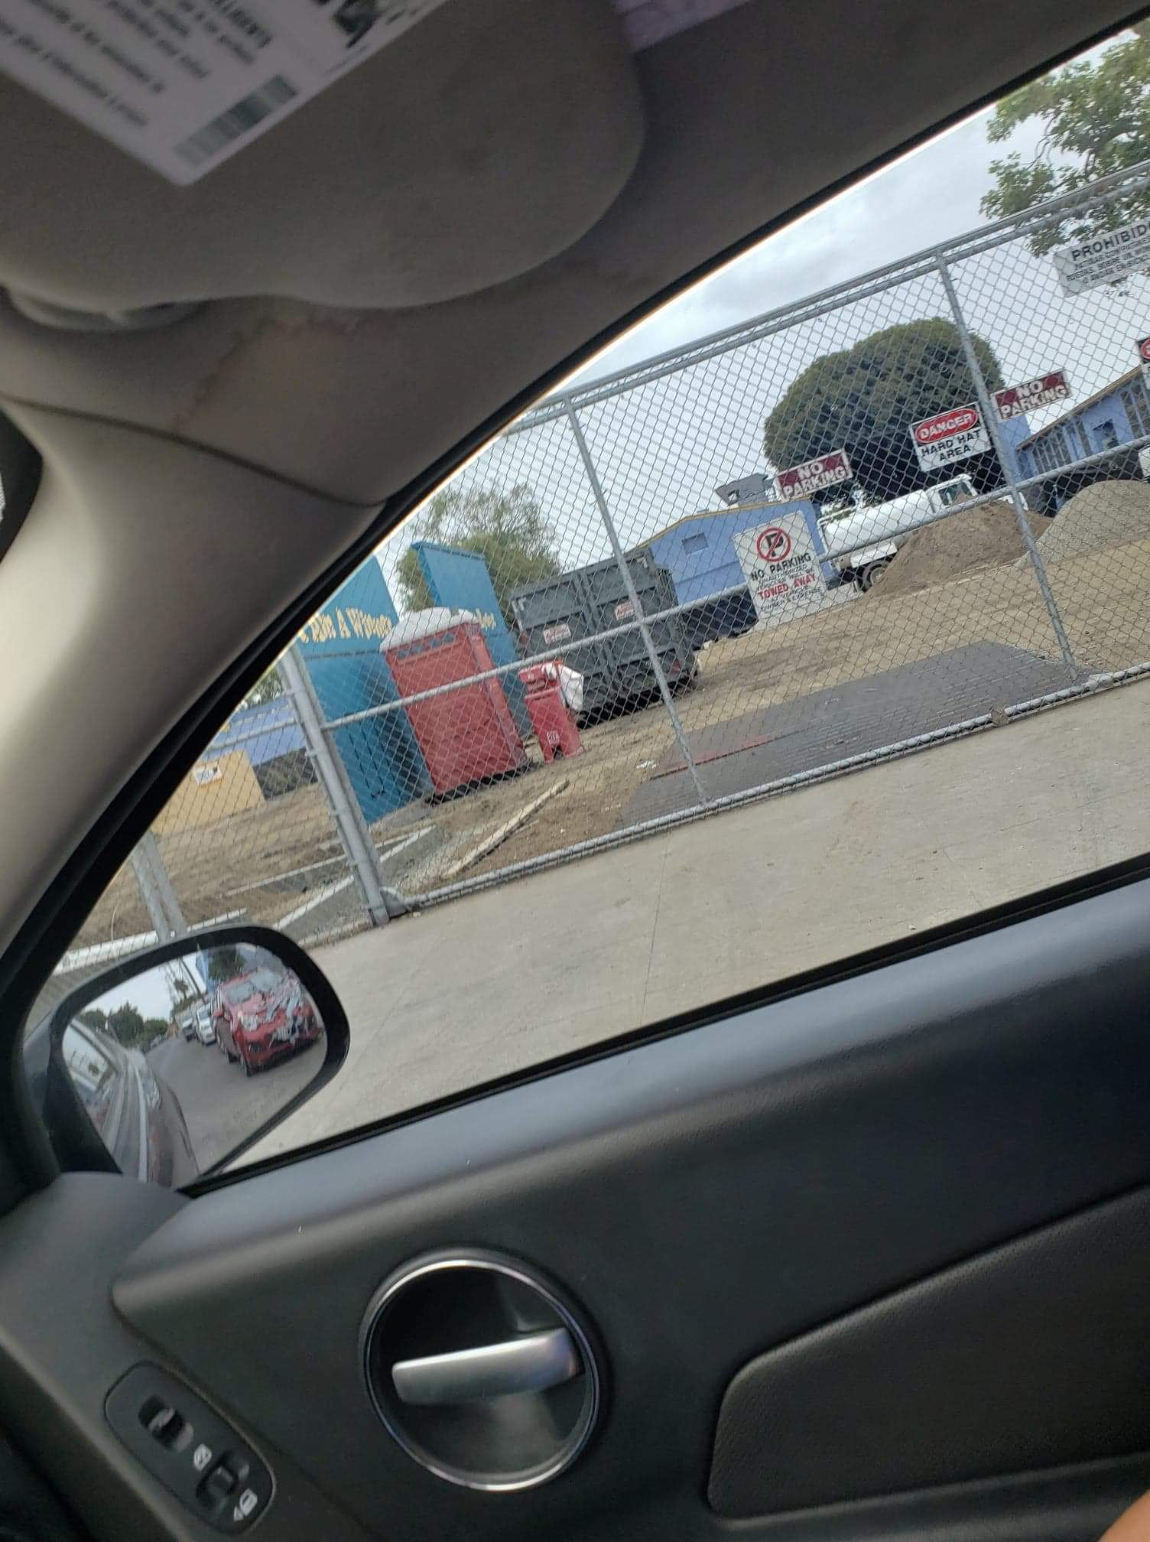
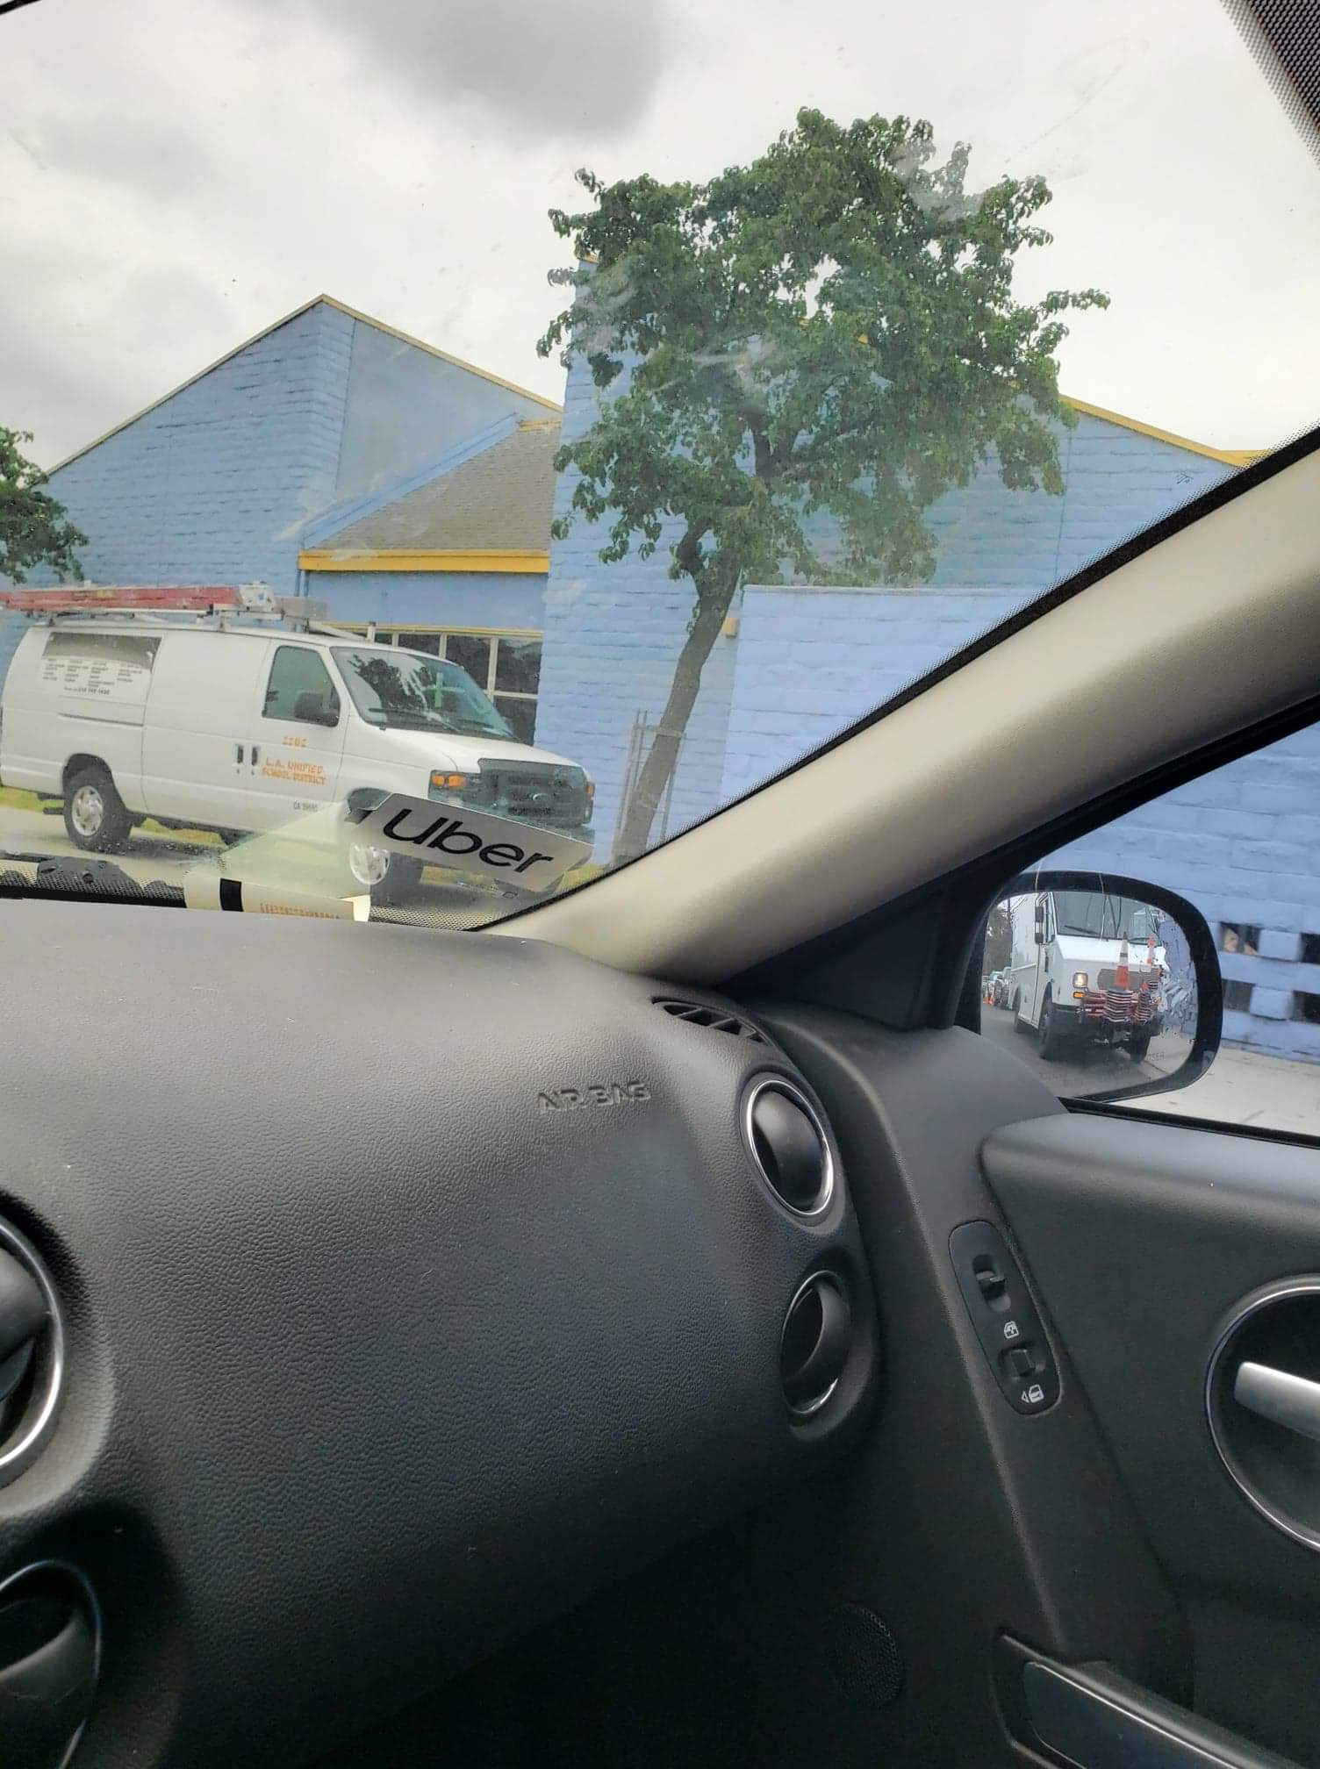
Continued..

Slide 6

Spoken Word
Driving cars, Driving cars that honk.
Little Kids , little kids that walk
Sleepy drivers, awake children lost in sleep with their phones
Everyone rushing trying to get home
Surviving against that savage pothole
Oopps, they almost hit a bicyclist
Oops they almost hit those kids
Kids unaware of the risks
Cross the street for an ice cream
Run on to traffic the Cheetos are almost gone
Ignore the red and white octagon
Ignore the kid getting punched
Did you seem them? They take drugs
Nobody thinks something terrible will happen
Until something terrible happens
Then you see it in in the news “child hurt in school”

