Slide 1
Quit Smoking
Junyi He
English 1B
5/19/19

Slide 2
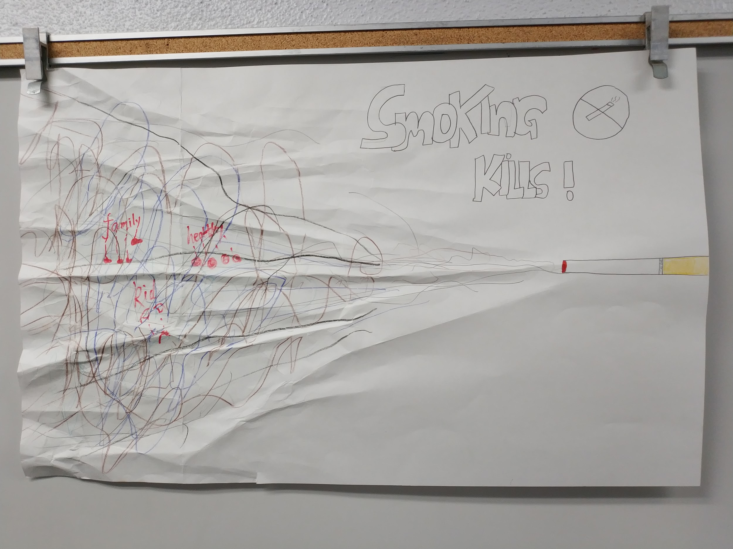

Slide 3
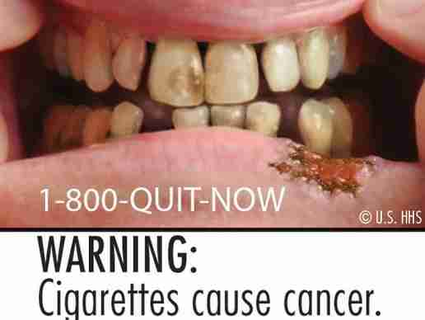
Photograph

Slide 4
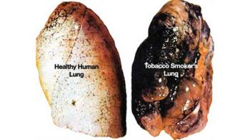
Photograph

Slide 5
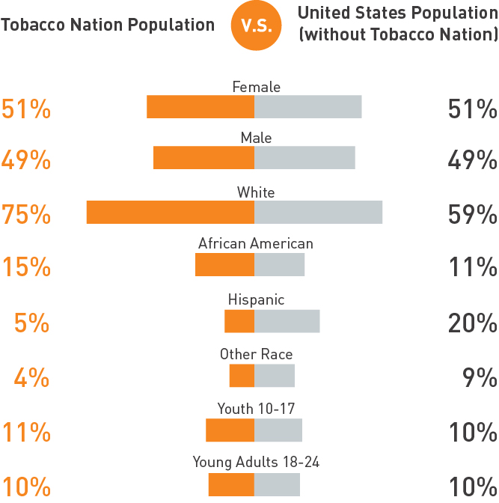

Slide 6
Link
https://youtu.be/OQV-13N4-gU

