Slide 1
High Impact Practices (HIP) Service Learning Internship Community Engagement (SLICE) with Spoken Word “Fix-It” Presentation
Joseph Flores
Responsibilities over Education
English-1B
May 21, 2019

Slide 2
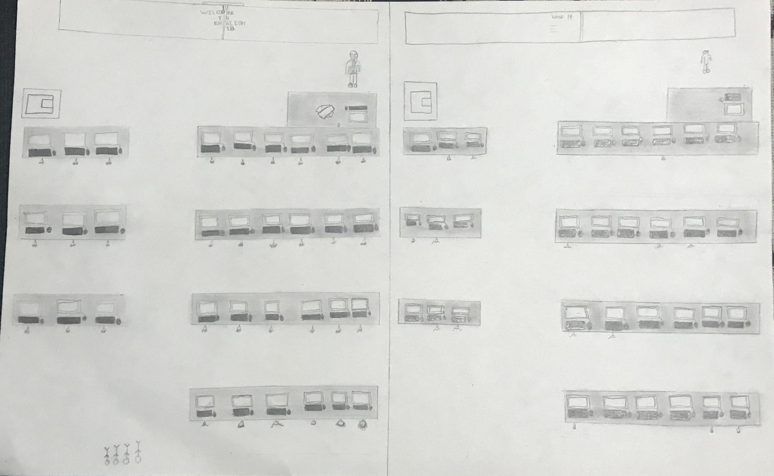
Poster

Slide 3
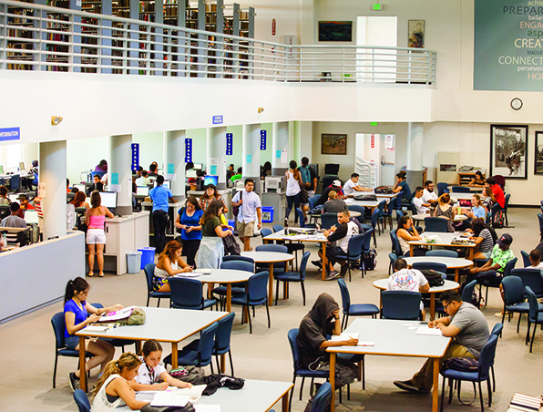
Week 1

Slide 4
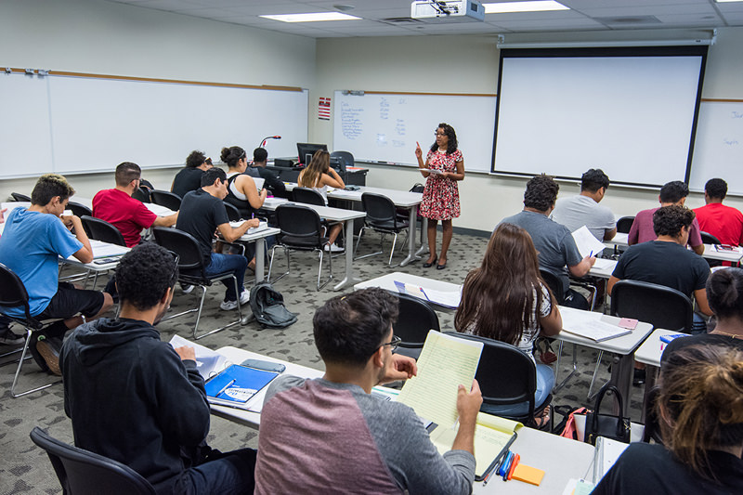
Week 6

Slide 5
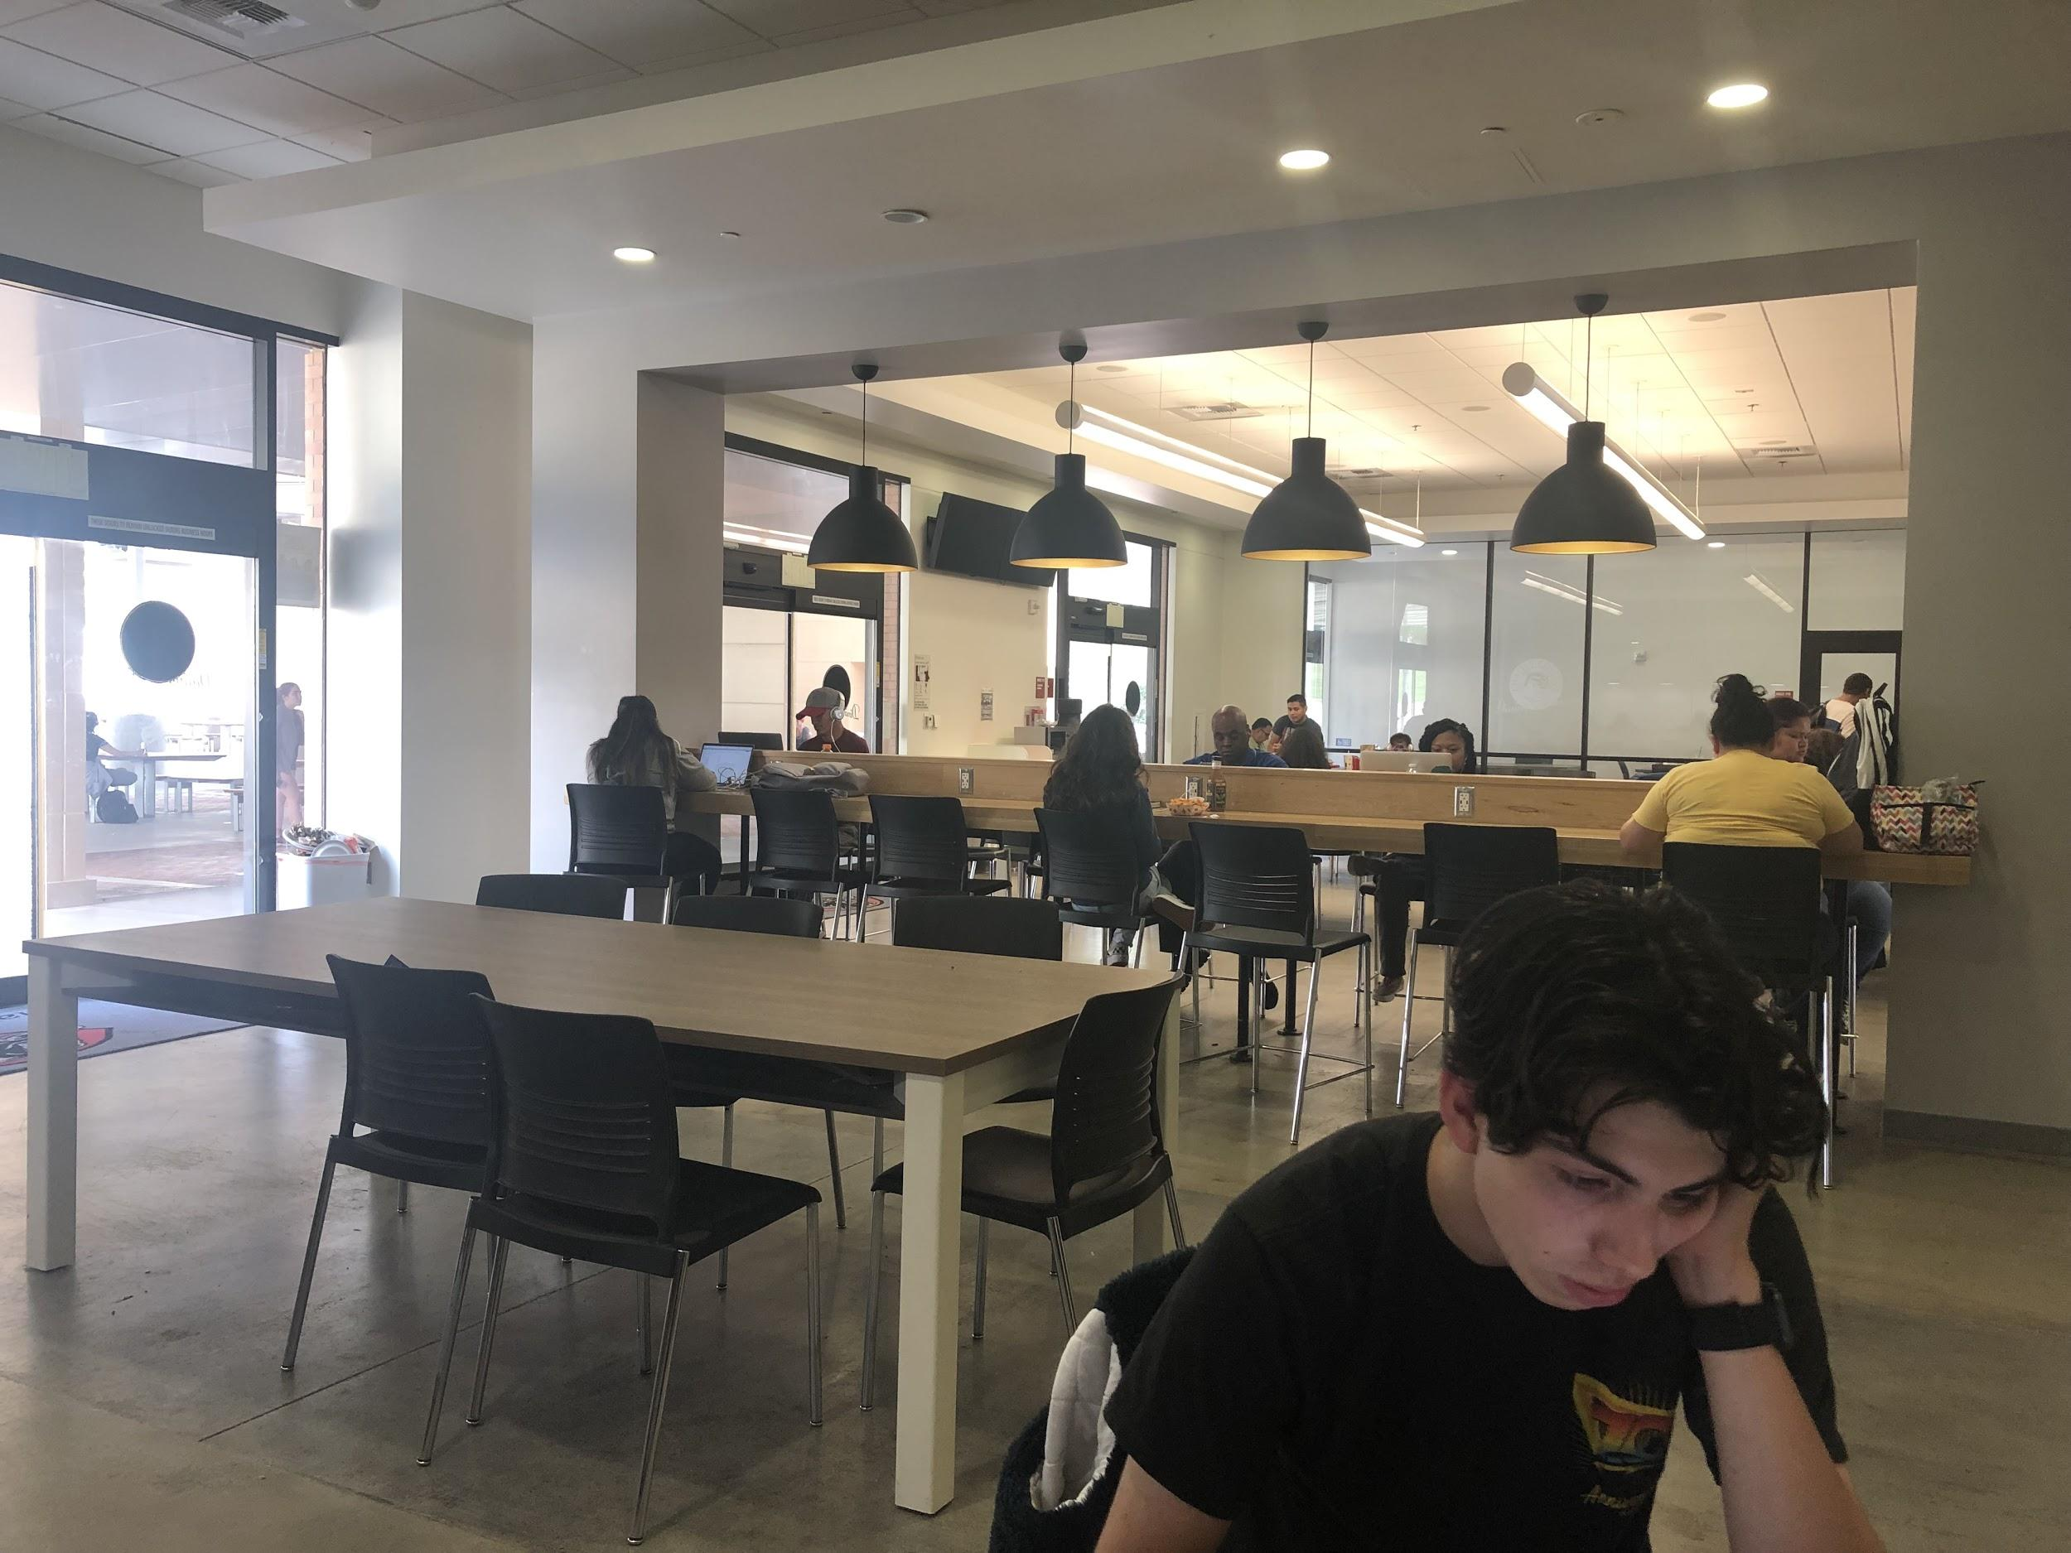
Week 15

Slide 6
Video Link
https://youtu.be/GywpVO0RlcQ

