Slide 1
Fast Driving by my house
ENG 350 2019

Slide 2
About the issue
Everyday there are drivers that go over the speed limit. Many of those cars that reach a high rate of speed make a lot of noise that can be heard down the block.In relation to the speeding, they endanger themselves and pedestrians. Luckly, there has not been many accidents recently.

Slide 3
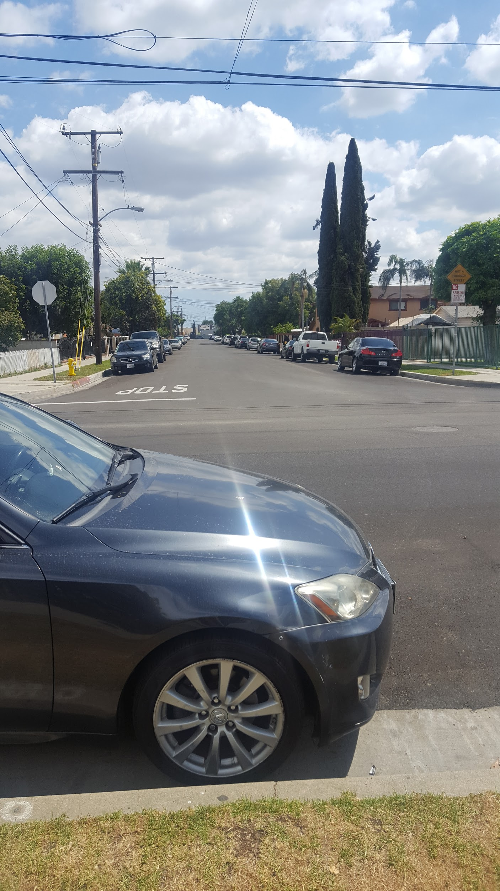
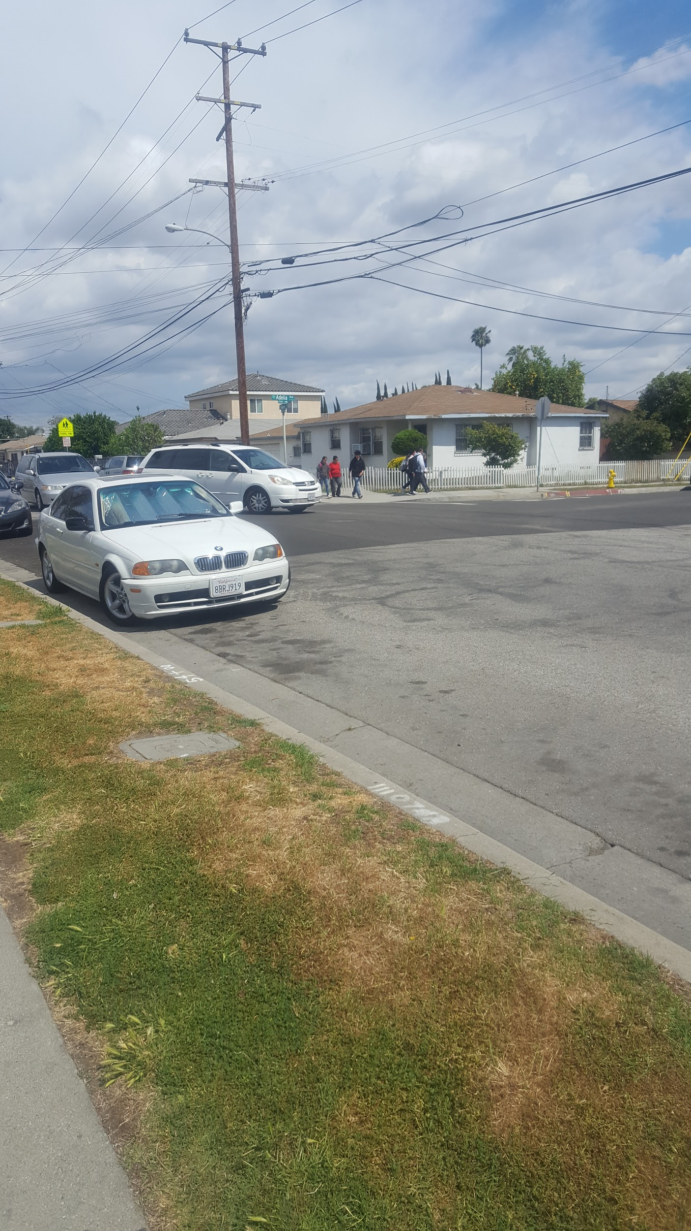

Slide 4
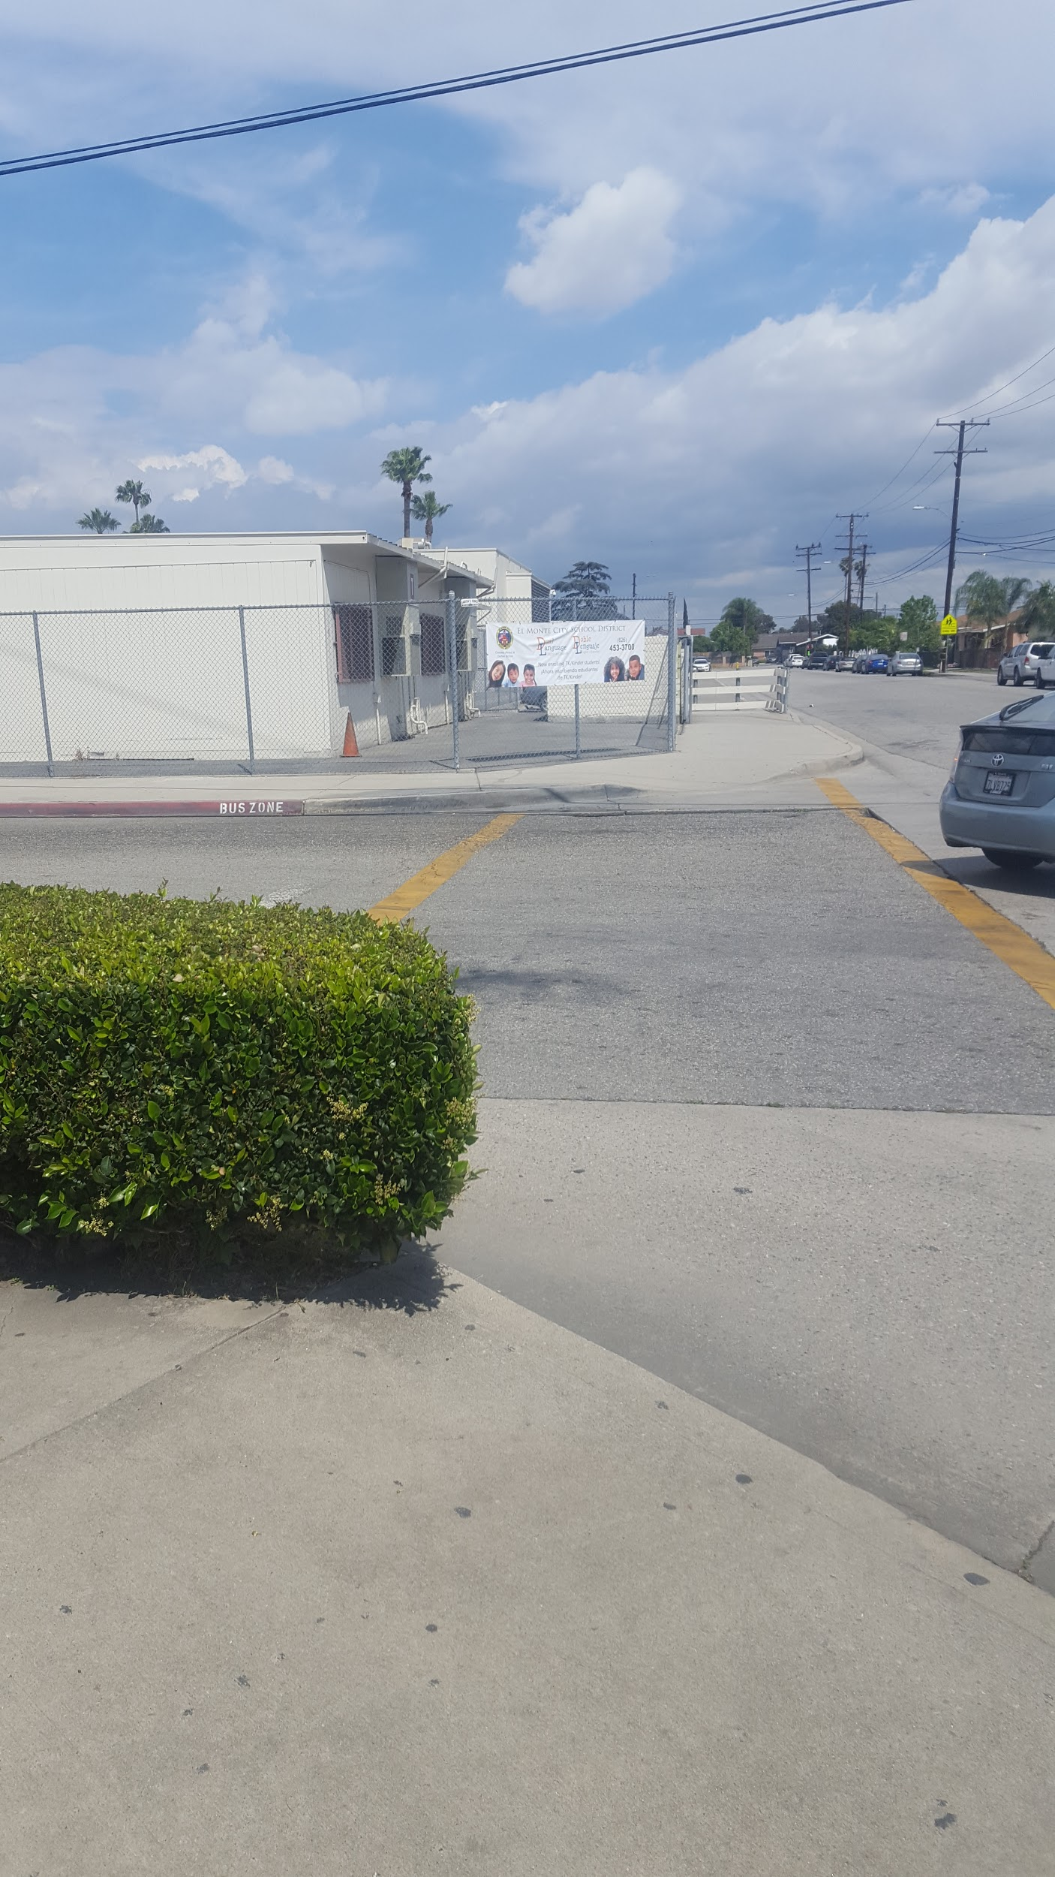
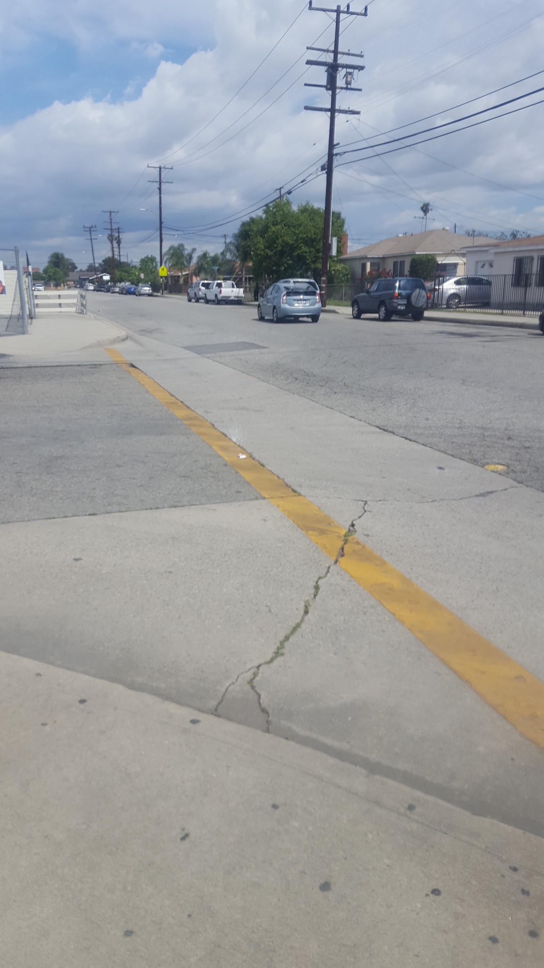
The school by my house
There is a crossing guard at the other end

Slide 5
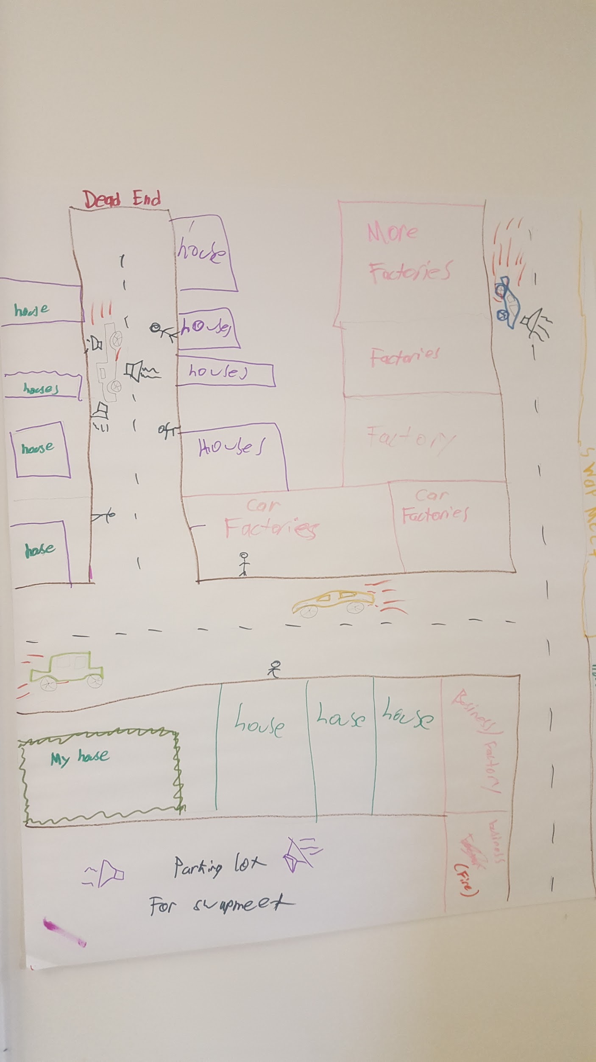

Slide 6
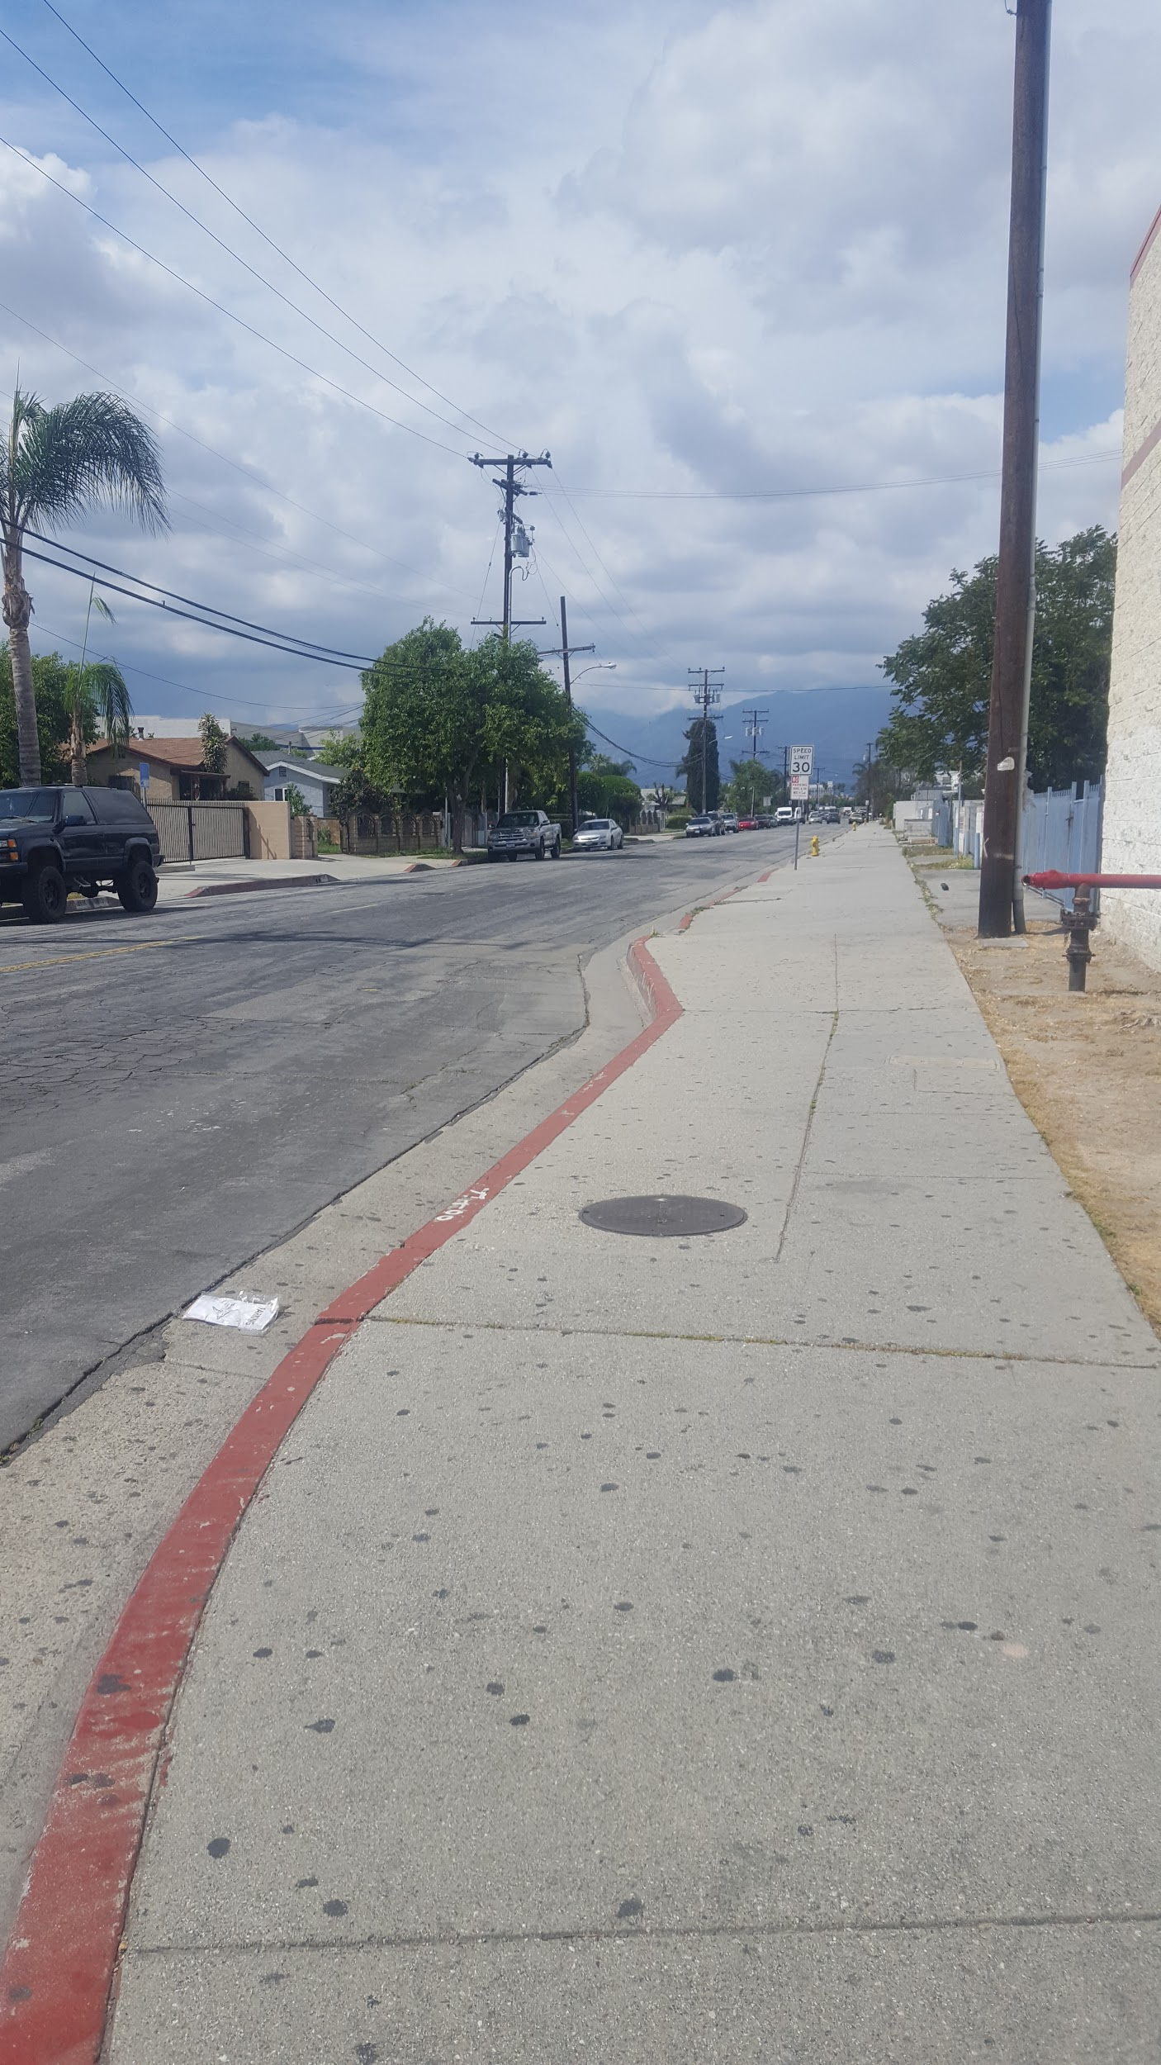
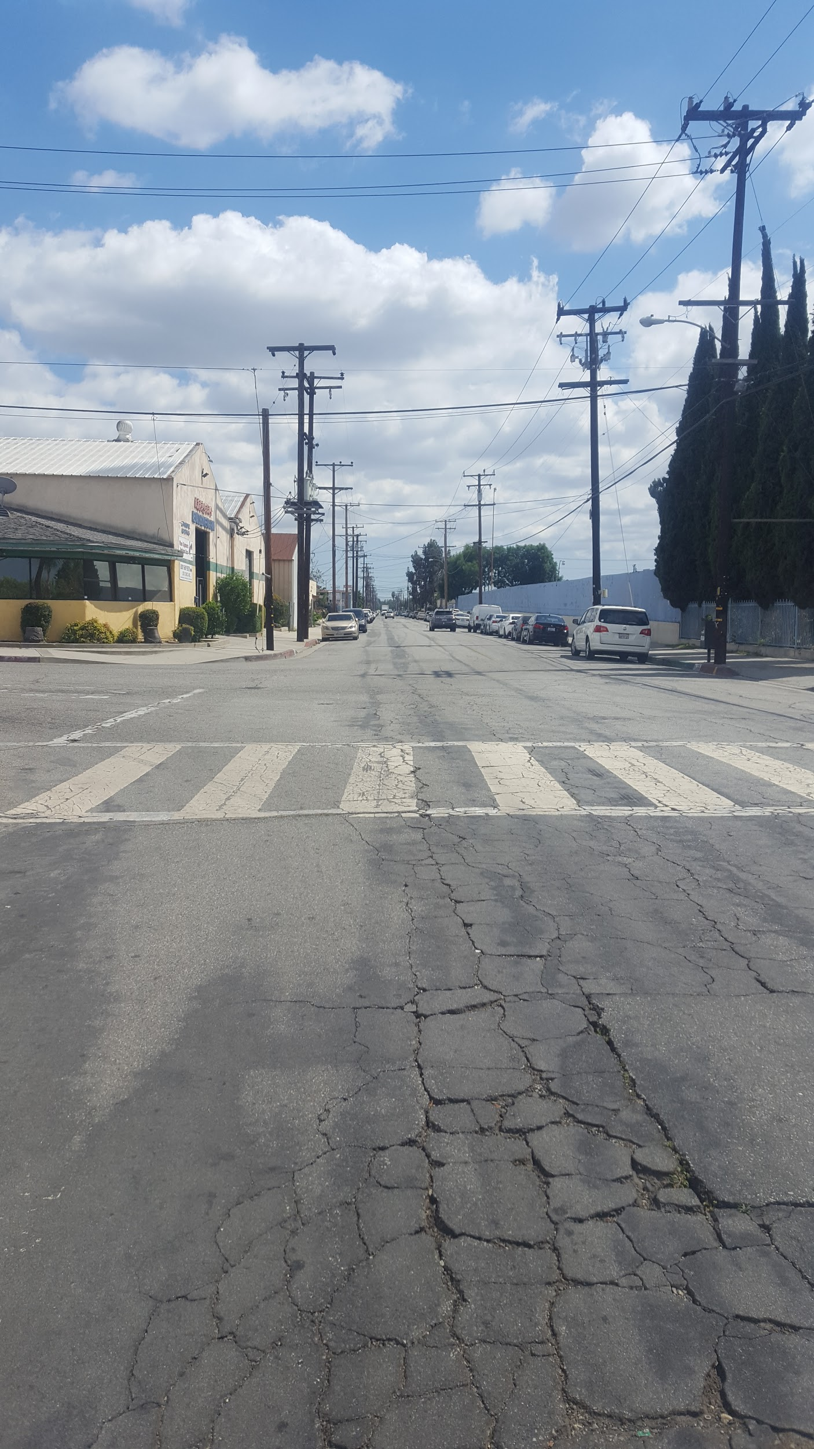

Slide 7
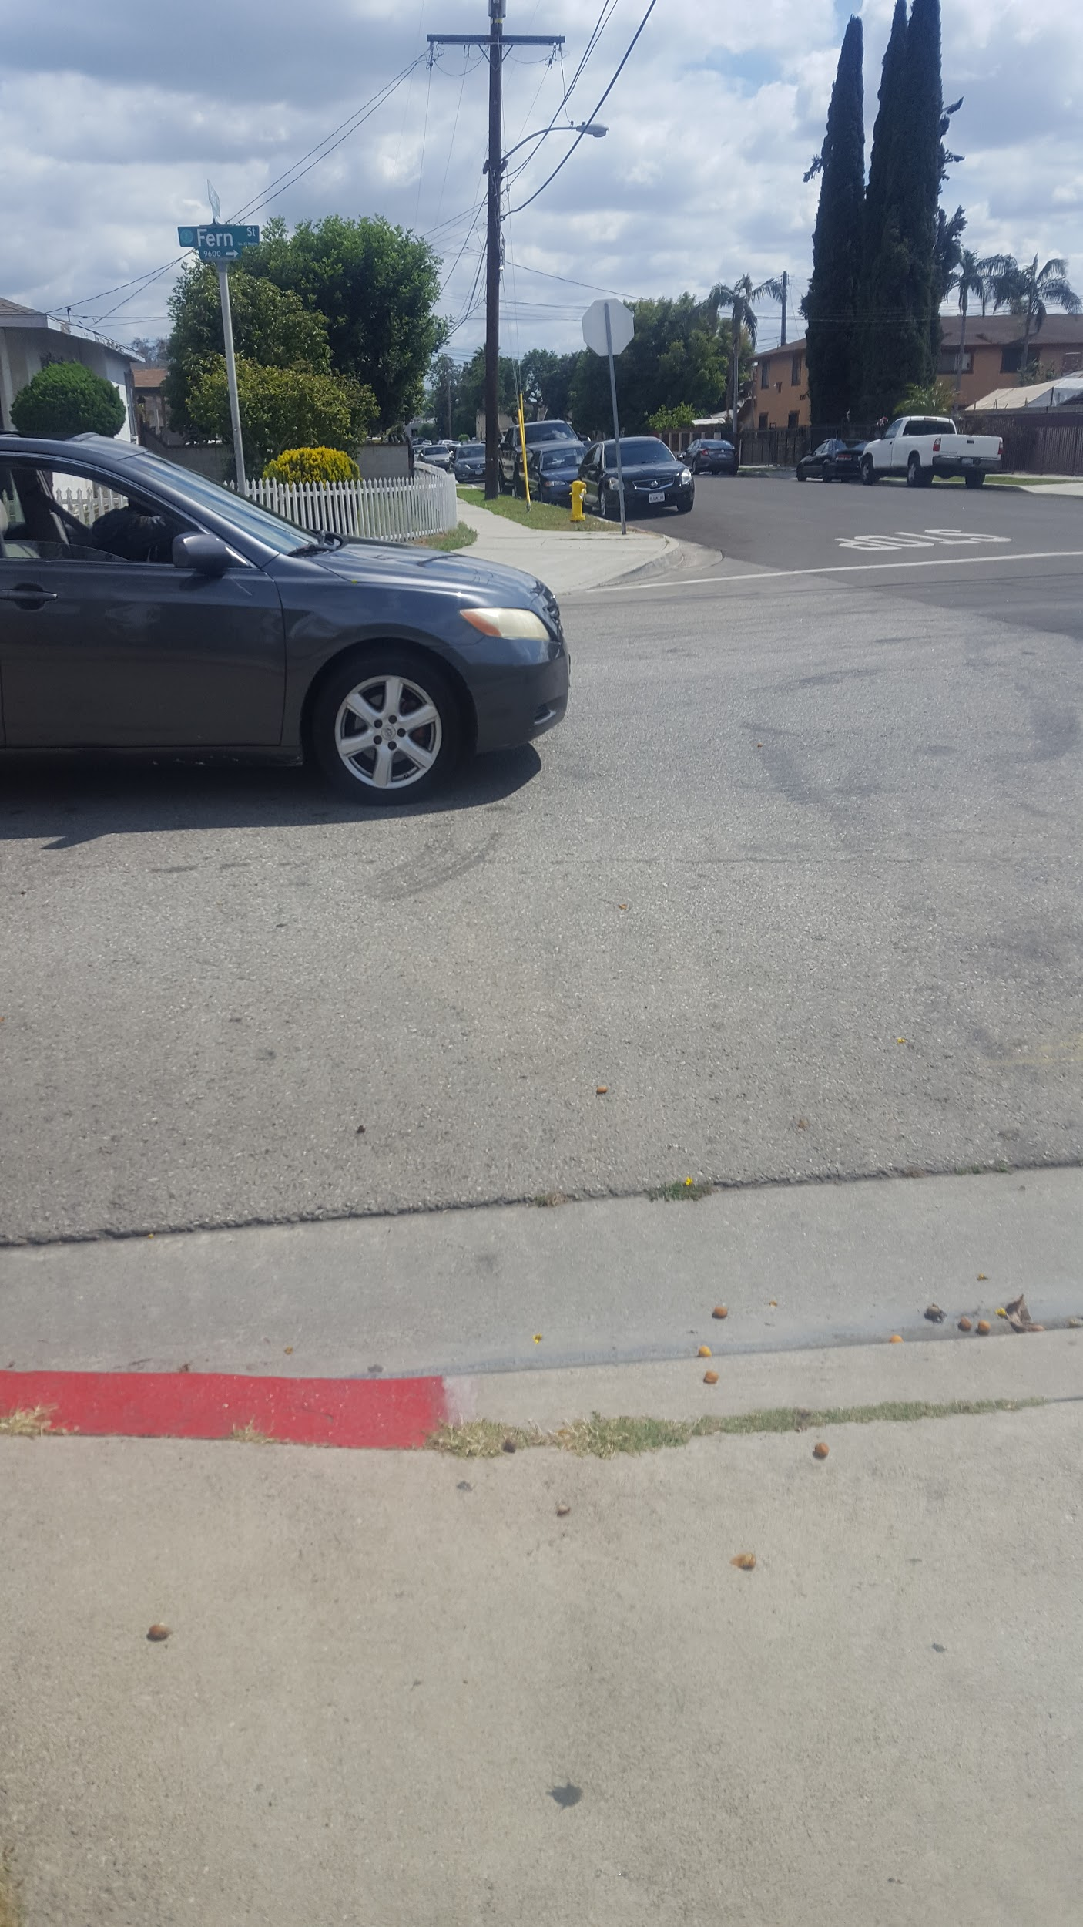
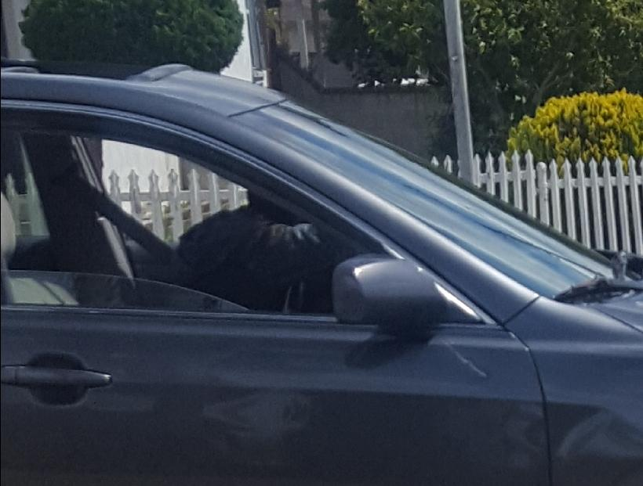

Slide 8
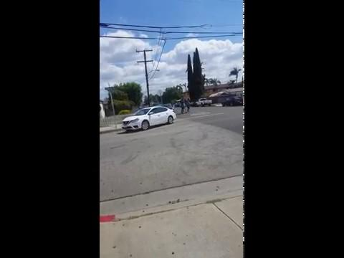

Slide 9
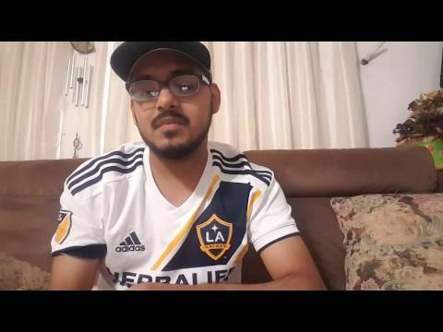
Its a sound that can energize the soul.
But what if that sound is responsible for death?
When some people hear it, it may bring a thrill or be an annoyance.
The sound these four legged beast make on the street can echo day & night
Wide spread blocks full of nothing that matters, only a few ending blokes
What if this noise we hear ended in a squeal or a boom?
I’ve hear them all to often.
That salesman said zoom zoom zoom but at what price?
The sound of beast and child do not mix! It brings catastrophe
All they want to do is speed past life but life literally gets in the way and its dead
Or if they want to show the world they can fly, they end up crashing and die
If you are ok but the beast is dead because you could slow down the slide
Hey Rafa, give me a ride.

