Slide 1
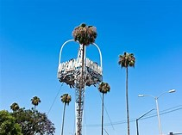
Graffiti In Norwalk, CA
Hip Slice "Fix It": FOcusing on the graffiti that is on the wall of the liquor store by my house.
Brought to you by Irene Rios-Vergara

Slide 2
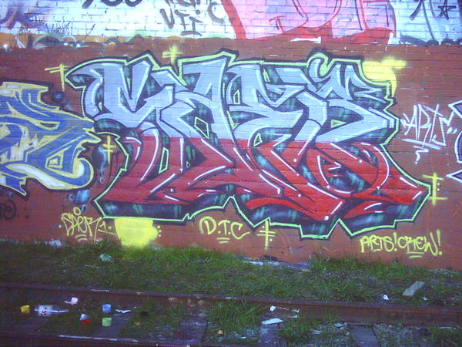

Slide 3
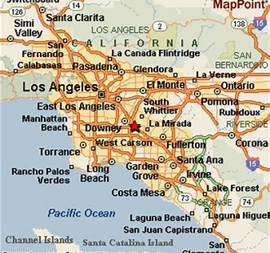
Norwalk, CAlifornia
Predominantly hispanic, working class population.

Slide 4
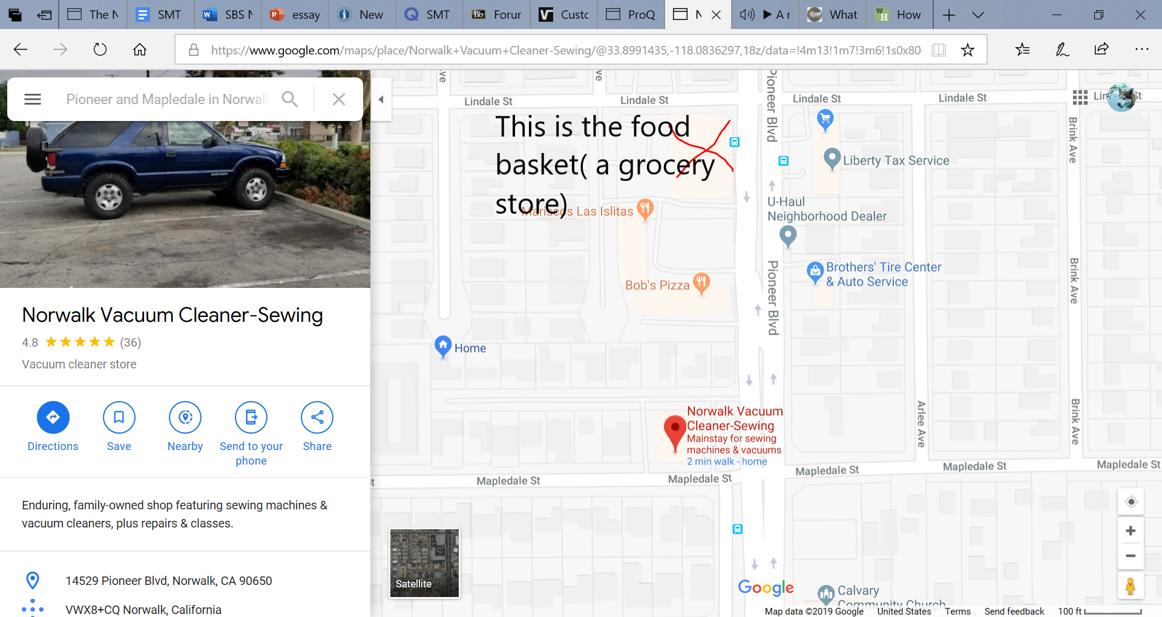


Slide 5
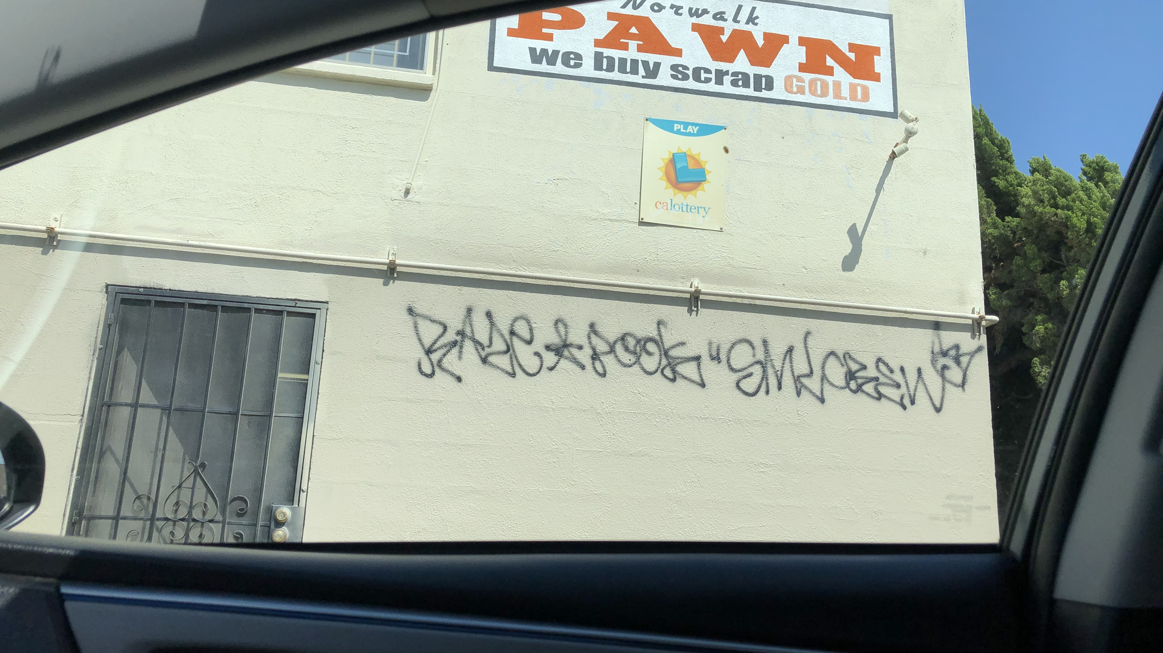
Liquor Store Parking Lot on Pioneer & Mapledale in Norwalk, CA

Slide 6
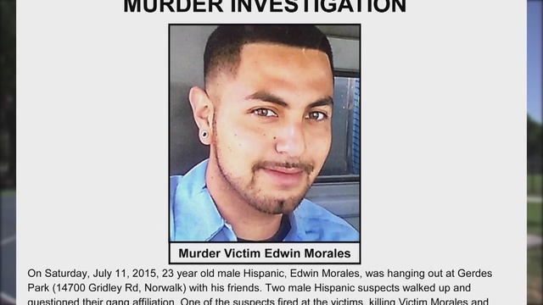
Edwin Morales was shot and killed after being asked "Where are you from?" He was a twenty-year-old killed at a park playing basketball with his friends
Rest in peace edwin Morales
#justiceforEdwin

Slide 7
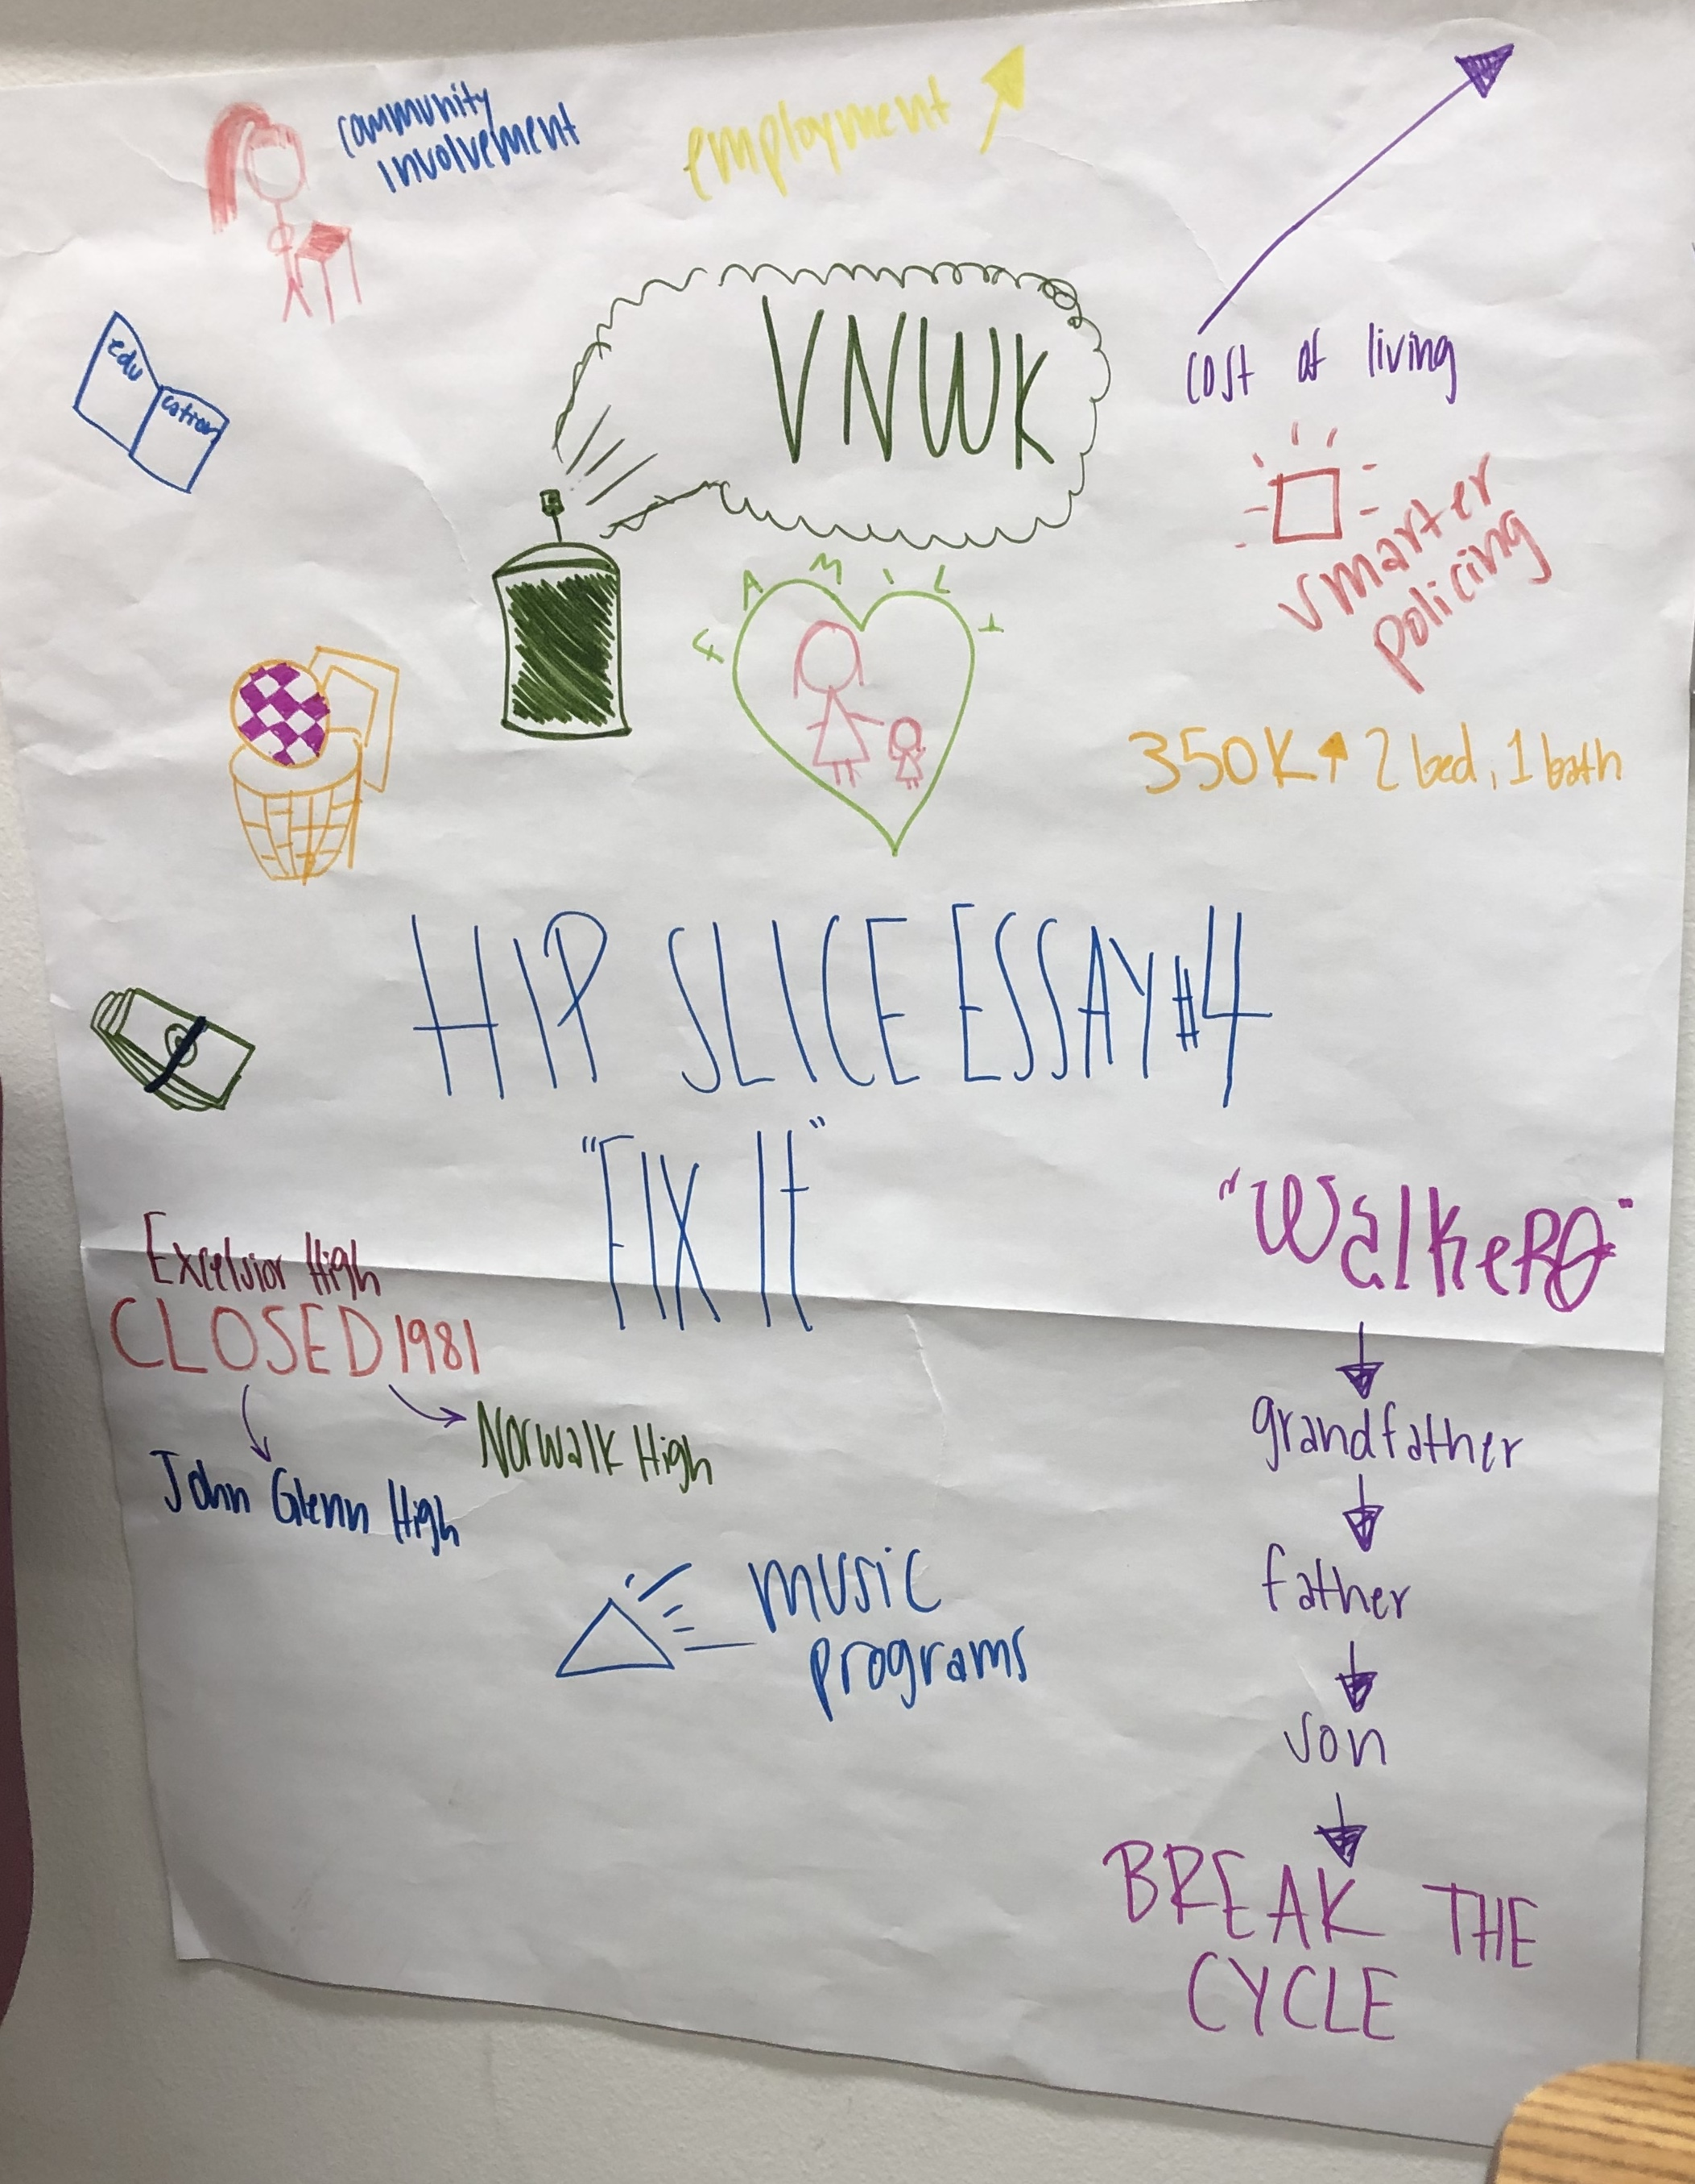
Poster

