Slide 1
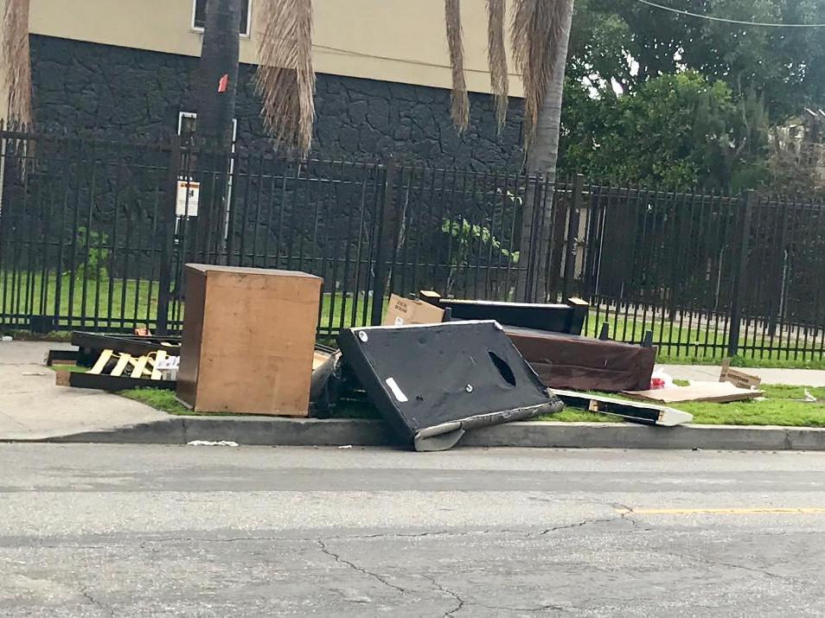
City of Trash
Zoila Cosio
trash, garbage, waste, illegal dumping
English 350
May 08, 2019

Slide 2
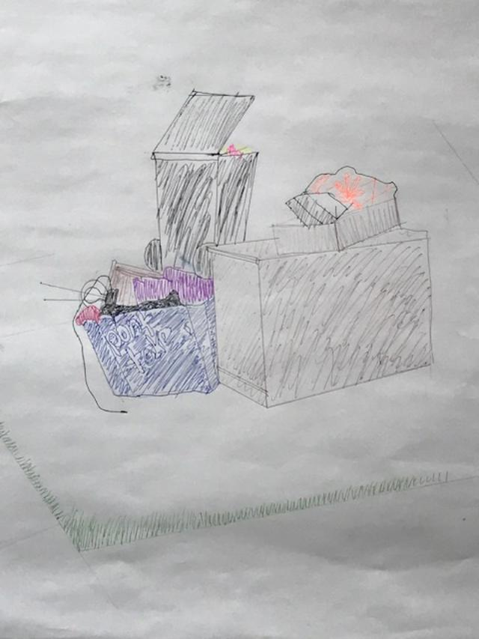

Slide 3
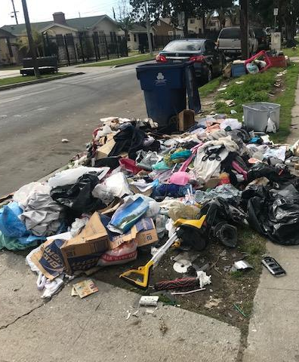

Slide 4
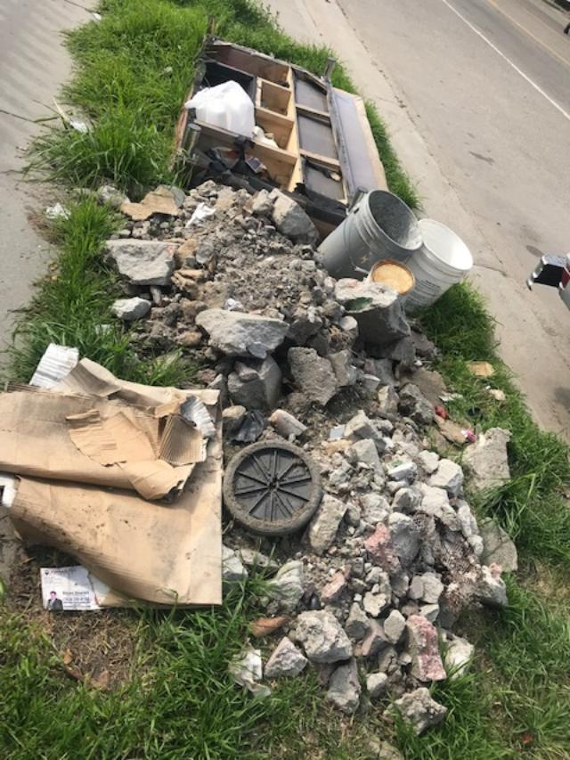

Slide 5
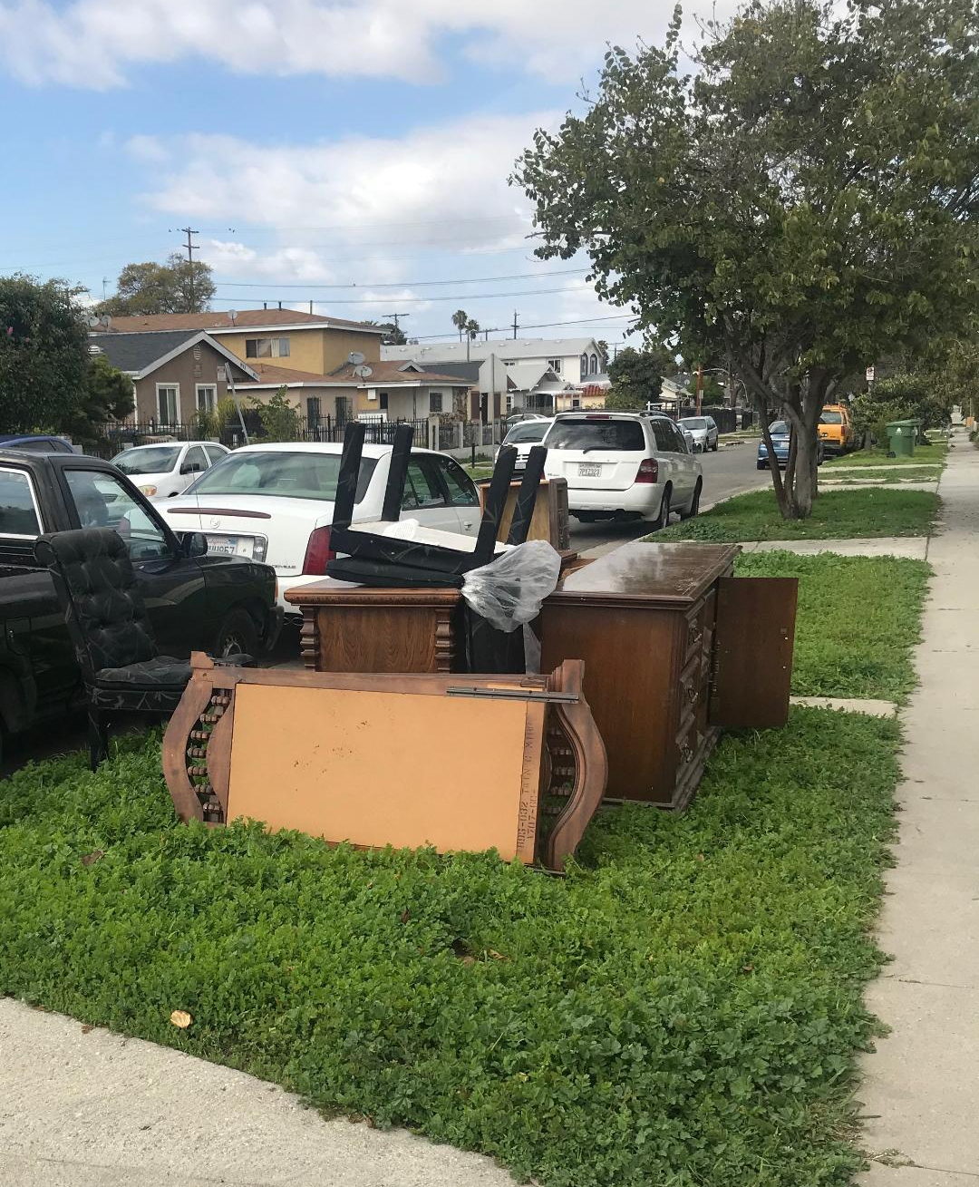

Slide 6
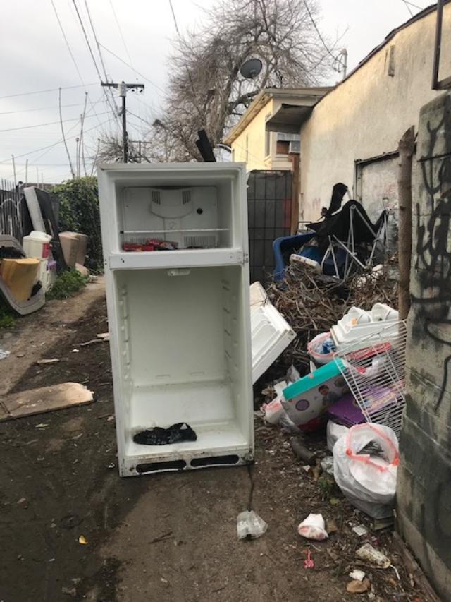
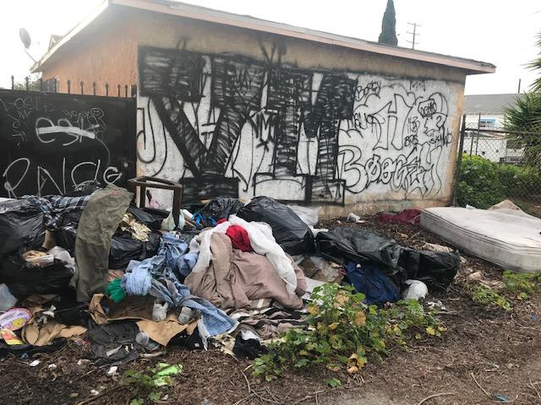

Slide 7
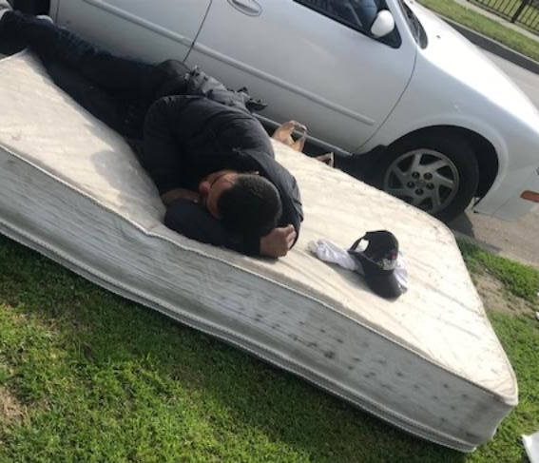
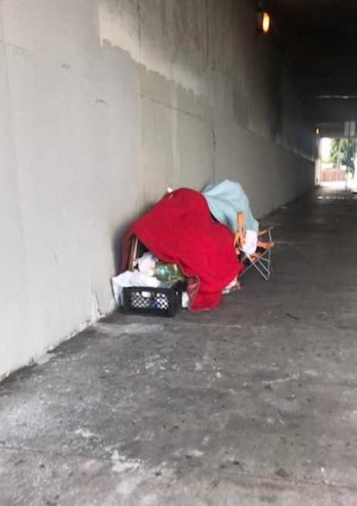

Slide 8
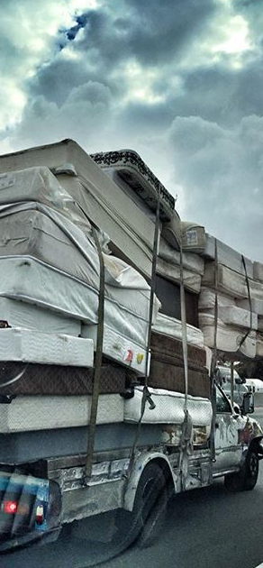
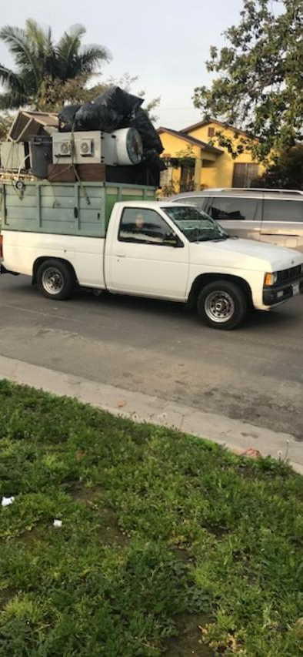
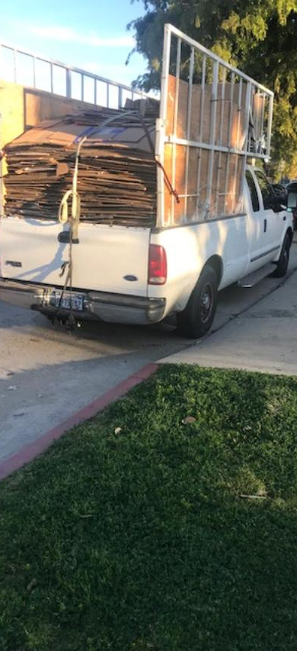

Slide 9
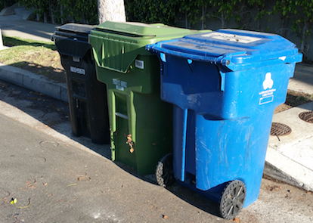
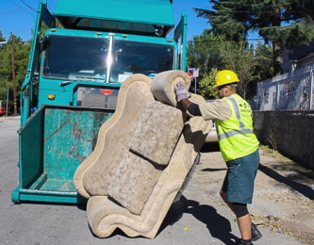

Slide 10
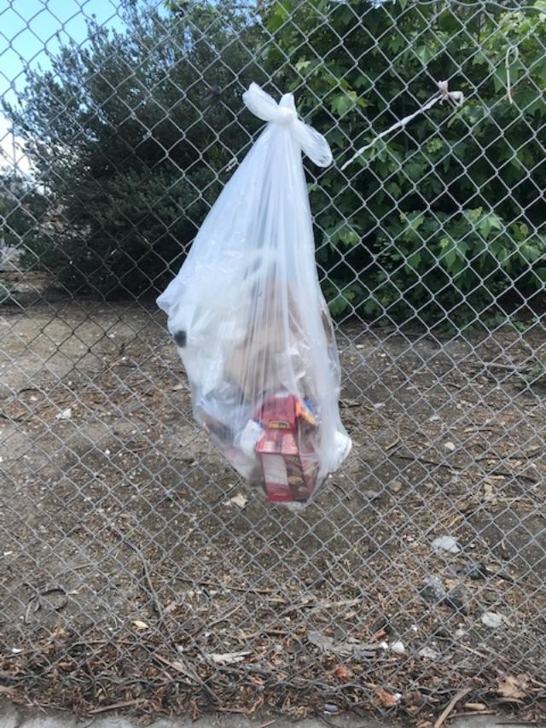

Slide 11
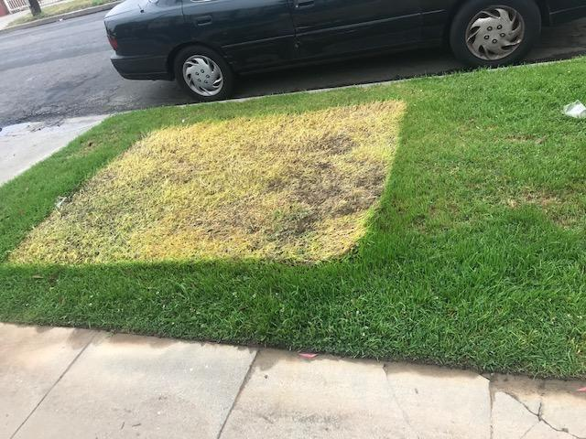

Slide 12
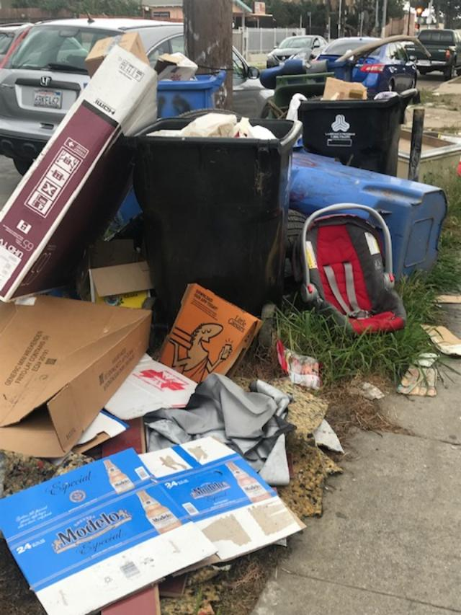

Spoken Word
I live in Los Angeles city of angels,
but is it really city of angels?
From downtown LA, to East LA, to South LA
I walk through the city and see trash, garbage, waste, and illegal dumping
I thought the havens were beautiful
But LA doesn’t look like where angels would live
If only trash would turn into cash
If only litter would turn into glitter
If only people had more knowledge about garbage
If only we could erase the waste
If only illegal dumping would all go away

