Slide 1
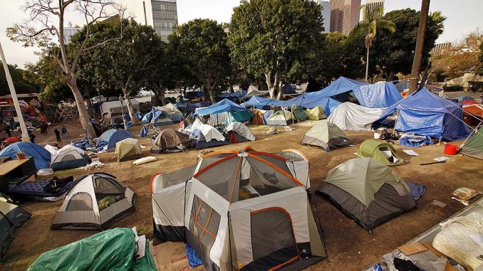
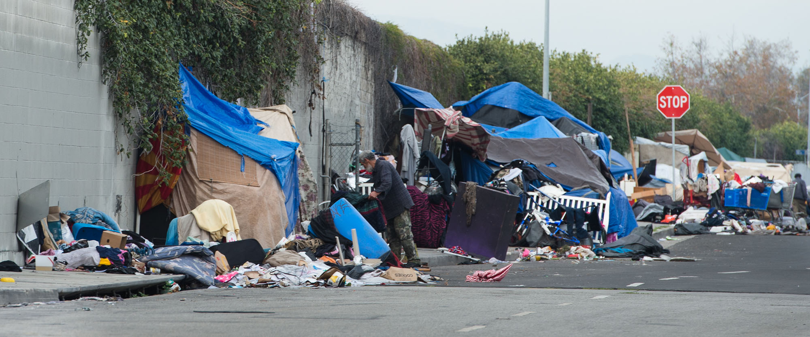
Homelessness in LA
Aracely Rodriguez
ENG:350
Professor: Dean

Slide 2
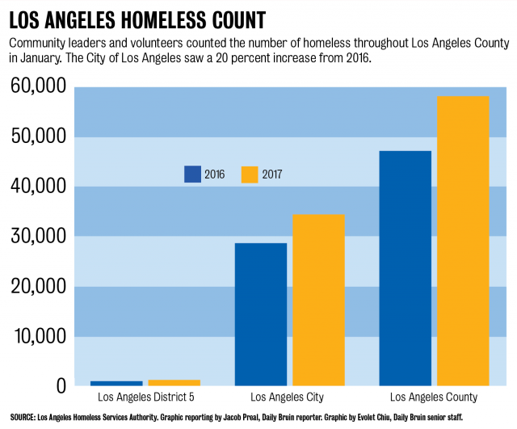
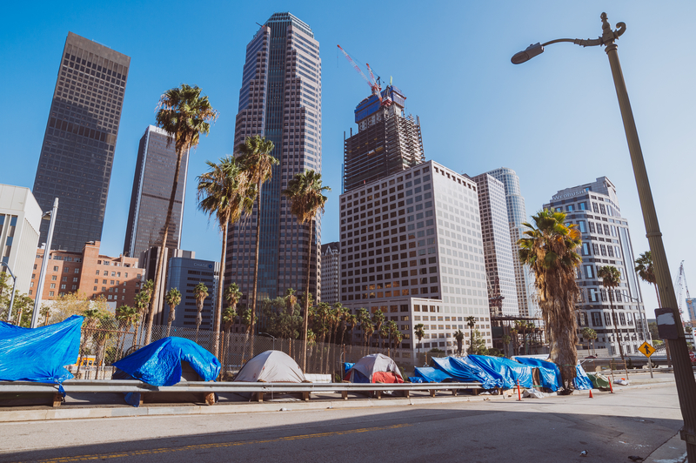
Poster
Homelessness
Rate
Citys
Crime
Poverty
Home rate

Slide 3
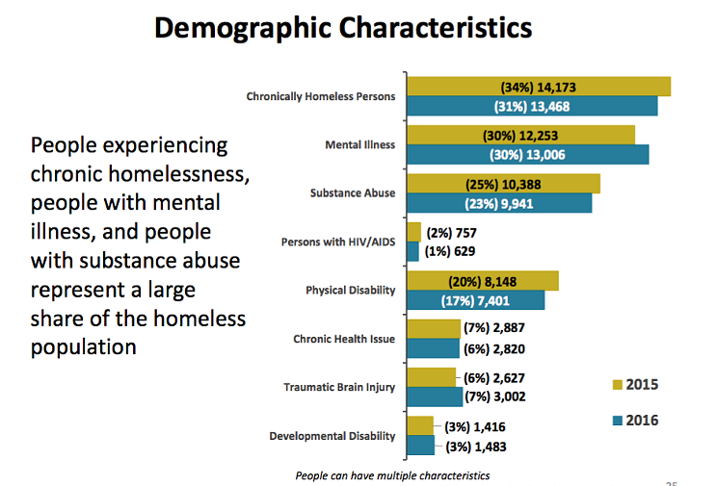
Data

Slide 4
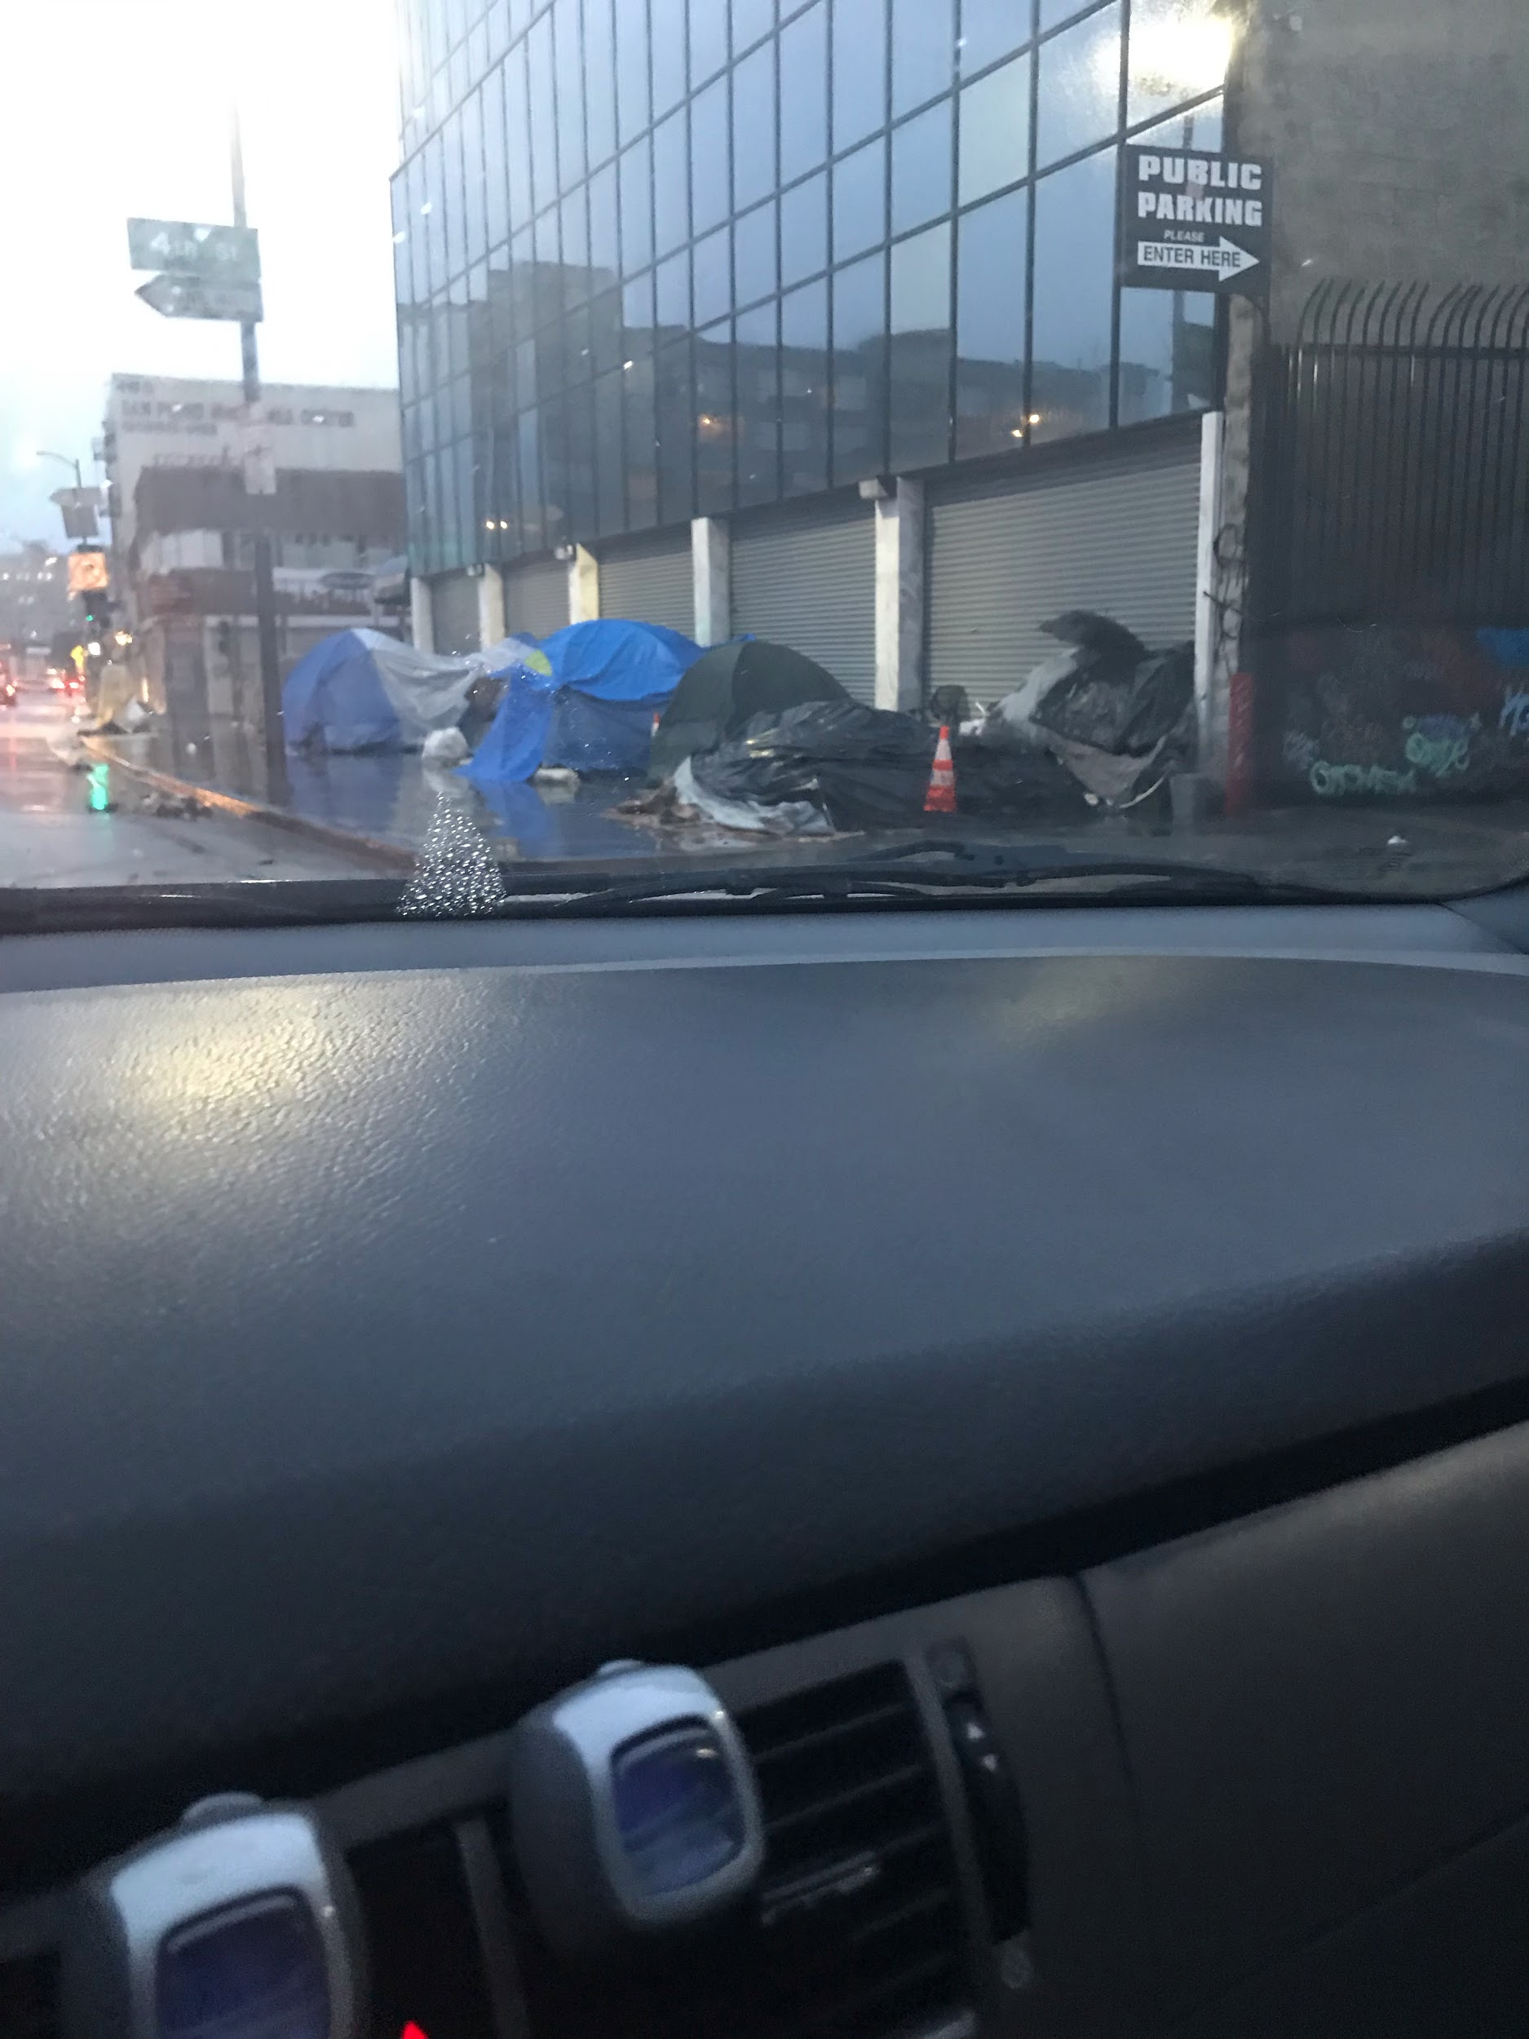
Picture #1
In Front of a business
Police station right across.

Slide 5
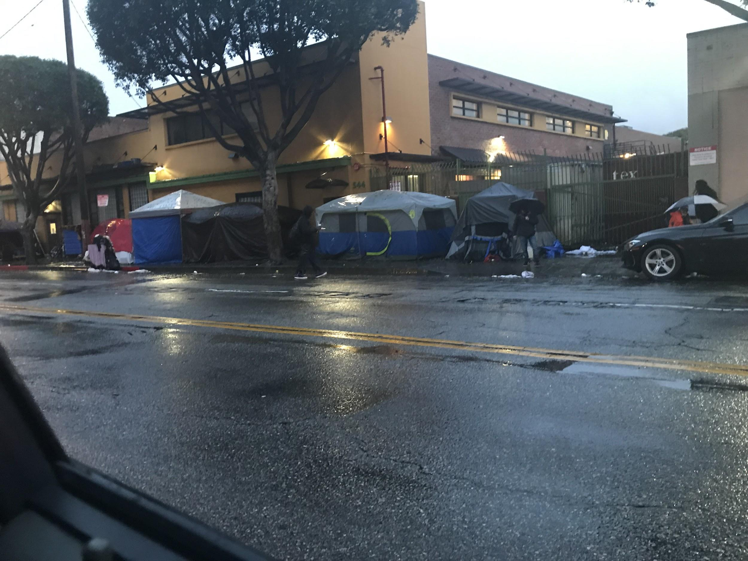
Picture #2
Next to a shelter home
Blocks filled with homeless people.

Slide 6
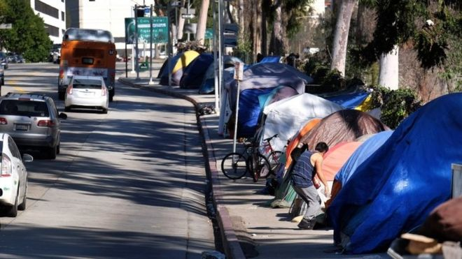
Picture #3
Next to the 405 freeway

Slide 7
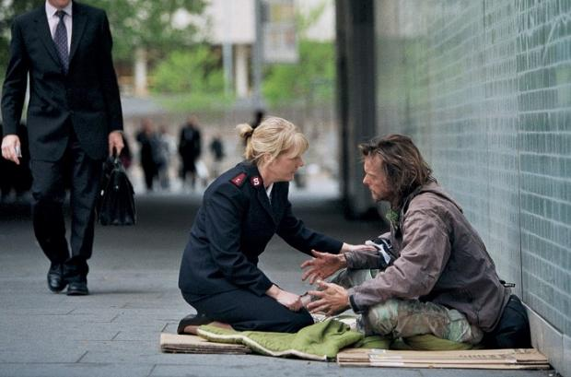
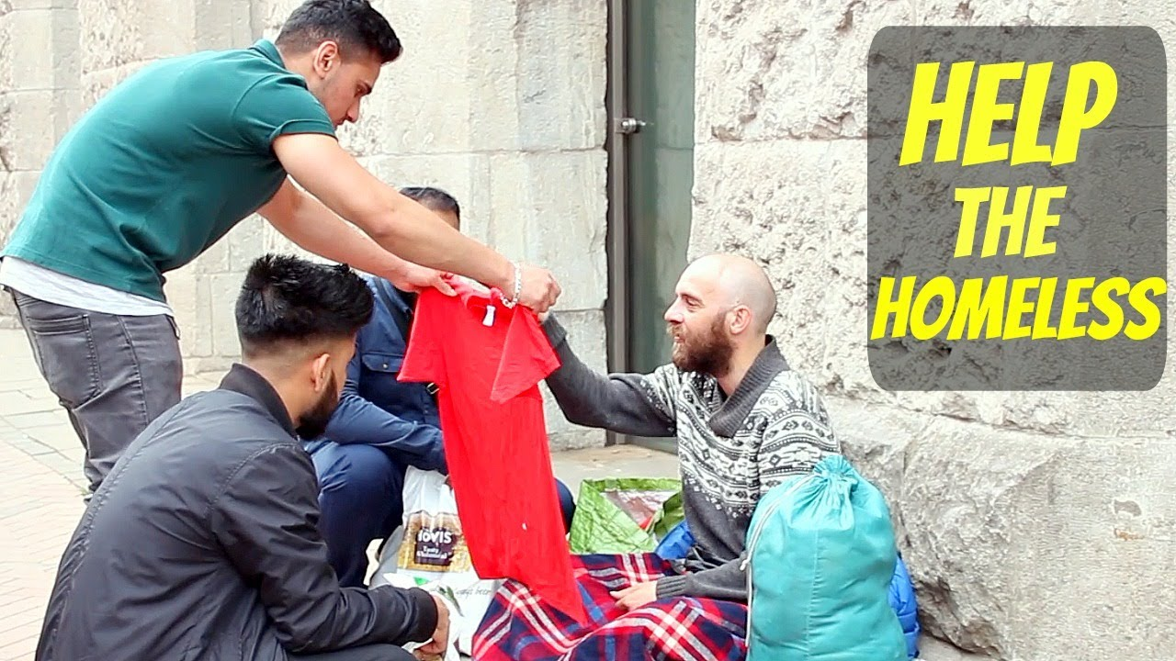
Solution

Slide 8
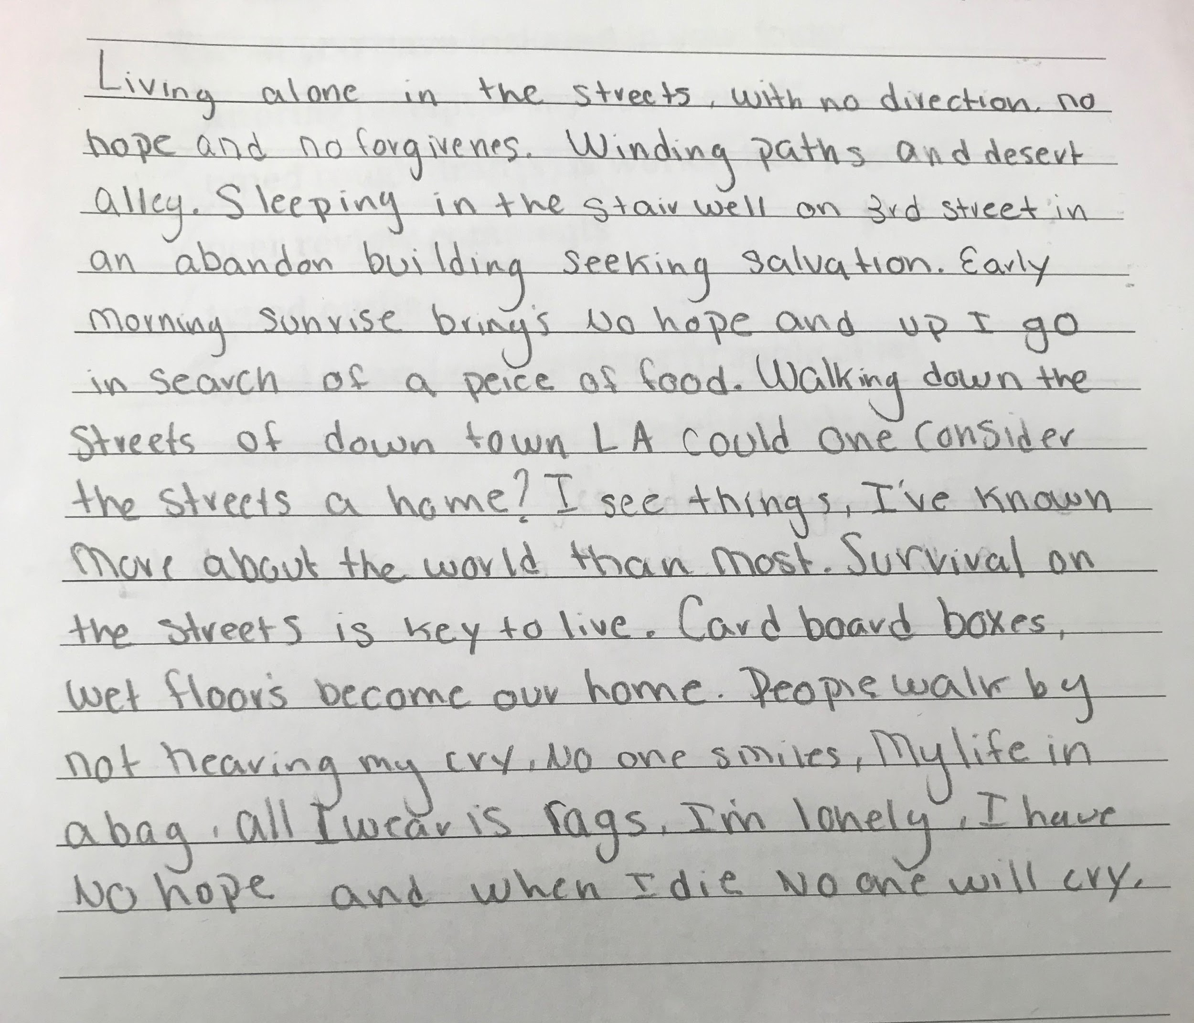
Video
https://youtu.be/HI6GRSgRyzw

