Slide 1
Los Angeles Drug Reform
Jade Morris
Eng 350

Slide 2
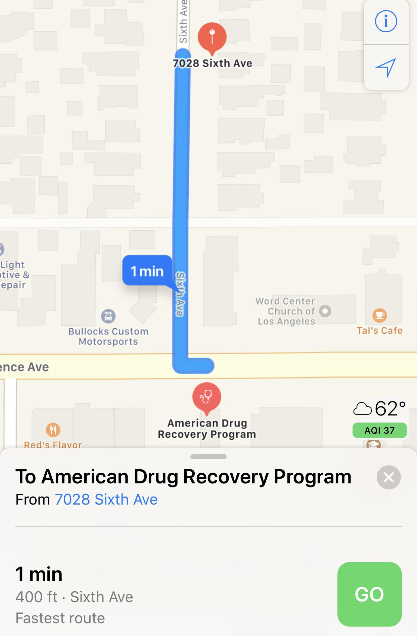
This image shows the distance between a daycare center and
what is medical marijuana dispensary shop disguised as a
drug recovery center.

Slide 3
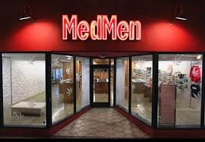
Hollywood Medical Dispensary

Slide 4
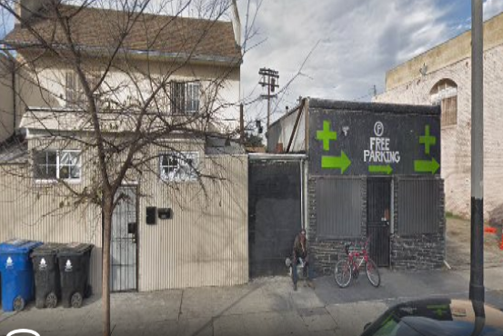
South Central Dispensary

Slide 5
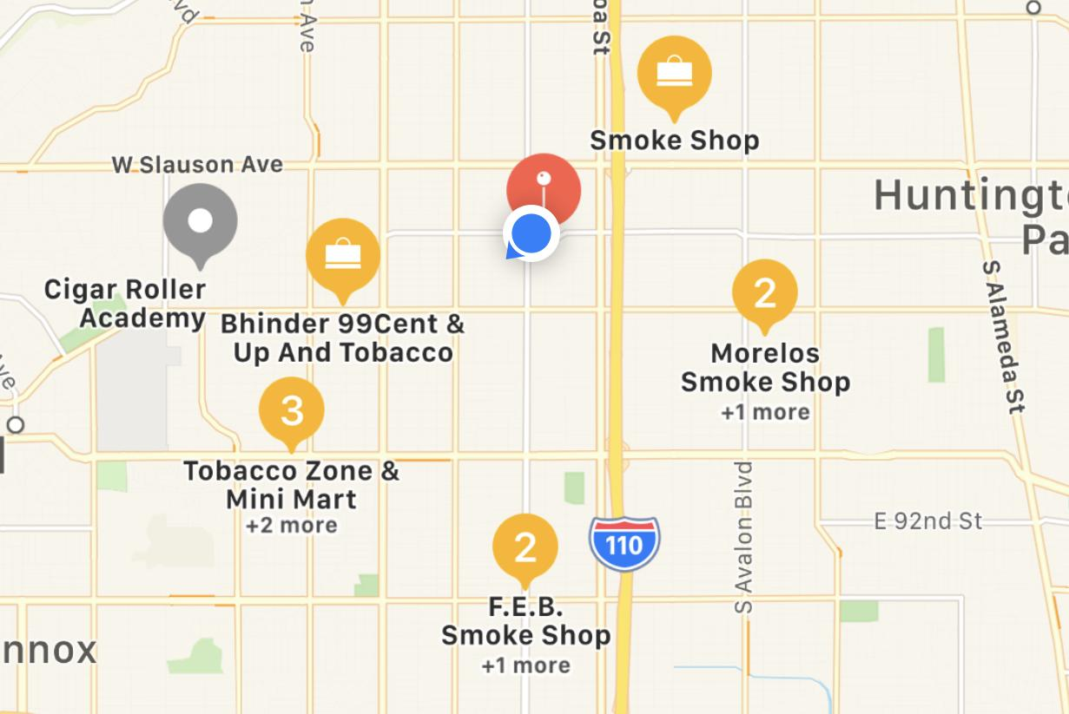
Noted Tobacco Store within my neighborhood

Slide 6
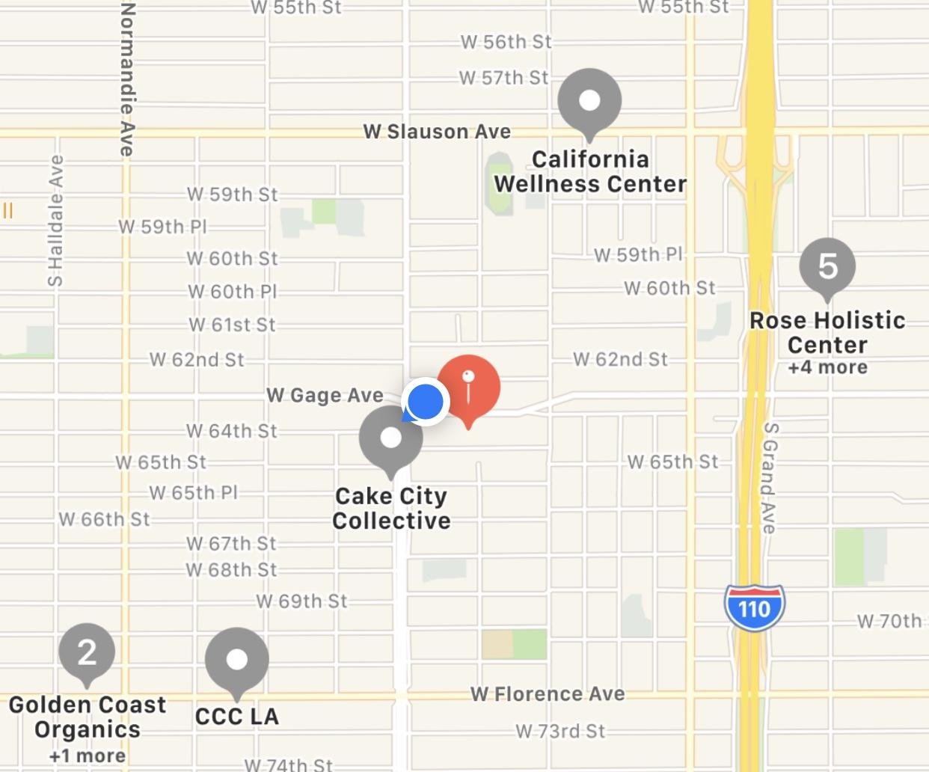
Legally ran Medical Marijuana Dispensaries in
my neighborhood.

Slide 7
It’s the Hood
They can shoot they can kill
Because it’s the hood
It’s the city of Angeles ran by Satan
Because it’s the hood
There’s gangs, there's, violence, there’s tragedy
Because it’s the hood
No consideration for the struggles faced south of the 10 freeway
Because it’s the hood
Out of sight out mind
Because it’s the hood
The 5 o’clock news tell the story of drugs, murders, and victims
Because it’s the hood
The issues are exploited but not addressed
Because it’s the hood

Slide 8
