Slide 1

HIP/SLICE “Fix-It” Presentation
Attachment Anxiety and Morning Drop-off
Anxious Ashley Reed
English 350
9 May 2019

Slide 2
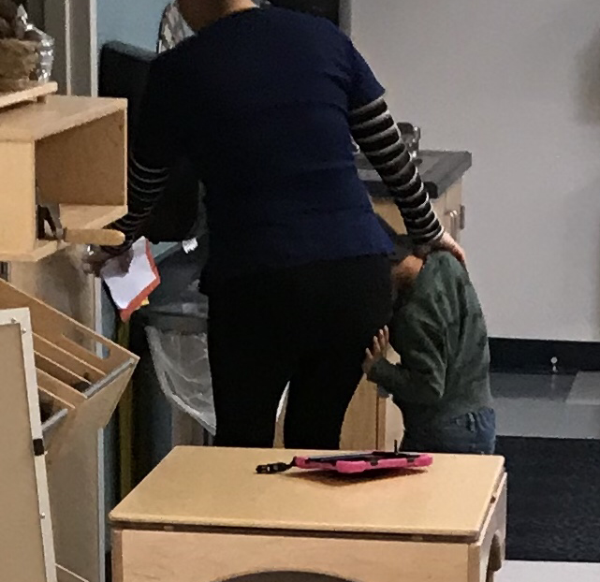
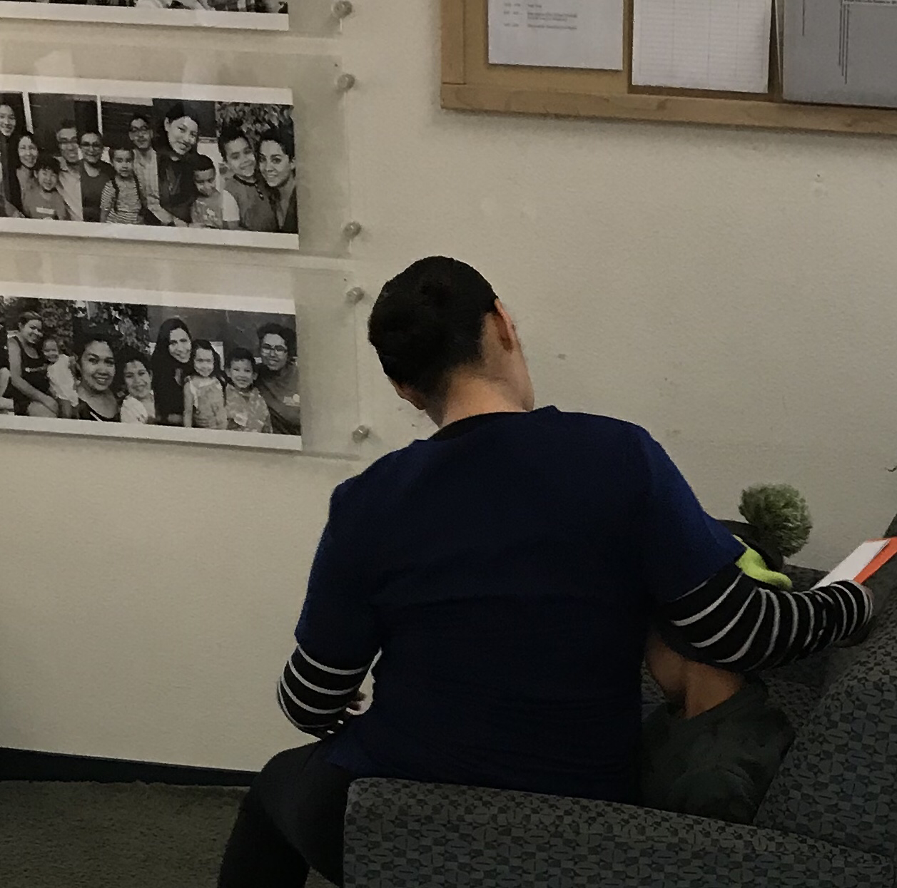
saying goodbye can be hard

Slide 3
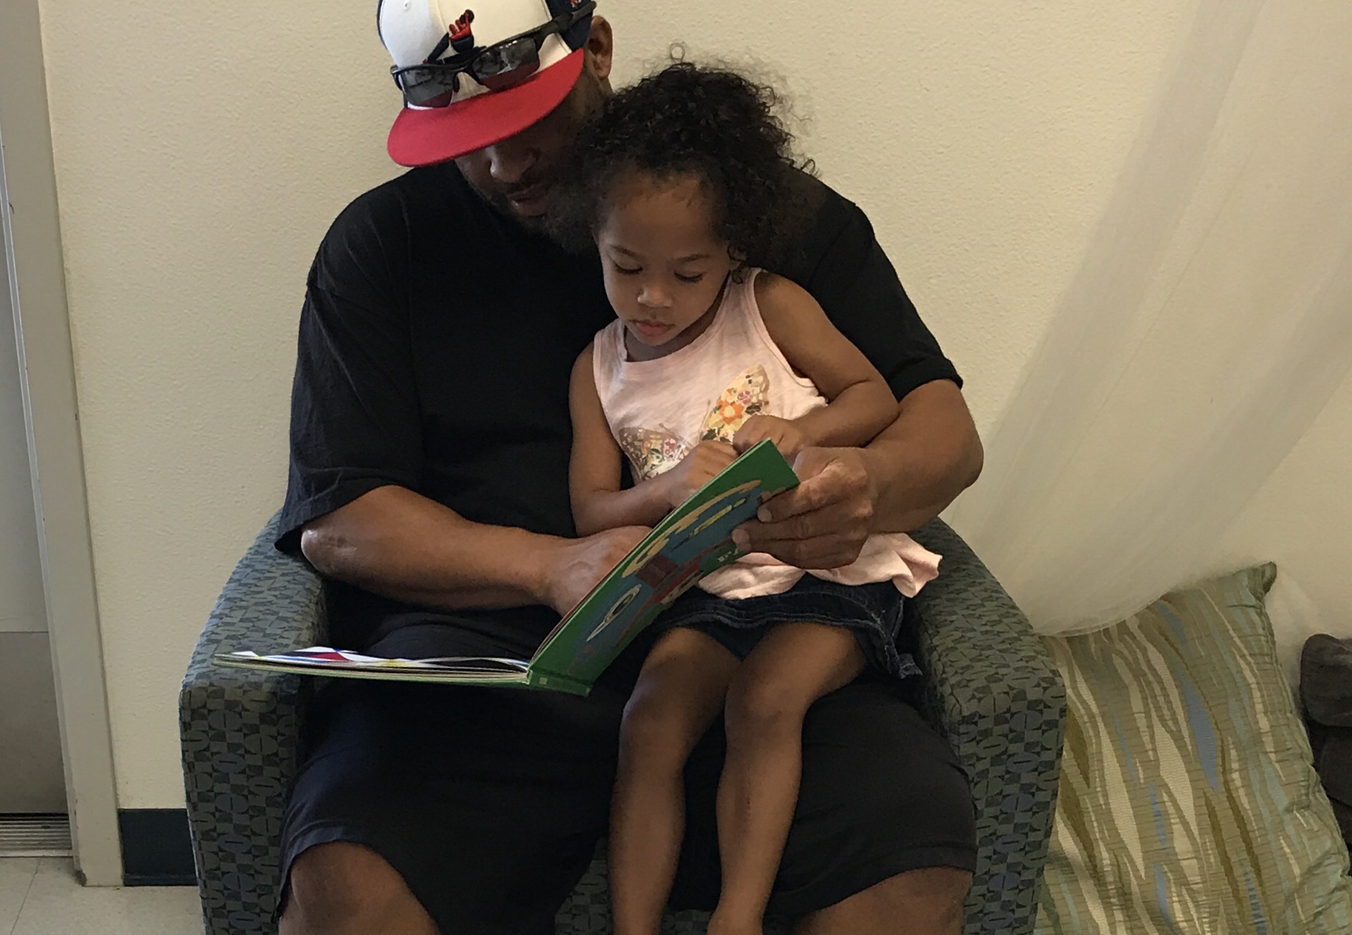

but spending a little time with your child can make the transition easier

Slide 4
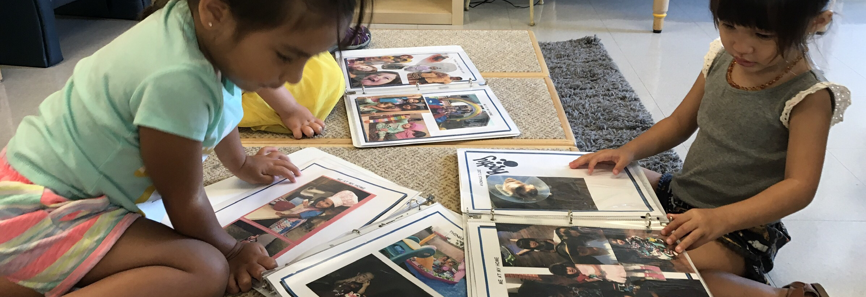
so can a little help from your friends.

Slide 5


Mommy Don’t Go
8 am
And Mommy is in a rush
There is no time to make a fuse
A quick kiss goodbye
They can’t comprehend why
“Mommy don’t go” they cry and cry
“I’ll be back soon” they do not hear
These words do not console their fears
So take a pause
And stay a while
The delay will surely make them smile
And put their little souls at ease
So that everyone’s day will be a breeze

