Slide 1
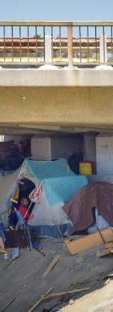
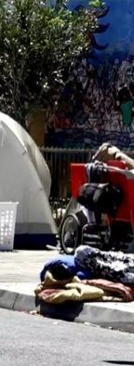
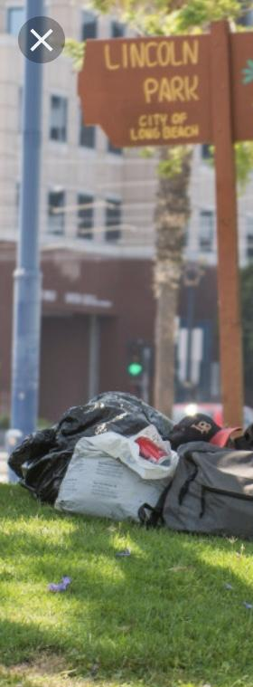
Homeless
Long
Beach
Brittany Davidek May 2019

Slide 2
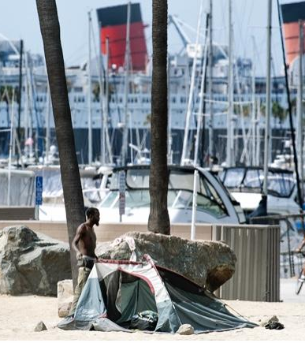
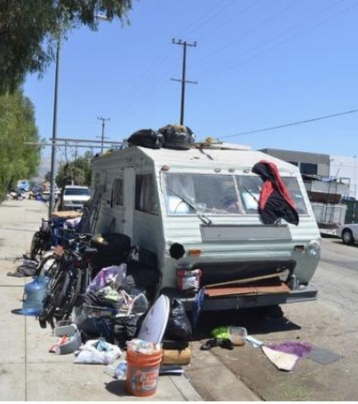
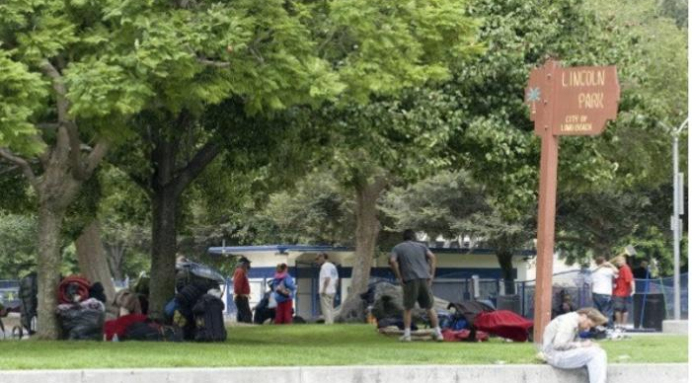
The things we take for granted our what others are longing for.

Slide 3
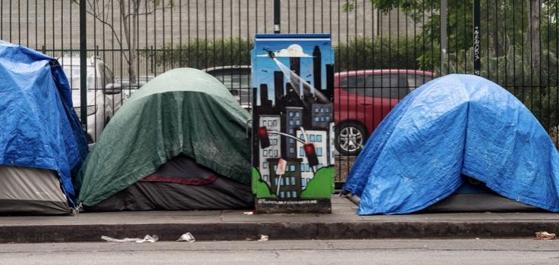
This is home...

Slide 4
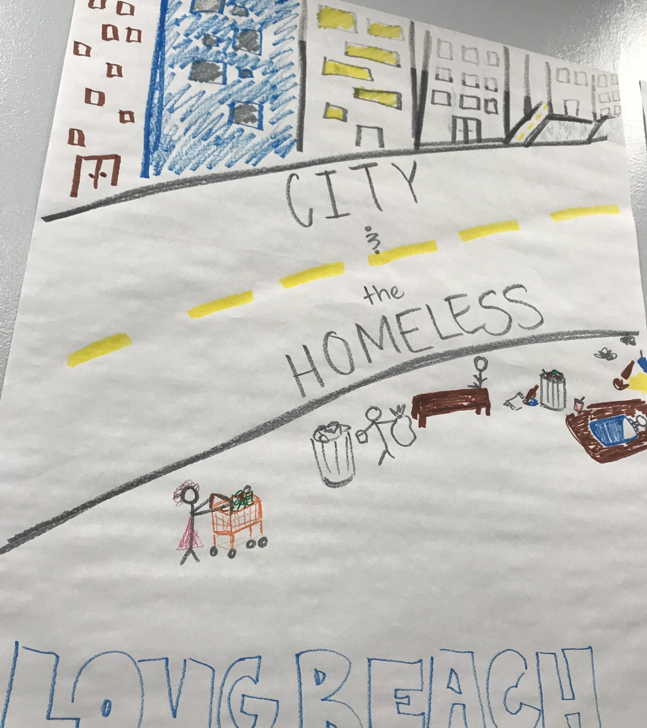
Long Beach
7th Street Downtown

Slide 5
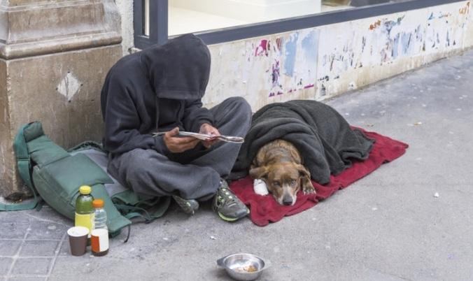
Spoken word
Shopping cart in my living room
Stale chips in the kitchen
Your walking through my hallway
Can’t you see me
I’m cold and shivering
I feed my dog bud before I feed myself
Bud is my only family and friend, yet you judge me as you walk by and smile at bud.
I take car of him and feed him.
You throw away food?
Why don’t you feed me?
I’m hungry
I’m tired
My feet hurt from walking
You have 20 shoes in your closet, and my only pair have 20 holes.
You complained about busy downtown parking.
But your parking in my home.
The street, the cold pavement street,
That is my home.
“Home”
By Brittany Davidek

