Slide 1
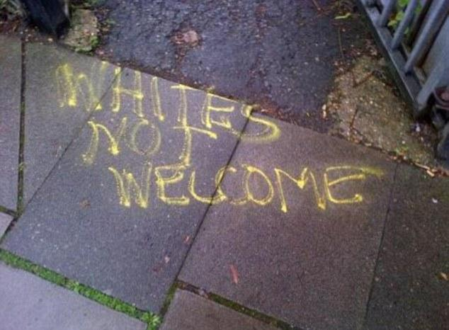
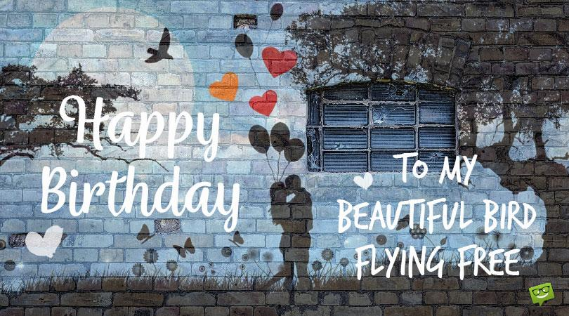

Graffiti-Art Or Not?

Slide 2
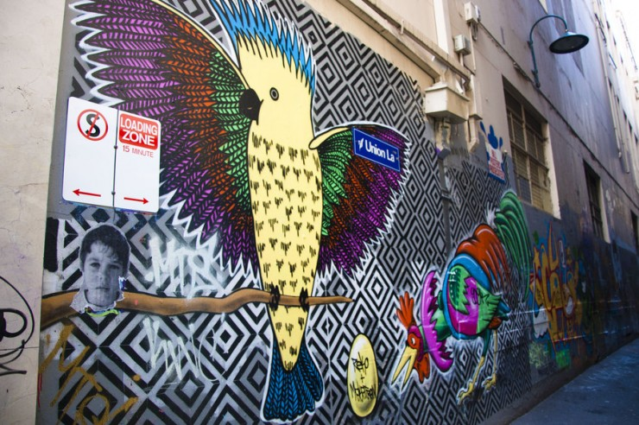
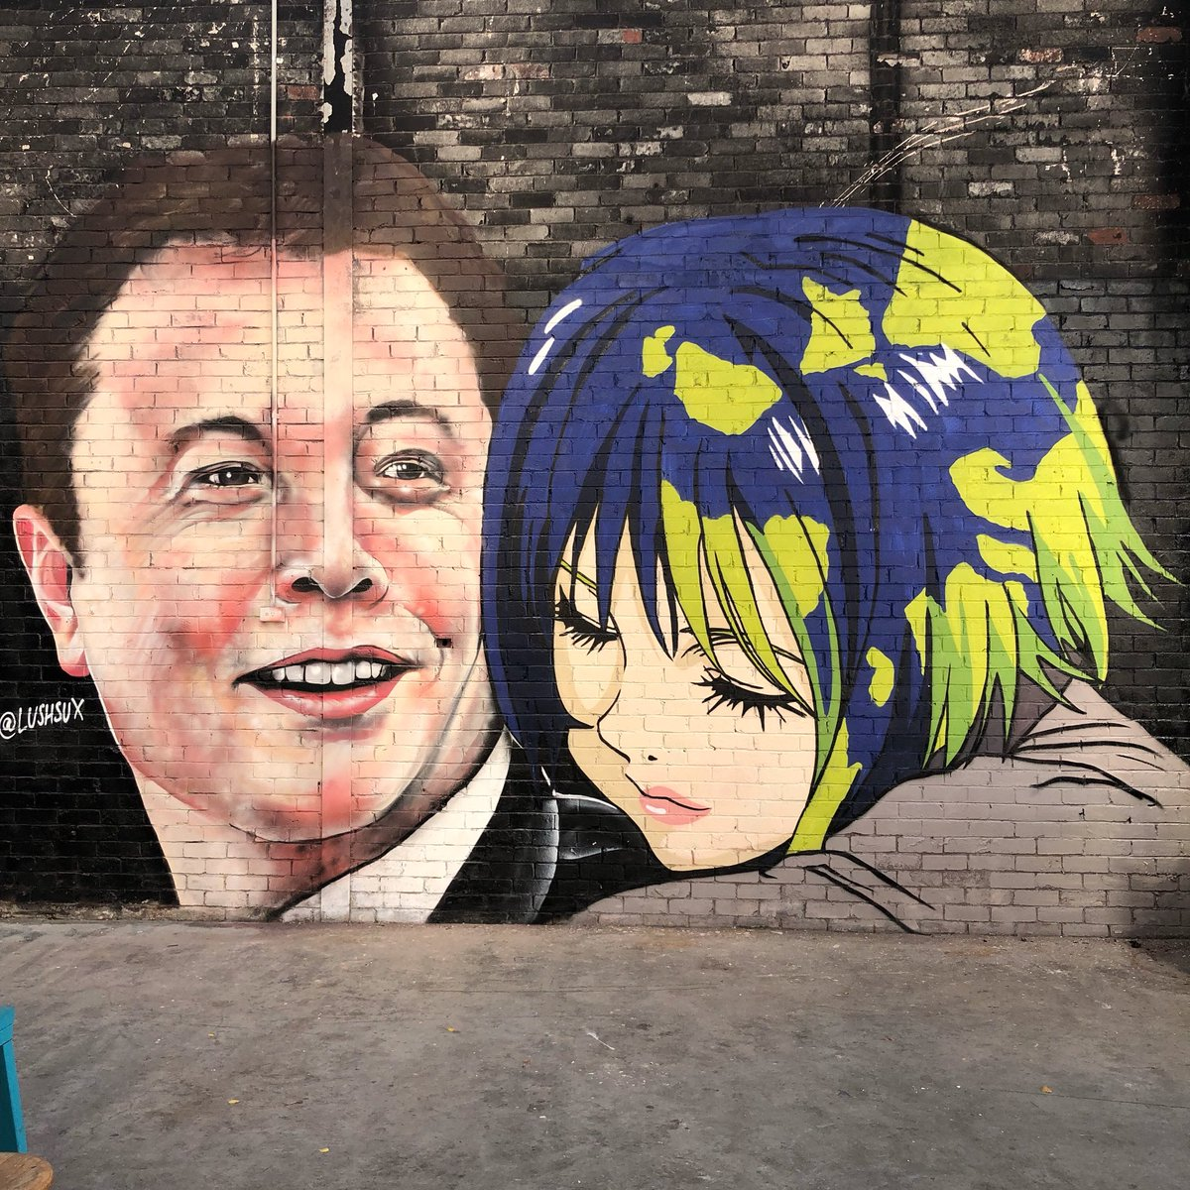
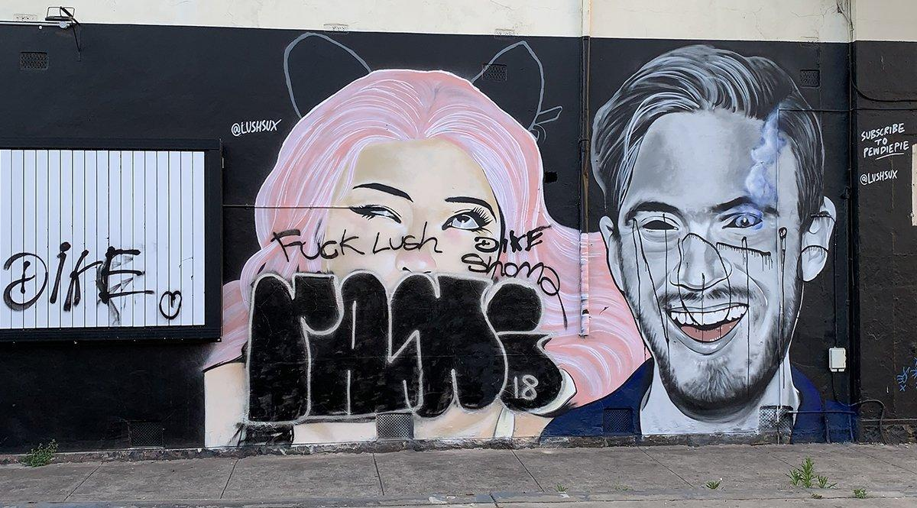
Melbourne,Australia-The City Of Street Art/Graffiti
Melbourne, the capital of Victoria and the second largest city in Australia, has gained international acclaim for its diverse range of street art and associated subcultures. Throughout the 1970s and 1980s, much of the city's disaffected youth were influenced by the graffiti of New York City, which subsequently became popular in Melbourne's inner suburbs, and along suburban railway and tram lines.Here are a few examples of the art.

Slide 3
Recent crackdown on Street Art
Los Angeles, a city once known as the mural capital of the world, issued a citywide mural moratorium in 2002 to crack down on the growing issue of outdoor advertising passing as street art. The ban remained in place until a 2013 ordinance overturned it and set down strict new rules prohibiting commercial messages in street murals.

Slide 4
New Street Art/Graffiti
But in one of the first murals to go up the following year, by famous graffiti artist Risk, onlookers quickly noticed the spade-shaped logo of Miller Fortune beer. The advertisement sparked outrage and was quickly removed for violating the ordinance.

Slide 5
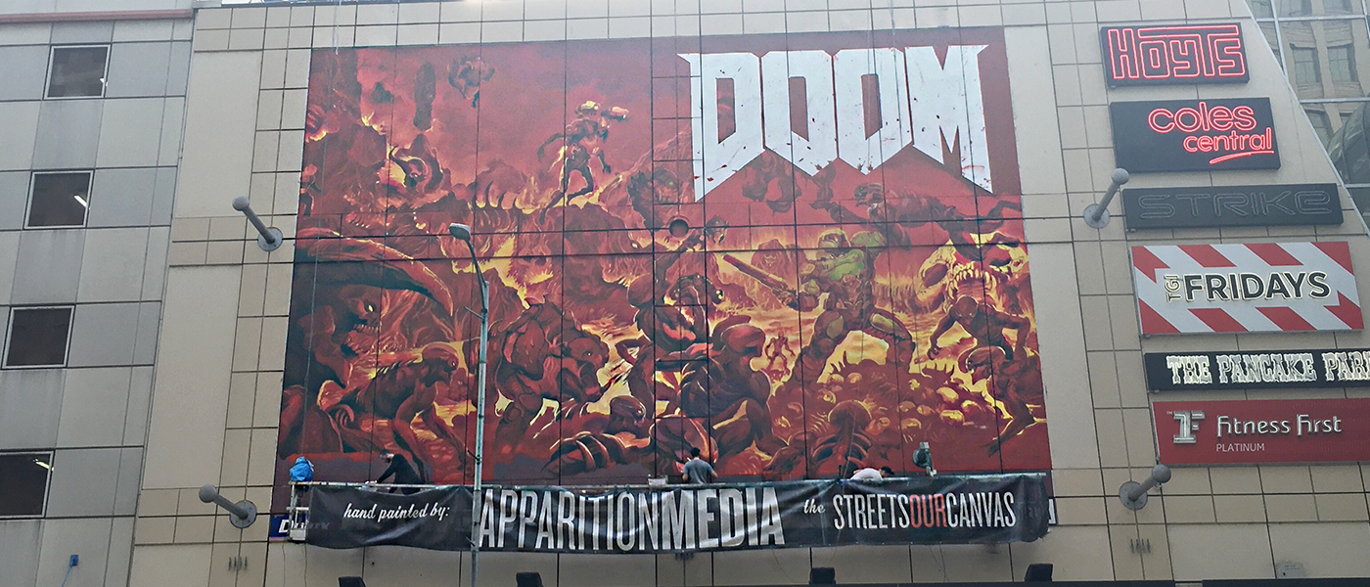
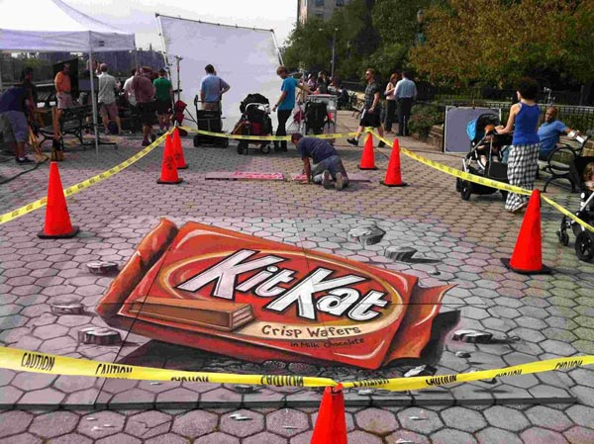
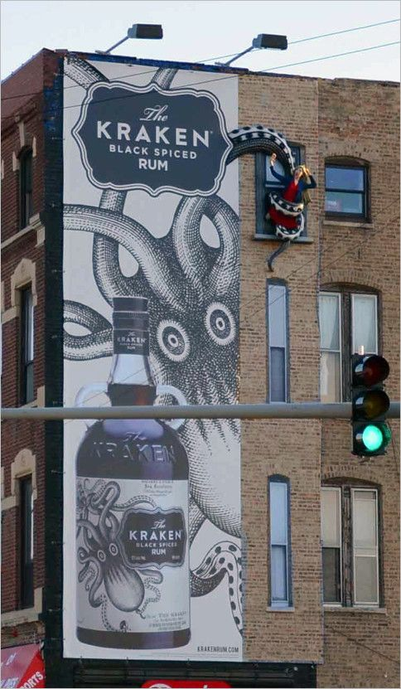
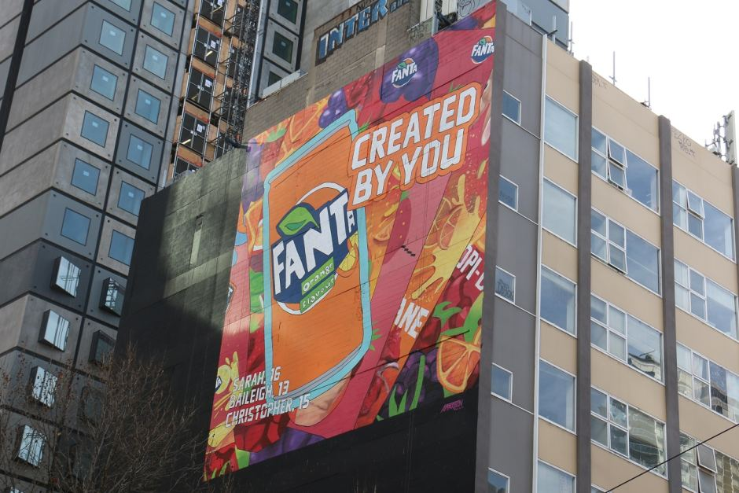
Examples

Slide 6
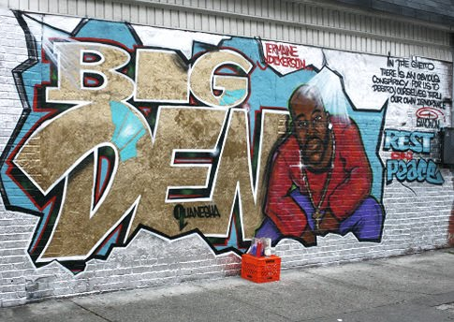
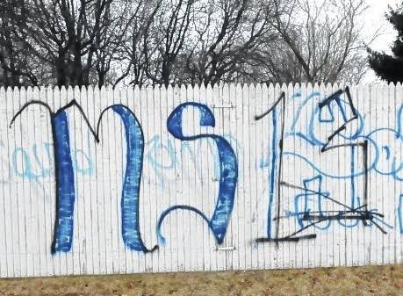
Authentic Graffiti

Slide 7
Spoken word
https://youtu.be/LbimVah14I0

