Slide 1
High Impact Practices (HIP) Service
Learning Internship Community
Engagement (SLICE)with Spoken
Word “Fix-It” Presentation
Vincent Castillo
A society in Dire Need of help
English 1B
20 May 2019

Slide 2
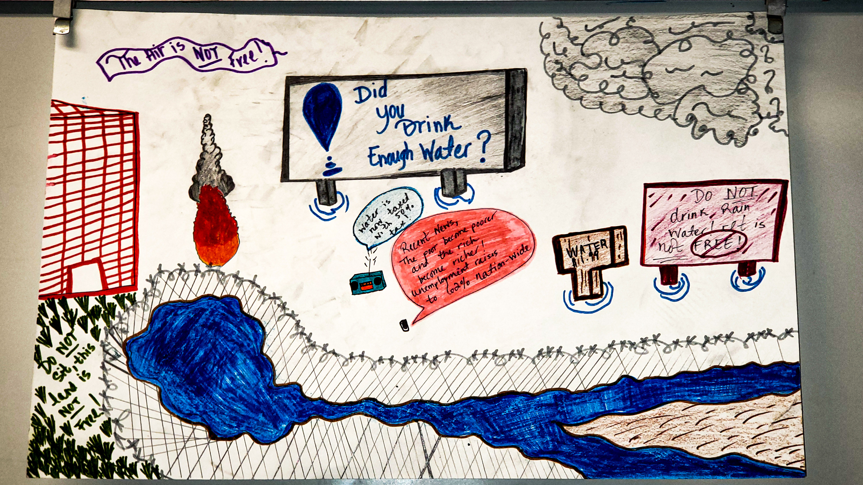
Poster: A Land of Greed

Slide 3
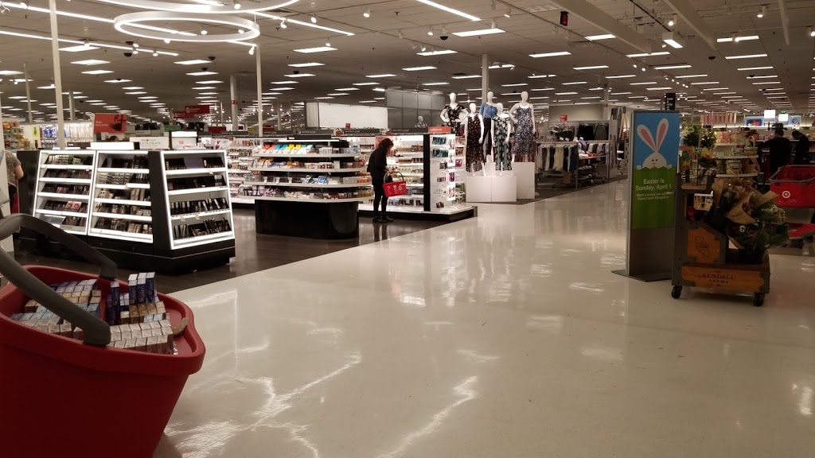
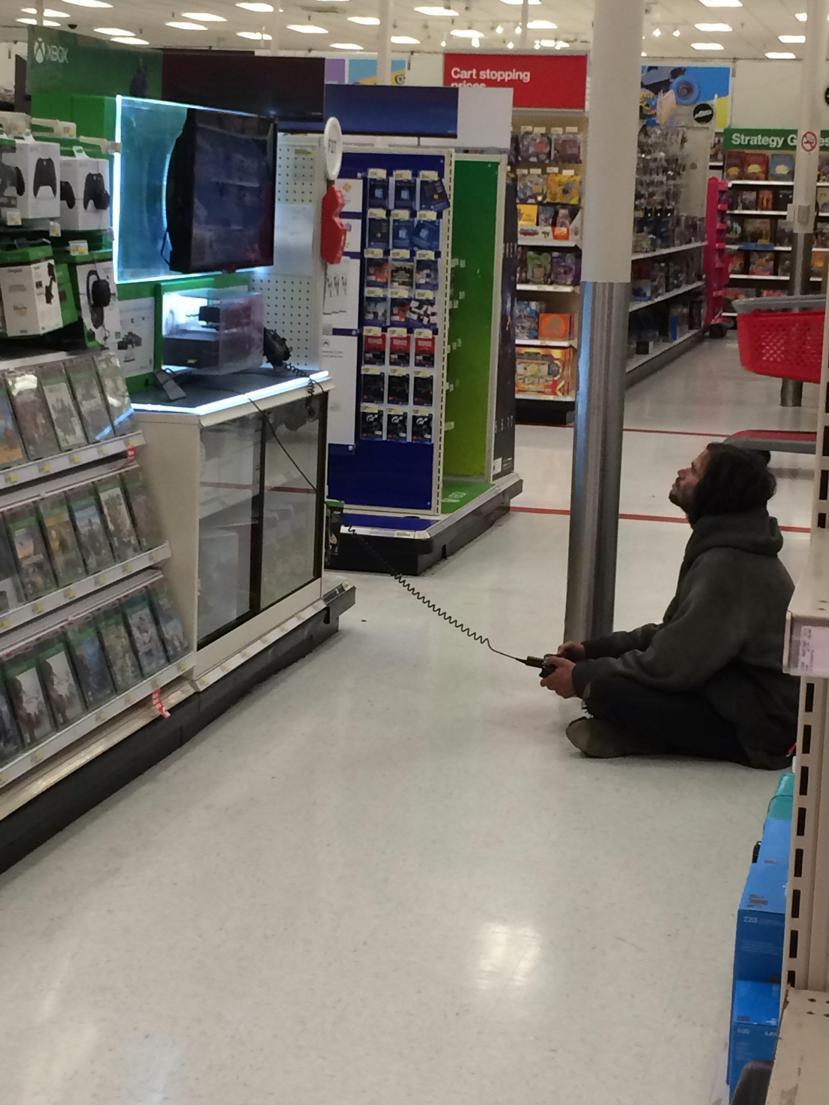
Target: Observing Homelessness

Slide 4

Mental Illness and Physical Disabilities

Slide 5
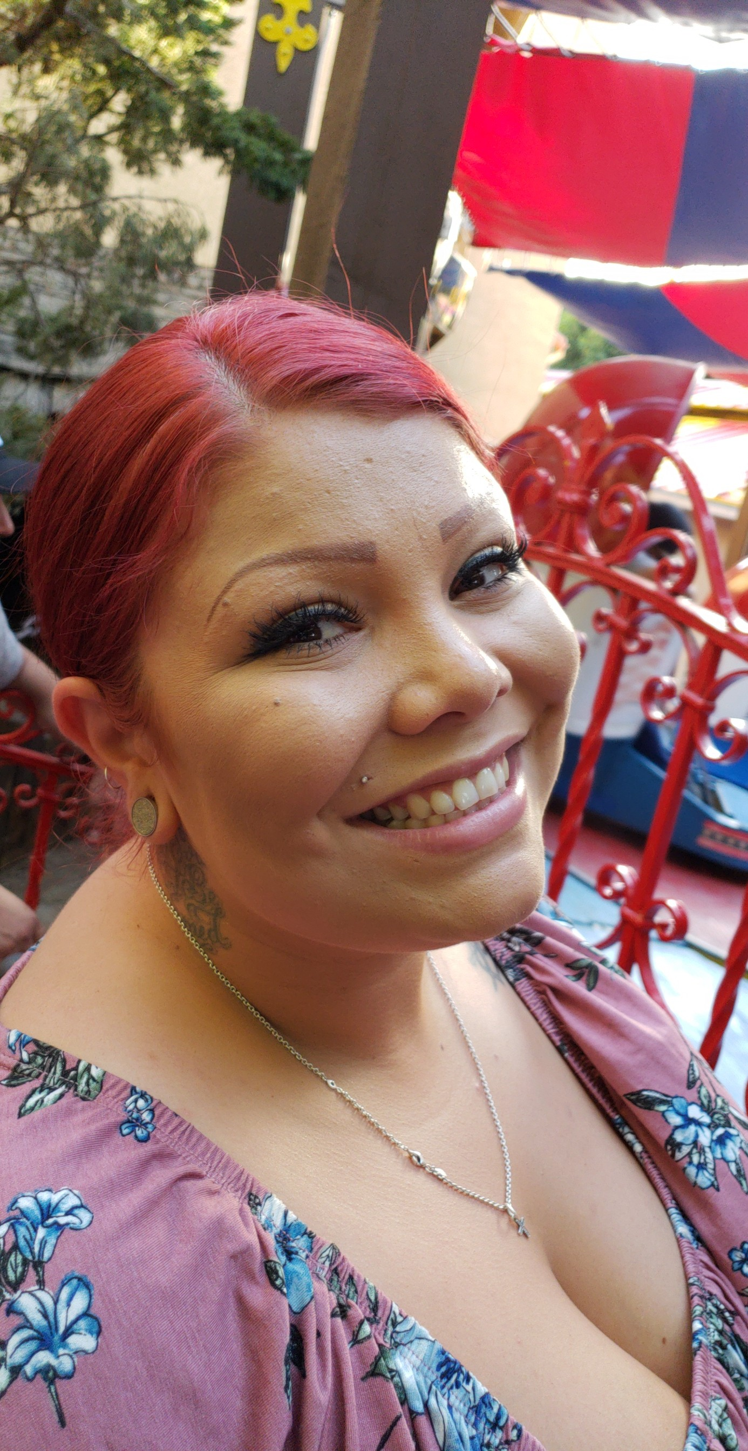
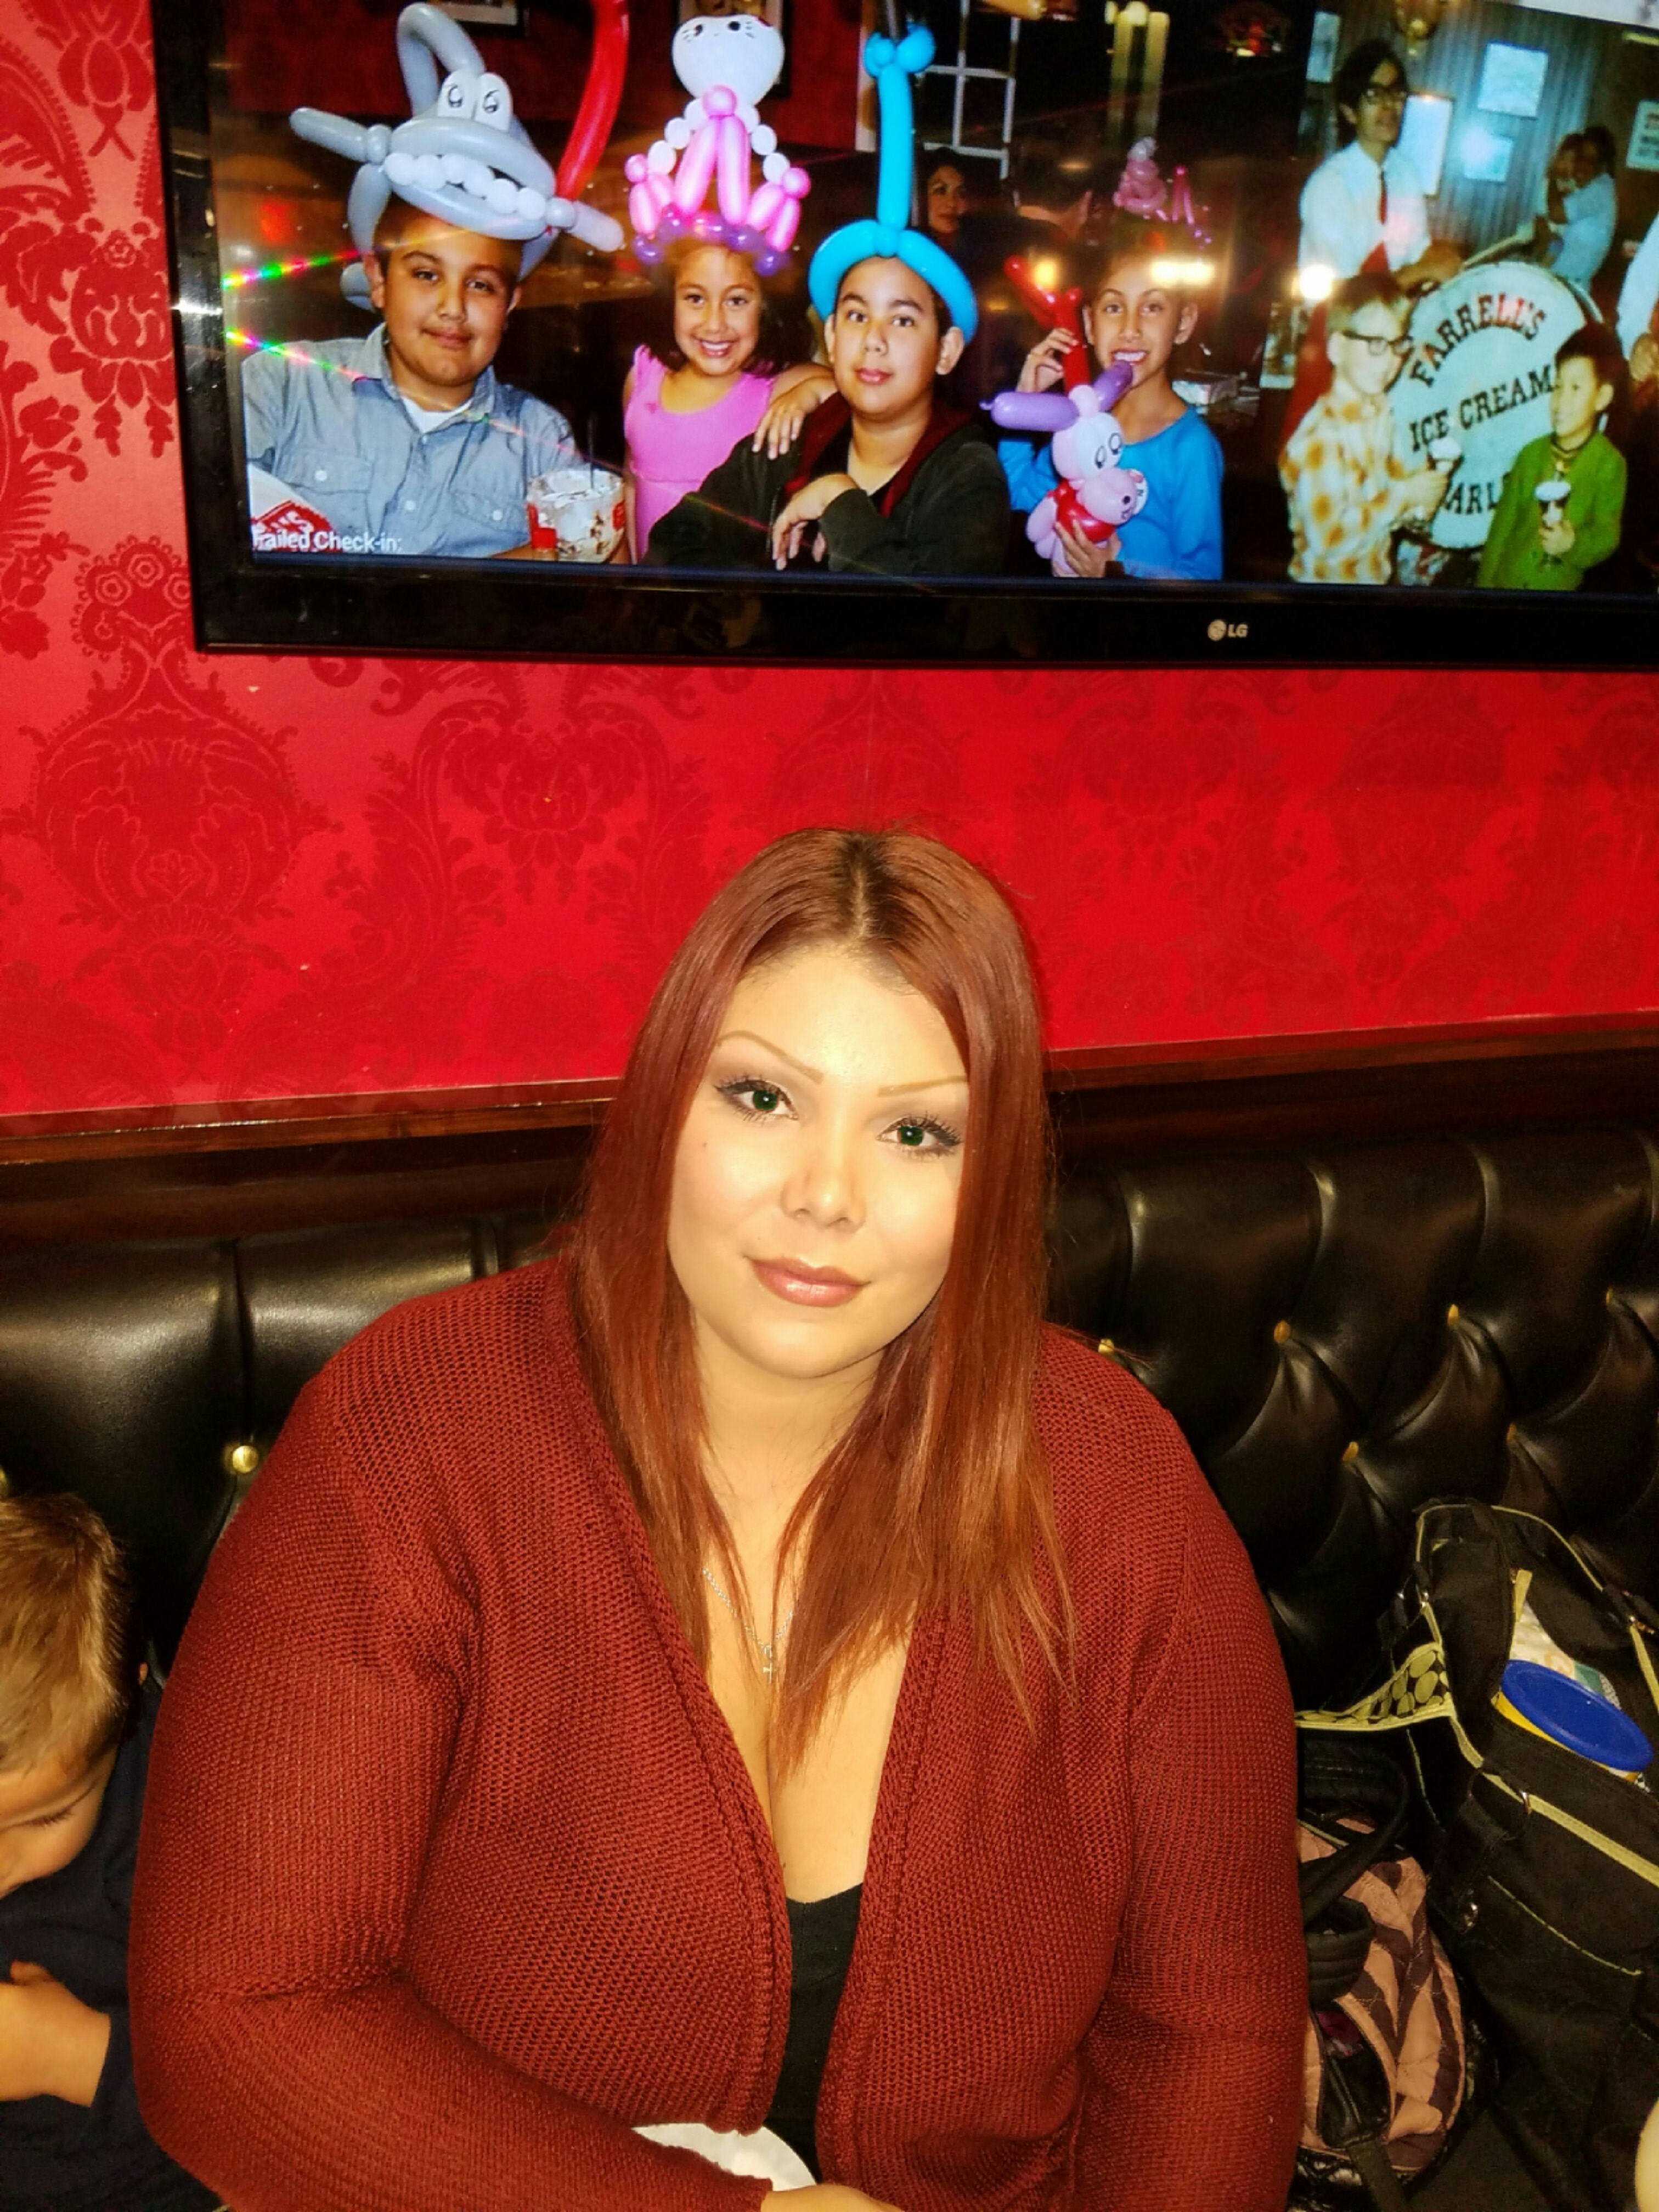
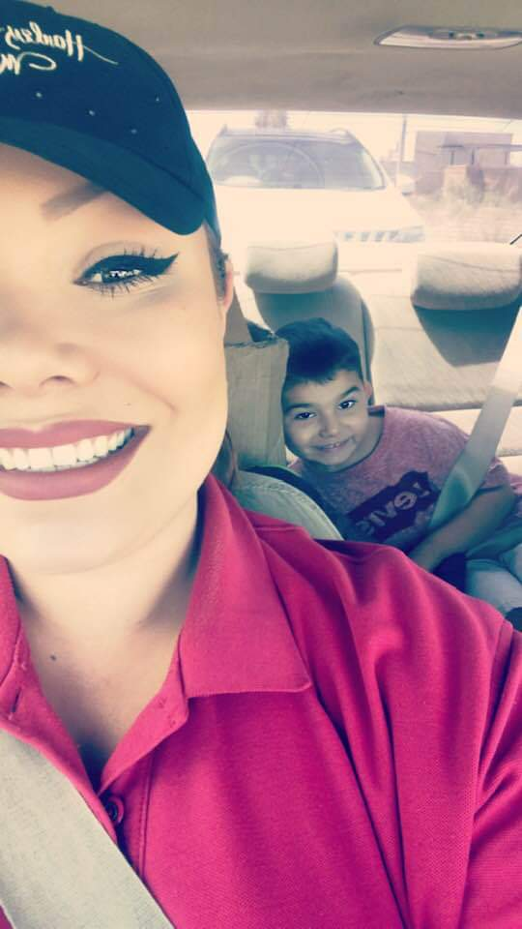
Far From Home

Slide 6
Spoken Word
https://youtu.be/8wyGjhVOPOE

