Slide 1
Drive Sober.
A Presentation Against Drunk Driving
by Octavio Castillo

Slide 2
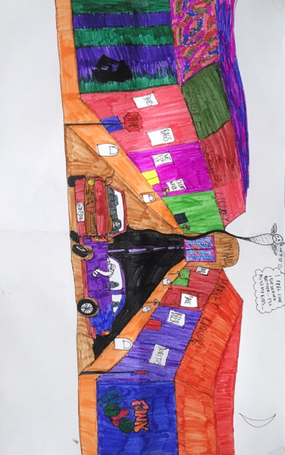
Poster

Slide 3
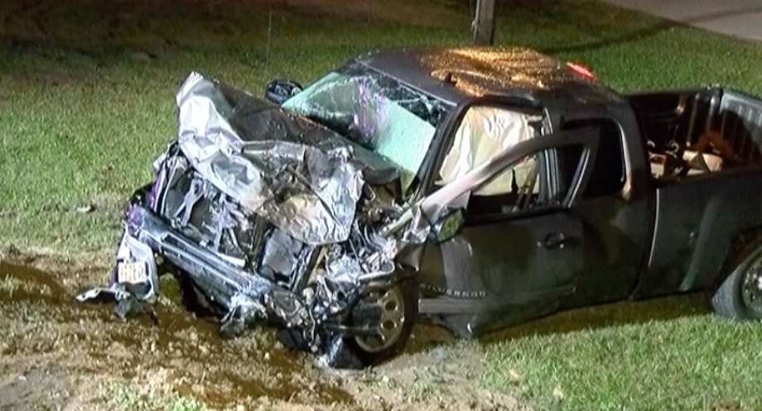
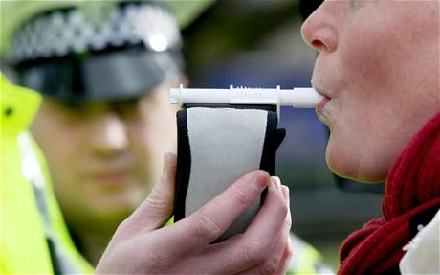
Photos

Slide 4
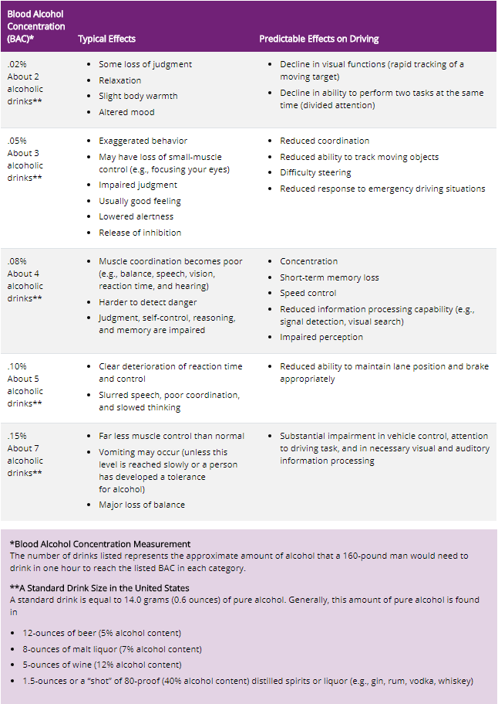

Photos

Slide 5
Spoken Word
“You just had a few” you tell yourself
“It’s not your fault” you tell yourself
But it’s just not enough
“I didn’t see him” you tell yourself
You say anything to convince yourself
But it’s just not enough
The paramedics tried it all
From CPR to religious calls -->
But this man’s gonna die tonight because you couldn’t say “enough”
Your friends begged you to take you home
You swore up and down you’d make it home
This man will never go home again, see his family again, enjoy sunny days again
Were those beers good? I bet they weren’t that good, no, not good enough
https://www.dropbox.com/s/u223qbqgpszl1zr/20190517-233941.m4a?dl=0

