Slide 1
High Impact Practices (HIP) Service
Learning Internship Community
Engagement (SLICE)with Spoken
Word “Fix-It” Presentation
Kiara Barcenas
Graffiti
English 1A
5/19/19

Slide 2
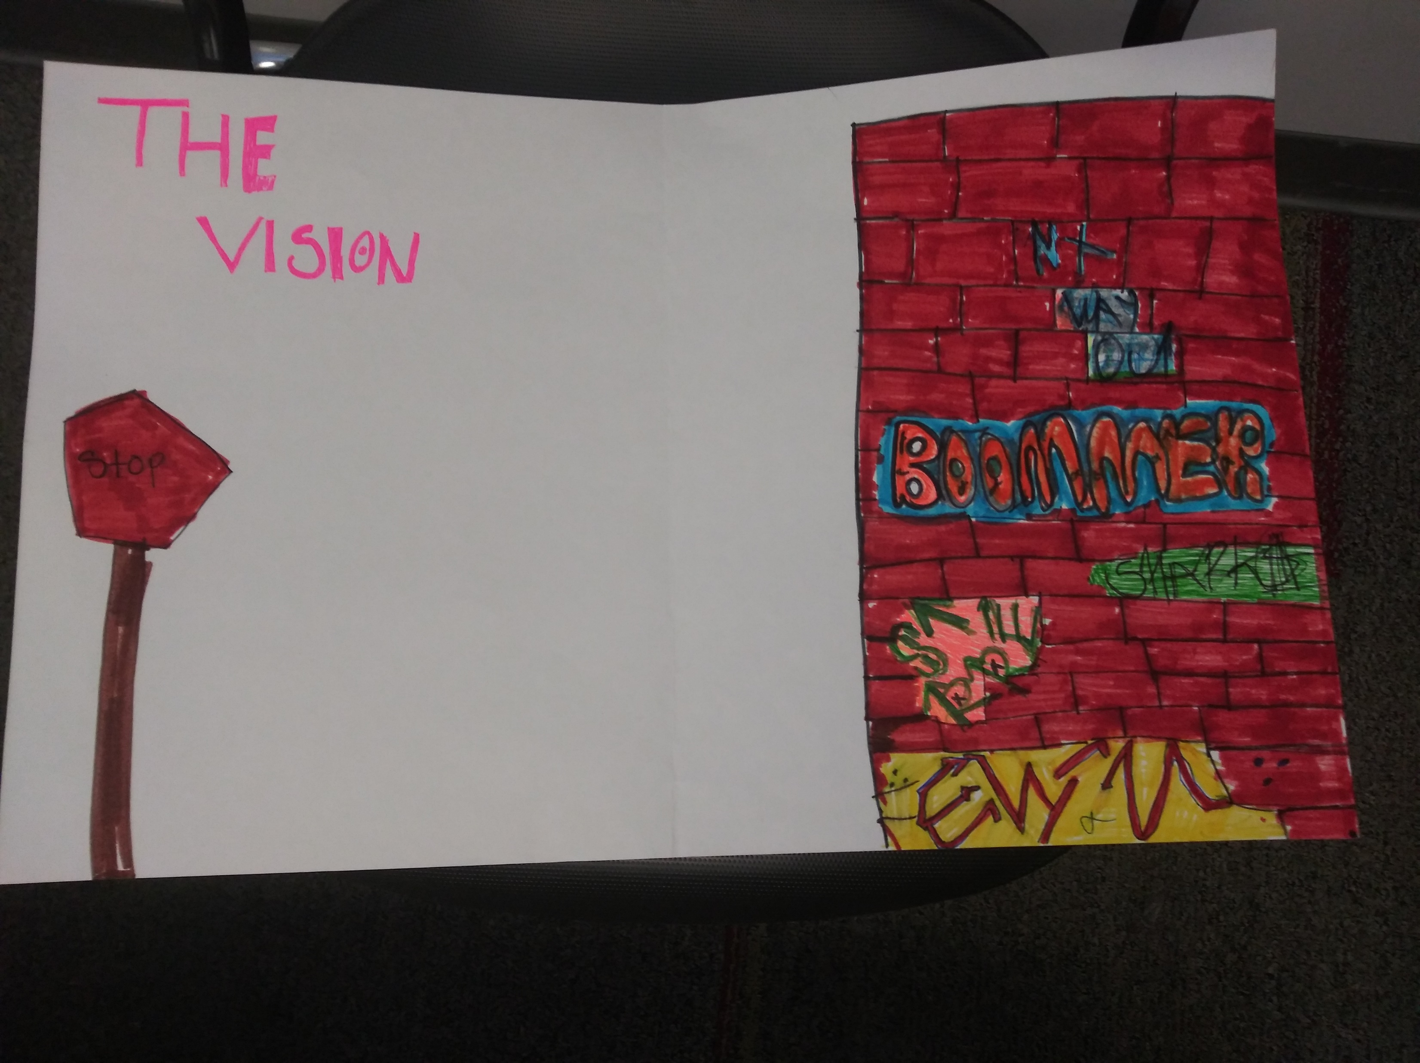

Slide 3
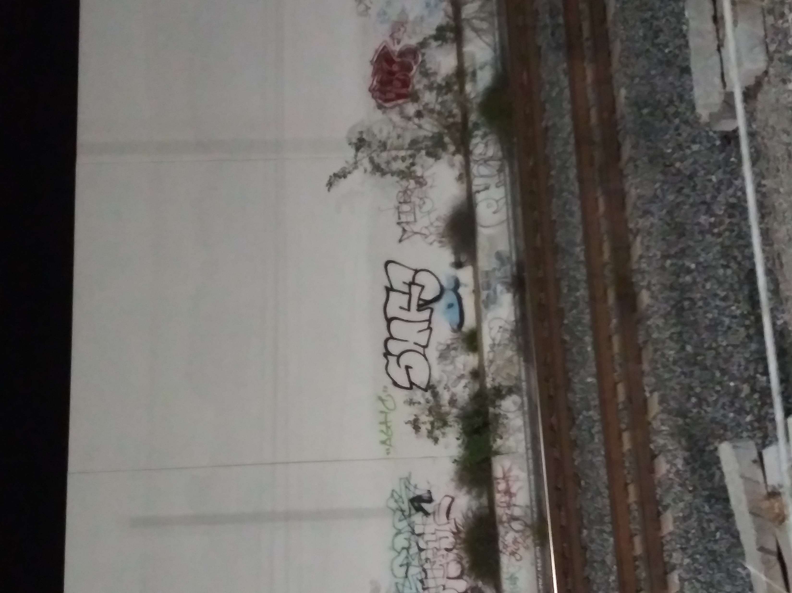

Slide 4
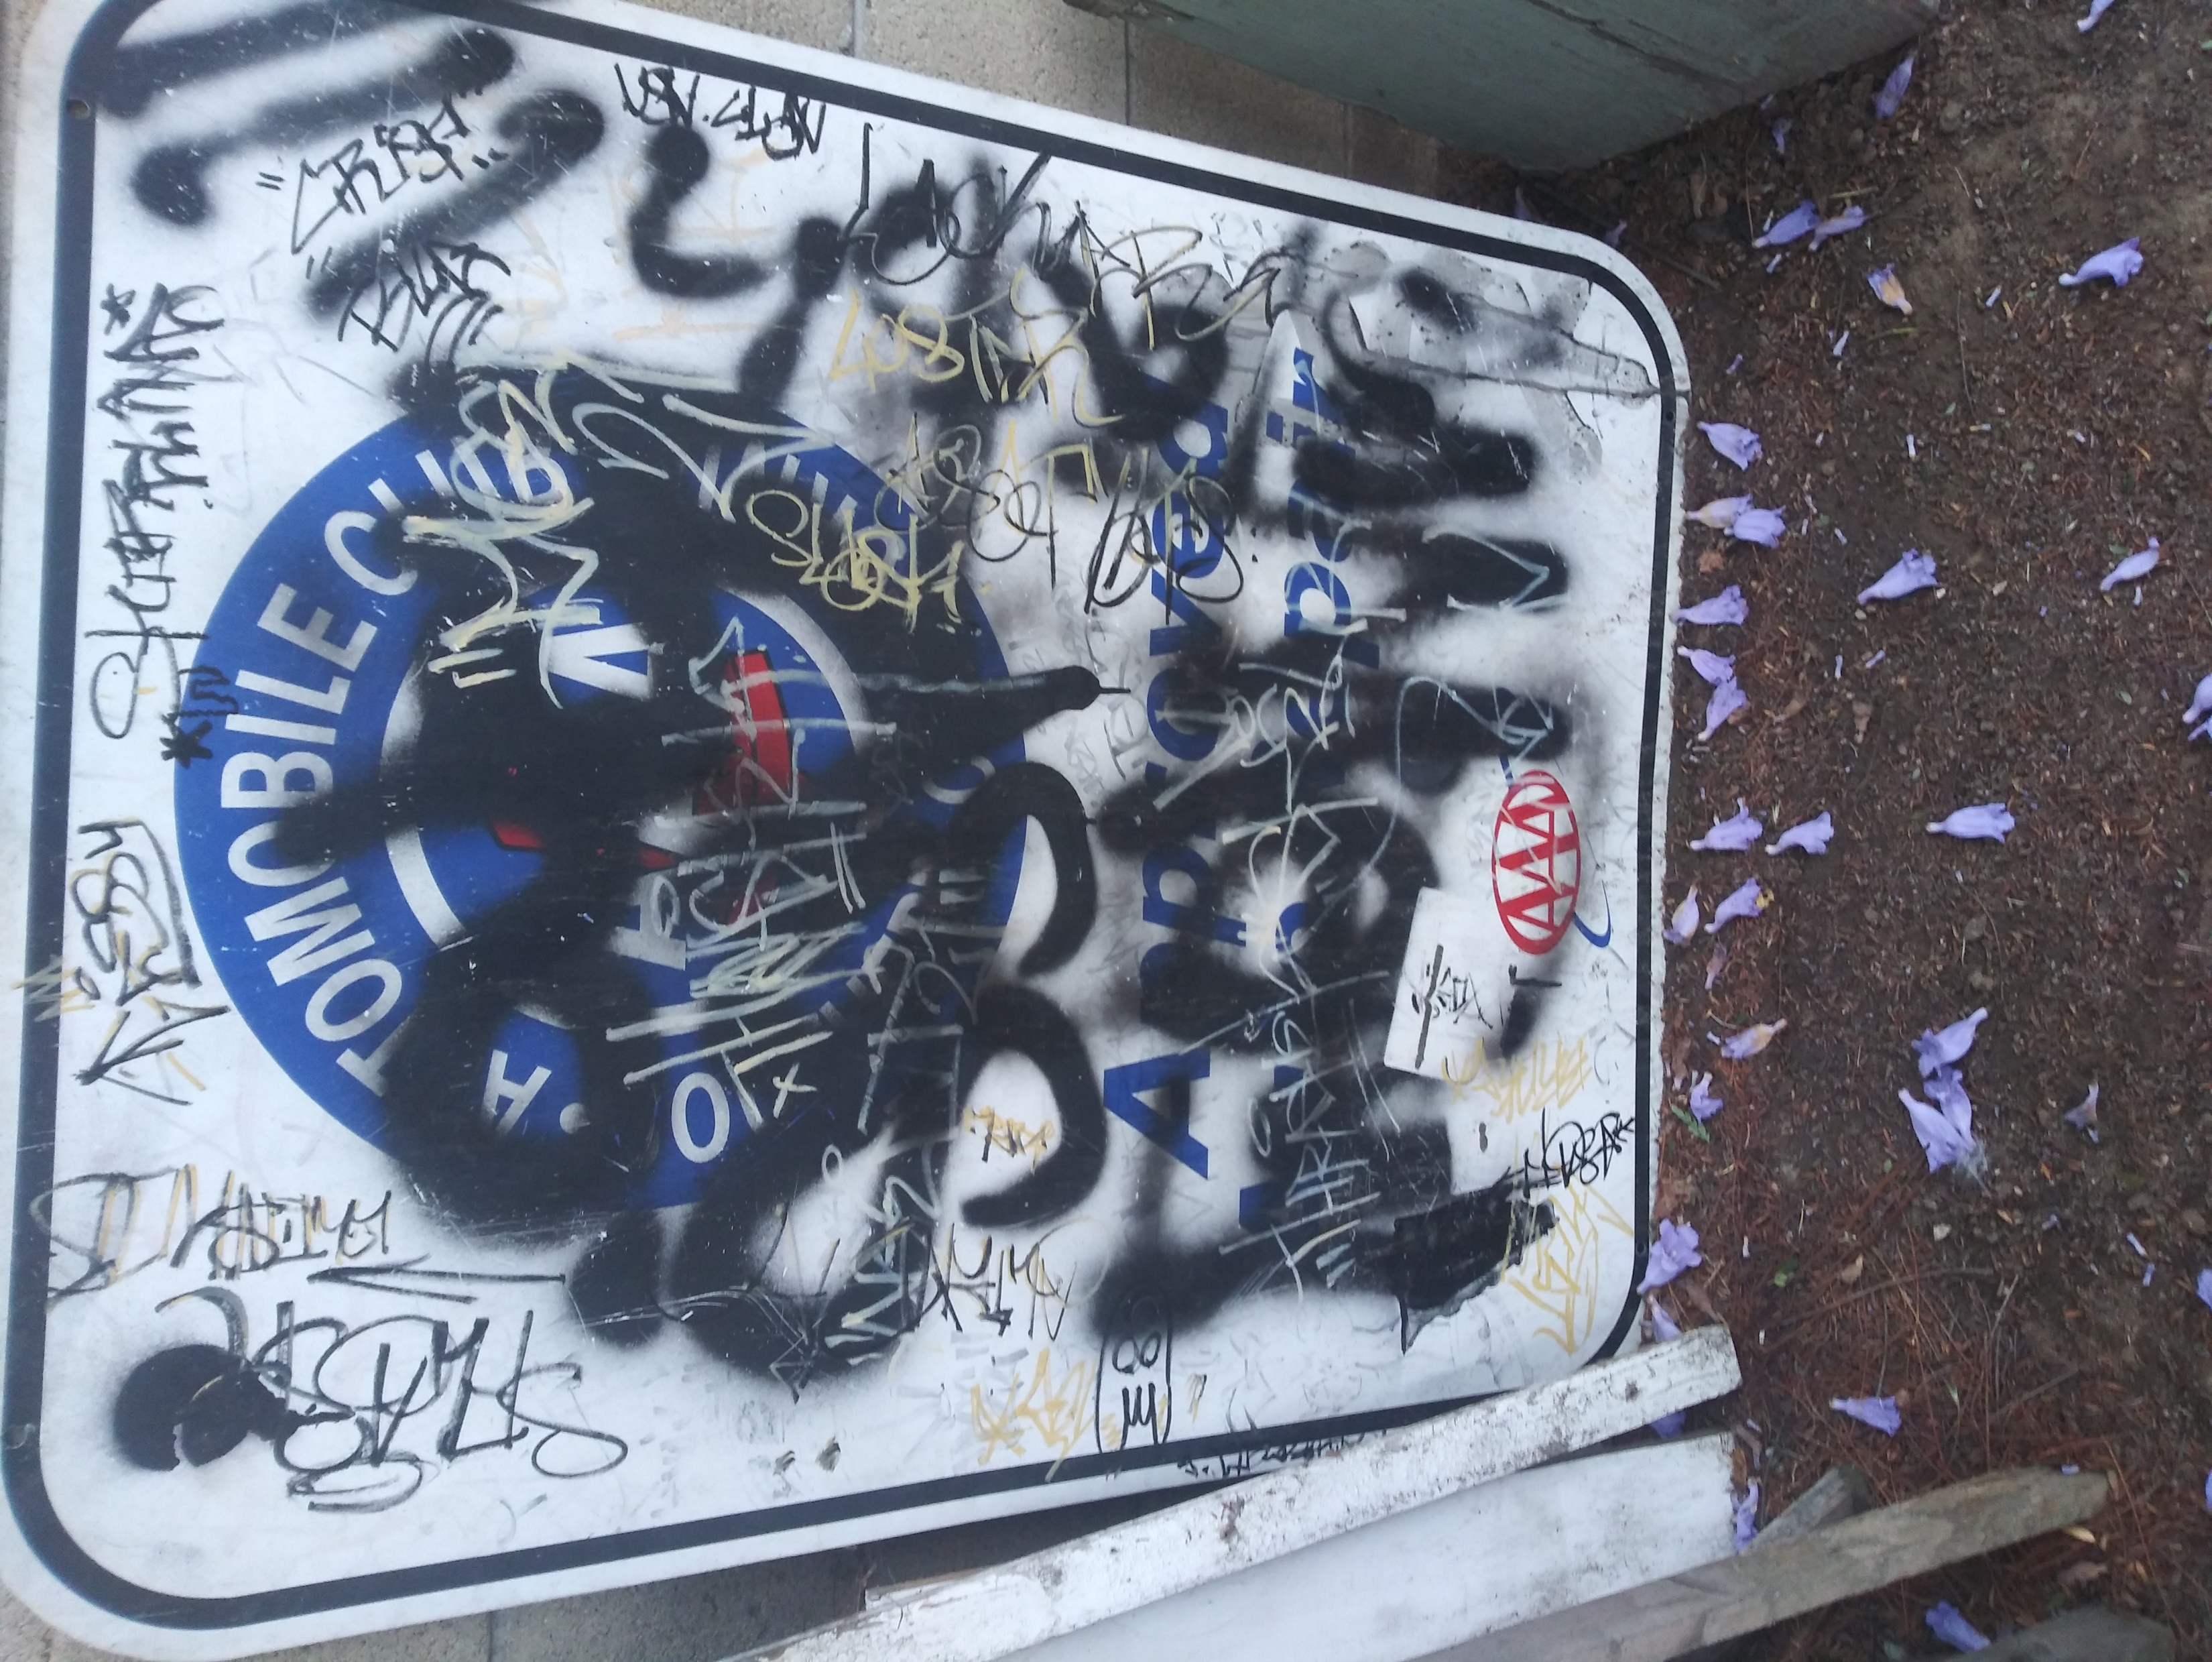

Slide 5
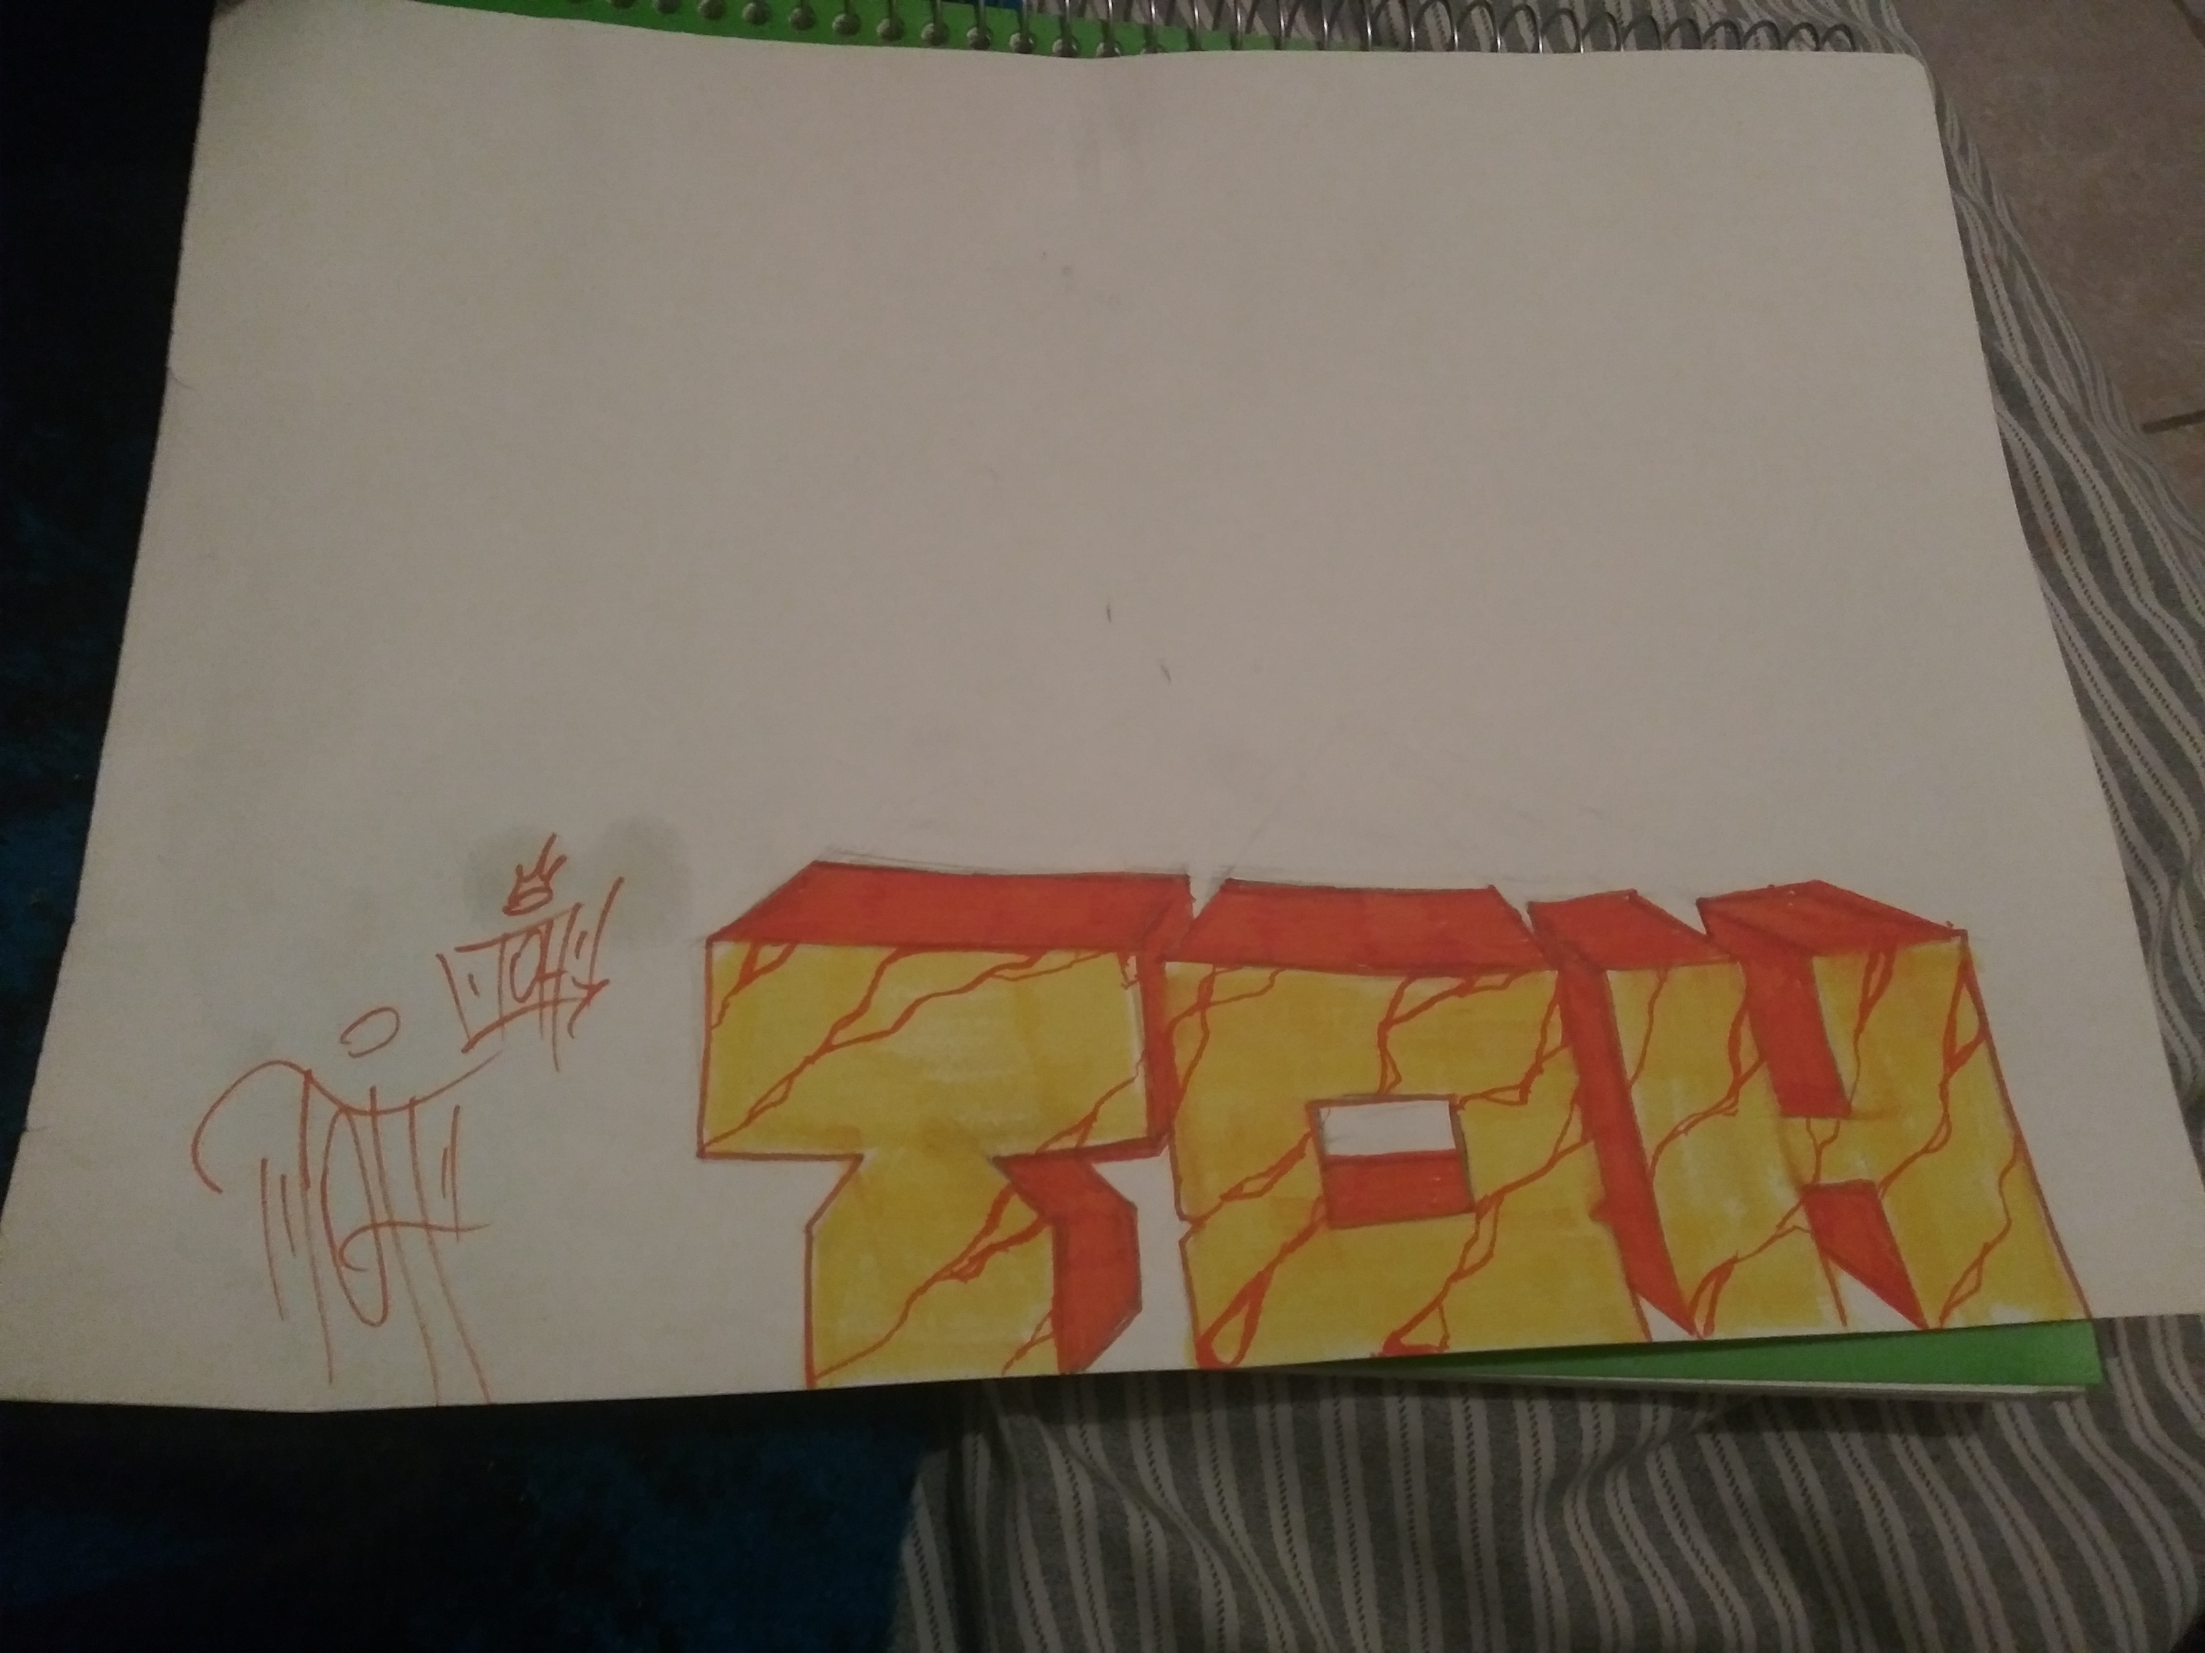

Slide 6
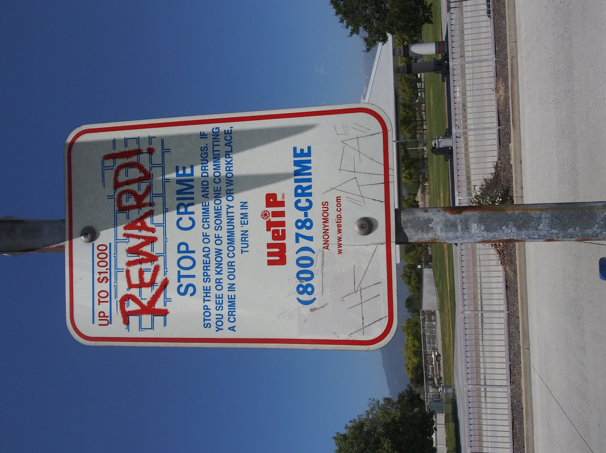

Slide 7
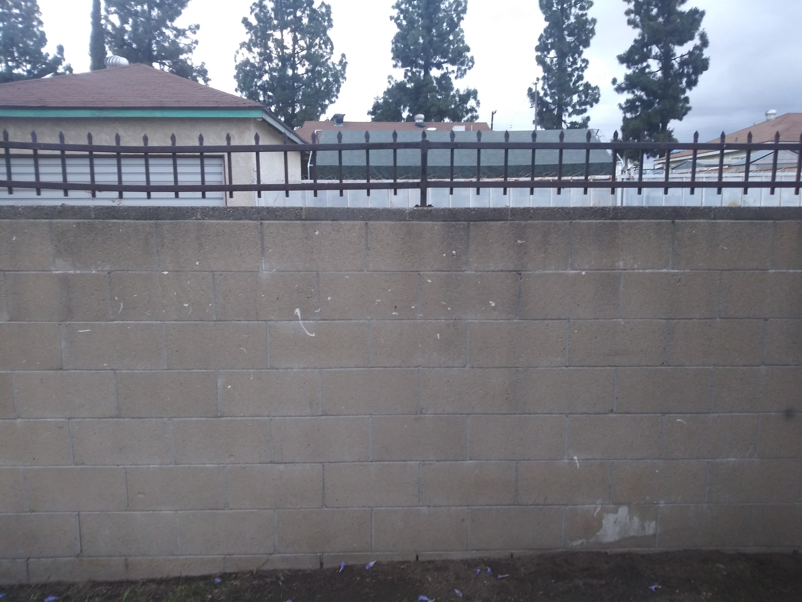

Spoken Word
Hey you yes you
Stop staining community walls with letters we do not understand. Those marks all over the wall do not look so pretty. Here is an advice to street bangers instead of using graffiti go confront your rival face to face
if you are doing graffiti to show expression
Please do not chose to damage the walls instead go to a studio
Allow your community walls to look nice and clean. Chose to be graffiti free.

