Slide 1
Maya Baker
Hip-Slice
English 1B
May 22 2019

Slide 2
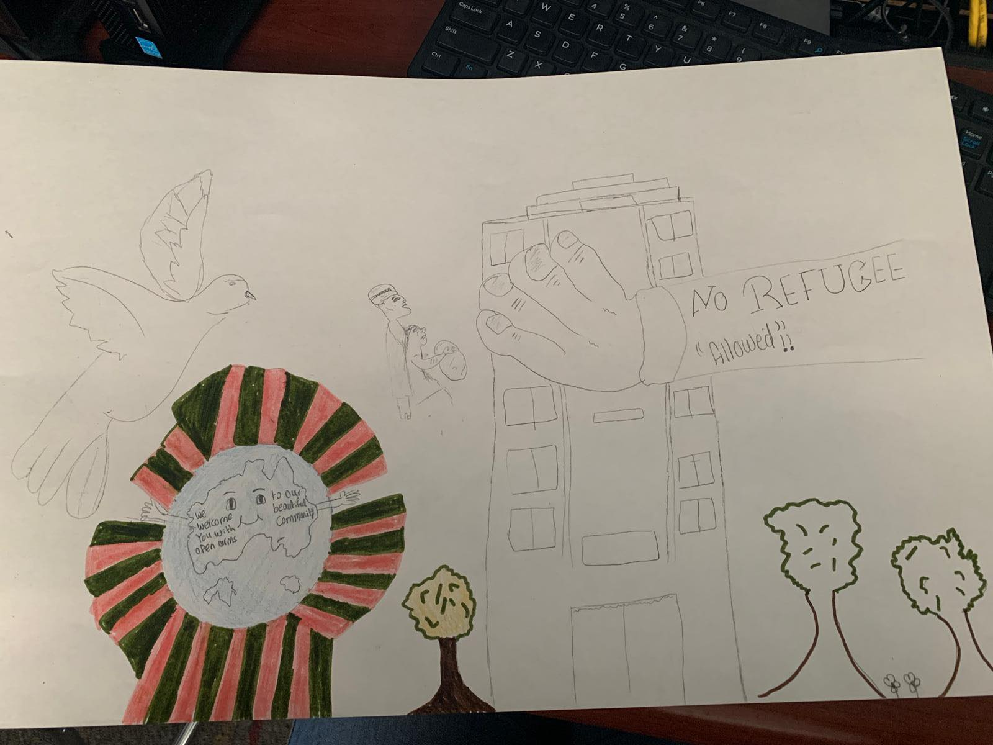
Poster

Slide 3
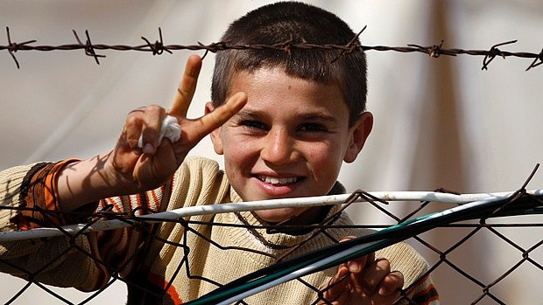

Photograph

Slide 4

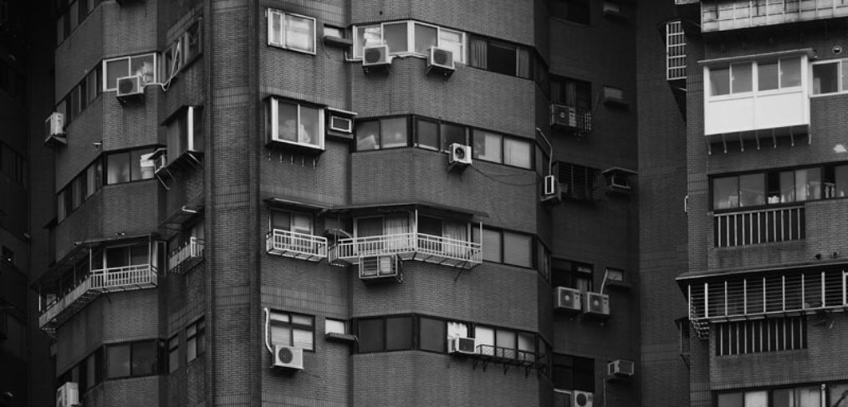
First Solution Photograph

Slide 5
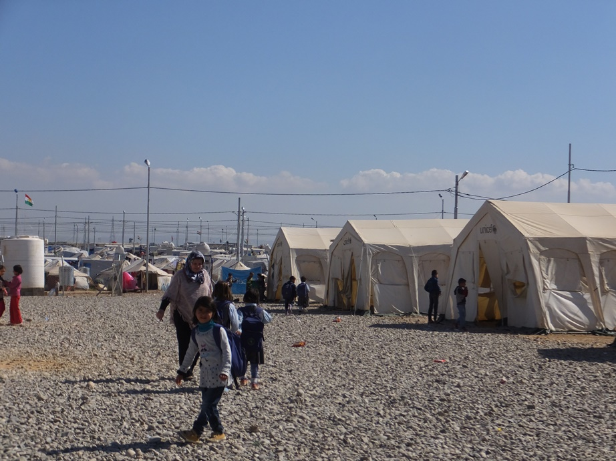
Second solution photograph

Slide 6
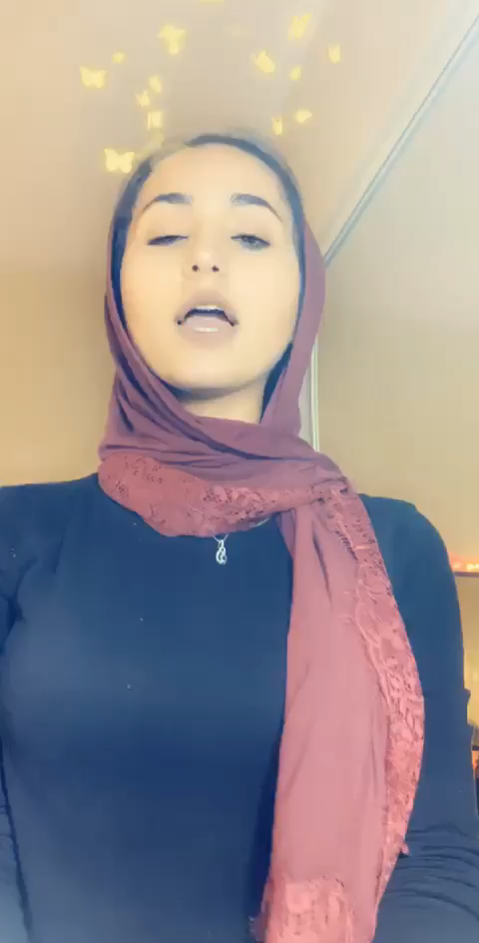
Poem

