Slide 1
High Impact Practices (HIP) Service Learning Internship Community Engagement (SLICE)with Spoken Word “Fix-It” Presentation
Nitzia Aguilar
English 1 B
May 13

Slide 2
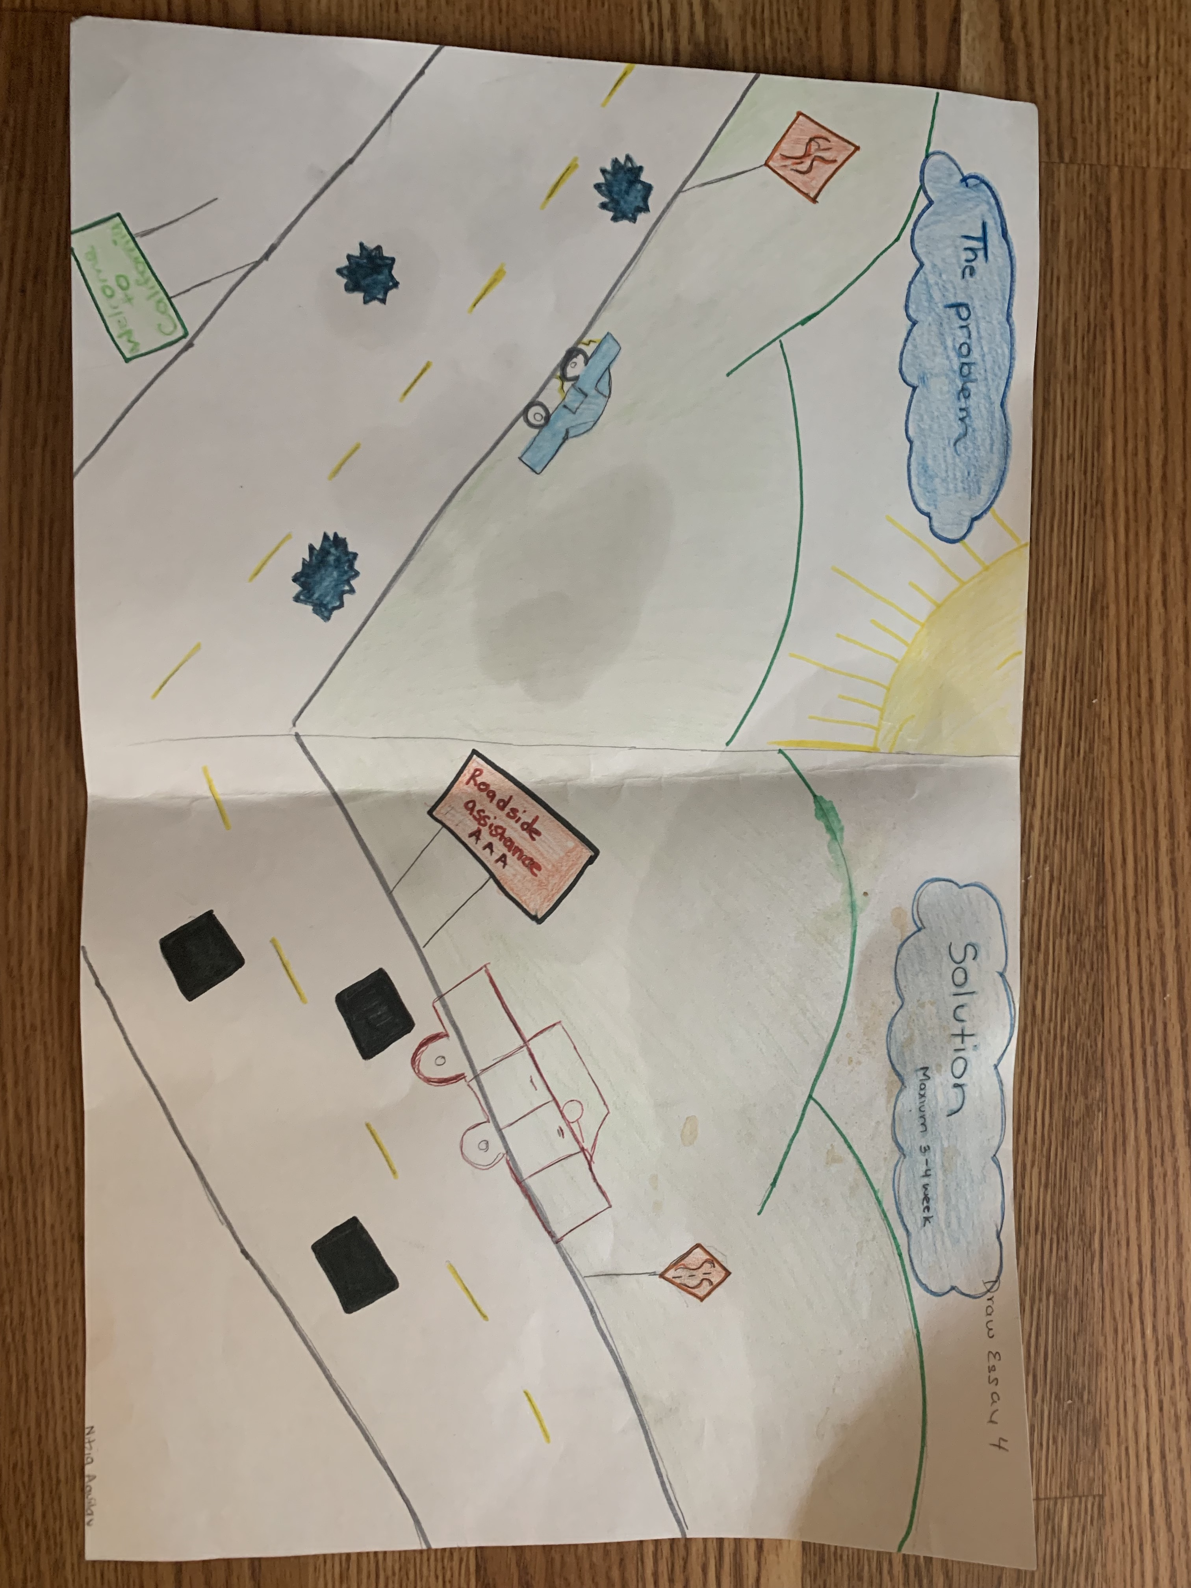
POSTER

Slide 3
Potholes

Slide 4
The problem

Slide 5
After 2 weeks

Slide 6

“WHAT I SEE"
ii

